Slide 1
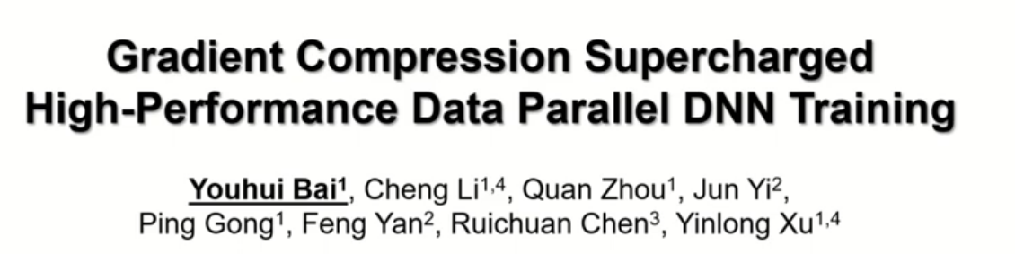
CS – 6663 Adv Parallel Processing Presenter: Brandon Wherry
Notes:
First Page: Introduction to paper and authors

Slide 2
Background & Motivation – Cloud Computing
Azure Google Cloud
AWS
Why ML over the Cloud?
No need to buy hardware
The presented paper used AWS EC2 P3 Instances
No need to maintain said hardware
Pay for what you need, no more, no less
Easy to scale services based on need
Cheaper for data centers, they can use “economies of scale”, keeping prices lower
Virtualization is becoming more and more efficient, hardware support
For these reasons, and many others, Distributed Machine Learning frameworks are becoming more and more popular
But there are some challenges, as we’ll see!
Notes:
Techniques used in paper are implemented over the cloud

Slide 3
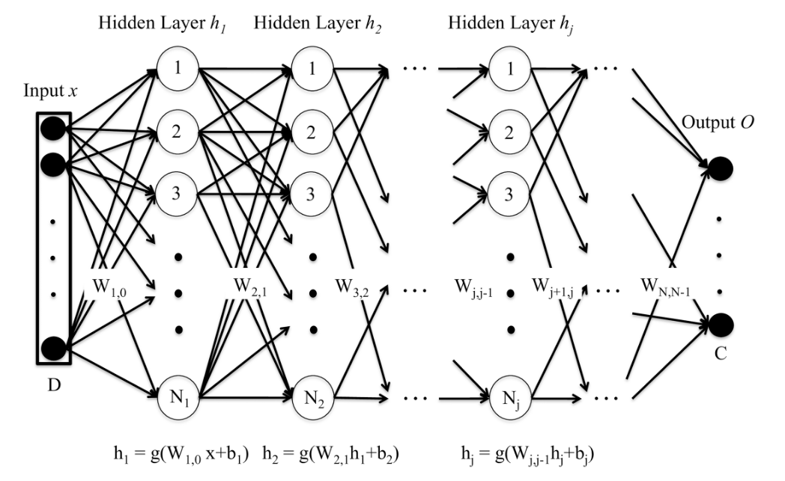
Background & Motivation – DNNs (Deep Neural Networks) Quick Review
Fig 1 [1]
Popular Python Libraries: TensorFlow
PyTorch MXNet
GPU support is usually built-in, but no distributed support (no cloud support)
Input can be anything:
NLP, Images, CV, etc
Forward propagation to calculate output ( a lot of matrix multiplications )
Then we compare the output with the provided label to find error and loss
Keep doing this until our weights to converge. We may have to run through our training data hundreds of times to achieve this.
We use derivative of loss function to find the gradients needed to adjust our weights, then back propagation
Notes:
Background details of ML with Cloud. Quick background ML over the cloud – quick explanation as to why we would use Cloud for ML

Slide 4
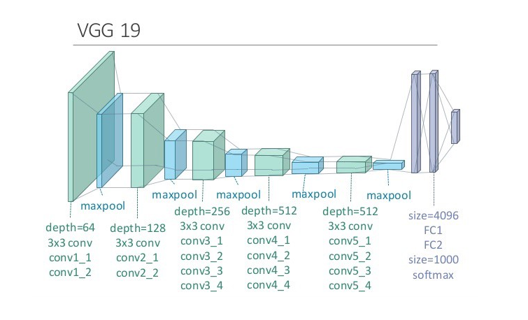
There are a few common types of DNNs, one of which is called CNN, short for Convolutional Neural Network. Below is the VGG19 CNN (which is really just fancy type of DNN). This ML framework has 19 layers and is mostly used for image processing.
Fig 2 [2]
16 Convolutional layers – Main building block of CNN
3 Dense Layers (Neurons)
Implementation is easy due to popular Python modules.
Moving forward, we’ll just refer to this as a DNN
Notes:
The paper mostly uses CNNs, and we saw CNNs in class last week
Recall that these convolution layers apply kernals/filters to incoming data to create feature maps. Early conv layers try to identity simple features, like an edge, or line. Later conv layers try to identity more sophisticated features like entire objects. “Houses” “Cat”. These are completely trainable by the model. Conv layers are used to detect patterns through the use of filters, and each filter has trainable weights associated with it. We do not need to predefine any filters, the model trains these values

Slide 5
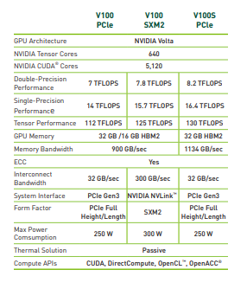
Combining Cloud Computing with Machine Learning
The training data is partitioned based on the number of nodes N.
Note: training data can be very large
The communication overhead becomes large as N increases.
Let’s start with 16 Nodes via AWS EC2 P3 Instances (Pre-packaged Deep Learning Containers)
Each Node has 8 NVIDIA V100 GPUs, 96 vCores, in 100Gbps network
All nodes must synchronize on weight adjustments.
This is called gradient synchronization
Node 1:
Node 14:
As N increases, 1 Epoch time (cycle time) is less, and less memory needed. Less data movement. More effective use of caches/less cache misses, etc
…
Node 2:
Node 15:
These weight adjustments, or gradients, take the form of a large matrix, which could have millions of values
…
However, there is one major draw back…
Node 3:
Node 16:
Goal of paper is to solve this issue with the use of Gradient Compression
…
Notes:
8 Nvidia V100 GPUs, built with ML in mind, These 16 nodes are running 16 instances* of the ML algorithm. This has many pros, and some cons that we must deal with.
After 7)

Slide 6

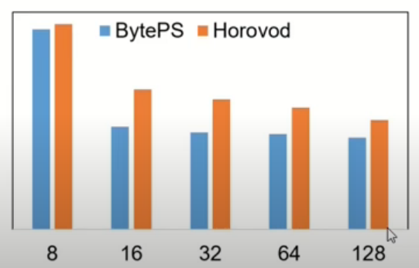


The case for Gradient Compression
BytePS and Horovod are distributed frameworks that sit atop of popular ML frameworks, such as Tensorflow, PyTorch, MXNet, etc.
This drop in scaling efficiency is largely due to communication overhead
For example, with Horovod, Distributed Deep Learning can be achieved with just 5 lines of code [3]
This suggests the need for gradient compression.
#GPU
Fig 3 [4]
Scaling Efficiency =
Note: 128 GPUs would be 16 nodes
Notes:
Gradient Synchronization -

Slide 7
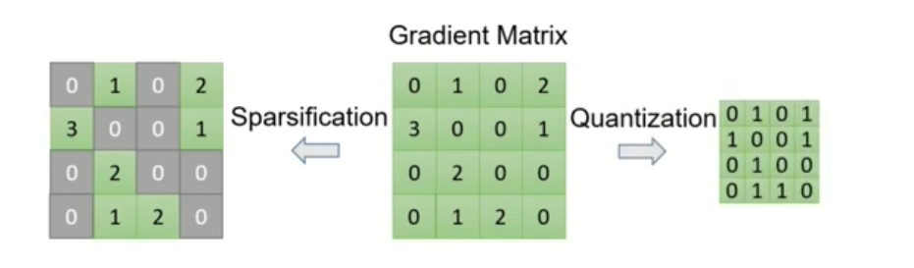
How to implement Gradient Compression?
There are a few known algorithms, most fall into 1 of 2 categories [2]
Fig 4 [4]
What are some potential problems with compression?
The goal of this paper was to provide high-level support that achieves both compression-aware synchronization (CaSync) and a high-level interface that abstracts away on-GPU programming details (CompLL). These two are bundled together in an open-source framework called HiPress.
1)There will be added computational overhead (Encodes and Decodes). Need to make sure these decodes and encodes are on-GPU
2) This added computation must not be implemented post-hoc, we need to make sure that our synchronization techniques are “compression-aware”
Notes:
Gradient compression is not new, there are known algorithms, and they mostly fall into 2 categories
Quantization doesn’t increase the number of epochs, surprisingly
Next slide, what does compression-aware synchronization mean?

Slide 8
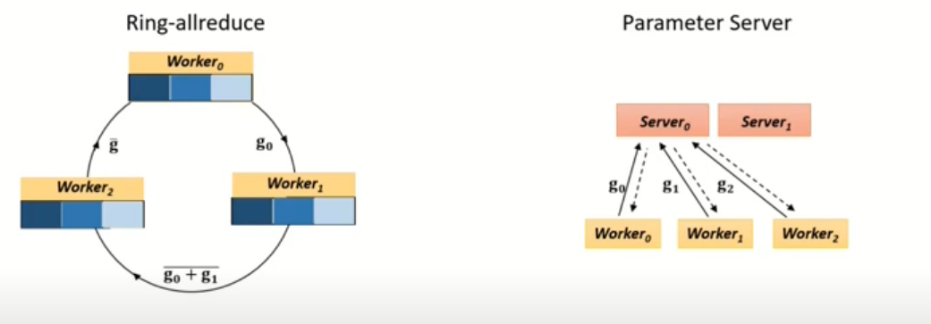
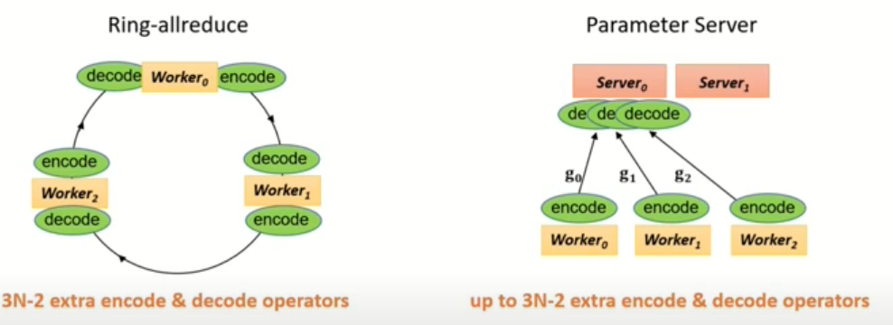
What does compression-aware synchronization mean? (Provided by CaSync Architecture)
There are two popular synchronization techniques.
Compression-aware Synchronization aims at hiding compression-related costs along synchronization path. Ideally, we don’t want communication and compression to be serialized, we need these to be pipelined, but details can be very messy.
Fig 5 [4]
Notes:
DNN over Cloud, part 2, the problem with scaling N
After) Intra-machine communication matters, CPU assisted aggregation not needed because of NVLink, no need to go through PCIe
I found several papers devoted to just this

Slide 9
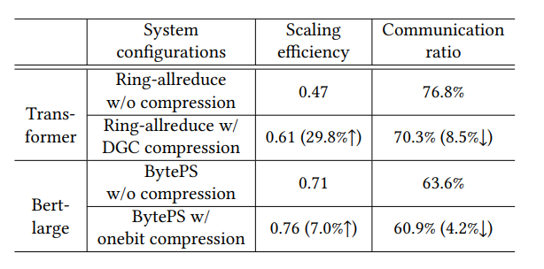
16 Nodes:
Each with 8 NVIDIA V100 GPUs, 96 vCores In 100Gbps network
Transformer model: Model for NLP or CV [6].
Bert-Large model: Transformer based NLP model [7].
DGC - (Deep Gradient Compression), employs sparsification (over-simplification)
Onebit – employs quantization
Notes:
Next slide, to give a bit of context to complexity

Slide 10
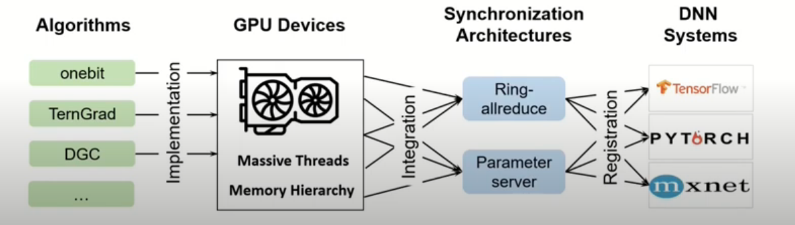
Fig 5 [4]
As we see, implementing gradient compression is not simple.
Ultimately, this is the motivation behind CaSync. This is the proposed synchronization architecture by authors, aimed at optimizing compression & communication. It goes beyond previous compression attempts.

Slide 11
In addition to CaSync architecture. A high-level library is also needed for on-GPU programming details of compression algorithms (using NVIDIA CUDA API).
As on-GPU compression can greatly accelerate compression-related computation. As the CPUs are already very busy with optimizers (calculating correct gradient values). [5]
This is the motivation behind CompLL, which stands for Compression Language and Library.
“Compression algorithms on GPU is non-trivial, and integrating them into DNN systems usually requires substantial system expertise and manual efforts. Thus, we design a toolkit CompLL, which allows practitioners to easily develop highlyoptimized compression algorithms using GPU capability. The CompLL-generated code is then consumed by CaSync, thus enabling an automated integration of compression algorithms with CaSync into DNN systems.” [2]

Slide 12
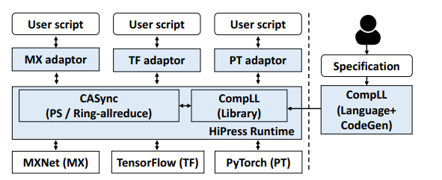
Putting it all together → HiPress Framework
HiPress has 7.5k lines of C/C++ code, and 3.3k lines of Python
Notes:
Shadow boxes are new components that are introduced by HiPress

Slide 13
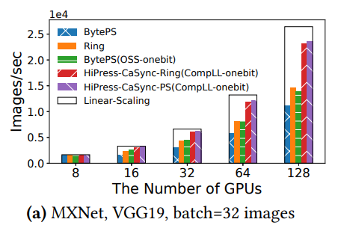
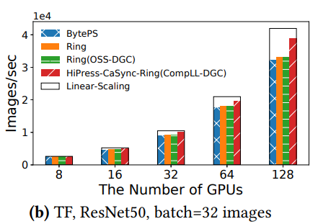
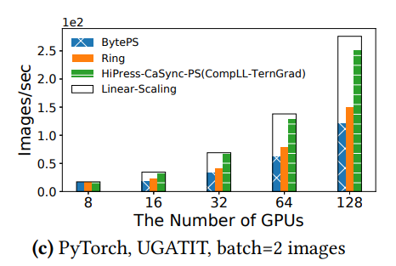
Some results of HiPress

Slide 14
In Conclusion
“Driven by CaSync and CompLL, HiPress addresses the fundamental tensions imposed by gradient compression. CaSync innovates a general, composable, and adaptive gradient synchronization architecture that is compression-aware. CompLL facilitates an easy development of highly-optimized on-GPU gradient compression and an automated integration into modern DNN systems with minimal manual efforts. HiPress is open-sourced, and achieves a scaling efficiency of up to 0.92 and a training speed improvement up to 110.5% over the state-of-the-art baselines across six popular DNN models in a cluster of 16 nodes with 128 NVIDIA V100 GPUs and 100Gbps network.” [5]
Notes:
DNN over Cloud, part 3, Need for gradient synchronization through network

Slide 15
References:
[1]https://journals.plos.org/plosone/article/figure?id=10.1371/journal.pone.0182580.g001
[2] Youhui Bai, Cheng Li, Quan Zhou, Jun Yi, Ping Gong, Feng Yan, Ruichuan Chen, and Yinlong Xu. 2021. Gradient Compression Supercharged High-Performance Data Parallel DNN Training. In Proceedings of the ACM SIGOPS 28th Symposium on Operating Systems Principles Association for Computing Machinery, New York, NY, USA, 359–375. DOI:https://doi-org.libweb.lib.utsa.edu/10.1145/3477132.3483553
[3] https://www.youtube.com/watch?v=4y0TDK3KoCA&ab_channel=UberEngineering
[4] https://www.youtube.com/watch?v=xFSeIdO_gYg&ab_channel=ACMSIGOPS
[5] Youhui Bai, Cheng Li, Quan Zhou, Jun Yi, Ping Gong, Feng Yan, Ruichuan Chen, and Yinlong Xu. 2021. Gradient Compression Supercharged High-Performance Data Parallel DNN Training. In Proceedings of the ACM SIGOPS 28th Symposium on Operating Systems Principles Association for Computing Machinery, New York, NY, USA, 359–375. DOI:https://doi-org.libweb.lib.utsa.edu/10.1145/3477132.3483553
[6] https://en.wikipedia.org/wiki/Transformer_(machine_learning_model)
[7] https://en.wikipedia.org/wiki/BERT_(language_model)
Notes:
Scaling Efficiency As N increases, scaling efficiency decreases

