Slide 1
Exploring Distributed Training with PyTorch’s Distributed Data Parallel (DDP) Strategy
CS – 6243 Machine Learning Brandon Wherry
Zwe996
Full detailed documentation:
https://github.com/Brandon1126/DistributedMachineLearningPyTorch
Notes:
First Page: Introduction to paper and authors

Slide 2
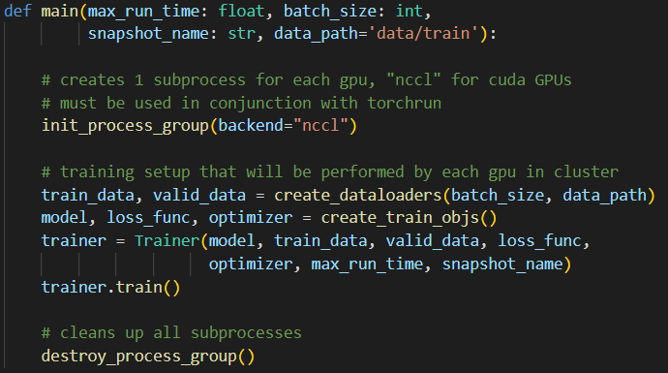
DDP Enabling Code

Slide 3
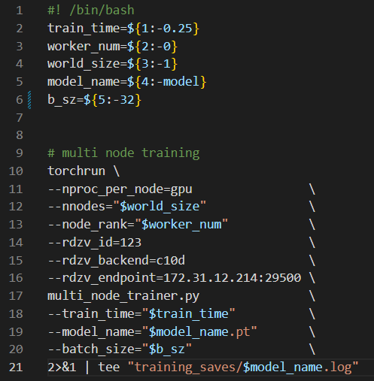
DDP Enabling Code – Cont.
$ python -m torch.distributed.launch --use_env train_script.py
$ torchrun train_script.py

Slide 4
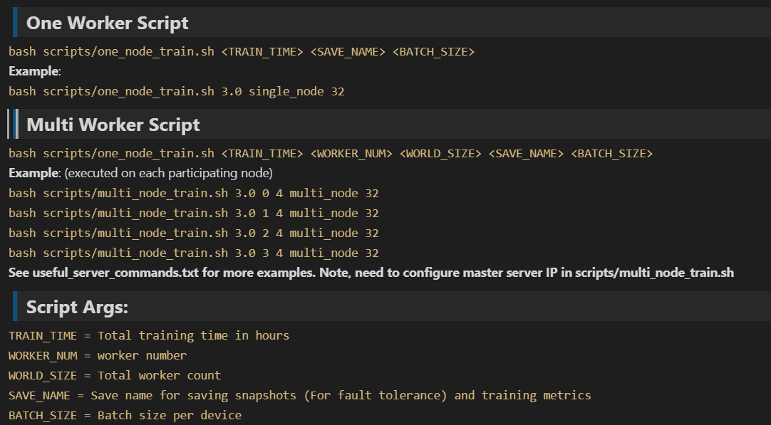
Git repo README has good explanation of all the code.

Slide 5
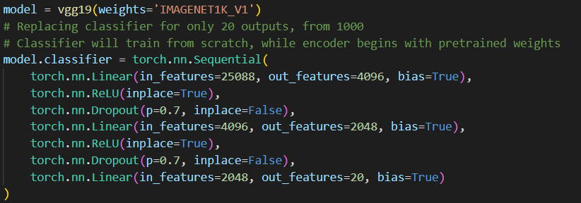
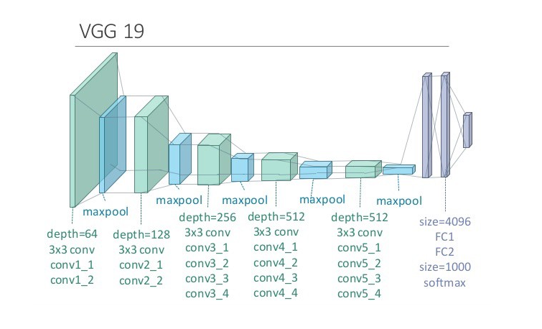
Data
20 class slice of imageNet
https://www.kaggle.com/datasets/ambityga/imagenet100
Notes:
Recall that these convolution layers apply kernals/filters to incoming data to create feature maps. Early conv layers try to identity simple features, like an edge, or line. Later conv layers try to identity more sophisticated features like entire objects. “Houses” “Cat”. These are completely trainable by the model. Conv layers are used to detect patterns through the use of filters, and each filter has trainable weights associated with it. We do not need to predefine any filters, the model trains these values

Slide 6
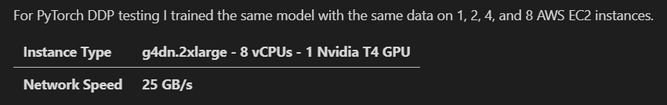
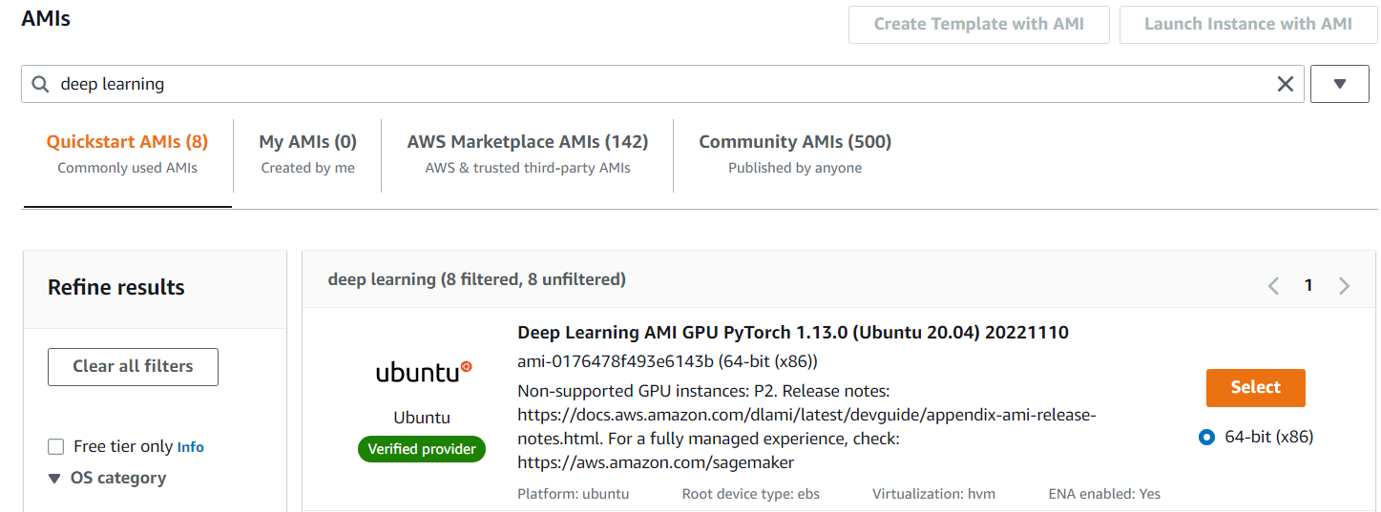
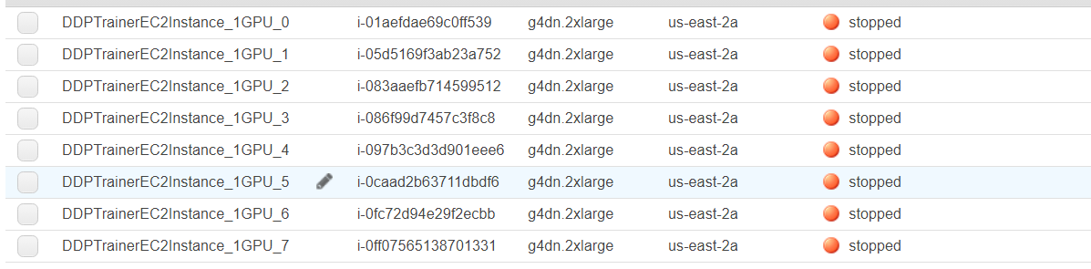
AWS EC2 Experiment

Slide 7
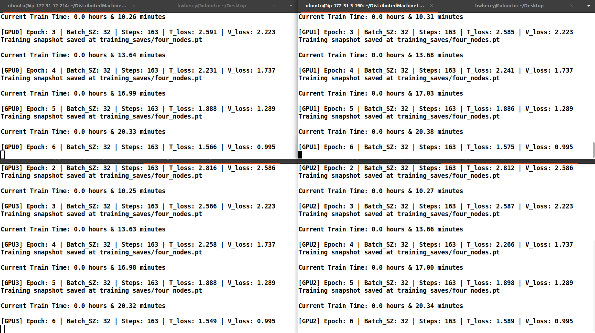

Slide 8
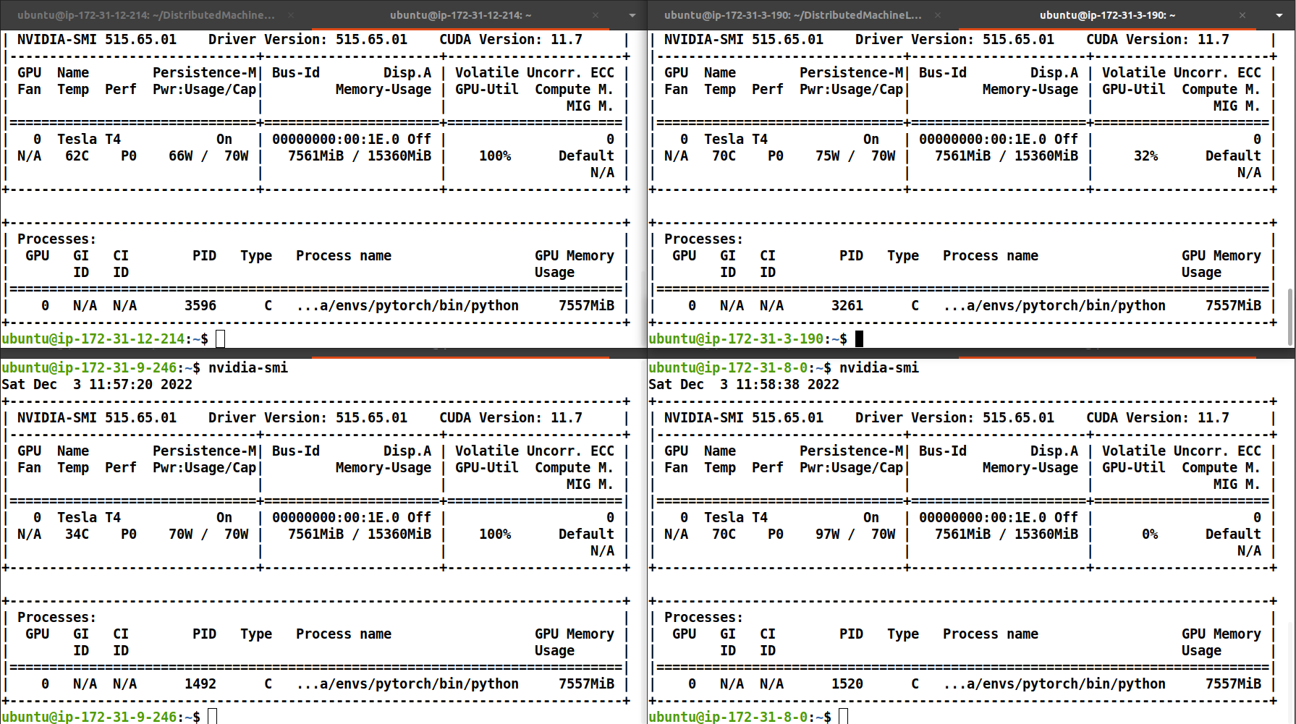

Slide 9
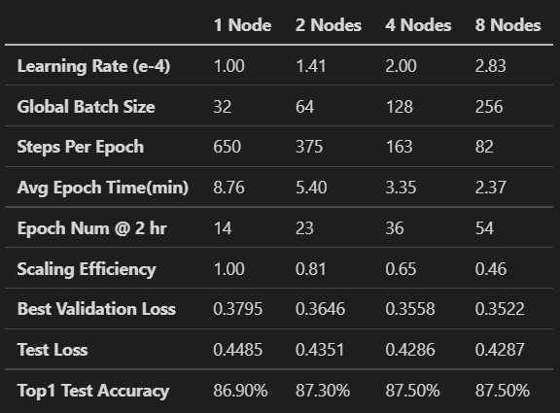
Experimental Results

Slide 10
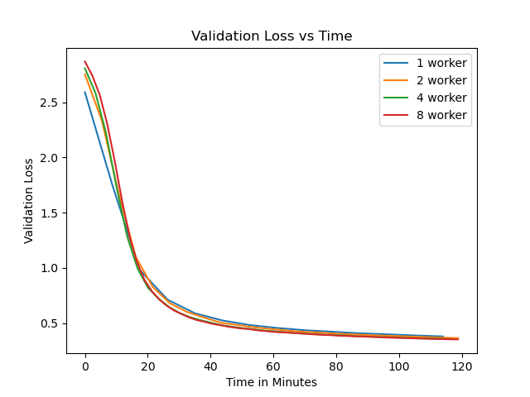
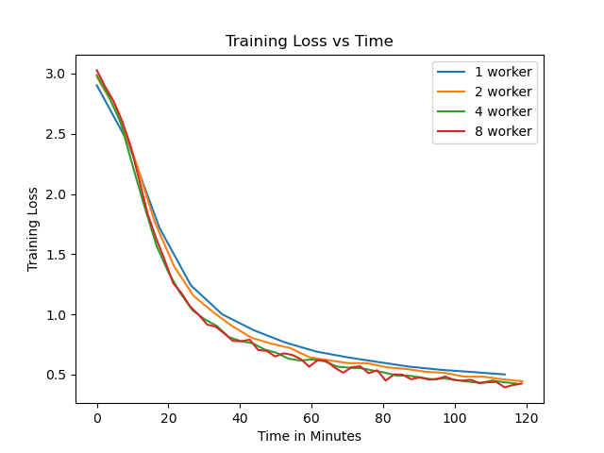
Summary Graphs

Slide 11
Conclusion
Network speeds are a huge bottleneck for DDP training
Scale up before scaling out
Good balance between batch size and learning rate must be found to truly optimize training times
Realistically, Model Parallelism will have to be included as well for modern model sizes.

