Slide 2
cost = raw_cost + elam * unsup_loss
The loss we use for optimization (raw_cost is the MSE, elam is a coefficient set to 0.005, unsup_loss is mean of diff_per_set from function calculate_ec_loss)

Slide 3
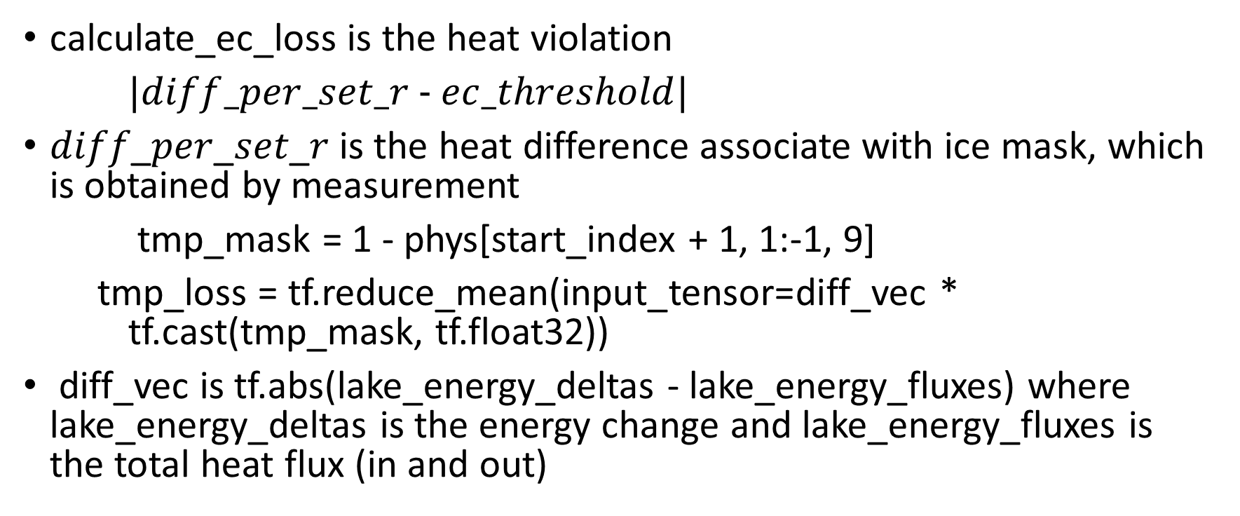
calculate_ec_loss is the heat violation
$|diff_per_set_r - ec_threshold|$
𝑑𝑖𝑓𝑓_𝑝𝑒𝑟_𝑠𝑒𝑡_𝑟 is the heat difference associate with ice mask, which is obtained by measurement
tmp_mask = 1 - phys[start_index + 1, 1:-1, 9]
tmp_loss = tf.reduce_mean(input_tensor=diff_vec * tf.cast(tmp_mask, tf.float32))
diff_vec is tf.abs(lake_energy_deltas - lake_energy_fluxes) where lake_energy_deltas is the energy change and lake_energy_fluxes is the total heat flux (in and out)

Slide 4
lake_energy_fluxes is calculated by measurement associate with the predicted surface temperature and other measurements.
calculate_lake_energy_deltas is the difference of energies obtained by lake_energies, which is the total energy of the lake for every timestep, sum over all layers.

Slide 5
Useful information
Raw data contained 3550 days
n_steps = 353 first 353 sets of data were used for training,
N_sec = 19, a coefficient used for training
n_depths =50 Depths ranging from 0 to 25m (usually 20m), we wish to get data from 50 different depths with gap of 0.5 m. However, this is not always the case. If such criteria is not met , we take what we have.
Raw data contained 3550 days

