Slide 1
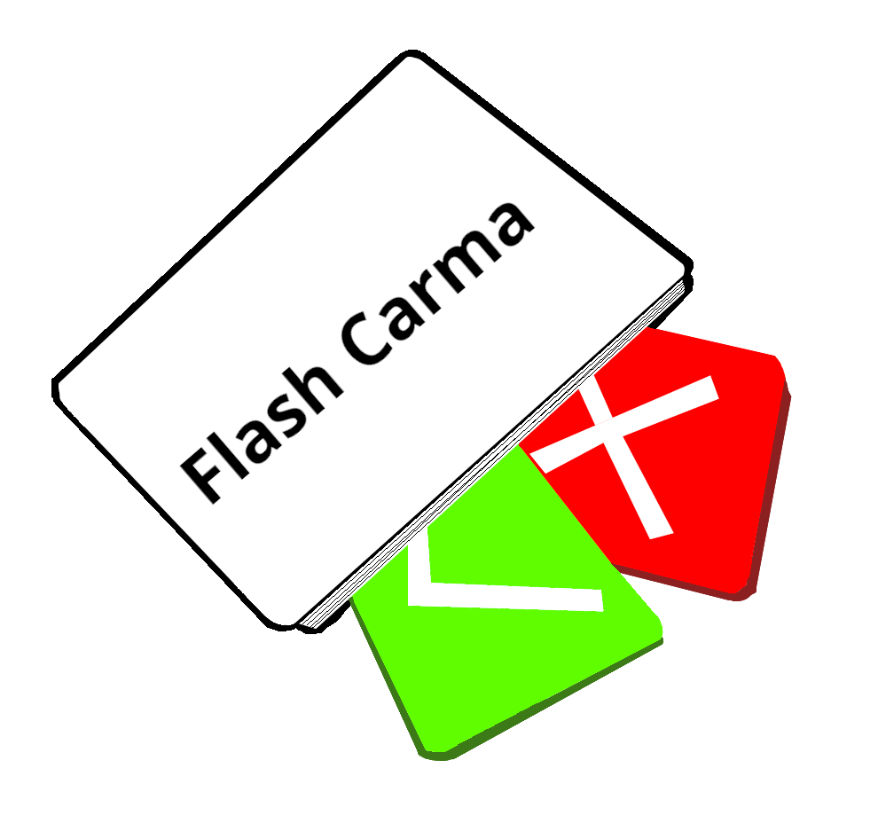

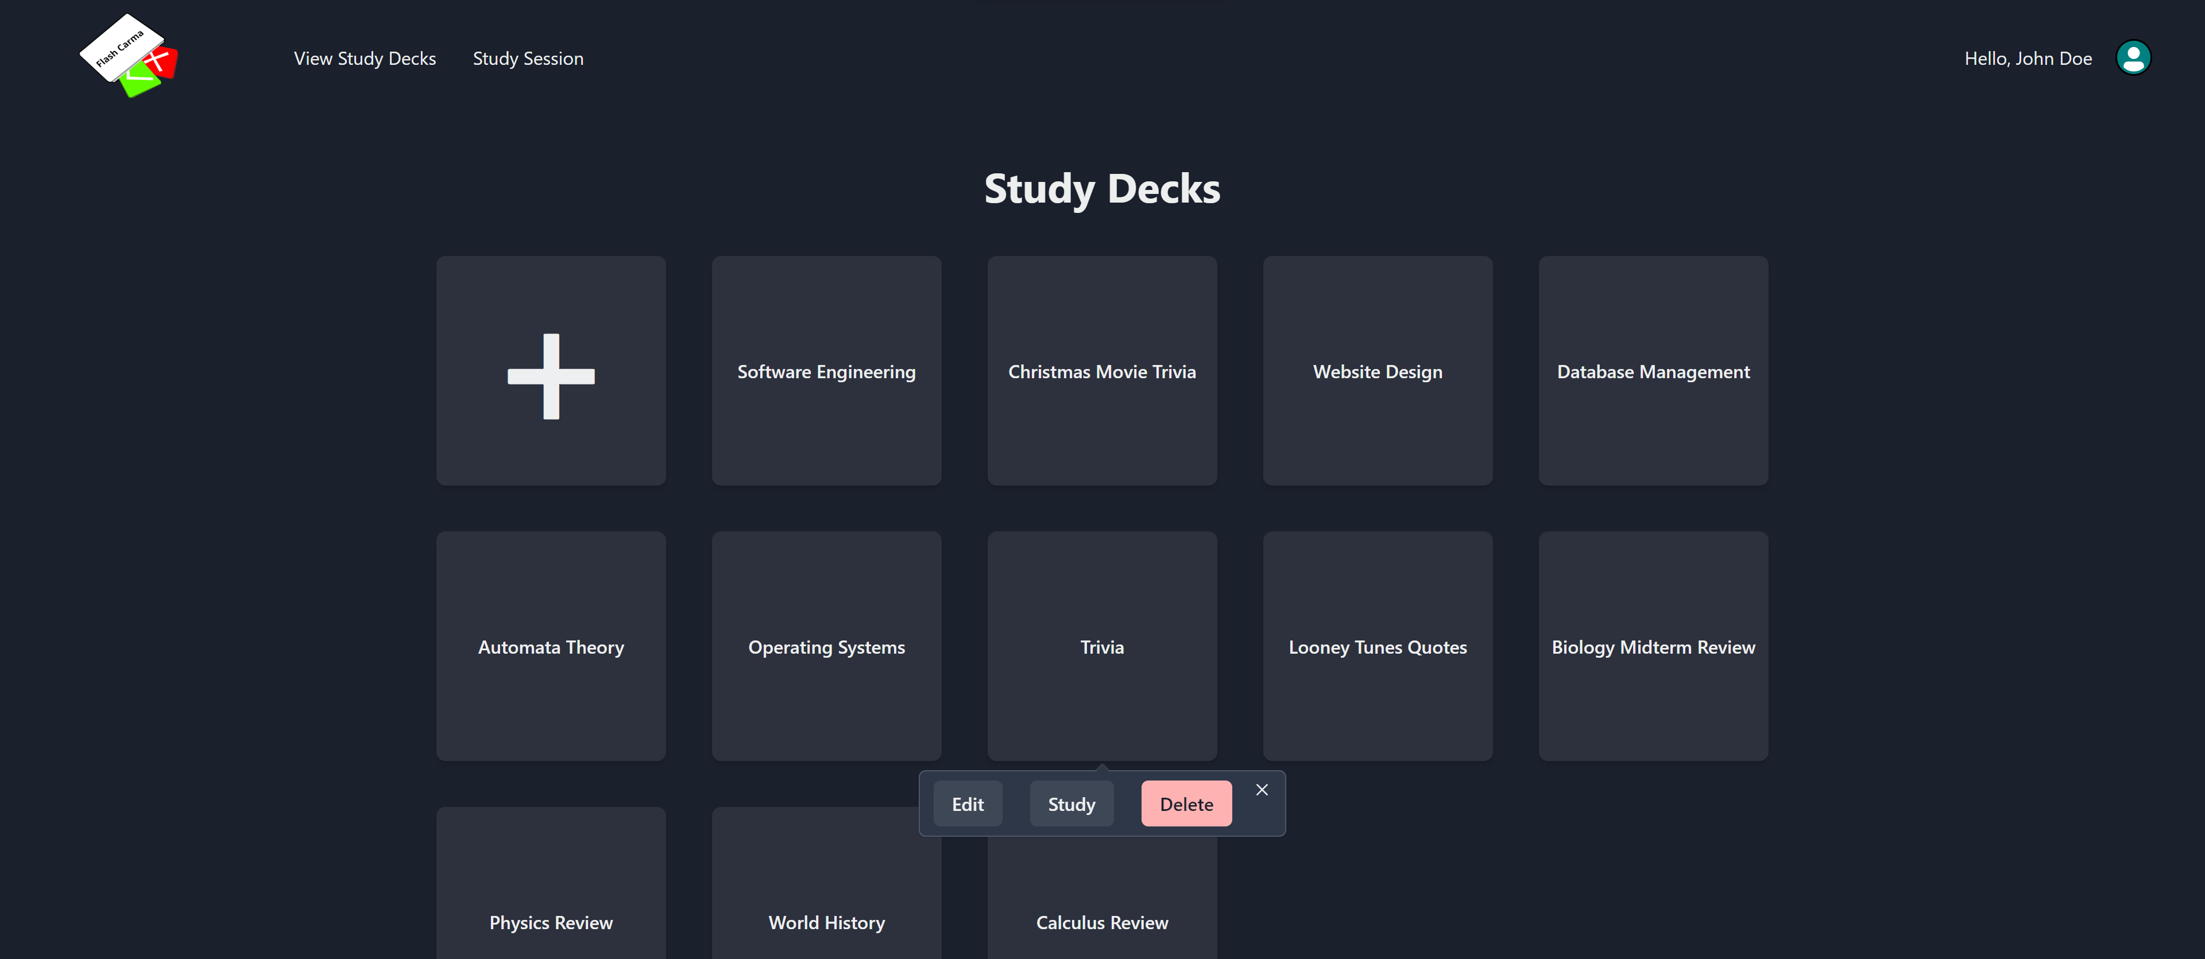
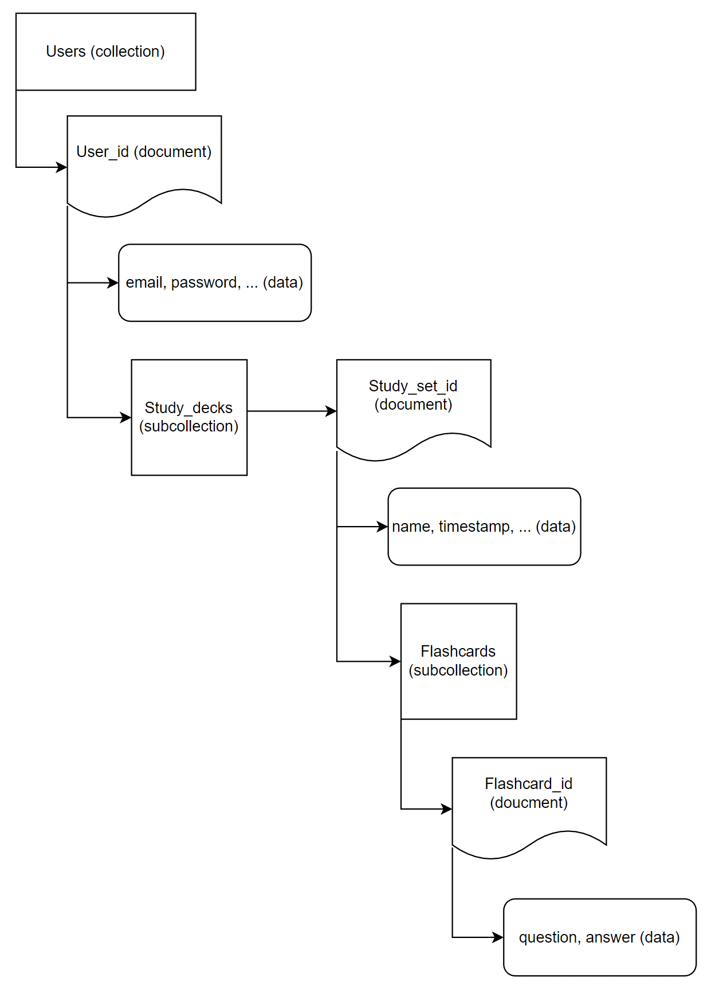
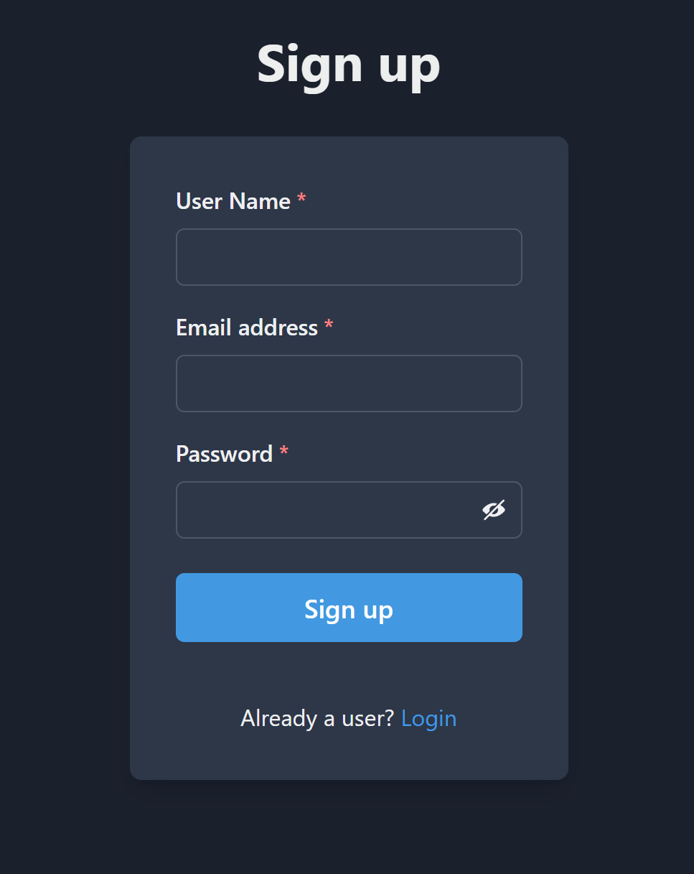
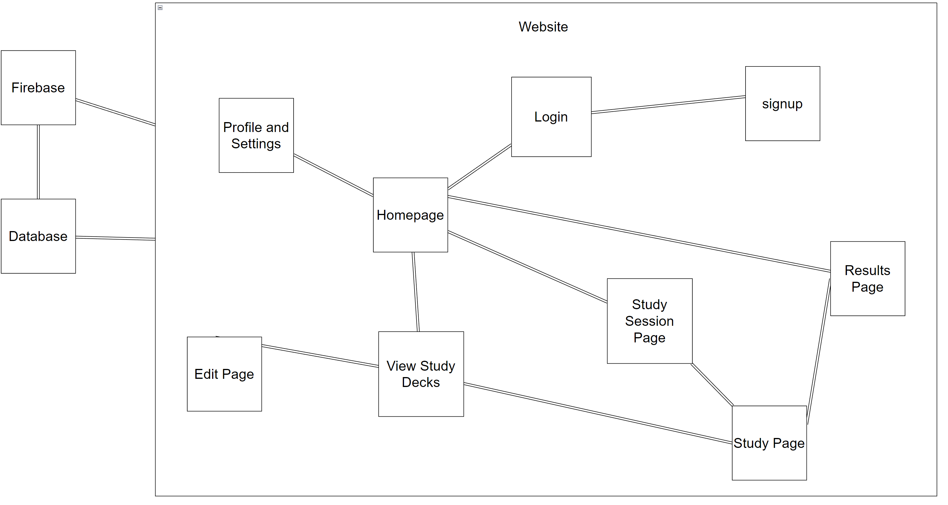
Flash Carma
Adrian West, Brandon Sitz, Joseph Ramos-Garcia, and Josh Moore
Dept. Of Computer Science and Information Technology
Abstract
Design
Technology
Future Work
Flash Carma is a web-based application that utilizes digital flash cards and helps the user study their custom material in an entertaining and enjoyable manner. Using Flash Carma, the user is able to create multiple digital flashcards with their custom questions and answers that they can then store in a study deck. When the user wants to study, they simply select a study deck and are taken through a study session, which presents each flash card in the study deck in a sequential order and awards points for answering correctly. The user is able to create up to 200 different study decks, each containing up to 200 flashcards. These study decks are stored with the user’s profile, so unless the user chooses to delete each of their study decks, they will be available for the user to review time and time again.
Upon entering the URL for the application, the user is met with the Login page, where they can log in to their existing profile. If the user is new and does not yet have a profile, they can click the “Sign Up” link and will be taken to the Sign-Up page, where they can create a new profile. Once the user’s profile has been accessed, they are directed to the Home page and given access to the application’s navigation bar. On the Home page, the user can see their cumulative score across all their study sessions as well as their most recently studied decks. The user can use the navigation bar to begin a study session by clicking “Study Session”, adjust their settings or profile information by clicking the profile icon, return to the Home page by clicking the Flash Carma logo, or access the View Study Decks page where they can view, edit, and delete any of their existing study decks or create a new study deck.
Firebase technologies were used to provide us with user authentication, a database to store the user’s data, and a means to host the site itself. Since Visual Studio Code provided numerous extensions that benefited the production of Flash Carma, we decided to use it as our coding environment. One of the most useful extensions was the Chakra UI extension, which provided numerous resources for creating the pages of Flash Carma. React was used as a framework for the application, and Node JS was used as a packet manager. Our logo was created using the GNU Image Manipulator, and the streak icon was created using Microsoft Word. Discord was our means of communication, while GitHub was used primarily for version control as well as a means for us to access each other’s developments and divide the work.
In future updates, a search bar will be implemented that will allow the user to search for the name of a particular study deck from their existing study decks. In the user’s settings, they will be able to switch between a grid layout and a list layout for their study decks to be presented in, and they will also have the option to enable the Leitner system to help them study.
References
React : https://reactjs.org/docs
Chakra UI: https://chakra-ui.com/docs
Firebase: https://firebase.google.com/docs/build
Leitner-system: https://examstudyexpert.com/leitner-system
Purpose
Acknowledgements
Studying can be a daunting task no matter the scholastic level, and traditional flash cards are time-consuming and exhaustive to create. Purchasing the raw materials can also add unnecessary expenses for students. To solve these problems, we created Flash Carma. As students who regularly use flash cards, we designed Flash Carma to be an easy-to-use, cost-effective alternative to traditional flash cards that won’t take enormous amounts of the user’s time to create.
We would like to thank Dr. John Nicholson for his support and guidance during the development of Flash Carma. Without his instruction, we would not have grown nearly as much as developers nor Flash Carma grown as an application. We would also like to thank Dr. Karen Meisch for her support of students in the College of Science, Technology, Engineering & Mathematics, and Dr. Leong Lee for his support of students in the Department of Computer Science and Information Technology.
Figure 2: Screen capture of the View Study Decks page.
Figure 1: Screen capture of the Sign-Up page.
Figure 4: Data model for the firestore database.
Figure 3: Block Diagram for the Flash Carma application.

