Slide 1
LU Decomposition Introduction
Goal : Matrix factorization first! Then
Solve Ax = b faster!

Slide 2
Finding LU- Decomposition
Definition 1 :
A factorization of a square matrix A is A=LU,
L : lower triangular
U : upper triangular
is called LU-decomposition (or LU-factorization)
.

Slide 3
Solving a Linear Equation by LU Factorization
A is a n x n matrix and A = LU
Solve Ax = b
(1)Rewrite the system to
LUx = b
(2)Define a new n x 1 vector y by
Ux = y --- step 2
(3)Use (2) to rewrite (1) as
Ly = b --- step 1
(4)Substitute y in (2) and solve for x
Solve y (Forward Substitution).
(Back Substitution).

Slide 4
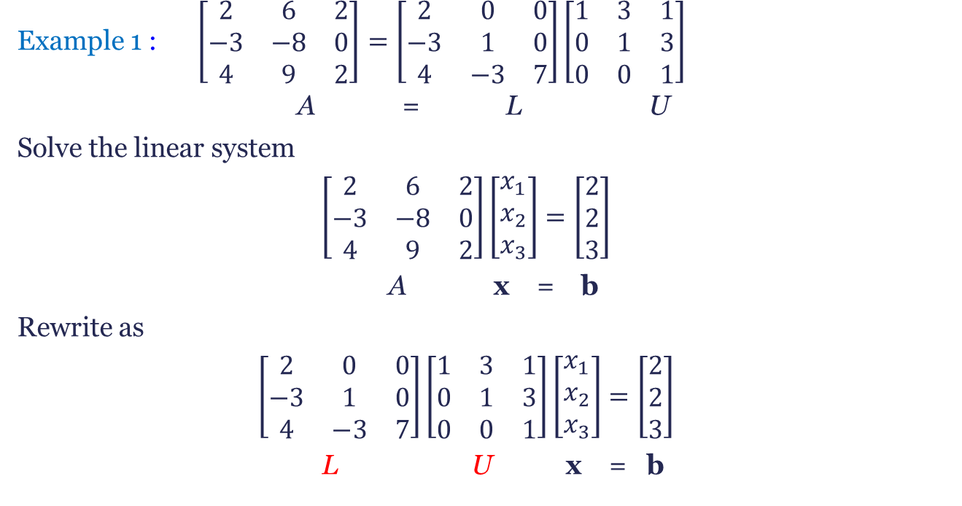
Ax=b solved by LU-Decomp. (II)
Example 1 : $\left[\begin{matrix}2 & 6 & 2 \\ −3 & −8 & 0 \\ 4 & 9 & 2\end{matrix}\right]=\left[\begin{matrix}2 & 0 & 0 \\ −3 & 1 & 0 \\ 4 & −3 & 7\end{matrix}\right]\left[\begin{matrix}1 & 3 & 1 \\ 0 & 1 & 3 \\ 0 & 0 & 1\end{matrix}\right]$
A = L U
Solve the linear system
$$\left[\begin{matrix}2 & 6 & 2 \\ −3 & −8 & 0 \\ 4 & 9 & 2\end{matrix}\right]\left[\begin{matrix}x_{1} \\ x_{2} \\ x_{3}\end{matrix}\right]=\left[\begin{matrix}2 \\ 2 \\ 3\end{matrix}\right]$$
A x = b
Rewrite as
$$\left[\begin{matrix}2 & 0 & 0 \\ −3 & 1 & 0 \\ 4 & −3 & 7\end{matrix}\right]\left[\begin{matrix}1 & 3 & 1 \\ 0 & 1 & 3 \\ 0 & 0 & 1\end{matrix}\right]\left[\begin{matrix}x_{1} \\ x_{2} \\ x_{3}\end{matrix}\right]=\left[\begin{matrix}2 \\ 2 \\ 3\end{matrix}\right]$$
L U x = b

Slide 5

Ax=b solved by LU-Decomp. (III)
Define $y_{1}$, $y_{2}$, and $y_{3}$ by the equation
$$\left[\begin{matrix}1 & 3 & 1 \\ 0 & 1 & 3 \\ 0 & 0 & 1\end{matrix}\right]\left[\begin{matrix}x_{1} \\ x_{2} \\ x_{3}\end{matrix}\right]=\left[\begin{matrix}y_{1} \\ y_{2} \\ y_{3}\end{matrix}\right]$$
U x = y
And rewrite as
$$\left[\begin{matrix}2 & 0 & 0 \\ −3 & 1 & 0 \\ 4 & −3 & 7\end{matrix}\right]\left[\begin{matrix}y_{1} \\ y_{2} \\ y_{3}\end{matrix}\right]=\left[\begin{matrix}2 \\ 2 \\ 3\end{matrix}\right]$$
L y = b
Or equivalently as
$$2y_{1} =2 \\ −3y_{1}+y_{2} =2 \\ 4y_{1}−3y_{2}+7y_{3}=3$$
Forward substitution, yields $y_{1}=1$, $y_{2}=5$, $y_{3}=2$

Slide 6
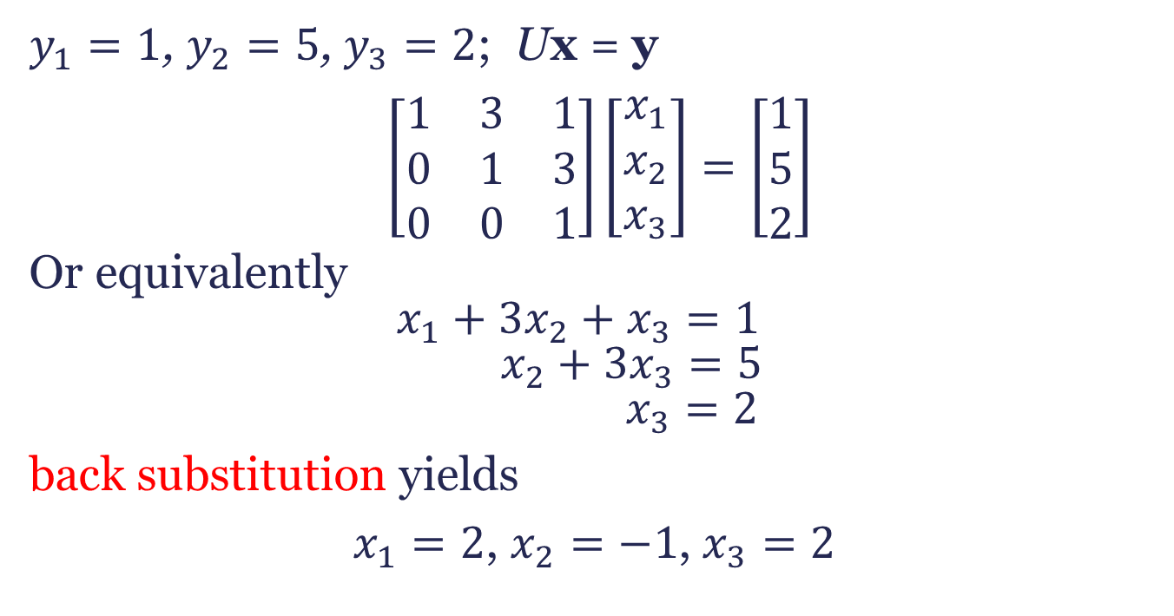
Ax=b solved by LU-Decomp. (IV)
$y_{1}=1$, $y_{2}=5$, $y_{3}=2$; Ux = y
$\left[\begin{matrix}1 & 3 & 1 \\ 0 & 1 & 3 \\ 0 & 0 & 1\end{matrix}\right]\left[\begin{matrix}x_{1} \\ x_{2} \\ x_{3}\end{matrix}\right]=\left[\begin{matrix}1 \\ 5 \\ 2\end{matrix}\right]$
Or equivalently $$x_{1}+3x_{2}+x_{3}=1 \\ x_{2}+3x_{3}=5 \\ x_{3}=2$$
back substitution yields
$x_{1}=2$, $x_{2}=−1$, $x_{3}=2$

Slide 7
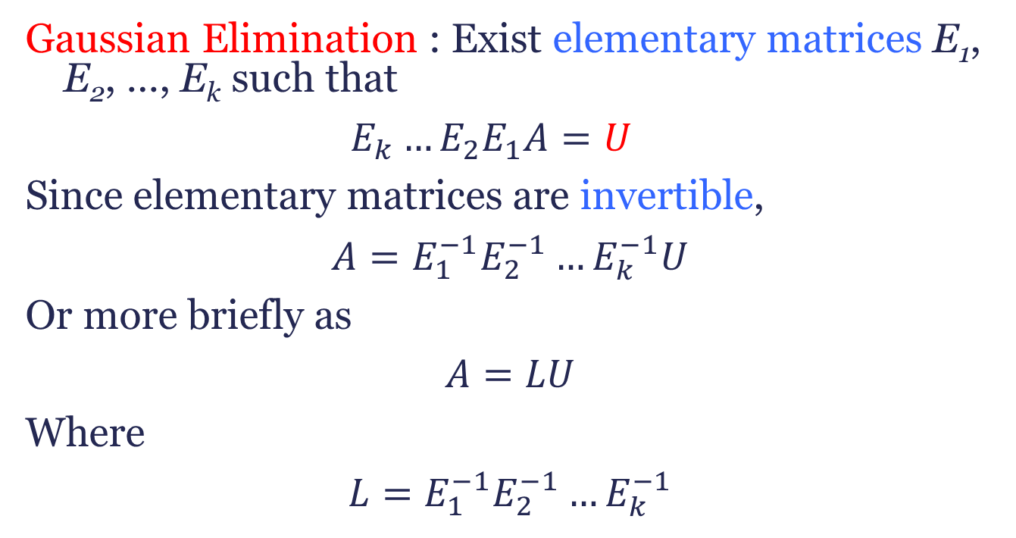
LU-Decomposition by Gaussian Elimination
Gaussian Elimination : Exist elementary matrices E₁, E₂, …, E_{k} such that
$$E_{k}…E_{2}E_{1}A=U$$
Since elementary matrices are invertible,
$$A=E_{1}^{−1}E_{2}^{−1}…E_{k}^{−1}U$$
Or more briefly as
$$A=LU$$
Where
$$L=E_{1}^{−1}E_{2}^{−1}…E_{k}^{−1}$$
.

Slide 8
LU-Decomposition by Gaussian Elimination
If A is a square matrix that can be reduced to a row echelon form U by Gaussian elimination without row interchanges, then A can be factored as A = LU, where L is a lower triangular matrix.
.

Slide 9
Finding a LU Decomposition (I)
A=

Slide 10
LU Decomposition (II)
Example:
A =
U =
A = E₂₁[2] E₃₁[1] E₃₂[-2] D₃[-1] ∙ U
=

Slide 11
LU Decomposition (III)
A = E₂₁[-2] E₃₁[-1] E₃₂[2] D₃[-1] ∙ U

