Slide 1
Assigning scores to movie reviews by sentiment analysis -
Final Presentation
Troy Carloni
Brandon Butler

Slide 2
Introductions
We were tasked with analysing IMDB movie reviews and trying to determine the sentiment of the review.
This can be accomplished by comparing words within the document under review to a large collection of predetermined positive/negative reviews. We look at the occurrences in the predetermined data pool and use this data to assign scores to words within the document being reviewed.
Based on the amount of positive or negative words found in the document we can roughly determine whether it is positive or negative.

Slide 3
Progress Made
We normalized the sentiment score of the reviews on a scale from 1 - 10
Using rake-nltk we are now able to look at 2 word phrases to grade the reviews
We created an independent test set.

Slide 4
Experiments
Review to be Graded
In order to test our program we need example of positive and negative reviews.
We grabbed some defined positive and negative reviews
With this test set we looked through the entire review for words and phrases that are then graded on how positive are negative they are.
We then compare those words and phrases with the review in question.
Based on how many words are used, shared, and left out of the review compared, we can determine over all what the overall sentiment is
Positive test set
Grading Process
Negative test set
Grading Result
Positive Review
Negative Review

Slide 5
Demonstration

Slide 6
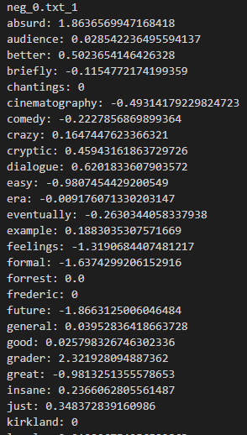
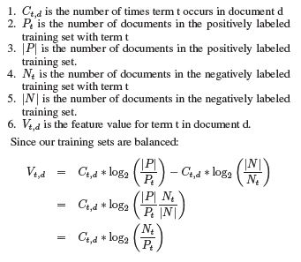
Determining a words score
Negative score = positive, Positive score = negative

Slide 7
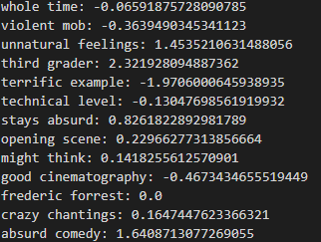
Determining a 2 word phrase score
Phrases are extracted using Rake - nltk. Rake determines word importance by taking the sum of the number of co-occurrences (times a word appears within a phrase), then dividing them by their occurrence frequency. Occurrence frequency means how many times the word occurs in the primary corpus. Through this we can target and extract key phrases. For our testing we kept phrases to a min length of two words. We then compute scores for phrases the same way we do single words. The single word scores and phrase scores are combined to determine the final scoring.

Slide 8
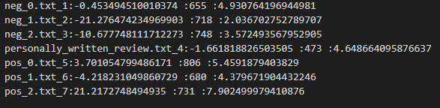
Results
Name of Text
Raw Score
Length of Document
Final Score
To calculate the final score we use the following:
((totalWordSum*-1)/(lengthOfDocument/100))+5
totalwordSum = score based off individual word/ phrase sentiment value, we times it by -1 in order to make positive scoring a positive value and vice versa
lengthOfDocument is included to normalize scoring, without this longer documents would always have more dramatic scoring.
Dividing the length of doc by 100 provides a a scoring within the desired range of 1-10
In sentiment analysis scoring, a score of 0 indicates a neutral value, since our scoring system is 1-10 we use 5 as our neutral value and the final word scores either subtract or add to this value for final scoring.
As mentioned previously we score on a scale of 1-10 where 5 or below is a more negative review and 5 and above more positive.

Slide 9
Conclusion

