Slide 1
Assigning scores to movie reviews by sentiment analysis
Troy Carloni
Brandon Butler

Slide 2
Problem
Being able to interpret the semantics of text is a problem worth solving in today's world. With so many people’s opinions and thoughts posted online, determining their outlook on what they post can be a powerful precursor to their underlying motives. It could potentially identify those considering suicide or a potential terrorist attack. If we were able to easily determine the semantics of text an autonomous system could identify red flag posts and provide alerts to specific authorities, or even just provide useful information on how the majority feel about a certain topic. While there have been strides in accomplishing this, we cannot guarantee with high enough certainty that the results will always be accurate. Textual data online can be formatted poorly making it difficult to parse and analyze. Additionally, techniques that work for one language may yield different results when interpreting text in another language.

Slide 3
Review of Relevant Literature
Delta TFIDF: An Improved Feature Space for Sentiment Analysis
Delta TFIDF
Assign feature values by calculating difference of that words TFIDF score in positive and negative training corpora.
Boosts the importance of words that are unevenly distributed between positive and negative classes and discounts evenly distributed words.
Zero value means evenly distributed
Positive score means negative semantic
Negative score means positive semantic
Bag of words
Each word is associated with a value, commonly word count in document
Values are weighted by how biased they are to one corpus(Collection of text)
Outperforms standard TFIDF when determining text semantics

Slide 4
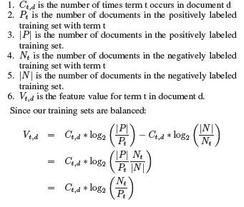
Review of Relevant Literature
Delta TFIDF: An Improved Feature Space for Sentiment Analysis (Continued)
How Delta TFIDF determines word value:

Slide 5
Review of Relevant Literature
Tripathy, Agrawal, and Rath looked over several IMDB reviews and used the following techniques to review the sentiment of the documents.
Sentiment Analysis - Analyzes people’s opinions as well as emotions towards products, organization, entities etc. Conducted on three different levels.
Document
Classifies whether the document’s opinion is overall positive, negative, or neutral towards a given topic.
Sentence
Determines whether a given sentence is overall positive, negative, or neutral towards a given topic.
Aspect
Focuses on all expressions of a sentiment given within a document and aspect for which it refers.
(Classification of Sentiment reviews using n-gram machine learning approach. Tripathy, A., Agrawal, A. and Rath, S.K.)

Slide 6
Review of Relevant Literature. cont.
Machine learning techniques were used to perform these sentiment analysis. These were performed using the following machine learning techniques
Supervised
The dataset is labeled and trained to obtain a certain output which informs proper decision making.
Unsupervised
Much more freeform due to the fact that this doesn’t require any label data. Clustering algorithms are used to solve processing this unlabeled data.
While looking over these movie review, the trio realized how unstructured the movie reviews were and that they were only text. Because of this stop words and unwanted information is removed.
(Classification of Sentiment reviews using n-gram machine learning approach. Tripathy, A., Agrawal, A. and Rath, S.K.)

Slide 7
Review of Relevant Literature. cont.
When looking over these reviews they put the documents through verterizations.
The text from the document would be converted into a matrix of numbers
The matrices are then given inputs to different machine learning techniques for classification.
Different parameters are then used to evaluate the performance of the algorithms.
(Classification of Sentiment reviews using n-gram machine learning approach. Tripathy, A., Agrawal, A. and Rath, S.K.)

Slide 8
Research, Design, and Development plan.
Our current goal is to create a standard TFIDF and use it against the provided dataset. Perform tests mentioned in research article to verify it is working correctly and then iterate on the design to accommodate the Delta TFIDF variant. Once this is accomplished we will redo testing to confirm delta variant is providing a higher level of accuracy of the semantics of the text.

Slide 9
Evaluation Plan
Compare results against standard bag of unigram and bigram words.
Unigram: one word sequence
Bigram: pair of one word sequence
Ten fold cross validation
One data set divided randomly into 10 parts, 9 used for training and one reserved for testing, repeat this procedure ten times each time reserving a different tenth for testing
T-tests, used to prove statistically significance improvement in classification accuracy.
Used to compare the means of two groups
Three t-tests, one sample, two sample, and paired

Slide 10
Summary of Results Obtained
Since our team is at the early stages, we haven’t collect any results yet. We plan on getting some more concrete results in the following days.

Slide 11
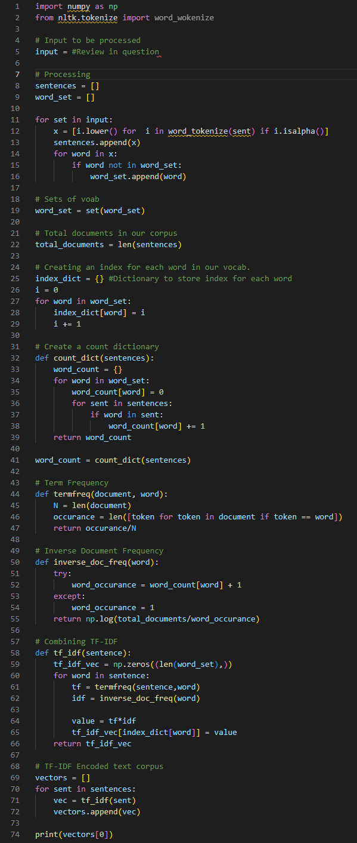
Demo of Preliminary Results
Since our team is at the early stages, we haven’t got a working code just yet. However, we have started and have a conceptual prototype.
Like previously mentioned using Delta TFIDF is a method we can use to get an idea of the general sentiment of a given document. We plan on using the adjacent code to process the document and discern it sentiment.
This done by preprocessing the text and make a set of words. We then create a “dictionary” to keep a count of the documents that use a given word. This will also give context to those words to hopefully determine a sentiment. Finally, we get the term frequency and its inverse term frequency and then apply it to get our results.

