Slide 1
Shared Leadership
03/05/2021

Slide 2
Goal
To design and experiment a method to automatically detect leadership practices in open source software community, based on developers’ comments during issue discussion/resolution processes.

Slide 3
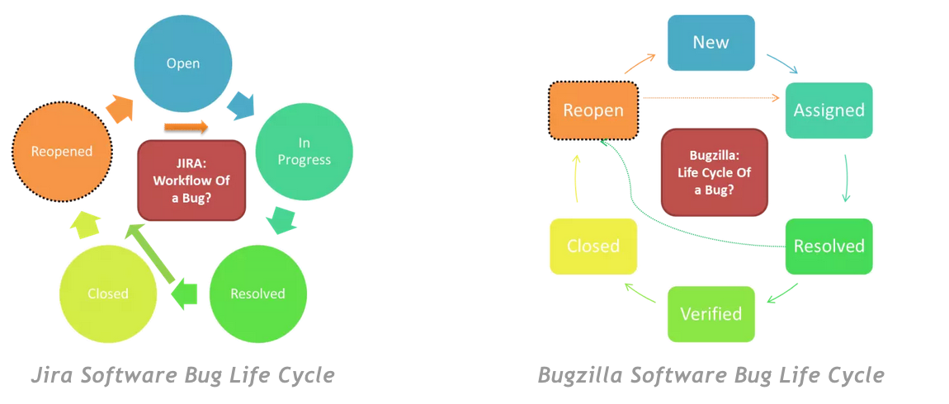
Background (1): Lifecycle of a Software Bug/Issue

Slide 4
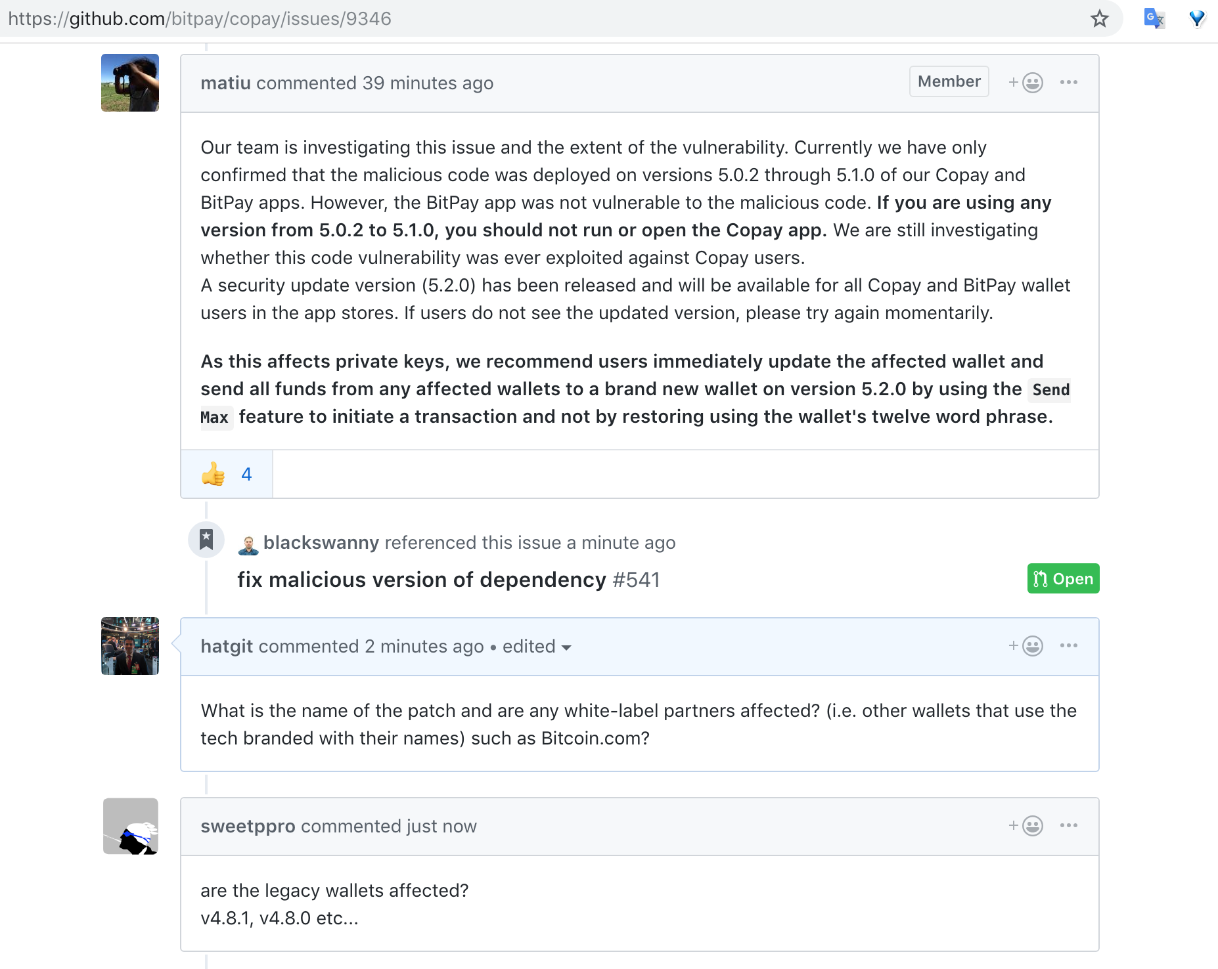
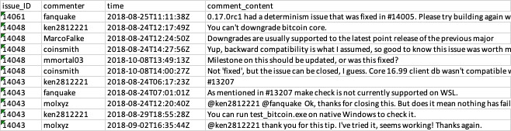
Background (2): Issue Tracking on Github
Github Interface
Issue Comments data example

Slide 5
Research Methodology
Defining leadership practice types
Data collection and preprocessing
Manual annotation
Automated labeling
Experimental evaluation

Slide 6
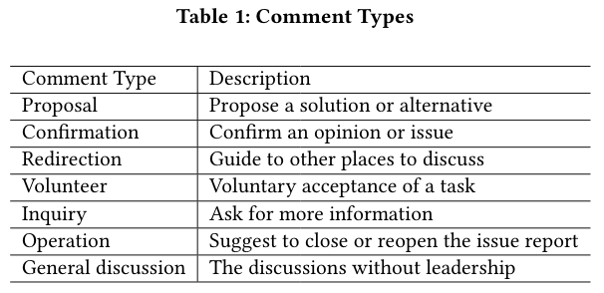
1. Defining leadership practice types

Slide 7
2. Data collection and preprocessing
Extract issue history from selected Github projects
Filtering
Preprocesssing

Slide 8
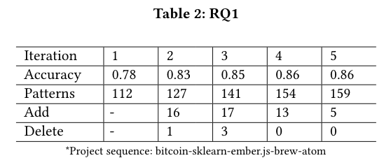
3. Manual Annotation
Labelling team
Pattern pool

Slide 9
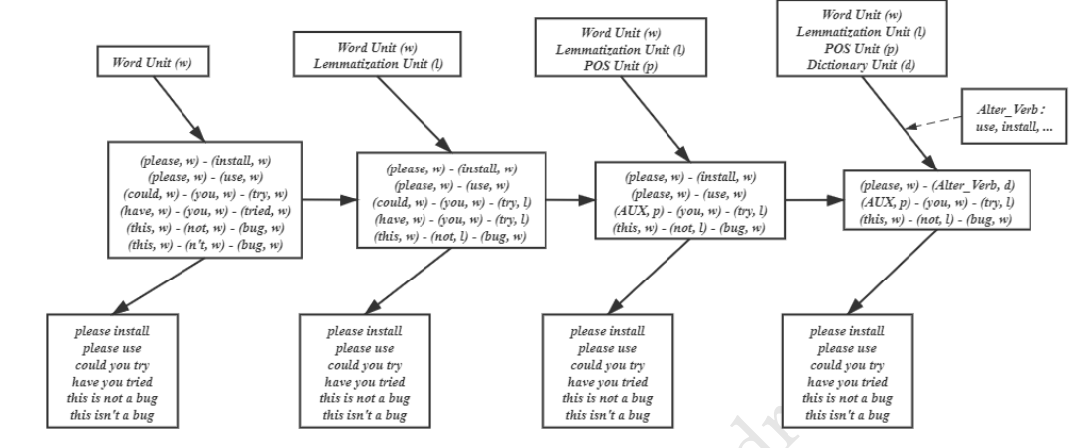
4. Autoamted Labelling

Slide 10
5. Experiment
Accuracy Analysis
Correlation between leadership and other contribution indicators

Slide 11
Research Tasks
Analyzing prediction errors
Visualization : Gelphi, python, MATLAB
Manual examination of comment content
Explore ways for interpreting and improving accuracy

