Slide 1
Preliminary Engineering Advisory Board Senior Project Review
Brandon Essary, Sunya Chay, William Flores

Slide 2
Introductions
Team Introductions
Project name: kofc-wa.org website update
Project client: Dr. Olwell- Knights of Columbus Washington state council

Slide 3
Purpose of the project
The purpose of this project is to update the current Knights of Columbus Washington website to provide the client and user a secure website that is sleek and easy to use. With this project we will provide a website that is easy to navigate for both the end user and the website administrator. The end state for this project is for the elected members to be able to communicate in mass with current and future members about past, current and future events in real time.

Slide 4
Roles and responsibilities
Responsibilities
All members are responsible to commutate with each other. The best teams will fail if there is poor or no commutation.
When presenting a roadblock team members should present options to get past the problem or be open to solicitation form other teammates.
Any team member should be ready to fill the role of another if that person is unavailable .
Roles
Brandon Essary (Team lead) Brandon is responsible for contact with the customer and setting up meetings. Research and coding.
Sunya Chay (Team member) Research, coding and web design.
William Flores (Team member) Research, ADA requirements, coding.

Slide 5
Technical/qualitative project restraints
Official permission from Knights of Columbus to update and secure new website.
ADA requirements for websites. Our goal for the new website is to be compliant to the checklist level AA at the time of development.
Having to learn webhost control panel to maximize website for the end user.
If decided not to start with a webhost, ensuring that current prototype can be passed to and from team members so as the project is moving forward.

Slide 6
Risk
Currently the team is in contact with Dr. Orwell. There is has been no contact with the Knights of Columbus state council. There is a chance the project will not get the approval from the state council until there is a working prototype.
There are unknown factors the team may face during the building phase of the project. One unknown factor we are expecting is a large dataset that will have to incorporated into the project.
By the end of spring semester 2023 the project might not be competed (operational). This project might have to be handed off to another team for completion(in the prototype phase).

Slide 7
Current Schedule
Date | Event | Notes
October 10th, 2022 | First Meeting
October 31st, 2022 | Schedule, ADA Requirements, Use Cases for Meeting Due
November 7th, 2022 | List of Requirements Completed and Ready for Approval | Needs to also include, budget, restraints and risks
November 10th, 2022 | Meeting with Members to Approve List of Requirements
November 14th, 2022 | Mock-up of website
November 17th, 2022 | Meeting wit Members to Approve the Mock-up
November 21st, 2022 | Presentation, and Video Needs to be done and recorded
December 6th, 2022 | Presentation Due to YouTube | -Also need to email every link to Tam Leger and Prof. Nelson
Date | Event | Notes
December 9th, 2022 | Final Written and Oral Presentation Due
February 17th, 2023 | Poster 1 Due
February 20th, 2023 | Front end completed | Homepage with links to other pages
February 27th, 2023 | Login pages completed
March 13th, 2023 | Security completed | Making sure that the website is secure
March 16th, 2023 | Meeting with Members to approve the website
March 20th, 2023 | Finalize prototype and set up in host system | Placing prototype into server like AWS or Azure
March 27th, 2023 | Launch Prototype and Finish and Record Presentation
April 6th, 2023 | Submit Presentation and All Links

Slide 8
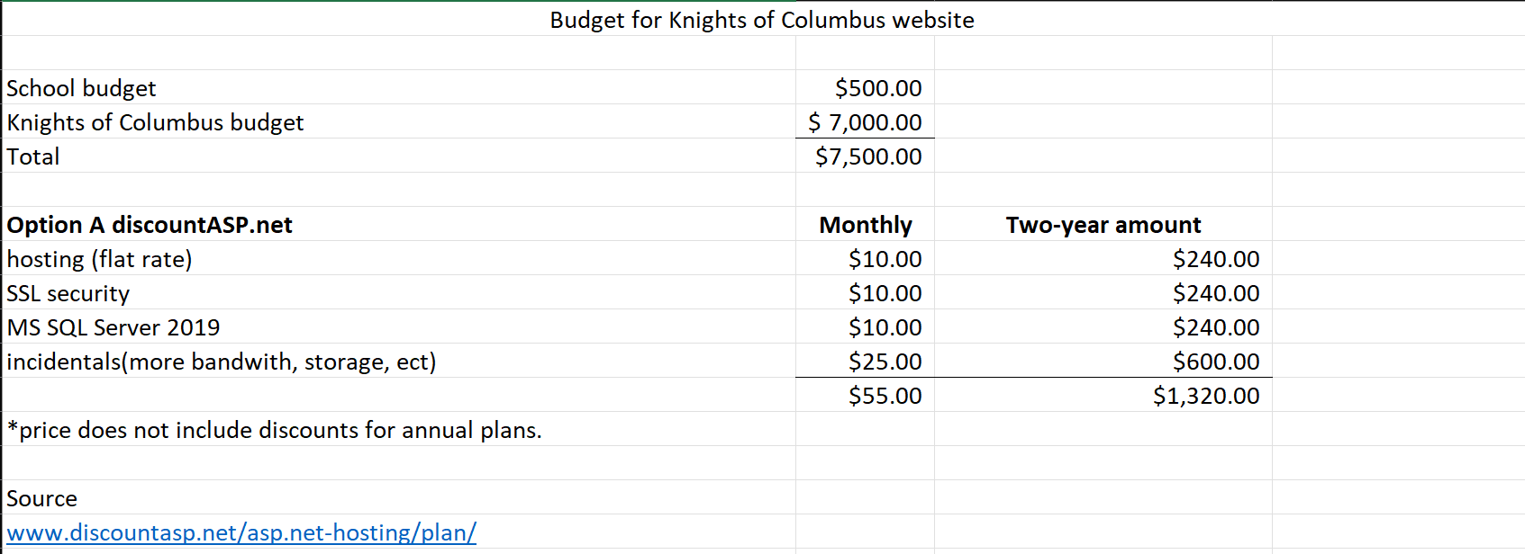
Budget
Pros
Great for small websites.
Current webhost for site
Cons
Can get expensive quickly.
Webhost is metered where another webhost are not.
Exceeds the school budget.

Slide 9
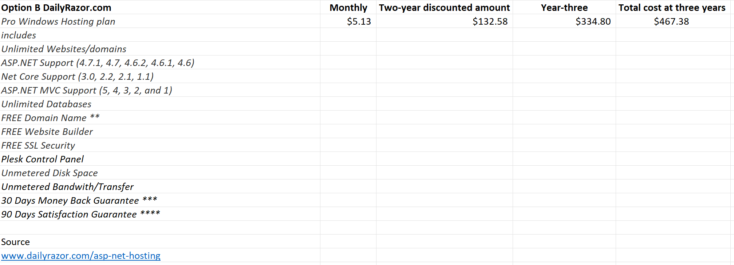
Budget
Pros
Much cheaper that current webhost.
Added value with contract
At three years inside the school budget.
Cons
May not be able to choose database.
Customer service will be limited to email and live support.

Slide 10
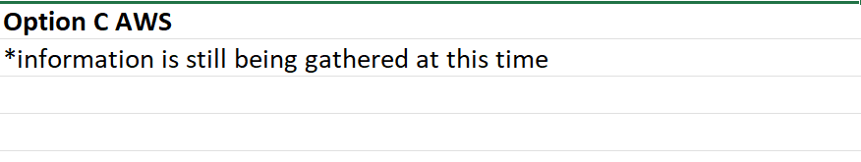
Budget
Pros
World class customer service.
Cons
No known cost currently.

Slide 11
Next Steps
Looking to the state council for approval of the project. This is not limited to the layout of the site; the group will need approval for all aspects of the website to include the look and contents of the website.
Decide the web provider to host the site.
Get to coding the site.

