Slide 1
Team Larfleeze
Final Project
By:
Nathan Graham
Matt Wilhelm
Brandon Fowler

Slide 2
Basics:
“Dungeon and dragons” theme
Dungeon crawler
Programmed in Java language
Command Line Based(No GUI)

Slide 3
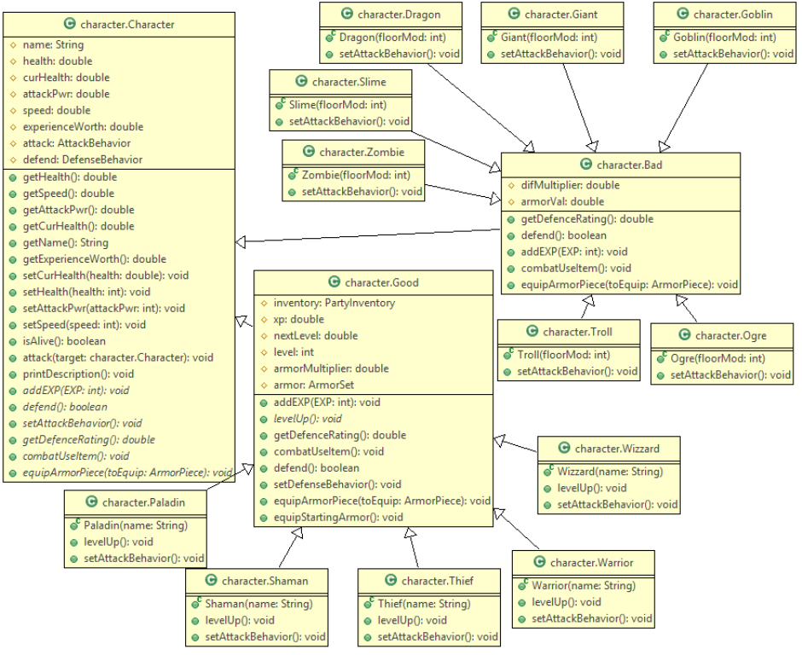
UML Diagrams
Character Hierarchy

Slide 4
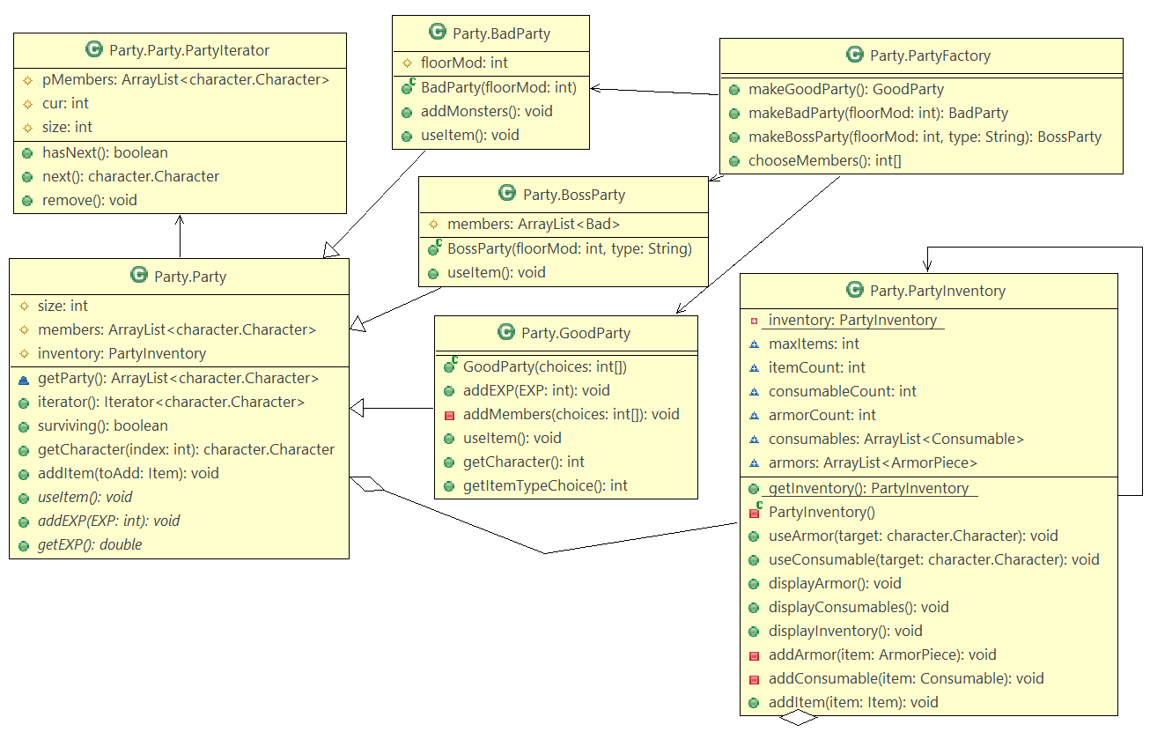
UML Diagrams
Party System

Slide 5
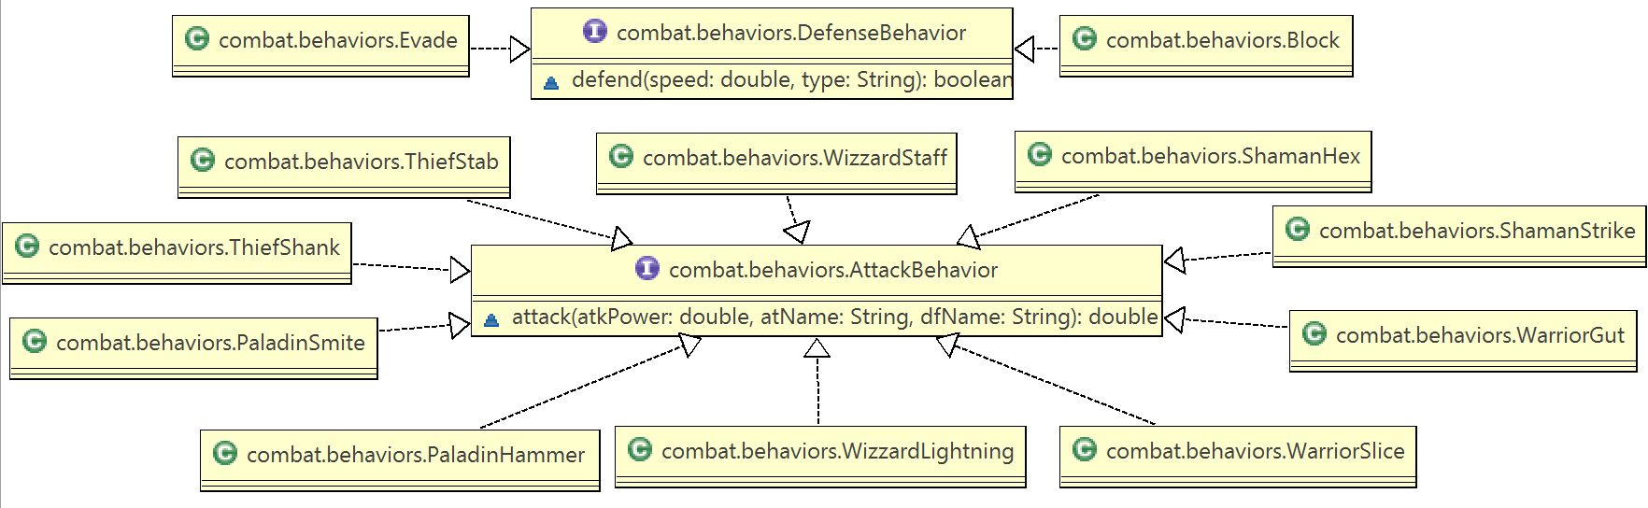
UML Diagrams
Hero Attack Behaviors

Slide 6
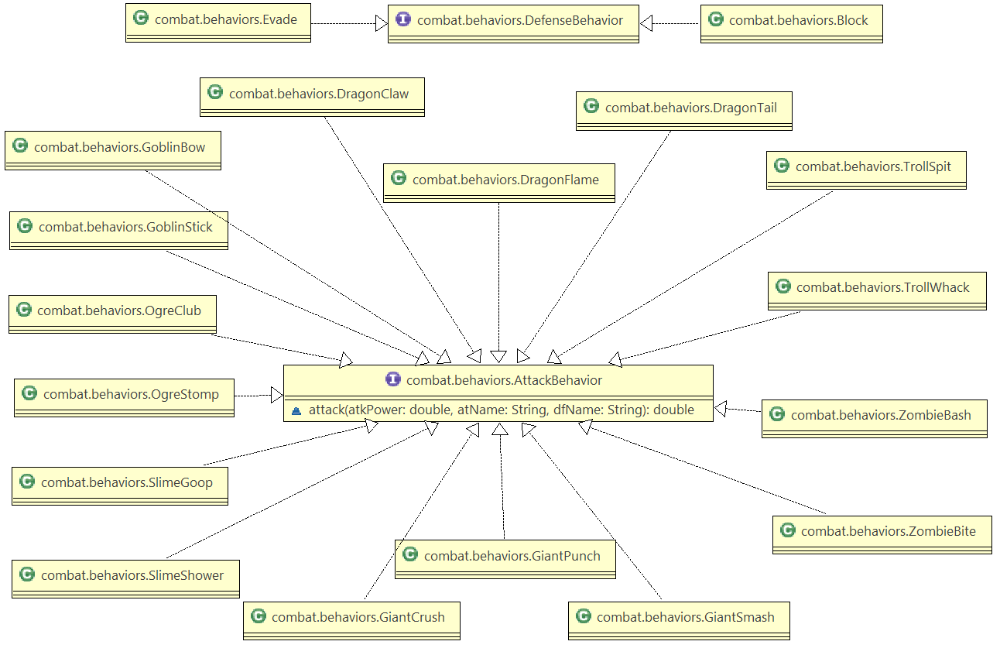
UML Diagrams
Monster Attack Behaviors

Slide 7
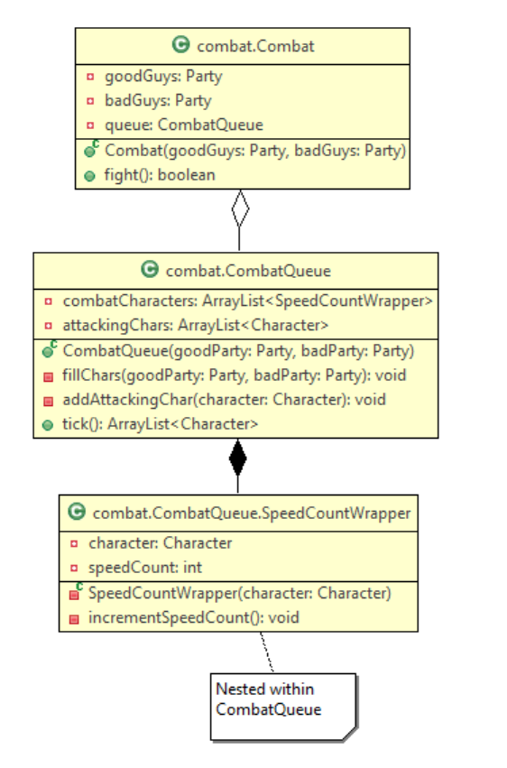
UML Diagrams
Combat System

Slide 8
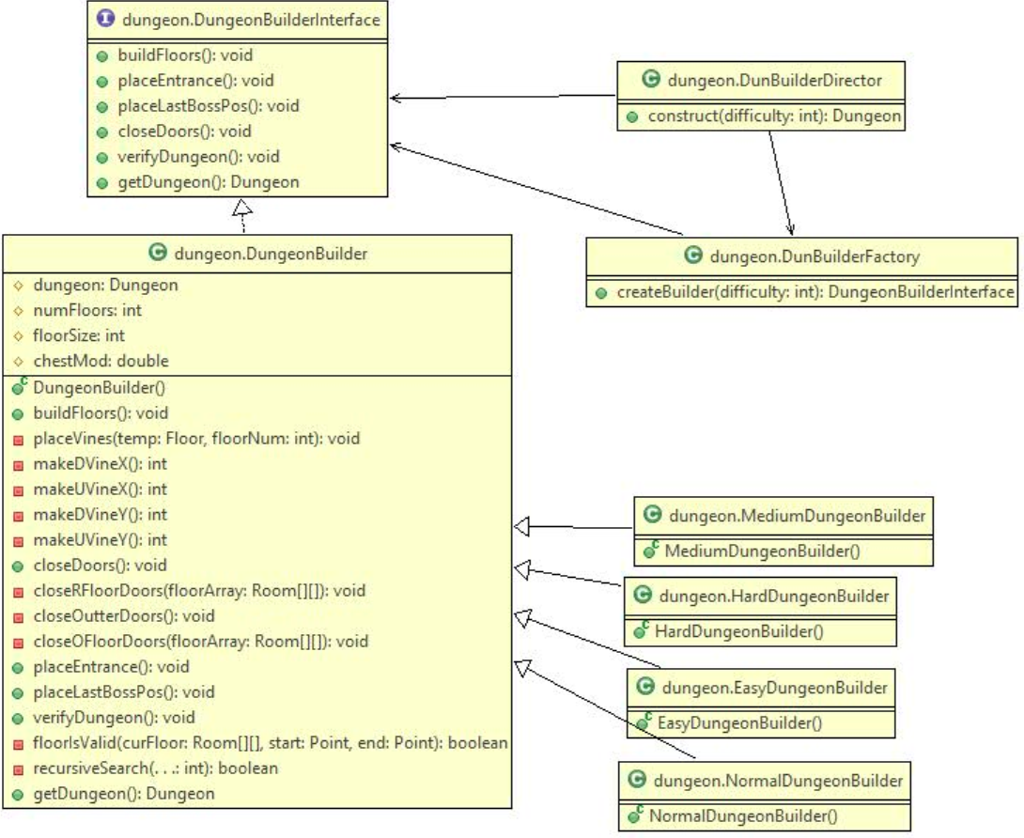
UML Diagrams
Dungeon Builder

Slide 9
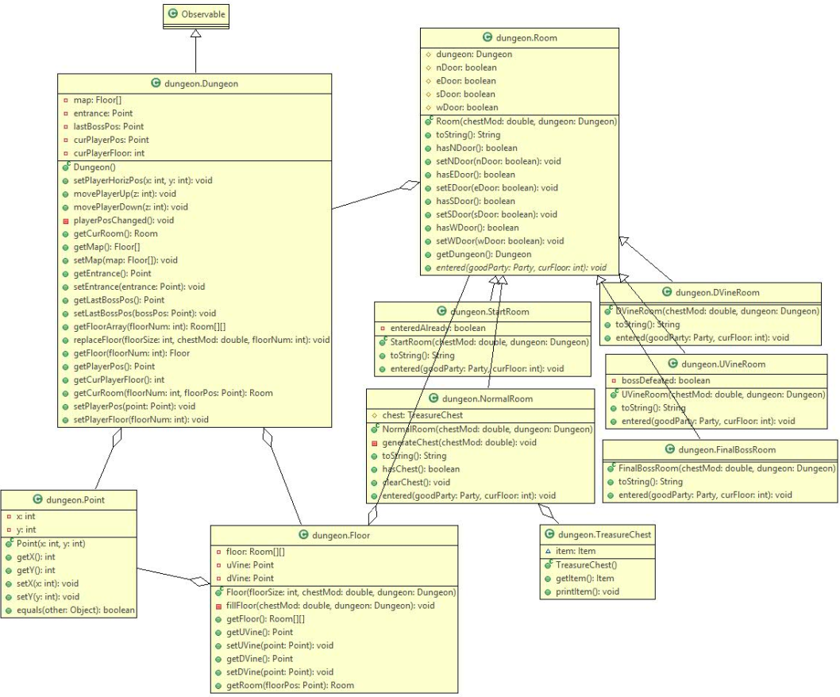
UML Diagrams
Dungeon Structure

Slide 10
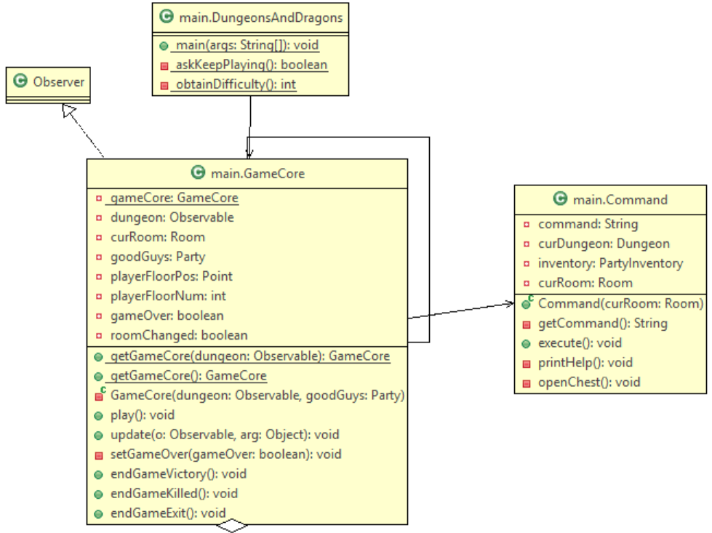
UML Diagrams
Main

Slide 11
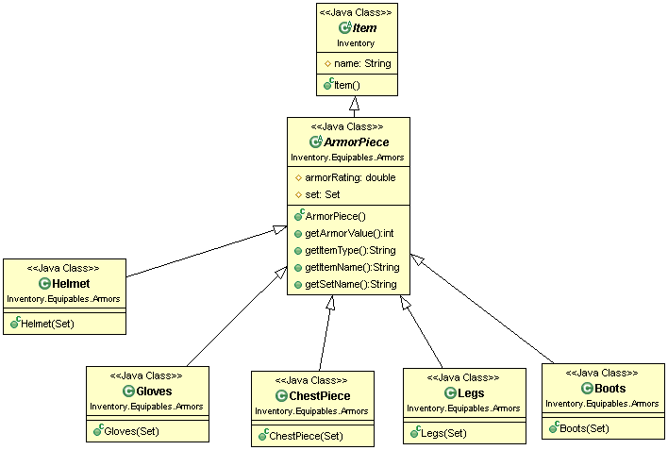
UML Diagrams
Armor Implementation
Used a generic name for the item type.
Core statistics were based on a set which used a strategy pattern to emulate statistic "behavior."

Slide 12
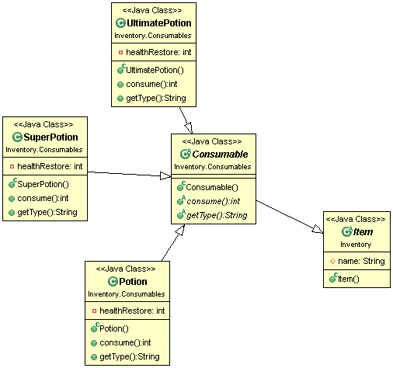
UML Diagrams
Consumable Implementation
Used a strategy pattern to outline specific unique behaviors.

Slide 13
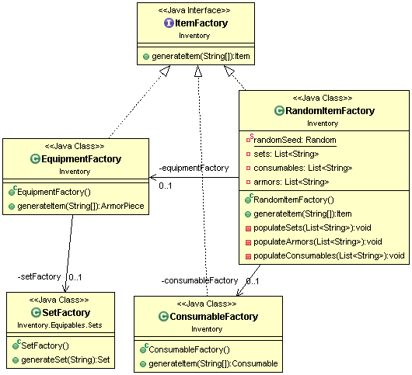
UML Diagrams
Item Factory
Used an abstract Factory to drive underlying behaviors of item factories.
Item generation was done by the more specific factories.
The Random item factory contained references to the two types of factories and used them to generate items randomly.

Slide 14
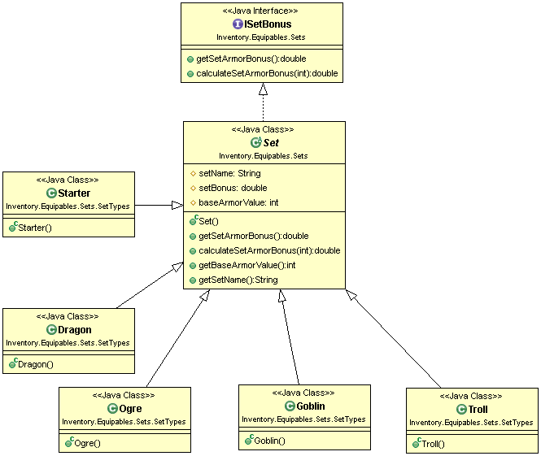
UML Diagrams
Set Implementation
Sets were implemented using a strategy pattern and drove the behaviors of certain armor characteristics such as defense points or set bonuses.

Slide 15
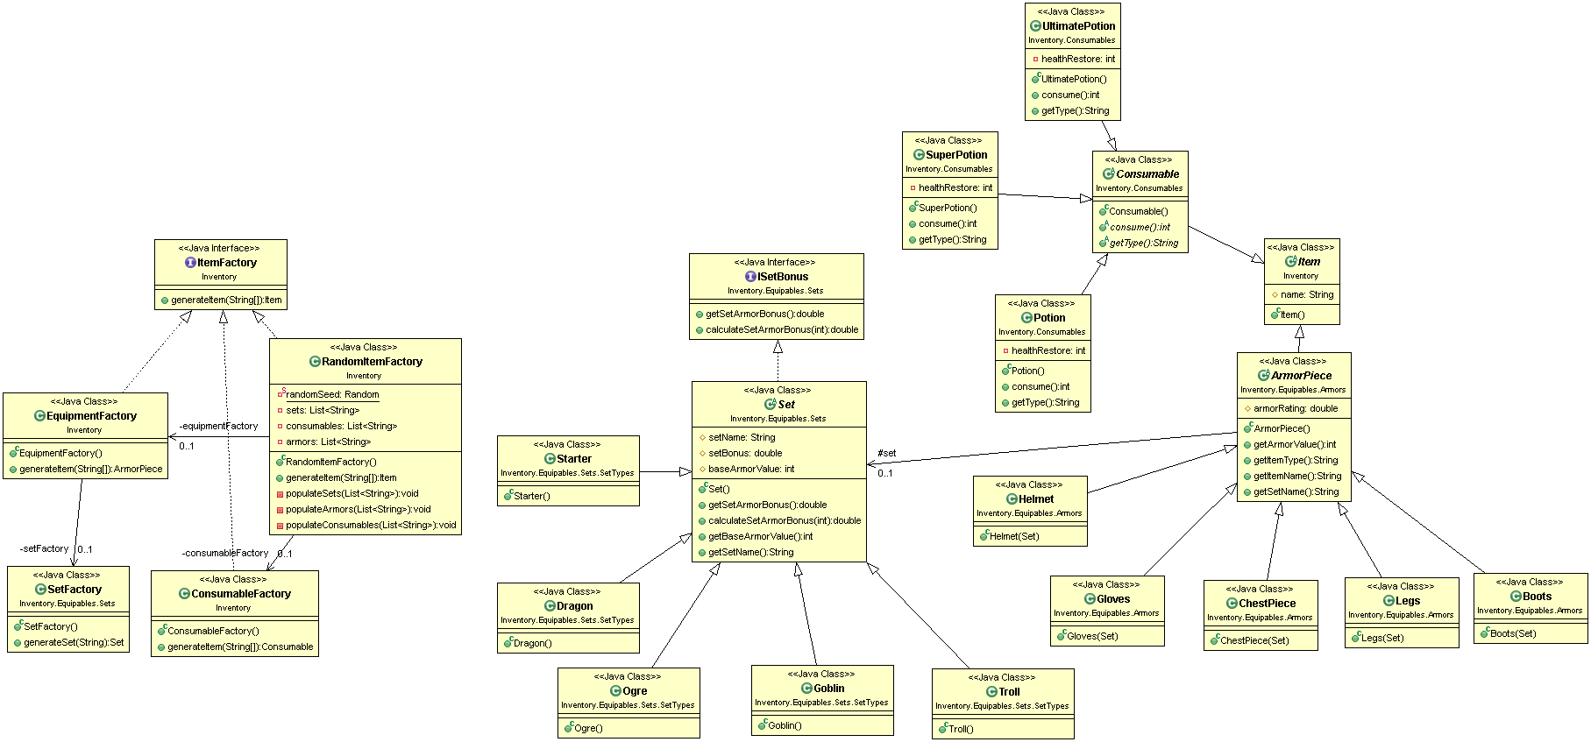
UML Diagrams
Entire Item System

Slide 16
Demo

