Slide 1
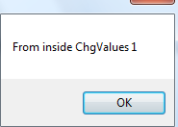
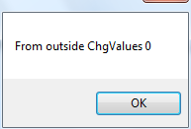
Passing Arguments by Value
All the examples so far have been pass by value, i.e. a copy of the arguments have been passed into the parameters of the method.

Slide 2
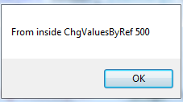
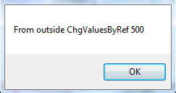
Pass By Reference
Rather than passing a copy of the variable, you can pass a reference (which in fact is the memory address) of the variable.
Note:
In C# you use the “ref” keyword in both the method header and when calling the method. In fact it would be syntax error if you don’t call the method with “ref” keyword.
As num2 is in fact now pointing at orig2, whatever you do to num2 you are actually doing it to orig2
In C# the variable MUST be initialized to some value before it is passed by reference, i.e. orig2 has to be initialized to some value first.

