Slide 1

A Computer processes data into information.
Software are computer instructions that tells the computer how to process data into information.
Data
Processes
Software
Information

Slide 2
7601, “Ian Puccini”, 28.2,14.25
234, “Joe Wong”, 42,10.75
6215, “Katie Brown” 45.5,12.45
(Data)
Computer Processes
(Information)
Employee Employee Hours Hourly
Number Name worked Rate Pay($)
7601 Ian Puccini 28.20 14.25 401.85
234 Joe Wong 42.00 10.75 451.50
6215 Katie Brown 45.50 12.45 566.48

Slide 3
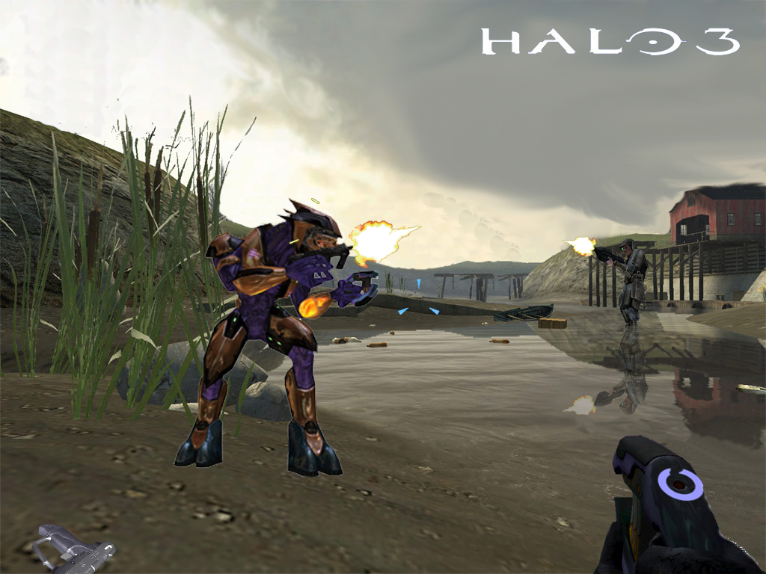

Slide 4
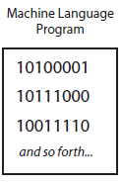
Machine Language (1st GL)
Computers only understands machine language,
which is in the form of 1s and 0s.

Slide 5
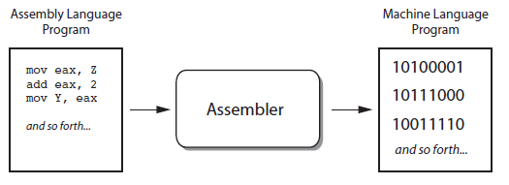
Assembly Language (2GL)
Unfortunately it is too difficult to develop in machine
language, so assembly language was created as an
alternative.
However you still need to translate the assembly
language into machine language before that
program can be executed.

Slide 6
High level Language (3GL)
Assembly language requires you to write a large number of instructions for even the simplest of programs. It also requires you to know a lot about the specific CPU
In the 1950s high level languages began to appear which allows you to create more powerful and complex programs, without knowing how the CPU works and having to write large number of low level instructions.
Most high-level languages use English-type words, making it easier to understand and write.

Slide 7
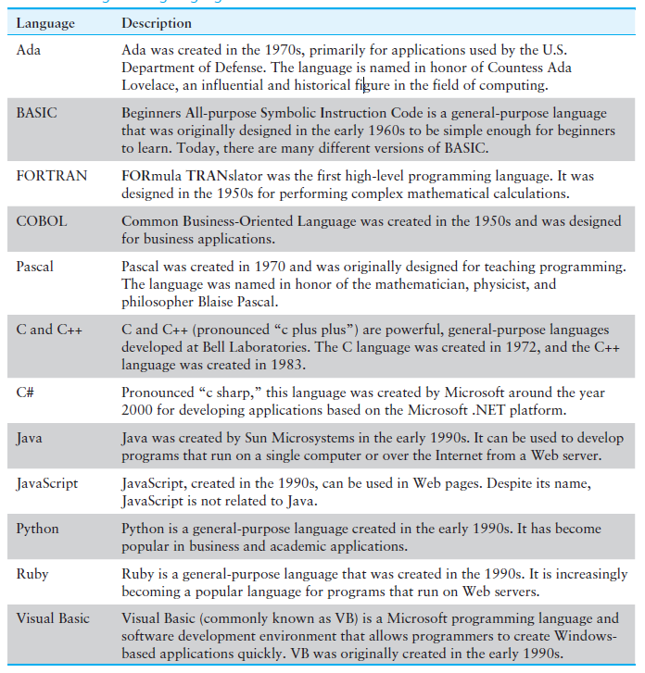

Slide 8
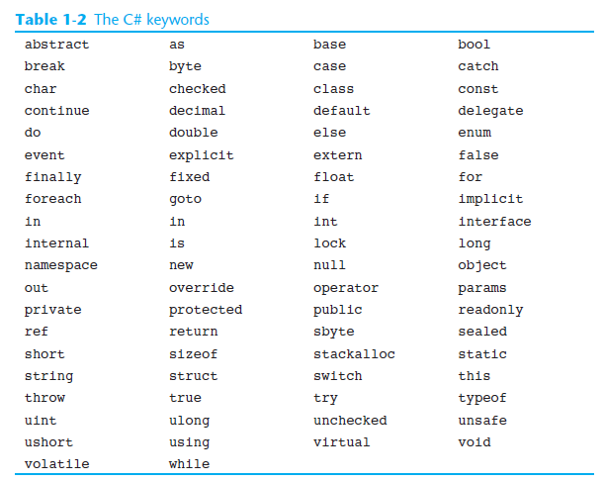

Slide 9
Fourth Generation Language (4GL)
Developed from the 1970s through the 90s.
Minimal use of code.
Primarily used for Database management ,like Oracle Developer Suite, and large Business development like CASE tools
Fifth Generation (5GL)
Used mainly for artificial intelligence, e.g: Prolog and LISP. 5GL is also known as natural language, as it allows the user to “talk” to the computer.

Slide 10
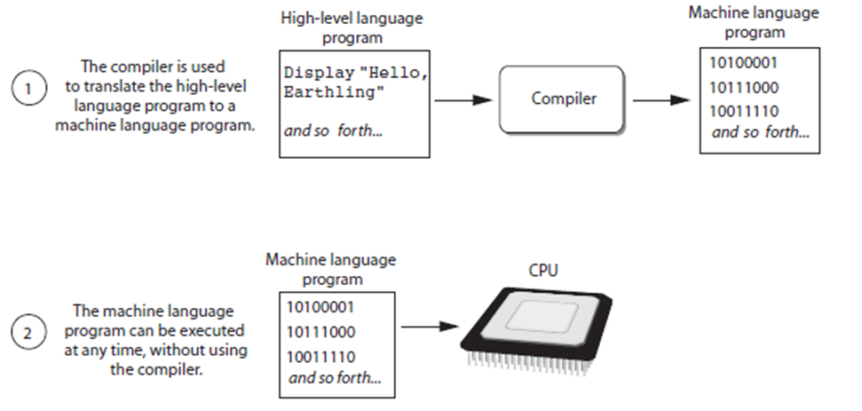
Compilers and Interpreters
A compiler translates high-level language into machine language. The machine language can then be executed.
(Java, C#, C/C++ all use compilers)

Slide 11
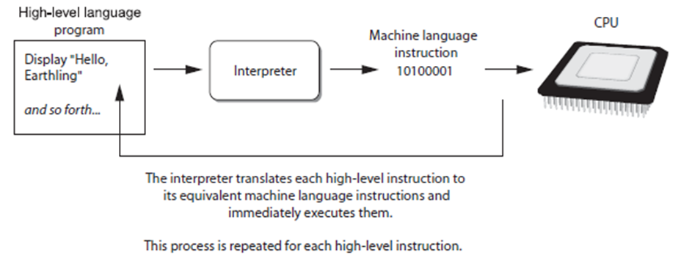
An interpreter translates and executes the instructions in a high level language.
(JavaScript, PHP use interpreters)

Slide 12
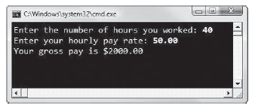
Types of Programs
Console-based
These programs use a command-line interface (console interface).
This is a text-based environment
In text based environment, the program determines the order of input, i.e. the program asks for hours worked before asking for the next input.

Slide 13
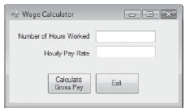
GUI-based
These programs use a graphical user interface.
It uses graphical elements as well as mouse clicks.
In a GUI environment, the user determines the order in which things happen, i.e. user can enter hourly rate before hours worked. He or she can even click the button to calculate before entering the necessary input for calculation. Because GUI programs must respond to user action, they are event-driven. The user causes events by clicking on a button, and your program must respond to them.

Slide 14
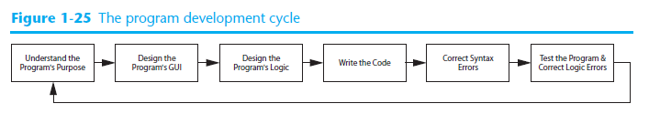
Program Development

Slide 15
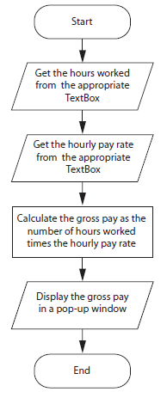
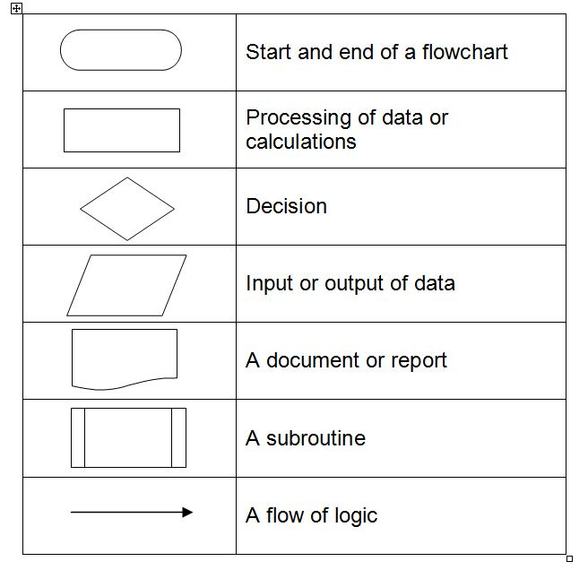
Design the program’s logic
Flowchart
A flow chart is a diagram using symbols to show the step-by-step
sequence of procedures in a program.
A flow chart describes the logic and program flow of a
computer program graphically.

Slide 16
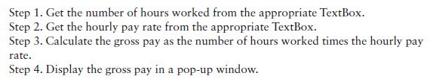
Pseudo code
This is “fake” code, i.e. the algorithm is written out in
plain English statements.

Slide 17
Control structure
This is a structure of statements in programming that
allows the programmer to control the flow of a program.

Slide 18
SEQUENCE CONTROL STRUCTURE
Sequence control refers to the linear execution of codes
within a program.
In sequence control, the statements are executed one by one
in consecutive order.

Slide 19
SELECTION CONTROL STRUCTURE
There are times when you want your program to make a decision based
on the situation given.
Selection control enables the programmer to assign different events for
different situations.

Slide 20
REPETITION CONTROL STRUCTURES
A repetition control structure allows the programmer to specify an
action to be repeated while some condition remains true or false (yes or no).

Slide 21
Draw flowchart for:
Display numbers from 1 to 10
If your age is greater than 55, then display “time to retire, otherwise display “keep working”
Display numbers from 10 to -10 BUT skip over 0
Rewrite above using pseudo code.

Slide 22
Errors
There are three types of errors uncovered during the
testing of your program: syntax errors, logic errors
and run-time errors.

Slide 23
SYNTAX ERROR
When the code violates the syntax of the programming language, a syntax error occurs. A syntax error is caused by a wrong spelling in command and declaration. Other syntax errors include case sensitive, punctuation and wrong word command
LOGIC ERROR
If the expected output and actual output do not match for any set of data, the program has a logic error. A logic error is an error in the design that causes inaccurate outputs.
RUN-TIME ERROR
Run-time error is an error that occurs while the program is running or executing. A run-time error may cause the program to stop running.

Slide 24
Objects
An object is a program component that contains data and performs operations. Programs use objects to perform specific tasks.
Most programming languages that are used today are object oriented.
In programming, an object is a software component that exists in the computer’s memory. In software, an object has two general capabilities:
• An object can store data. The data stored in an object are commonly called fields, or properties .
• An object can perform operations. The operations that an object can perform are called methods .

Slide 25
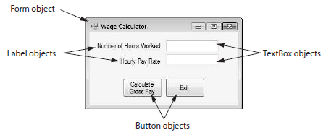

Slide 26
Classes
A class is a template or blueprint from which objects are derived from.
Essentially, it specifies the data that an object can hold (the object’s fields or properties), and the actions that an object can perform (the object’s methods).
.NET Framework
The .NET Framework is a collection of classes and other code that can be used, along with a programming language such as C#, to create programs for the Windows operating system. For example, the .NET Framework provides classes to create Forms, TextBoxes, Labels, Buttons, and many other types of objects.
When you use Visual C# to write programs, you are using a combination of the C# language and the .NET Framework.

