Slide 1
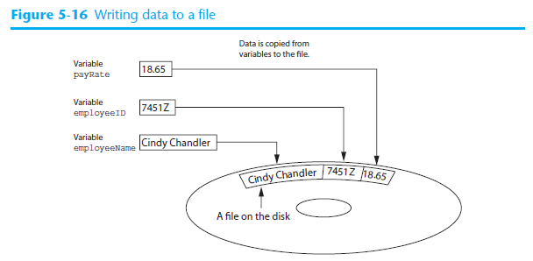
Programmers usually refer to the process of saving data in a file as writing data to the file.
The term output file is used to describe a file to which data is written.

Slide 2
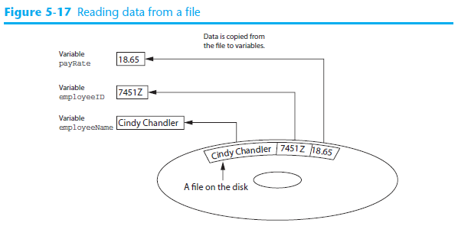
The process of retrieving data from a file is known as reading data from the file.
When a piece of data is read from a file, it is copied from the file into a variable in RAM.
The term input file is used to describe a file from which data is read.

Slide 3
There are always three steps that must be taken when a file is used by a program.
Open the file —Opening a file creates a connection between the file and the program. Opening an output file usually creates the file on the disk and allows the program to write data to it. Opening an input file allows the program to read data from the file.
Process the file —In this step data is either written to the file (if it is an output file) or read from the file (if it is an input file).
Close the file —When the program is finished using the file, the file must be closed. Closing a file disconnects the file from the program.
Dealing with files is similar to books, in that you have to open a book first before reading or writing to it and you usually close it after you finish with it.

Slide 4
Types of Files
In general, there are two types of files: text and binary.
A text file contains data that has been encoded as text using a scheme such as Unicode. Even if the file contains numbers, those numbers are stored in the file as a series of characters. As a result, the file may be opened and viewed in a text editor such as Notepad.
A binary file contains data that has not been converted to text. As a consequence, you cannot view the contents of a binary file with a text editor.
This course deals with text files.

Slide 5
File Access methods
Most programming languages provide two different ways to access data stored in a file:
sequential access and direct access.
In sequential access you access data from the beginning of the file to the end of the file. If you want to read a piece of data that is stored at the very end of the file, you have to read all the data that comes before it—you cannot jump directly to the desired data. This is similar to the way cassette tape players work.
In direct access file (which is also known as a random access file ), you can jump directly to any piece of data in the file without reading the data that comes before it. This is similar to the way a CD player or an MP3 player works. (note you can jump, because along with the data file, there is also an “index” file accompanying it, that indicates the position of that record, like the index at the back of a book).
This course focuses on sequential access.

Slide 6
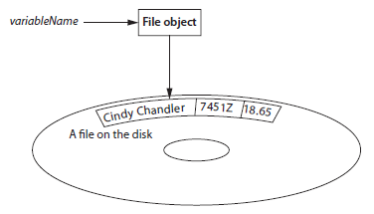
File objects
A file object is an object that is associated with a specific file and provides a way for the program to work with that file. In the program, a variable is linked with the file object. We say that the variable references the object.

Slide 7
When you want to write data to a text file, you use the StreamWriter class .
When you want to read data from a text file you use the StreamReader class .
These classes are in the System.IO namespace in the .NET Framework, hence you need:
using System.IO;
In C# you use a StreamWriter object to open a stream, such as a file, and write data to it.
You use a StreamReader object to open a stream, such as a file, and read data from it.

Slide 8
Note:
The File.CreateText method does the following:
It creates a text file with the name specified by the argument. If the file already exists, its contents are erased.
It creates a StreamWriter object in memory, associated with the file.
It returns a reference to the StreamWriter object.
The file by default is located in bin\debug subfolder, i.e. same location as the “exe” file.

Slide 9
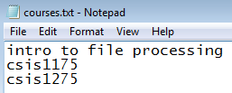

The WriteLine() puts a line break after each line.
Some programmers refers to files with one record per line as line sequential files.
If the outFile.Write() method was used then all the records would be written one after another

Slide 10
Add new data to existing file
What if you want to add new data to the file? You can do this with the “AppendText” method, but only starting from the end of the file. It works like the File.CreateText method, but the file is not erased if it already exists.
However, if the file indicated DOES NOT exist, then AppendText() will create a NEW file.

Slide 11

Reading Data from StreamReader Object
The File.OpenText method does the following:
It opens an existing text file with the name specified by the argument. If the file does not exist, an exception is thrown.
It creates a StreamReader object in memory associated with the file.
It returns a reference to the StreamReader object.

Slide 12
The read position
When a program works with an input file, a special value known as a read position is internally maintained for that file.
A file’s read position marks the location of the next item that will be read from the file. When an input file is opened, its read position is initially set to the first item in the file.

Slide 13
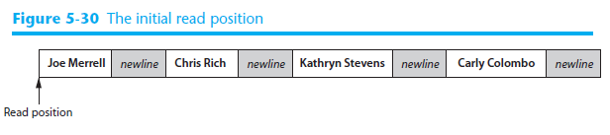
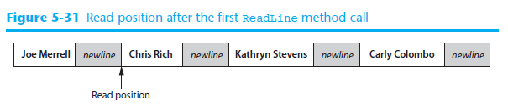
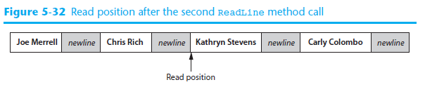

Slide 14
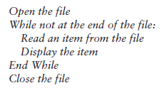
The program needs some way of knowing when the end of the file has been reached so it will not try to read beyond it.
StreamReader objects have a Boolean property named EndOfStream that signals whether the end of the file has been reached.
If the file’s read position is at the end of the file (and there is no more data to read), the EndOfStream property is set to true. Otherwise, it is set to false.

Slide 15
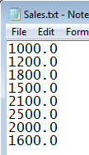
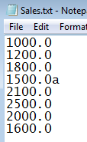
Draw flowchart to accumulate Sales
Write code in Total Sales project

