Slide 1
Declaring Variables as Fields
A field is a variable that is declared at the class level. A field’s scope is the entire class.

Slide 2
Note:
Declaring fields do involve an access modifier (it specifies how a class member can be accessed by other classes)
By default all fields are “private” i.e. can only be accessed by methods inside the same class as the field. It is still good programming practice to declare them as explicitly as private anyway.
Field’s lifetime
When you declare a field in a form class, the field’s lifetime is the time during which the form exists. This means that the field will exist in memory as long as the form exists. This is different than the lifetime of a local variable, which exists only while the method in which it is declared is executing. Local variables come and go in memory, but a form’s fields exist as long as the form exists.

Slide 3
Constants and constant field
A named constant is a name that represents a value that cannot be changed during the program’s execution.
You use the keyword const which tells the compiler to make the variable read-only.
const double TAX = 0.07;
When declaring a named constant an initialization value is required.

Slide 4
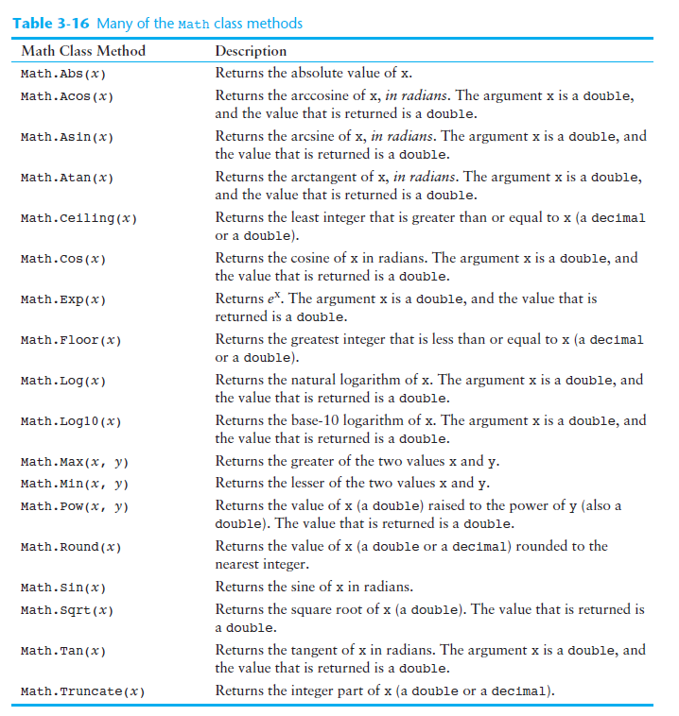

Slide 5
To make decisions we use the Descision structure (Selection structure).
if Statement
if( condition..)
{
statements;
}
if( condition..)
{
statements;
}
else
if(.. condition..)
{
Statements;
}
if( condition..)
{
statements;
}
else
{
Statements;
}
The condition evaluates to either True or False
You don’t need braces if the body of the if or else statement has only one statement

Slide 6
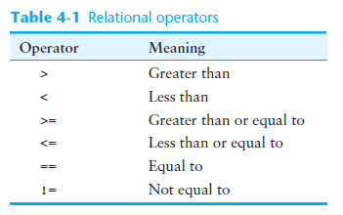
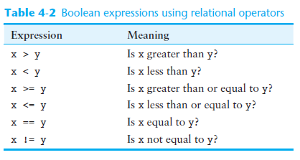

Slide 7
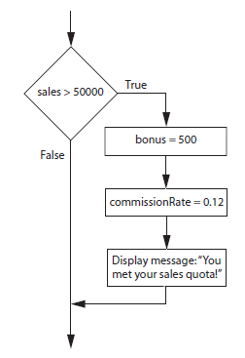
Use project Decision1 and translate into C# code

Slide 8
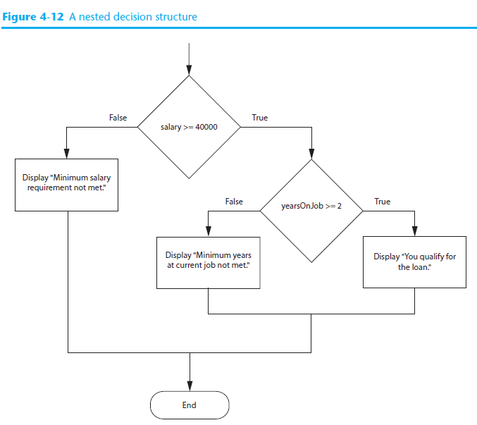
Use project Decision2 and translate into C# code

Slide 9
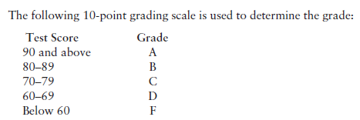
Use project Decision3 and translate into C# code

Slide 10
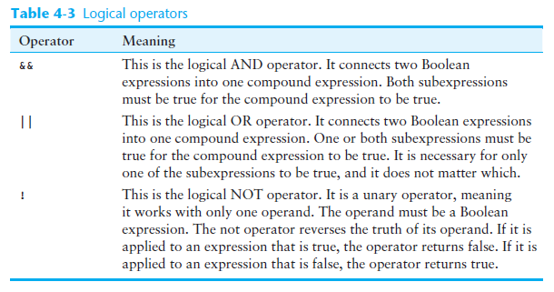
Logical Operators
The logical AND operator ( && ) and the logical OR operator ( || ) allow you to connect multiple boolean expressions to create a compound expression.
The logical NOT operator ( ! ) reverses the truth of a boolean expression.

Slide 11
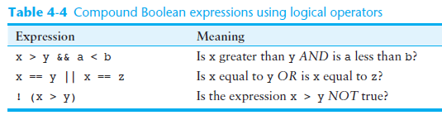

Slide 12
Truth Table (Assume 0 – False, 1 – True)
&& (AND)
Exp1 Exp2 Exp1 && Exp2
0 0
0 1
1 0
1 1
|| (OR)
Exp1 Exp2 Exp1 || Exp2
0 0
0 1
1 0
1 1

Slide 13
! (NOT, negation)
Exp1 !Exp1
0 1
1 0

Slide 14
x = 1, y = 1
if(x > 0 && y == 0)
Console.Writeln(“true”);
else
Console.Writeln(“false”);
x = y = z = 1;
if(x > 0 && y == 1 || z = 0)
Console.Writeln(“true”);
else
Console.Writeln(“false”);

Slide 15
if(y != 1)
Can be re-written as (using negation):
if( temperature <= 100)
Can be re-written as (using negation):

Slide 16
Check for numeric range:
Write an if statement to see if a number is between 20 (inclusive) and 40 (exclusive)

Slide 17
String comparisons
Recall from Chapter 1 that computers do not actually store characters, such as A , B , C , and so on, in memory. Instead, they store numeric codes that represent the characters. We mentioned in Chapter 1 that C# uses Unicode to represent characters. Here are some facts about the Unicode system:
The uppercase characters A through Z are represented by the numbers 65 through 90.
The lowercase characters a through z are represented by the numbers 97 through 122.
When the digits 0 through 9 are stored in memory as characters, they are represented by the numeric codes 48 through 57. (For example, the string “abc123” is stored in memory as the codes 97, 98, 99, 49, 50, and 51.)
A blank space is represented by the number 32.
In addition to establishing a set of numeric codes to represent characters in memory, Unicode also establishes an order for characters. The character A comes before the character B , which comes before the character C, and so on. This ordering becomes important later on when we have to sort a series of strings.

Slide 18
Note:
When testing for strings, it is important to trim any leading and trailing spaces, hence
string secretWord = inputTextBox.Text.Trim();
testing using equality operator will NOT take care of case sensitivity

Slide 19
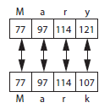
string name1 = "Mary";
string name2 = "Mark";
If one of the strings in a comparison is shorter than the other, only the corresponding characters are compared. If the corresponding characters are identical, then the shorter string is considered less than the longer string. For example, suppose the strings “High” and “Hi” are compared. The string “Hi” is considered less than “High” because it is shorter.
If you compare “Az” with “Ariel”, then “Az” is greater then “Ariel”, as “z” comes after “r”.

Slide 20
Relational operators cannot determine which string is greater or smaller than another, therefore we use:
String.Compare( string1, string2 )
The integer value returning back from the method will be one of the following:
> 0 if string1 is greater than string2 .
0 if string1 is equal to string2 .
< 0 if string1 is less than string2 .

Slide 21
To take care of case sensitivity, we can pass an extra boolean value to the compare method.
String.Compare( string1, string2, bool )
With true being not case sensitive
With false being case sensitive

