Slide 1
Load Event
When an application’s form loads into memory, an event known as the Load event takes place. You can write an event handler for the Load_event, and that handler will execute just before the form is displayed.
To get into the load event, you just double-click the actual form itself.

Slide 2
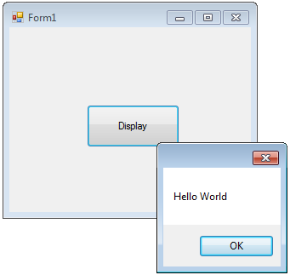
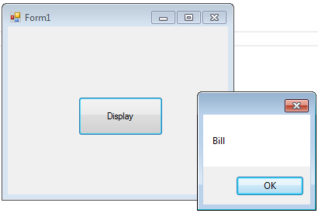
Note:
testStr is initialsed to “Hello World” in the Form1_Load event handler, and this is performed first before any other handlers you may have.
What happens in Form1_Load only happens ONCE.
Also remember that Form1_Load is a method, so if testStr was declared INSIDE the Form1_Event handler, then it would have been local and displayBtn_Click would NOT be able to access it.

Slide 3
The ++ AND - - operators (Ch5 page 280)
The x = x + 1 can be rewritten as either
x + = 1
x++ (postfix notation)
++x (prefix notation)
On their own there is NO difference between the postfix and prefix, as they both increment the value of x by one.
However, when they are part of a larger expression, then it does matter:

Slide 4
Other examples:
a) x = 0;
Console.WriteLine(++x);
b) x = 2, y= 10;
z = x+++y;
c) x = 2, y= 10;
z = --x * 2;

Slide 5
Modularizing Your Code with Methods
Method name: Same rules that applies to variable names apply to method names. However C# likes to use Pascal case whereby the first character is always in uppercase, to distinguish it from variable or identifiers.
Access modifier: specifies who can invoke the method, i.e “private” means only the code inside the same class as the method can call it.
Method Structure:
access_modifier return_type Method_name(type1 arg1,…)
{
}

Slide 6
Note the data type incompatibility
string goes to string
int goes to int, decimal,double
decimal goes to decimal
double goes to double

