Slide 1
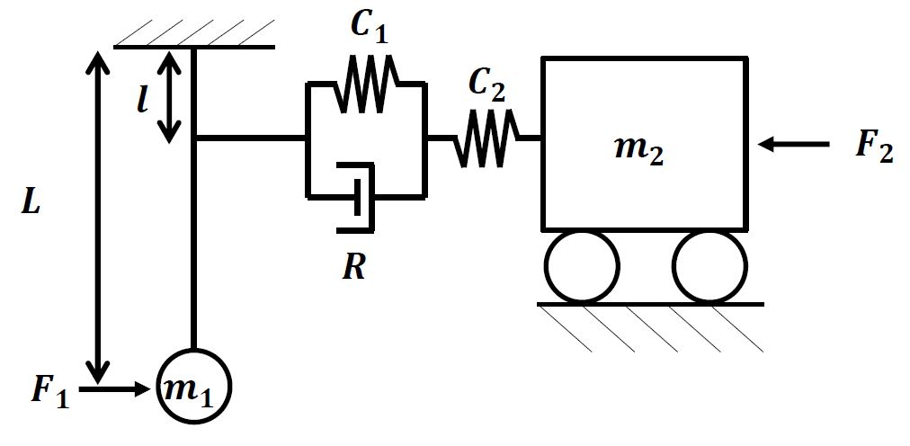



$x$₁
$x$₂
$x$₃
θ

Slide 2





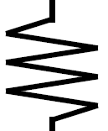



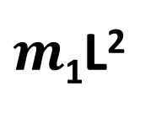
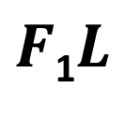
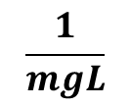
Hw3 Q2i
$$\frac{1}{mgL}$$
$F$₁$L$
$m$₁L²

Slide 3

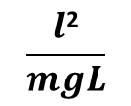
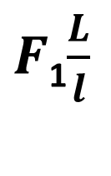
Hw3 Q2i
$$\frac{l\text{2}}{mgL}$$
$F$₁$\frac{L}{l}$
V₁
V₂
V₃
$$\frac{m\text{L}\text{2}}{l\text{2}}$$

Slide 4


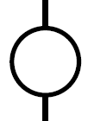



Hw3 Q1a
F_{a}
F_{c}
V₁
V₃
V₂
F_{b}

Slide 5

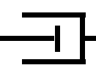
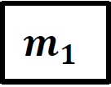



Hw3 Q1b

Slide 6
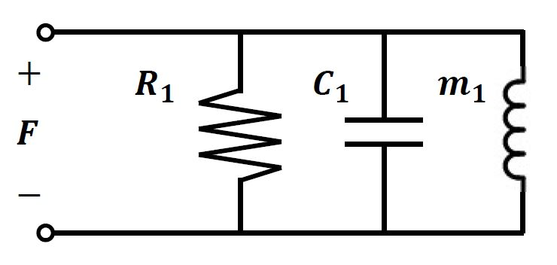
Hw3 Q1bP
V₁
V₂
V₃

Slide 7



Hw3 Q1c
F_{a}
F_{b}
F_{d}
V₂
F_{c}
V₁
V₃
V₄

Slide 8

Hw3 Q3

Slide 9
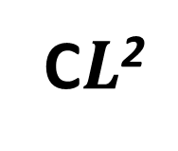

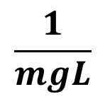
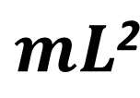
Hw3 Q4
$$mL\text{2}$$
$$\frac{1}{mgL}$$
$$L$$
C$L\text{2}$

