Slide 1
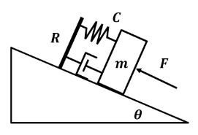

Slide 2
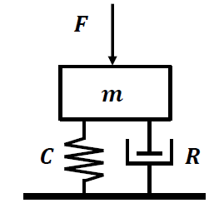
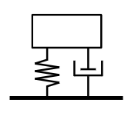


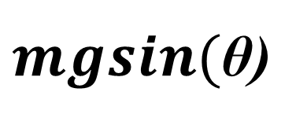
$mgsin($θ)

Slide 3





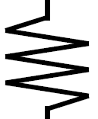


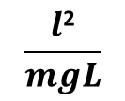
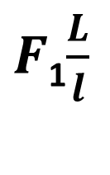
Hw3 Q2i
$$\frac{l\text{2}}{mgL}$$
$F$₁$\frac{L}{l}$
V₁
V₂
V₃
$$\frac{m\text{L}\text{2}}{l\text{2}}$$

Slide 4
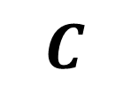

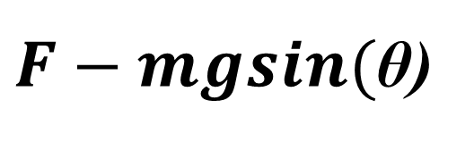
Hw3 Q4
$$m$$
$$C$$
$F−mgsin($θ)
R

Slide 5
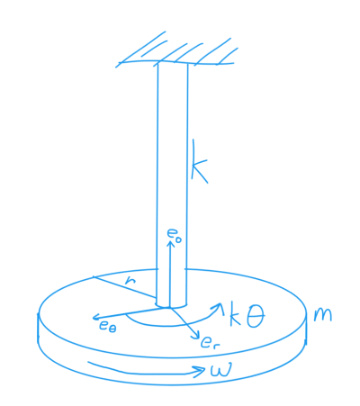





Hw3 Q4
$$G, L,d,$$
$$r$$
m
$$M$$

Slide 6


Hw3 Q4
$$I$$
$$M$$
$$C$$
R

