Slide 1
Project - 1
Brandon Linton

Slide 2
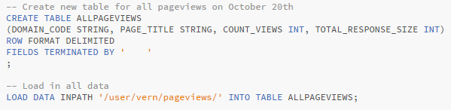
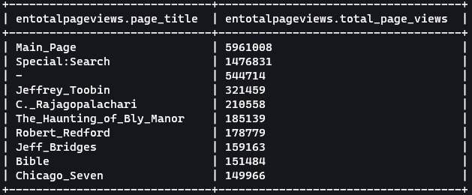

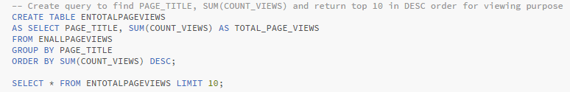
Question 1
Notes:
This question was relatively straight forward
I took up all the zipped files for October 20th and placed them inside their own table
Next, I created a new table that extracted records that started only with the domain name ‘en’ or ‘en.m’
Finally, I created only last table and query to Sum the views for each page, group by title to create a singular instance of each record, and sort by total page views

Slide 3




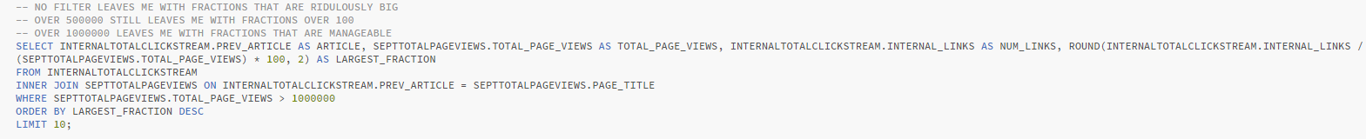
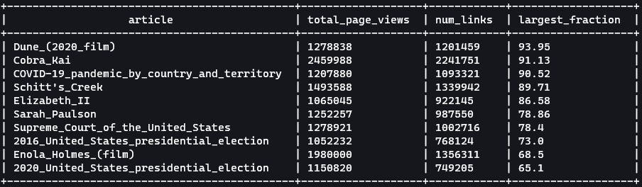
Question 2
Notes:
My answer for question 2 uses a similar process to question 1.
I started by creating a table housing all records from the entire month of September and proceeded to extract records that only had the domain code of ‘en’ or ‘en.m’
Next, I created a table that would Sum all views per article, grouped them by page title and ordered them by the number of views each record had.
I then created a table for clickstream that only contained records marked as ‘link’ or internal links and followed the same process as with page views where I Summed the occurrence and sorted them.
And finally I had to join these two tables on article name, and returned the largest fraction for each article, which in my case was total number of internal links over total number of pageviews for a given article
Some important things to note on the last query
- There were some articles with more links visited than page views
- I’m sure this is possible if someone clicks on multiple links while on the same article, but I wanted to display fractions only 100% or under
- My solution
- Was to set a minimum amount of page views an article must have, which in this case I used 1 million page views

Slide 4
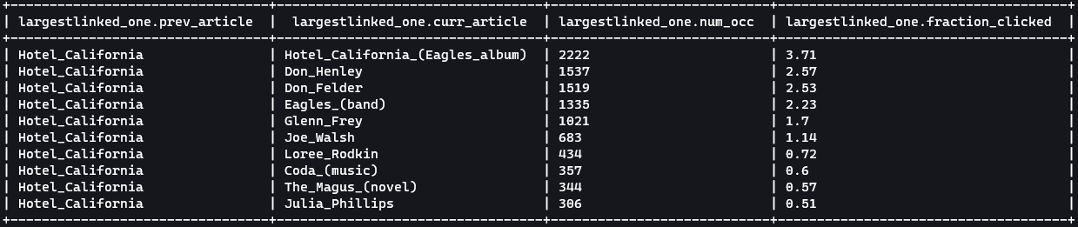
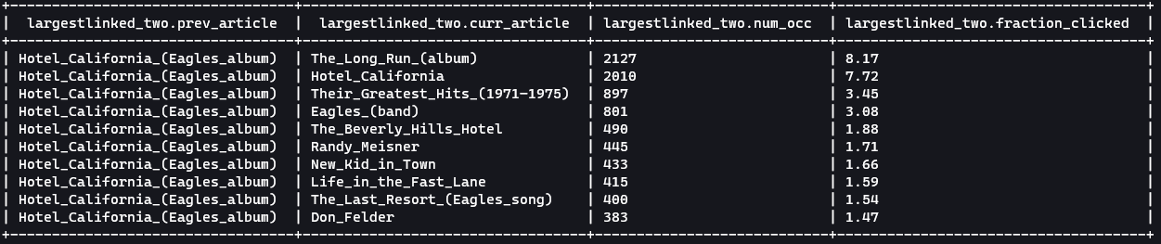
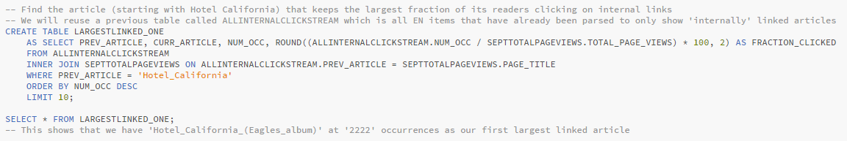
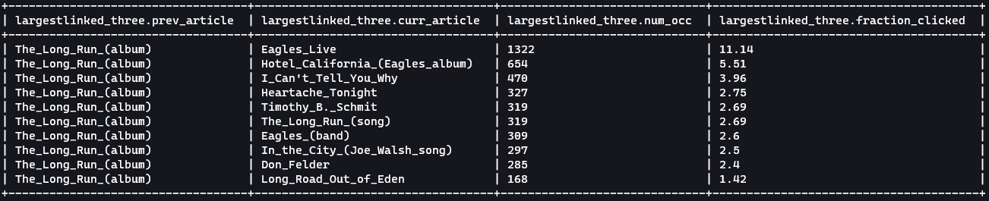
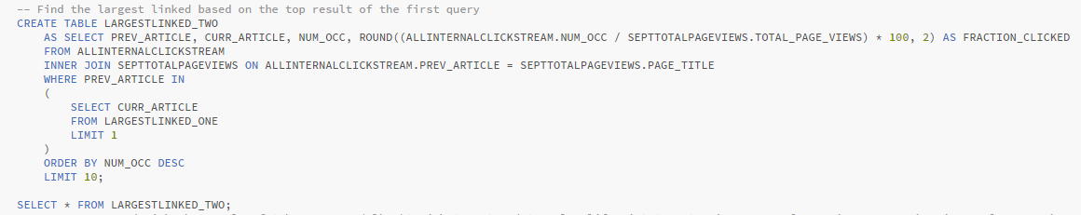
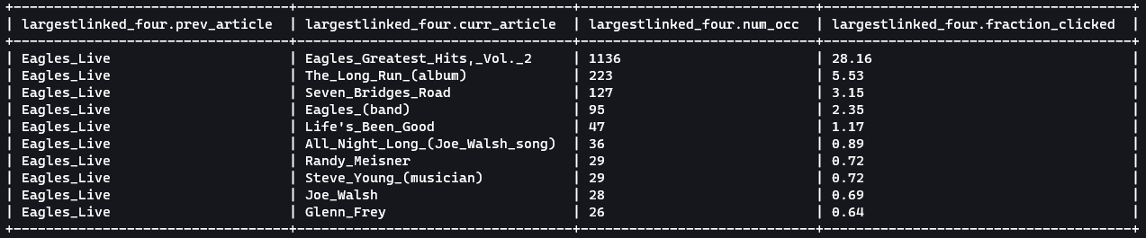
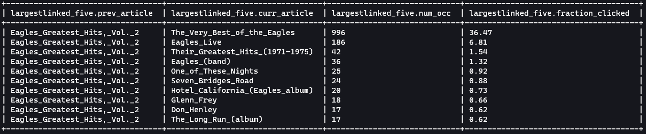
Question 3

Slide 5
Question 4
Important Notes –
We can infer US (EST), UK (UTC) and AUS (GMT) from enwiki pageviews
Online resources cite 7 pm – 11 pm as high internet traffic hours. Additionally, lunch hours.
Here I use 11am – 2pm and 7pm – 11pm for each respective timezone

Slide 6

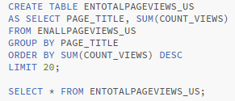
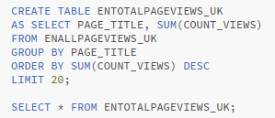
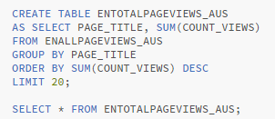
Question 4
Notes:
Create new tables for each US, UK, AUS similar to question 1
Each table will hold data from each respective time zone talked about previously (EST, UTC, GMC)
Create new sorted tables with only ‘en’ and ‘en.m’ articles
Query article title and number of views
Grouped by page title
Ordered by SUM(num_views)
I created 3 separate tables, each contained page views data from each respective time zone, and again reduced that data down to only contain data from ‘en’ and ‘en.m’

Slide 7
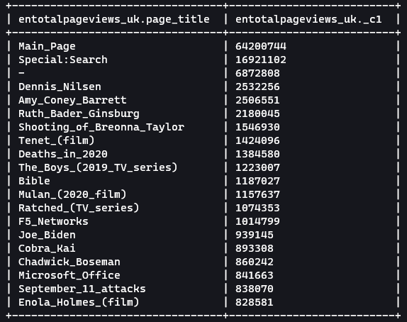
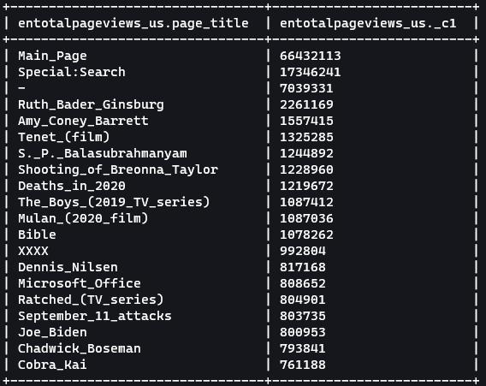
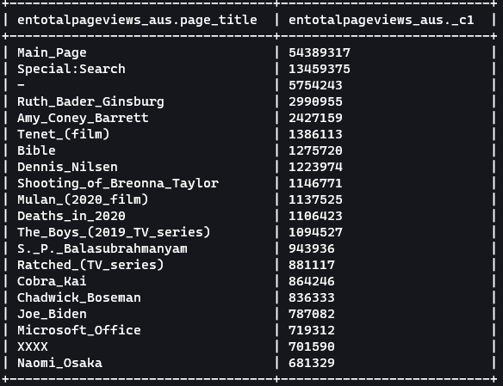
Question 4

Slide 8
Question 5
Important Notes -
Wikipedia cites 758.35 minutes (12.63 hrs) as the average revert time for an article
The WikiEdits file was filled with huge outliers
Negative numbers
Null
Times that suggested nearly 1 month before revert took place (much longer than 12.63 hrs)

Slide 9
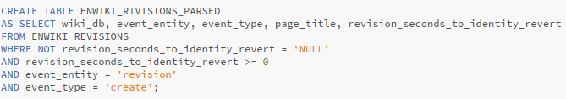


Question 5
Notes:
First I parsed the WikiEdits file in a huge table that I couldn’t post here
There were only two main columns that I was really worried about using in this dataset
page_title
Revision_seconds_to_identity_revert
I then made a table that broke the original table down into smaller pieces
I had a few important restrictions on this table
revision revert cannot be NULL
Revision revert must be greater than 0
And the record entity type must be a ‘revision’
Next, I created a table that would consist of all September pageview records, which I used a previous table for
My new table needed to contain each article with the number of visitors per second, which was calculated by dividing each articles total page view count by the number of seconds in a year
Then I used an inner join to combine these tables returning columns
Page_title
Revision seconds to revert
And avg user per second
The final step was a simple query where I multiplied every records seconds to revert and average users per second, followed by an AVG of all the returned records
In this case my average users may be larger than the actual average amount of users. I did not implement a limit on how many seconds can pass by on a revision, however I did play with idea, and I often got much lower results.

Slide 10
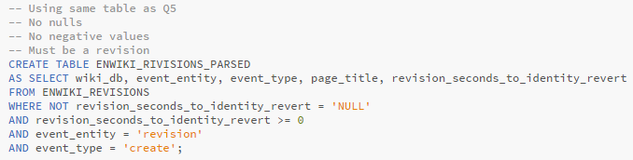

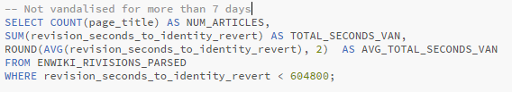


Question 6
Notes:
I decided to explore with the WikiEdits dataset a little more.
A couple things I was curious about in this dataset was
- How many articles are we considering being ‘vandalized’
- What’s the time between all ‘vandalized’ articles before they are reverted within a month
- What’s the average time it takes for a ‘vandalized’ article to be reverted
I achieved this by using the exact same table I made in the previous solution where
- No record can have a revert time be NULL
- No record can have a negative revert time
- And the record must be identified as a ‘revision’
I then made two queries, one where I would COUNT how many articles where edited (note this wasn’t distinct to many articles = 1 revision), I SUMMED the amount of time it took for each article to be reverted, and took an AVG of how long it would take for an article to be reverted
The second query was the same thing but had a constraint where the time it took for an article to be reverted couldn’t be longer than 1 week.
I found the results to be very interesting because in the first query
- the average time it took for an article to be reverted was nearly double than what I had read the average to be on Wikipedia
But in the second query where I specified no revision should be counted where it took longer than 1 week to be reverted
- we achieved an average very close to what we would expect of 12 hrs per revision reverted

