Slide 1
Dungeon Crawler Game
By Team Two

Slide 2
Overview
Insert completed Overview here

Slide 3
Gantt Chart for Phase Two
14 days
7 days
19 days
7 days
27 days

Slide 4
Roles and Responsibilities: RACI chart
 | PROJECT MANAGER | DEVELOPER | DEVELOPER | DEVELOPER
 | ELIZABETH | ANDREW | JAMES | JOEL
SYSTEM DESIGN DOCUMENT | R | C | C | C
MILESTONE LIST | R | C | C | C
DURATION ESTIMATE | R | C | C | C
GANTT CHART | R | C | C | C
SPRITE CREATION | C | A | A | R
SPRITE MOVEMENT | C | R | A | A
POWERS / INTERACTIONS | C | A | A | R
MAP DESIGN | C | R | A | A
INTERACTABLES | C | A | R | A
 | R = Responsible | A = Accountable | C = Consulted | I = Informed

Slide 5
Constraints
The constraints of this project are those provided by Dr. Wang. We will be making a game to fit within those specifications, using API’s and cutting-edge technology in the timeline specified.

Slide 6
API’s and Technologies Used
Unity:
Unity Scripting API
Rendering API

Slide 7
References
The reference documents used are:
Class Schedule
Course Syllabus
Project Proposal

Slide 8
Security
Internal security measures on Github have been taken to ensure that nobody but the team and Dr. Wang have access to the code and documents for this game. For the playing side, we will have a secure log in to the game for the “host” and the secondary player will need a password to join the game.

Slide 9
GUI pt 1

Slide 10
GUI pt 2

Slide 11
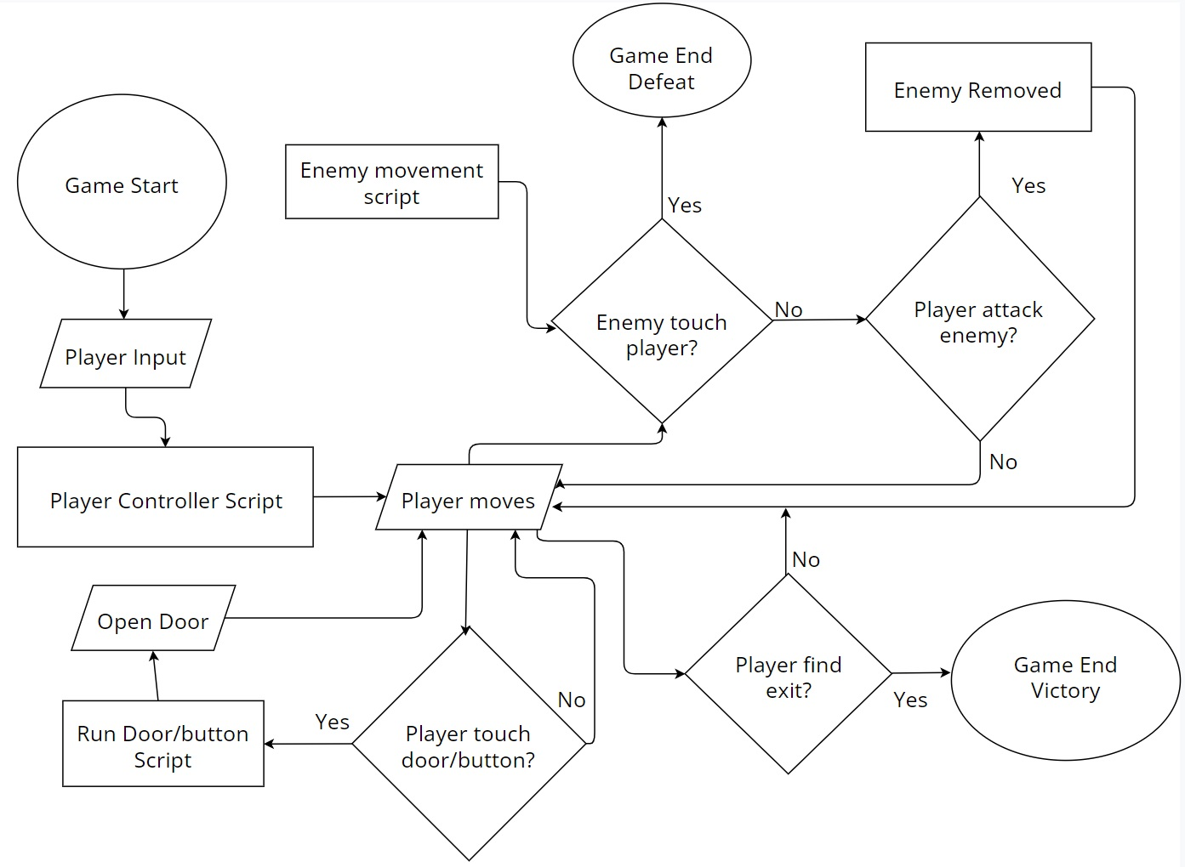
Database System and Design
Using Unity
Custom scripts for players and object controls
Dataflow Diagram and Queries

Slide 12
Software
Software required to run this game:
• Game Download

Slide 13
Hardware
Hardware required to run this game, at a minimum:
2gb Graphics Card
Windows 7
Intel i5 processor

