Slide 1

Conci
PRE-SEED · 2026
Gets the plan out of the group chat.
AI “executive” assistant that converts group ideas into action

Slide 2
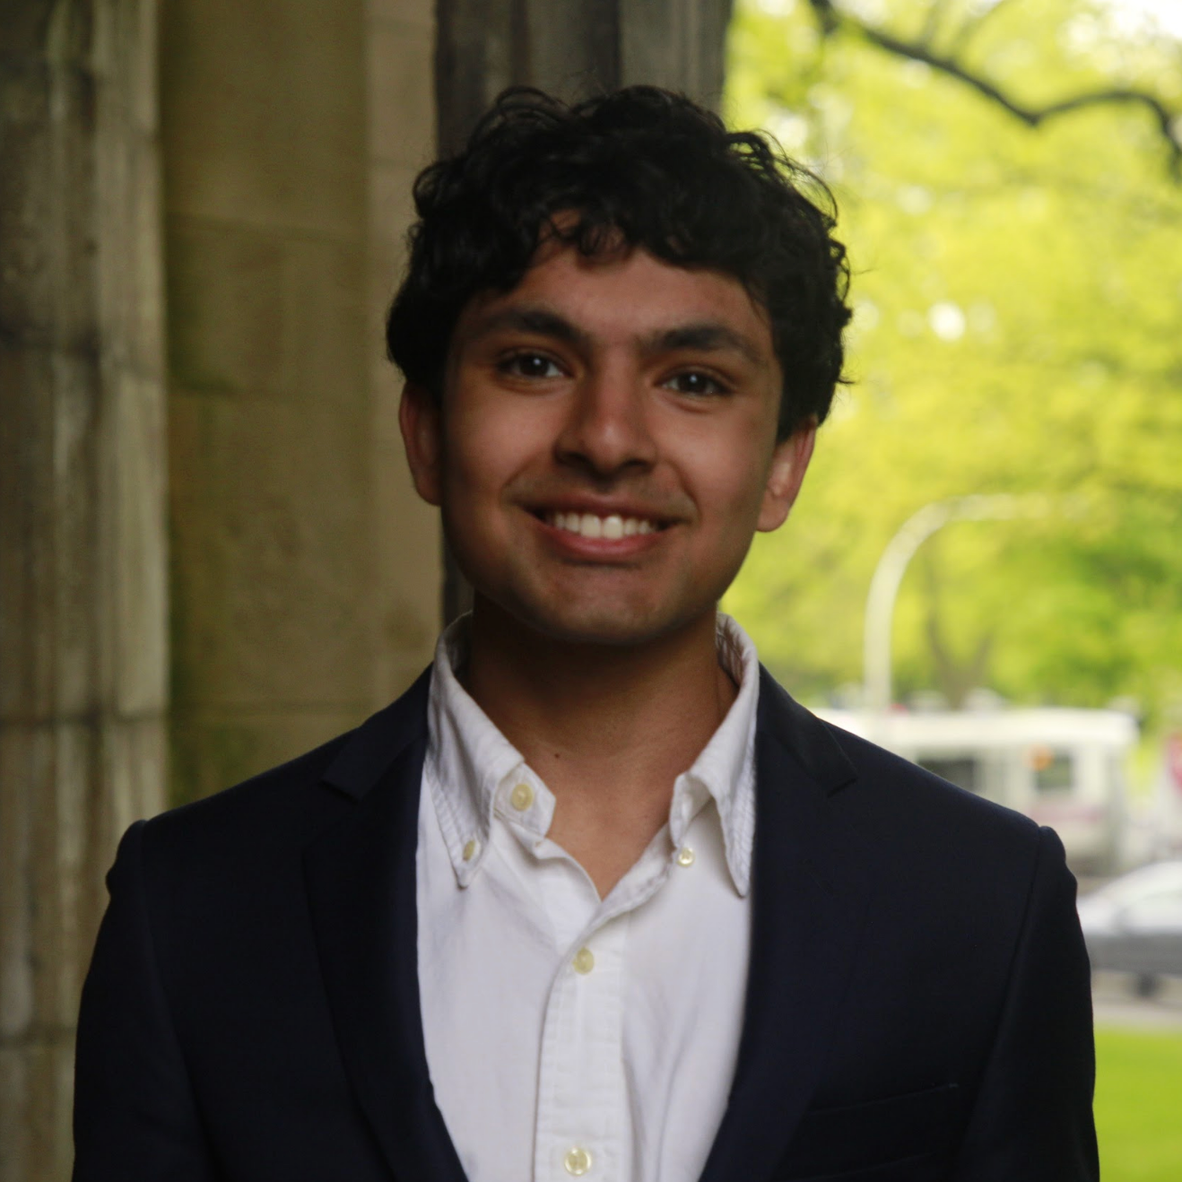


TEAM
Conci
Arnav Nigam
Sandeep Sethuraman
Brandon Lee
Business/Strategy
Technical
Technical
UChicago Econ & DS
#1 U.S. debater out of 18,000
Lead youth policy advisor to a mayor for 200,000+ city
Major GTM projects for Uber, Instacart, SF Unicorns
Manager for 1B+ Views Influencer
Stanford Math & CS
International master in chess (top 75 in the US)
3rd engineer at a Unicorn Startup
Built actively used AI Terminal for Congress
2nd-place at Stanford TreeHacks
Vanderbilt Math & CS
AI researcher at an adaptive learning lab
Built ML infrastructure at ASML
Helped develop proprietary LLM from ground up

Slide 3
THE PROBLEM
Conci
Group planning isn't an information problem. It's a commitment problem.
One person ends up collecting everyone's dates, comparing flights, finding lodging, picking restaurants, and then chasing six Venmos for weeks.
ok who's actually free that weekend??
i can do either, someone just pick 🙏
25+
0
none
flights are like $420 now btw…
messages
decisions
booked

Slide 4
THE SOLUTION
Conci
Conci does the work the group won't.
Drop in a group chat, a link, or a single sentence. Conci plans the trip, the group votes, everyone pays in, and it books. No 47-message thread, no shared doc edited into chaos.
1 PLAN
2 VOTE
3 PAY IN
4 BOOK

Slide 5
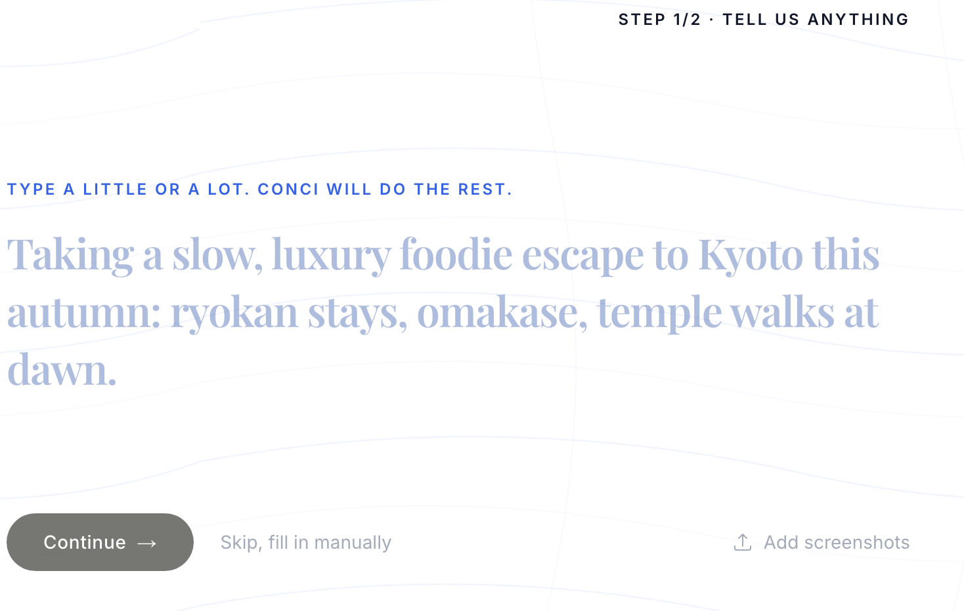
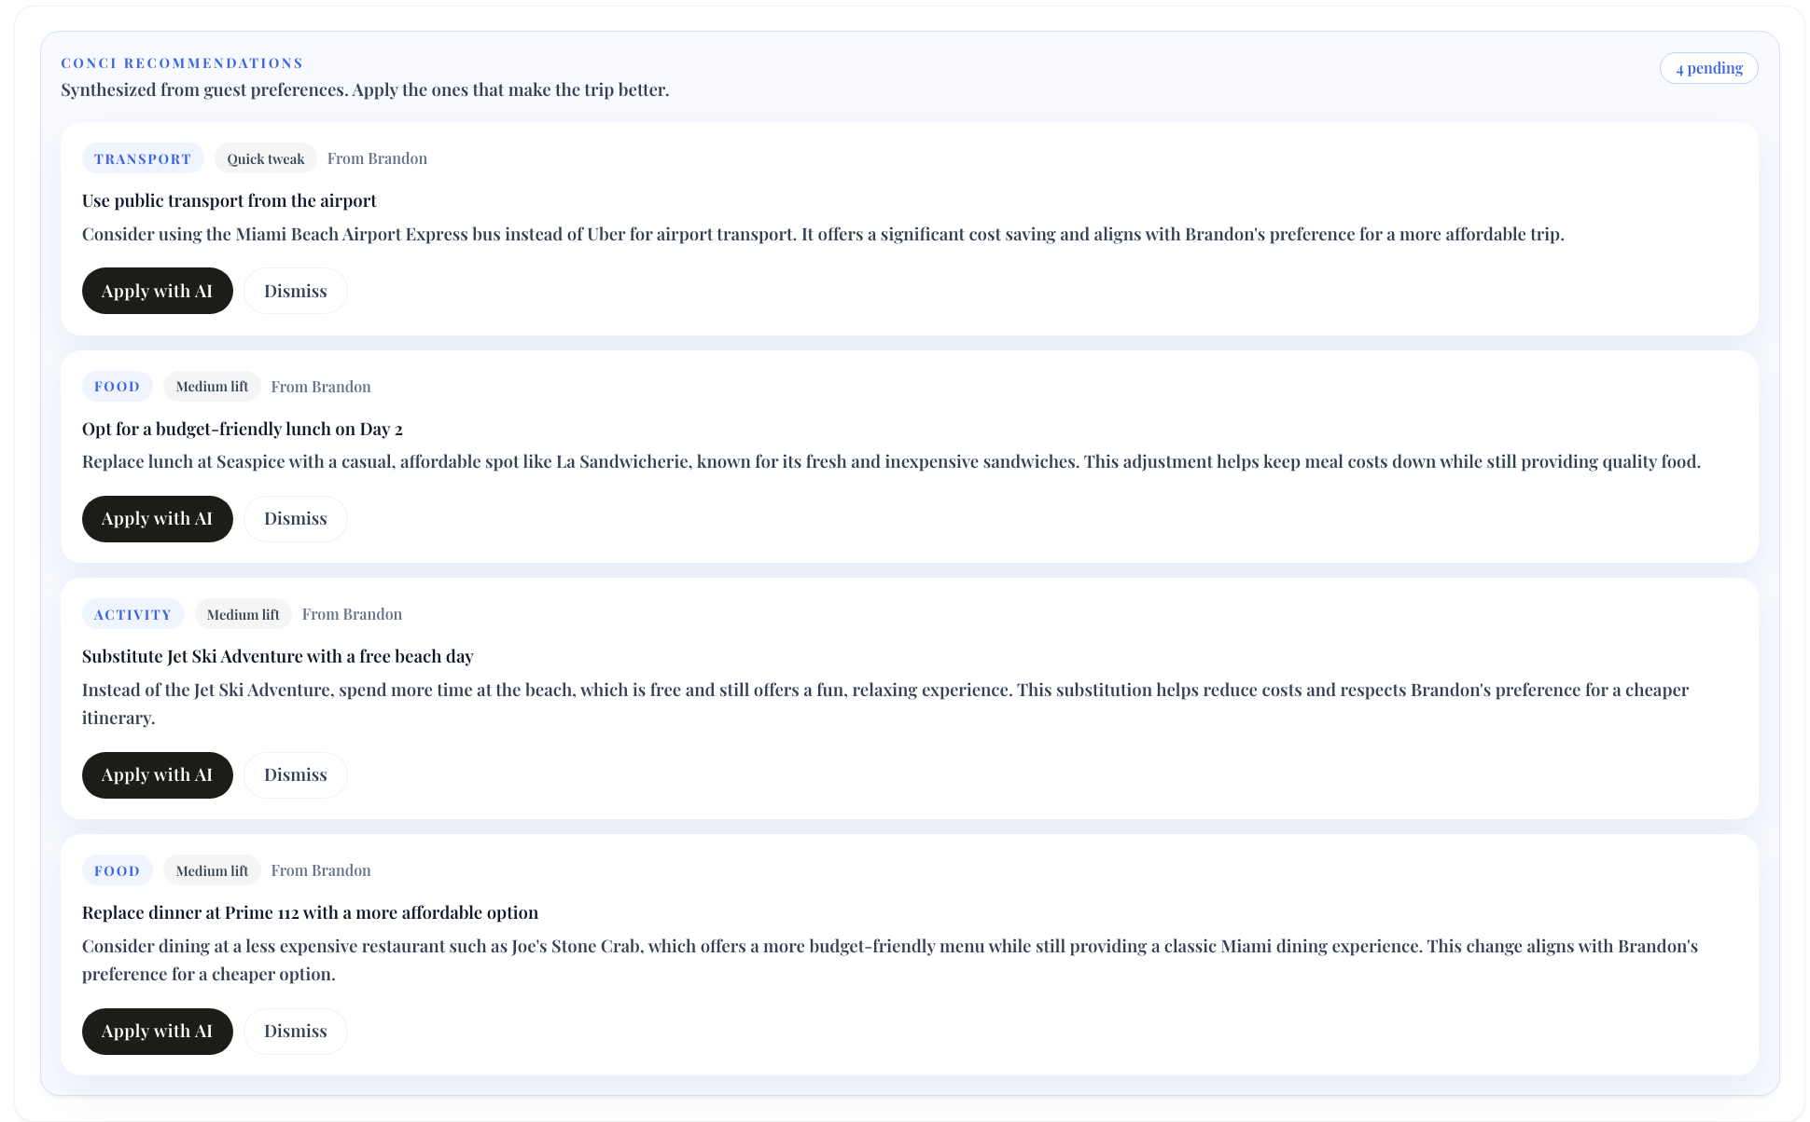
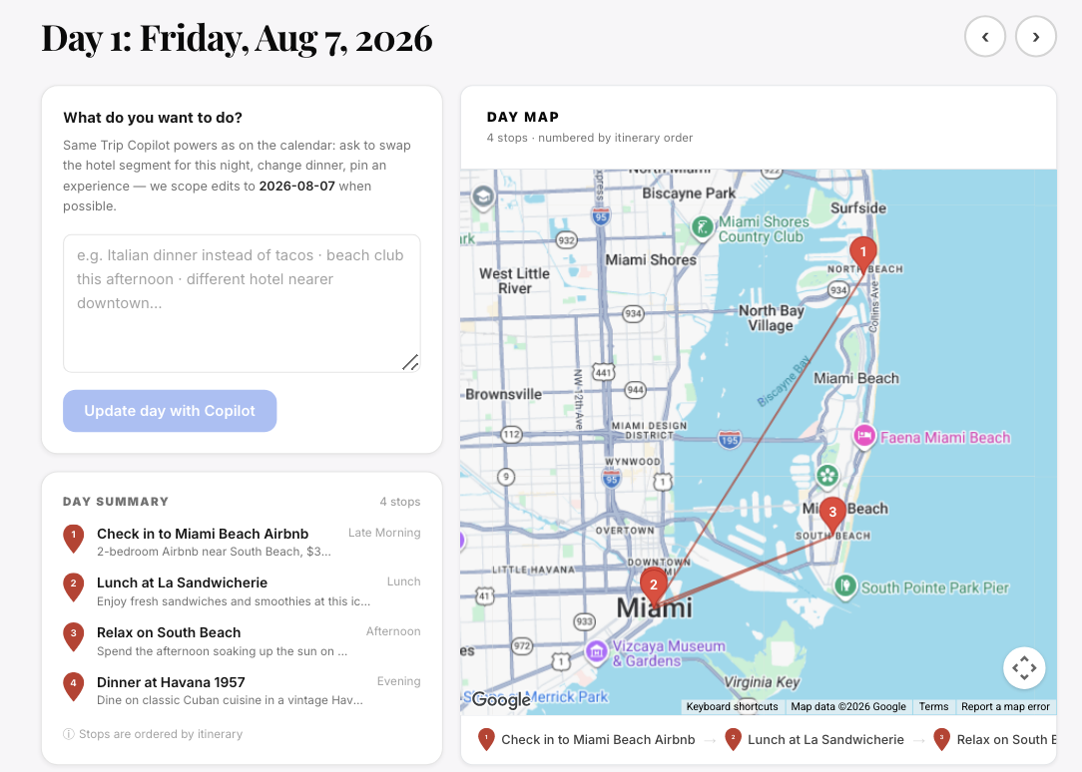
HOW IT WORKS
Conci
From a messy thread to a booked trip in three steps.
STEP 1
STEP 2
STEP 3
Drop it in
The group shapes it
Conci builds, books, and gives day views
Paste a group chat screenshot, a link, a voice note, or just type it. Conci parses dates, budget, and vibe into a structured plan.
Friends join by link or code, add preferences, vote on options, suggest swaps, and contribute money - without derailing anything.
Day view shows the itinerary for the day when clicking on any specific day within the trip.

Slide 6
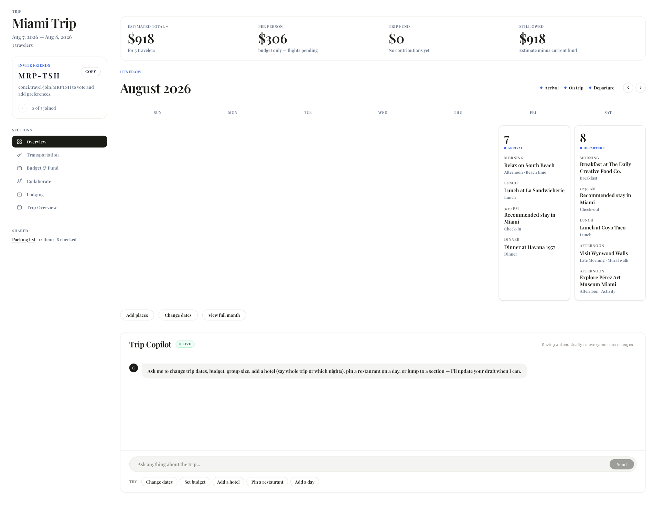
PRODUCT
Conci
A live, calendar-first itinerary the whole group can see.
Lodging by date, transport between cities, restaurants, activities, and cost-per-person - in one view.

Slide 7
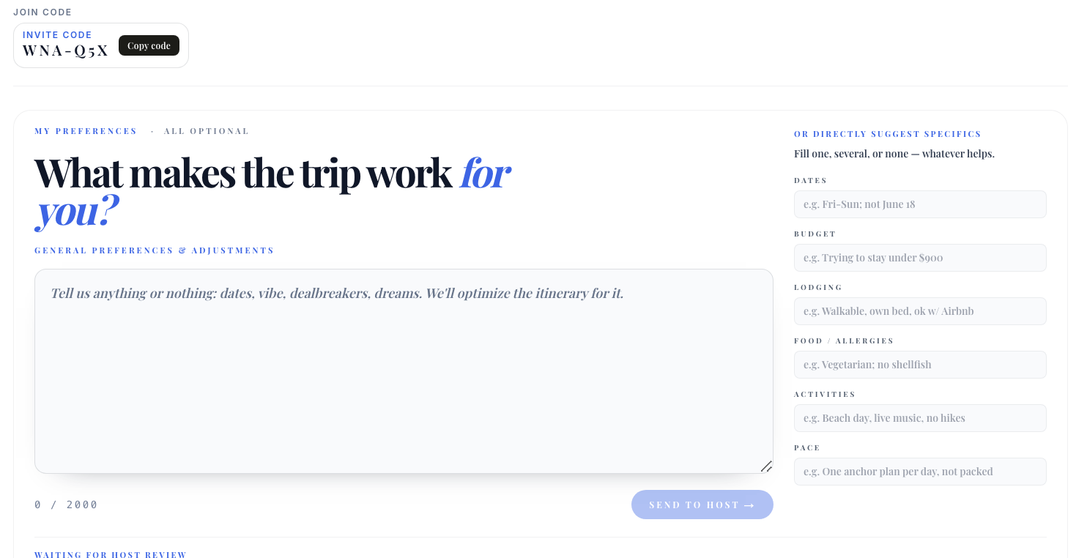
PRODUCT
Conci
Everyone has a say. Nobody runs a spreadsheet.
Guests can suggest any preferences onto the plan or none, mark “interested” or “not for me,” and flag budgets, allergies, and dates. Conci synthesizes it into the best group plan.
A shared memory layer learns each person and each group over time, so every next trip is easier.

Slide 8
WHY WE WIN
Conci
Everyone else is additive. Conci is reductive.
Travel apps add more options. Conci removes decisions. We focus on simplicity
We are young founders building inside the exact population where group plans begin - screenshots, group chats, low attention spans, and lack of coordination. We move faster than incumbents and iterate directly with users who face this problem
Demos shaping product pre-launch, functional MVP, 2M+ follower influencer-led launch path, early hotel conversations, AI-native, and a compounding group preference/data flywheel

Slide 9
COMPETITION
Conci
Everyone helps you look. Nobody gets the group to commit.
Drives commitment & booking ↑
Conci
Spreadsheets
TripIt
Mindtrip
Wanderlog
Layla.ai
Group chat
Does the work for you →

Slide 10
MARKET
Conci
Start with group trips. Expand to every plan.
Group travel
100M+ US millennial & Gen Z adults plan group activities
Dinners, events & reservations
1B+ everyday plans that never make it out of the chat
All consumer logistics
10B+ classes, bookings, errands - anything assistants handle

Slide 11
BUSINESS MODEL
Conci
Every plan is a purchase-intent signal stronger than a Google click.
PRIMARY · PURCHASE-INTENT ADS
SECONDARY · FREEMIUM
Travel advertisers pay $2–3 per click on Google for intent. A Conci plan is the intent itself. At a conservative $2 / sponsored result:
A simple fallback that monetizes power users if ads don’t scale.
Host mode option – create unlimited trips
$5 / mo
5M sponsored clicks / mo (<1% of travel searches)
$100M+ / yr
Path to $100M ARR (<4% of that group)
3.3M subs
500M sponsored clicks / mo (~50% of Skyscanner's searches)
$10B+ / yr
Enterprise & university group plans
Expansion

Slide 12
PROGRESS
Conci
People want this - and we have proof
80+
Pre-launch live demos over Zoom and in person. Feedback reshaped the UI down to two friction-free screens
MVP
Functional. Drop a chat in, invite friends, vote on options, and receive calendar invites
2M
Follower influencer ready to advertise pro-bono at launch - plus intros to other creator partnerships (~50K worth of sponsorships)
4,000+
Rooms hotel operator. In conversation with large hotel operator in the EU to discuss monetization strategy and potential partnership
We are also building a proprietary AI two-tower travel recommender and data flywheel to personalize hotels, flights, restaurants, and itineraries from every trip interaction

Slide 13
WEDGE & VISION
Conci
Start with the hardest plan. Earn everything after it.
Group trips are the highest-friction, lowest-commitment thing people try to coordinate. Win the hardest job and the same group comes back for the easy ones: the wedge into all of consumer logistics
1 · TODAY
THE WEDGE
2 · NEXT
REPEAT USE
3 · VISION
FUTURE
Group trips
Dinners, events & reservations
Everything you plan with other people
Highest friction, lowest barrier to entry - the plan that never makes it out of the group chat. Nail it and we own the group
Funding accelerates booking API integrations, creator-led distribution, and our proprietary travel recommender
The same groups and the same shared memory, now handling the everyday plans: creating ecosystem for repeat consumers
Classes, bookings, corporate outings: the AI operating system for logistics. The executive assistant everyone gets to keep

Slide 14

12 — TEAM
Conci
Arnav
Brandon
Sandeep
BUSINESS · STRATEGY
AI ENGINEERING
TECHNICAL · OPERATOR
UChicago Econ & DS
#1 U.S. debater out of 18,000
Lead youth policy advisor to a mayor with a $1.5B budget
GTM projects for Uber, Instacart, SF Unicorns
AI + systems builder
Built a RAG copilot at ASML
Built ML infrastructure from scratch in Go
Graph-search tooling over GitHub's social graph
Stanford Math-CS
7th hire / 3rd engineer at a unicorn
Built an AI Terminal for Congress
Zeus beat Operator 5×; IM-level chess

Slide 15

Conci
THE ASK
Raising a pre-seed round to get Conci into every group chat
Looking to raise [$750K-1M]
nigamarnav@gmail.com · Conci
GETS THE PLAN OUT OF THE GROUP CHAT.

