Slide 1
How Unemployment Insurance effects Unemployment Levels
Brandon Lange & Otis McCullough

Slide 2


Meet the Team
Brandon Lange ‘22
Business & Engineering
Otis McCullough ‘22
Business & Engineering

Slide 3
INTRODUCTION
In response to the economic fall-out and high volume of lay-offs onset by the COVID-19 pandemic, The U.S. government rolled out two programs to increase the amount of money provided by Unemployment Insurance (UI).
These programs included the Pandemic Emergency Unemployment Compensation (PEUC) and the Pandemic Unemployment Assistance (PUA).

Slide 4
INTRODUCTION Cont.
Shortly after the first "lock down" when economic activity began to return, unemployment numbers continued to remain high.
This caused some people to speculate that the level of unemployment was related to the additional UI benefits that were still being offered

Slide 5
INTRODUCTION Cont.
In response to this debate 26 states of the states that we observed ended PEUC and PUA benefits before the Federal deadline
The benefits lapsed at a Federal level September 1, 2021
Because of this, we chose to investigate the effect of additional UI benefits on the unemployment rate.

Slide 6
Why Unemployment?
The Unemployment rate is an important economic metric in and of itself.
Gives insight into the economic well-being of the average American seeking work
It can be seen as a measure of labor's output gap
Unemployment is also an indicator of other important economic measures
It has a negative long run relationship with GDP
Has an inverse relationship with inflation

Slide 7
Why UI?
Families and individuals rely on income to survive, either from employment or UI
If UI is taken away but the opportunity for employment is still low, people are put in financial jeopardy
As stated previously high levels of Unemployment is inherently bad and dampens Economic growth
The benefits gained from additional UI could be outweighed by an ever-slowing economy and inflation will reduce purchasing power

Slide 8
Contemporary Research
Harvard Business School conducted research to answer the same question.
Key differences:
Data Source: Earnin a financial intermediary who primarily services lower income individuals.
Indirectly monitored UI claims by looking for UI deposits in bank accounts.
Differences in collection and bias in userbase could lead to different conclusions
Sample size: Collected information on 18,000 individuals
Our data source has information on over 10 million UI claims
Notes:
Waiting for payday is the old way. Access your pay as soon as you work the hours. No hidden fees or subscriptions. Pay what you think is fair for Earnin's services. Unlock your pay. Cash back rewards. No mandatory fees. Community supported.

Slide 9
Contemporary Research CONT.
Findings: "...ending pandemic UI increased employment by 4.4% while reducing UI recipiency by 35%…" (Coombs et al, 2021)
While there was an influence on the employment rate the team also states
"...our evidence suggests that most of the employment gains were due to the mechanical exhaustion of UI benefits, as opposed to through greater incentives for job finding..." (Coombs et al, 2021)

Slide 10
Contemporary Research CONT.
Contemporary research has found that there is a correlation between UI benefits and unemployment levels, but it does not find UI benefits to be the main cause of increased levels of unemployment.

Slide 11
Our Model
Our proposed model would use Panel Regression with each state being the paneled data
We used state FIPS (Federal Information Processing Standards) codes as our panel variable
For our time variable we used the date of each week the data was captured for from March of 2020 to February of 2022
This model also includes a binary dummy variable that indicates the presence of additional UI benefits

Slide 12
Our Model CONT.
In this model we looked at the number of continued regular UI claims (representing the level of people on unemployment) as the dependent variable.
The Independent variable is a variable we created called "Pandemic Claims" which combines the number of continued PEUC and PUA claims. We chose this because this number represents the total amount of people receiving "additional" UI benefits

Slide 13
Our Model CONT.
Explanatory Variables: We used a number of variables as explanatory variables to help refine our regression analysis and lessen any omitted variable bias
New COVID-19 Cases
New COVID-19 Deaths
Total full COVID-19 vaccinations
The hope was that these variables would help to explain the effect of the COVID-19 pandemic on unemployment and reveal the "true" effect of pandemic UI benefits on unemployment.

Slide 14

Our Model CONT.

Slide 15


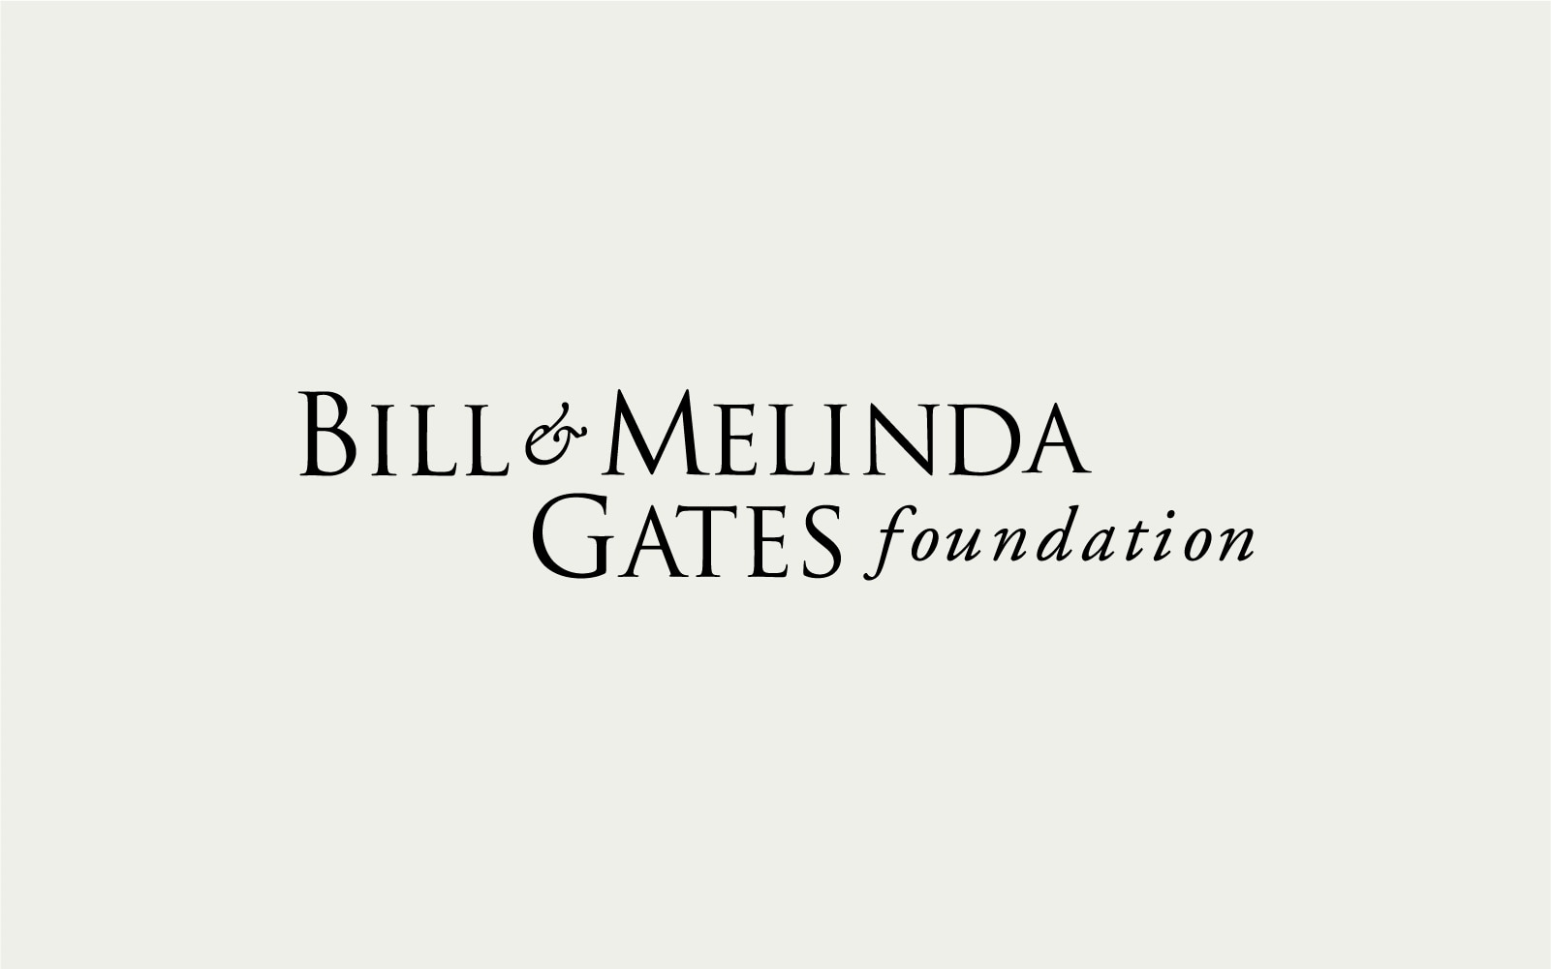


Data Sources
Opportunity Insights is a non-partisan, not-for-profit organization located at Harvard University that seeks to translate insights from rigorous, scientific research to policy change by harnessing the power of “big data” using an interdisciplinary approach.
Tracktherecovery.org

Slide 16
Data
Economic Tracker
Date
State FIPS
Continued Claims Regular (UI)
Pandemic Unemployment Claims (PUA)
Pandemic Emergency Unemployment Compensation (PEUC)
Combined Unemployment Benefits
Covid Tracker
Covid Cases
Covid Deaths
Full Vaccine
Notes:
79 weeks of benefits to qualifying individuals who are otherwise able to work and available for work within the meaning of applicable state law, except that they are unemployed, partially unemployed, or unable or unavailable to work due to COVID-19 related reason
PEUC basically extended UI for up to 53 weeks

Slide 17
Data Cleaning
Data stored in GitHub Repository as CSV
Date ➔ MM/DD/YYYY
State FIPS ➔ State Name
PEUC & PUA ➔ Total Pandemic Claims
COVID Data ➔ Weekly Data
Match Length of COVID Data ➔ Unemployment Data
Dummy Binary Variable

Slide 18
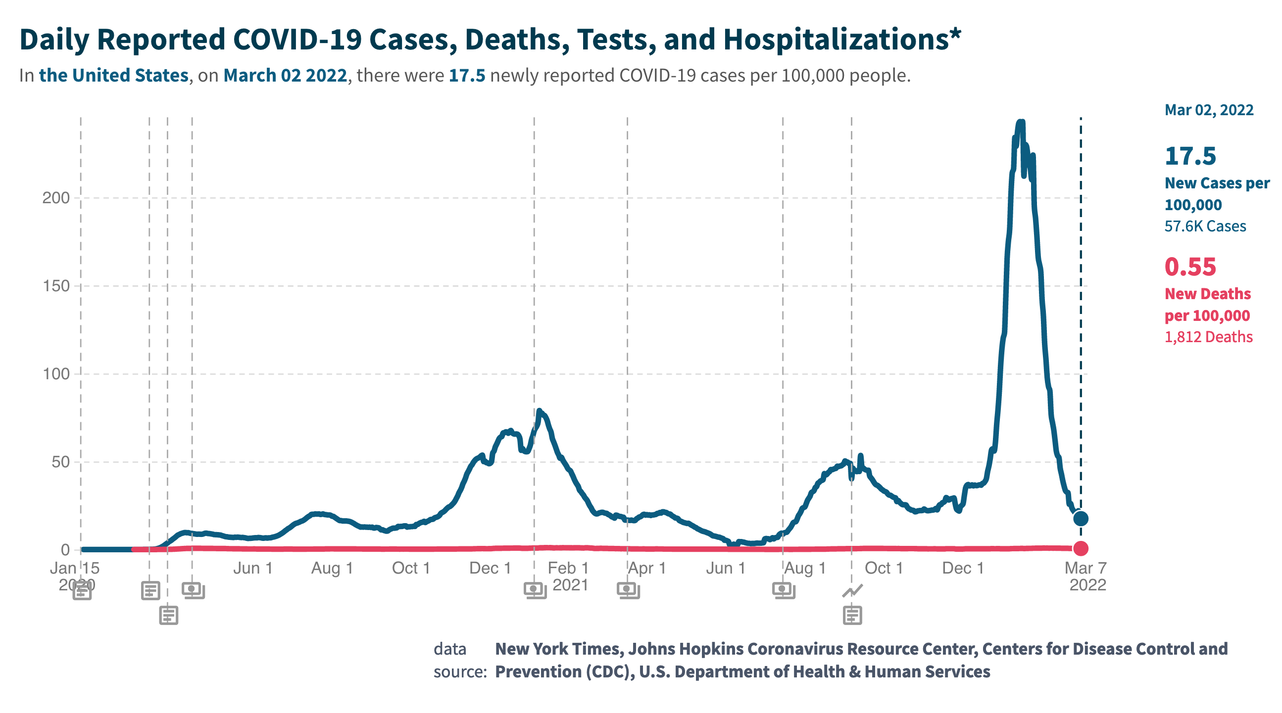
Deaths & Cases
Jan 15, ‘20 – Feb 17, ‘22
77.3M Total Cases
918K Total Deaths

Slide 19
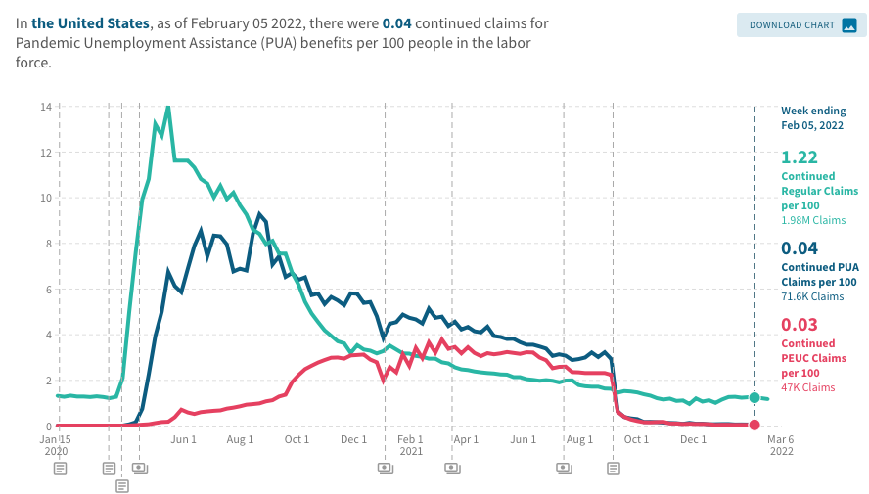
Unemployment Claims
Source:
US Department of Labor

Slide 20
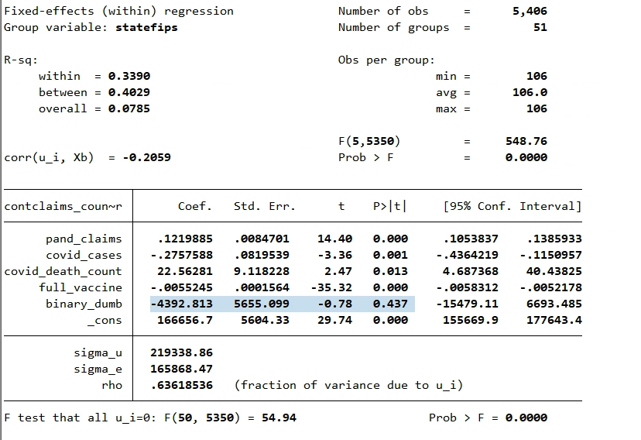
Results
Notes:
As time goes on covid case may not reflect unemployment like omicron

Slide 21
Conclusions
We are unable to reject the null hypothesis that additional UI benefits do not have a significant affect unemployment rates.
Interesting finding:
COVID-19 deaths had the greatest impact on unemployment rates, with a coefficient of 22.
Notes:
Otis

Slide 22
Conclusions Cont.
Additional UI benefits have a slight impact on the level of unemployment. However due to possible omitted variable bias and or reverse causality, it is unlikely that this effect would hold up in a "real world" situation.

Slide 23
Conclusions Cont.
Sources of Omitted Variable Bias:
Number of Job Postings
State GDP per capita
Reverse Causality: The CARES act was enacted in response to extremely high levels of unemployment. It is very likely that the level of unemployment drives the "pandemic claims"

Slide 24
Conclusions Cont.
Like the Harvard paper, we believe that the unemployment rate is not drastically influence by the level of UI benefits offered but is more likely influenced by other factors such as we saw with COVID deaths, or an economic slowdown.

Slide 25
Thank You
Presentation by:
Brandon Lange &
Otis McCullough
Any Questions?

Slide 26
References
“Charts Related to the Latest ‘The Employment Situation’ News Release | More Chart Packages.” U.S. Bureau of Labor Statistics, U.S. Bureau of Labor Statistics, 7 Jan. 2022, https://www.bls.gov/charts/employment-situation/civilian-unemployment-rate.htm.
Coombs, Kyle, et al. “Early Withdrawal of Pandemic Unemployment Insurance: Effects on Earnings, Employment and Consumption.” Early Withdrawal of Pandemic Unemployment Insurance: Effects on Earnings, Employment and Consumption - Working Paper - Faculty & Research - Harvard Business School, Harvard Business Review , Aug. 2021, https://www.hbs.edu/faculty/Pages/item.aspx?num=61668
Foundation, — The Century. “Unemployment Insurance Data Dashboard.” The Century Foundation, The Century Foundation, 2 Dec. 2021, https://tcf.org/content/data/unemployment-insurance-data-dashboard/?agreed=1.
Iacurci, Greg. “Ending Unemployment Benefits Had Little Impact on Jobs and Fueled $2 Billion Spending Cut, Study Finds.” CNBC, CNBC, 23 Aug. 2021, https://www.cnbc.com/2021/08/23/ending-unemployment-benefits-had-little-impact-on-jobs-study-says.html.
Narendranathan, W., et al. “Unemployment Benefits Revisited.” OUP Academic, Oxford University Press, 1 June 1985, https://academic.oup.com/ej/article-abstract/95/378/307/5190745.
United States, Congress, Labonte, Marc. Introduction to U.S. Economy: Unemployment. https://crsreports.congress.gov/product/pdf/IF/IF10443.
“The Economic Tracker.” Economic Tracker, https://www.tracktherecovery.org/.
Slide deck link

