Slide 1

UFCFV4-30-2 Data, Schemas & Applications
PHP Errors & Exceptions

Slide 2
Why handle errors/exceptions?
Produce more stable code - programs run longer without failing in the “wild”
Code is easier to debug
Code is easier to maintain
Logging allows for traceability – improves security
Traps fatal events gracefully
Improves the life of users/programmers
But ..
Can’t account for every eventually .. .. problem of closure – cost/benefit analysis required
Don’t over-do it! e.g. too much logging can slow performance. Find the right balance …

Slide 3
Error Types
Basically errors can be of one of two types
- External Errors (usually resource unavailability) - Logic Errors (a.k.a. Bugs)
What about these error types?
- External Errors will always occur at some point or another - External Errors which are not accounted for are Logic Errors (of a kind) - Logic Errors are harder to track down

Slide 4
PHP’s Internal Handlers
Four levels of error severity to start with
- Strict standard problems (E_STRICT)
- Notices (E_NOTICE)
- Warnings (E_WARNING)
- Errors (E_ERROR)
Others include E_ALL, E_USER_ERROR, E_USER_WARNING, E_USER_NOTICE

Slide 5
PHP’s Internal Handlers (2)
E_STRICT - messages that provide suggestions on improving code to reduce ambiguities and make code more portable
E_NOTICE - a runtime message that indicates something that might produce an unexpected result depending on the context
E_WARNING - a non-fatal run time error. Scripts continue to execute
E_ERROR - fatal runtime errors. Scripts stop executing.

Slide 6
PHP’s Internal Handlers Example
<?php
// E_NOTICE
$x = $y + 3;
// E_WARNING
$fh = fopen('thisisnotarealfile', 'r');
// E_ERROR
nonExistingFunction();
?>
Notice: Undefined variable: y in J:\xampp\htdocs\error_example1.php on line 3 Warning: fopen(thisisnotarealfile) [function.fopen]: failed to open stream: No such file or directory in J:\xampp\htdocs\error_example1.php on line 5 Fatal error: Call to undefined function nonExistingFunction() in J:\xampp\htdocs\error_example1.php on line 7

Slide 7
User Triggered Error
Almost the same as the ones in the previous slides
- User triggered notice (E_USER_NOTICE)
- User triggered warning (E_USER_WARNING)
- User triggered error (E_USER_ERROR)
Triggering them is done using trigger_error()
<?php
function getValPlusOne($val) {
if (3 > $val) {
trigger_error('val has to be greater than 3', E_USER_ERROR);
}
return ($foo + 1);
}
// trigger error
$val = 2;
$val = GetValPlusOne($val);
?>

Slide 8
Additional Error Types
Catchable fatal error
- E_RECOVERABLE_ERROR – a probably dangerous error occurred. If not handled by the user, the application will abort as if this was an E_ERROR
Parsing errors
- E_PARSE – there is a syntactic error found while parsing the script. This is a fatal error
Compilation errors
- E_COMPILE_ERROR – a fatal error occurred in the engine while compiling the script
- E_COMPILE_WARNING - a nonfatal error occurred in the engine while compiling the script
PHP core errors
- E_CORE_ERROR – a fatal runtime error occurred in the engine
- E_CORE_WARNING – a nonfatal runtime error occurred in the engine

Slide 9
Error Reporting Configuration Settings
Setting which errors PHP will report is done through the error_reporting directive
- in php.ini file
error_reporting = E_ALL & ~E_NOTICE
- at runtime error_reporting(E_ALL & ~E_NOTICE);
- in .htaccess or apache.conf
php_value error_reporting 6135

Slide 10
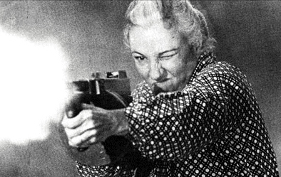
Handling Errors
There are four ways to handle errors
- Display them
- Log them
- Ignore them
- Act on them
Relevance of image??

Slide 11
Displaying Errors
How to display errors in the standard output -
- Set the display_errors directive to On
- Set the error_reporting to the appropriate severity level
<?php echo ini_get('display_errors'); if (!ini_get('display_errors')) { ini_set('display_errors', 1); } echo ini_get('display_errors'); ?>
Displaying errors is good for the programmer but bad for the user

Slide 12
Logging Errors
How to set PHP to automatically log errors
- Set the log_errors directive to On
- Set the error_log directive to your preferred logging option
PHP supports two options for logging errors
- Logging to a file – set the error_log to a file path
- Logging to syslog – set the error_log to syslog

Slide 13
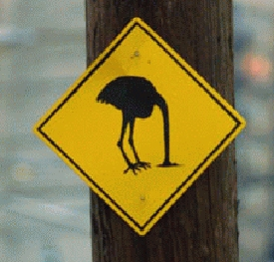

Ignoring Errors

Slide 14
Relevance of image …
Here’s what happens to your assignment mark if you forget error / exception handling. Likely to be in exam also ..

Slide 15
Acting on Errors
PHP enables us to set a default error handler using the set_error_handler() function
Five parameters will be passed to the user-defined error handler function
- integer $errno – error severity level
- string $errstr – error message
- string $errfile [optional] – filename where the error was raised
- integer $errline [optional] – line number where the error was raised
- array $errcontext [optional] - an array of every variable that existed in the scope the error was triggered in

Slide 16
Acting on Errors (2)
function demoErrorHandler($errno, $errstr, $errfile, $errline) {
switch ($errno) {
case E_USER_ERROR:
Logger::log(E_ERROR, $errstr, $errfile, $errline);
require_once(FULL_PATH_DEFAULT_ERROR_PAGE);
exit(1); // control the flow
break;
case E_WARNING:
case E_USER_WARNING:
Logger::log(E_WARNING, $errstr, $errfile, $errline);
break;
case E_NOTICE:
case E_USER_NOTICE:
Logger::log(E_NOTICE, $errstr, $errfile, $errline);
break;
default:
Logger::log(0, $errstr, $errfile, $errline);
break;
}
return true; // Avoid running PHP's internal error handler
}
set_error_handler("demoErrorHandler");

Slide 17
Acting on Errors (3)
What can the error handler do?
- Display a safer message to the user
- Insert the data into a DB - Write to a file - Send an email ...
Remember that for non-fatal errors, the script will carry on running

Slide 18
Handling External Errors
External errors will always occur at some point of an application's life-cycle
External errors which are not accounted for show up as bugs - likely causes are:
Assuming a DB connection always succeeds
Assuming a file is opened properly
Assuming an XML file has the right format
...
Assumptions about ‘events in’ or ‘states of’ the external world are always risky and bound to the occurrence of a counter-instance sooner or later (Murphy’s Law)

Slide 19
Handling External Errors (2)
$fh = @fopen($myfile, 'w');
$fh ->fwrite('save the rhinos!');
$fh = fopen($myfile, 'w');
if ($fh) {
$fh->write('save the rhinos!');
} else {
redirectToErrorPage('Failed opening an important file');
die(1);
}
$db = mysql_connect();
mysql_query('SELECT * FROM users WHERE id=18');
$db = mysql_connect();
if (! $db) {
redirectToErrorPage('Could not connect to the database!');
die(1);
}
mysql_query('SELECT * FROM users WHERE id=18', $db);

Slide 20
Exceptions
An Exception can be thought of as a flow-control structure, or as an error control mechanism
Exceptions should be used to handle logic errors
Exceptions may be considered as any other type of flowcontrol syntax (such as if-else, while and foreach)
Exceptions are slower and consume more memory than other flow-control syntaxes, therefore it is not recommended to use it as a flow-control structure per se
Unhandled Exceptions are fatal errors

Slide 21
Exceptions (2)
Exceptions are classes and therefore you may extend them to fit your needs or serve as markers
class DataBaseException extends Exception {
}
class MathException extends Exception {
}
Will make more sense in the context of object-oriented php

Slide 22
Exceptions (3)
Terminology:
throw – the act of publishing an Exception
try block – a segment of the code which may have an exception thrown in it
catch block – a segment of the code which handles an exception if one happens
finally – is not available in PHP, but common in other languages

Slide 23
Exceptions (4)
try {
if (0 == $denominator) {
throw new Exception('Zero denominator');
}
echo ($numerator / $denominator);
} catch (Exception $e) {
echo 'You can not divide by zero';
die; // make sure the script stops
}

Slide 24
Default Exception Handler
An user-defined top-level Exception Handler which will handle any uncaught Exception
Unlike a try-catch block, after handling an Exception with the default error handler, the script halts
Note that the default exception handler can not catch all uncaught exceptions which may happen in your code (think about why?)
function myDefaultExceptionHandler($exception) {
// do something about it
}
set_exception_handler('myDefaultExceptionHandler');

Slide 25
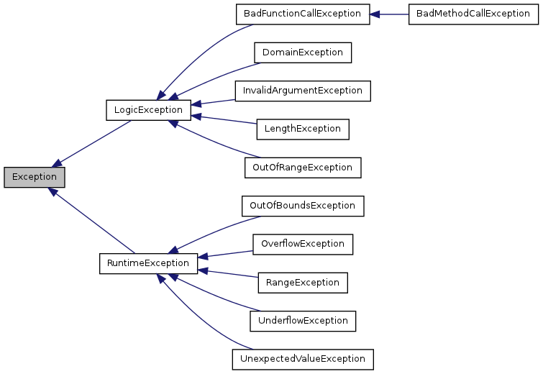
PHP Exception Types

Slide 26
Conclusions:
Errors happen, but it doesn't mean they should be
ignored
Watch out for external errors or they may turn to bugs
Use Exceptions to better handle errors and logic flaws
Use Exceptions to distinguish between different error cases
Have a default error handler and a default exception handler, even if you are sure that everything is covered

Slide 27
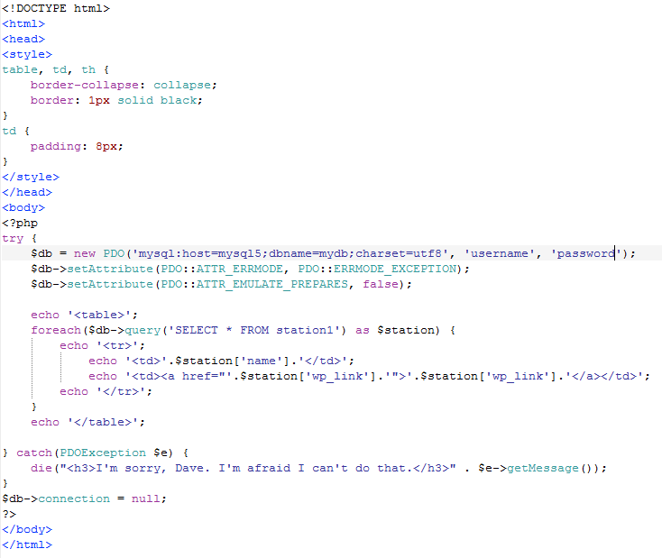

example script using pdo with try{} catch{} block
run example
run example (with error)

Slide 28

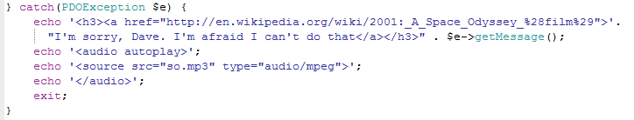

actual catch{} block

