Slide 1
测试执行与监控

Slide 2

课程概览
在本章中，我们将学习：
  测试的执行
  如何结束测试
  测试执行的监控

Slide 3

课程目标
完成此课程之后，学员将具备以下能力：
  执行测试用例
  理解测试执行的监控过程
  掌握结束测试的条件

Slide 4

课程目录
执行测试
监控测试执行
结束测试执行
Notes:
A good test engineer has a 'test to break' attitude, an ability to take the point of view of the customer, a strong desire for quality, and an attention to detail. Tact and diplomacy are useful in maintaining a cooperative relationship with developers, and an ability to communicate with both technical (developers) and non-technical (customers, management) people is useful. Previous software development experience can be helpful as it provides a deeper understanding of the software development process, gives the tester an appreciation for the developers' point of view, and reduce the learning curve in automated test tool programming. Judgement skills are needed to assess high-risk areas of an application on which to focus testing efforts when time is limited.

Slide 5
测试执行
测试执行是执行所有或部分选定的测试用例，并对结果进行分析的过程

Slide 6
测试执行的前提
进入系统测试执行的要求：
  软件实现基本已经完成
  所有需求、设计文档均已批准、定稿
  已经通过BVT测试或Smoke测试，检查主要功能是否能测试，表明该软件具备一定的可靠性，可以开始正式的、全面的测试
  测试计划、用例设计已完成。测试环境已准备好
Notes:
Regardless of the testing phase, it is important to define the entrance criteria (when testing can begin) and the exit criteria (when testing is complete) for a software test execution cycle.
The entrance criteria describe when a testing team is ready to start testing a specific build. In order to accept a software build during system testing, various criteria should be met. Some examples:
All unit and integration tests have been executed successfully.
The software builds (compiles) without any issues.
The build passes a smoke test, as discussed in Item 40.
The build has accompanying documentation (release notes) describing what's new in the build and what has been changed.
Defects have been repaired and are ready for retesting. (See Item 49 for a discussion of the defect-tracking life cycle.)
The source code is stored in a version-control system.
Only after the entrance (or acceptance) criteria have been met is the testing team ready to accept the software build and begin the testing cycle.

Slide 7
测试用例执行过程中的问题
软件是否有缺陷
填写软件缺陷报告
确定造成这些缺陷的原因
需求、设计是否有缺陷
测试环境和测试部件是否有缺陷
测试用例设计是否不合理

Slide 8
测试用例的手动执行
根据测试用例的要求人工的进行软件操作，输入数据，观测输出结果

Slide 9

测试用例的自动执行
使用录制回放工具
使用通用脚本

Slide 10
测试执行过程
根据测试的阶段、任务，选择执行全部或部分测试用例
任务分配：将测试用例分配给测试工程师
执行测试，记录原始数据，报告发现的缺陷
执行某些测试用例时，如果需要先将被测对象置于某个特定的状态，则应保留测试环境、状态
Notes:
Execute the test cases, report bugs, and capture information about the tests continuously, taking into account previous test results for each subsequent test.

Slide 11
测试执行过程
解决测试中阻碍进度的问题
向管理层报告测试的进度、发现的主要问题等等

Slide 12
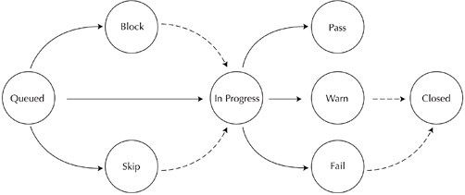
测试执行过程
测试用例的状态和生命周期
Notes:
说明各状态的含义，实线、虚线的含义

Slide 13
课程目录
执行测试
结束测试执行
监控测试执行
Notes:
A good test engineer has a 'test to break' attitude, an ability to take the point of view of the customer, a strong desire for quality, and an attention to detail. Tact and diplomacy are useful in maintaining a cooperative relationship with developers, and an ability to communicate with both technical (developers) and non-technical (customers, management) people is useful. Previous software development experience can be helpful as it provides a deeper understanding of the software development process, gives the tester an appreciation for the developers' point of view, and reduce the learning curve in automated test tool programming. Judgement skills are needed to assess high-risk areas of an application on which to focus testing efforts when time is limited.

Slide 14

测试执行的结束
测试执行的结束
  测试达到预期目的后，按计划结束
  受到时间进度、资源的限制，测试被迫结束
在测试计划中明确说明测试结束的条件
  Good-Enough原则
结束条件的判定是在质量和成本之间的折衷
Notes:
Lesson 185 in Lessons Learned in Software Testing states:
"Because testing is an information gathering process, you can stop when you've gathered enough information. You could stop after you've found every bug, but it would take infinite testing to know that you've found every bug, so that won't work. Instead, you should stop when you reasonably believe that the probability is low that the product still has important undiscovered problems.
"Several factors are involved in deciding that testing is good enough (low enough chance of undiscovered significant bugs):
You are aware of the kinds of problems that would be important to find, if they existed.
You are aware of how different parts of the product could exhibit important problems.
You have examined the product to a degree and in a manner commensurate with these risks.
Your test strategy was reasonably diversified to guard against tunnel vision.
You used every resource available for testing.
You met every testing process standard that your clients would expect you to meet.
You expressed your test strategy, test results, and quality assessments as clearly as you could."

Slide 15
测试执行的结束条件
达到了覆盖率的要求
  单元测试：语句覆盖、 …
  集成测试：API、API/参数组合
  系统测试：功能、用例、用例场景(scenario)
  例如：
    100%语句覆盖
    90%用例场景覆盖
Notes:
Coverage Goals
Coverage is a measure of how much has been tested compared with how much is available to test. Coverage can be defined at the code level with metrics such as statement coverage, branch coverage, and path coverage. At the integration level, coverage can be defined in terms of APIs tested or API/parameter combinations tested. At the system level, coverage can be defined in terms of functions tested, use cases (or user stories) tested, or use case scenarios (main path plus all the exception paths) tested. Once enough test cases have been executed to meet the previously defined coverage goals, we are, by definition, finished testing. For example, we could define a project's stopping criteria as:
100% statement coverage
90% use case scenario coverage
When this number of tests pass, we are finished testing. (Of course, there are many other combinations of factors that could be used as stopping criteria.) Not all testers approve of this approach. Glenford Myers believes that this method is highly counterproductive. He believes that because human beings are very goal oriented, this criterion could subconsciously encourage testers to write test cases that have a low probability of detecting defects but do meet the coverage criteria. He believes that more specific criteria such as a set of tests that cover all boundary values, state-transition events, decision table rules, etc. are superior.
Defect Discovery Rate
Another approach is to use the defect discovery rate as the criteria for stopping. Each week (or other short period of time) we count the number of defects discovered. Typically, the number of defects found each week resembles the curve in Figure 16-1. Once the discovery rate is less than a certain previously selected threshold, we are finished testing. For example, if we had set the threshold at three defects/week, we would stop testing after week 18.
Figure 16-1: Defect Discovery Rate
While this approach appeals to our intuition, we should consider what other situations would produce a curve like this—creation of additional, but less effective test cases; testers on vacation; "killer" defects that still exist in the software but that hide very well. This is one reason why Beizer suggests not depending on only one stopping criterion.
Marginal Cost
In manufacturing, we define "marginal cost" as the cost associated with one additional unit of production. If we're making 1,000 donuts, what is the additional cost of making one more? Not very much. In manufacturing, the marginal cost typically decreases as the number of units made increases. In software testing, however, just the opposite occurs. Finding the first few defects is relatively simple and inexpensive. Finding each additional defect becomes more and more time consuming and costly because these defects are very adept at hiding from our test cases. Thus the cost of finding the "next" defect increases. At some point the cost of finding that defect exceeds the loss our organization would incur if we shipped the product with that defect. Clearly, it is (past) time to stop testing.
Not every system should use this criterion. Systems that require high reliability such as weapons systems, medical devices, industrial controls, and other safety-critical systems may require additional testing because of their risk and subsequent loss should a failure occur.
Team Consensus
Based on various factors including technical, financial, political, and just "gut feelings," the project team (managers, developers, testers, marketing, sales, quality assurance, etc.) decide that the benefits of delivering the software now outweigh the potential liabilities and reach consensus that the product should be released.
Ship It!
For many of us, this will be the only strategy we will ever personally experience. It's often very disheartening for testers, especially after many arduous hours of testing, and with a sure knowledge that many defects are still hiding in the software, to be told "Ship it!" What testers must remember is that there may be very reasonable and logical reasons for shipping the product before we, as testers, think it is ready. In today's fast-paced market economy, often the "first to market" wins a substantial market share. Even if the product is less than perfect, it may still satisfy the needs of many users and bring significant profits to our organization; profits that might be lost if we delayed shipment.
Some of the criteria that should be considered in making this decision are the complexity of the product itself, the complexity of the technologies used to implement it and our skills and experience in using those technologies, the organization's culture and the importance of risk aversion in our organization, and the environment within which the system will operate including the financial and legal exposure we have if the system fails.
As a tester, you may be frustrated by the "Ship It" decision. Remember, our role as testers is to inform management of the risks of shipping the product. The role of your organization's marketing and sales groups should be to inform management of the benefits of shipping the product. With this information, both positive and negative, project managers can make informed, rational decisions.

Slide 16
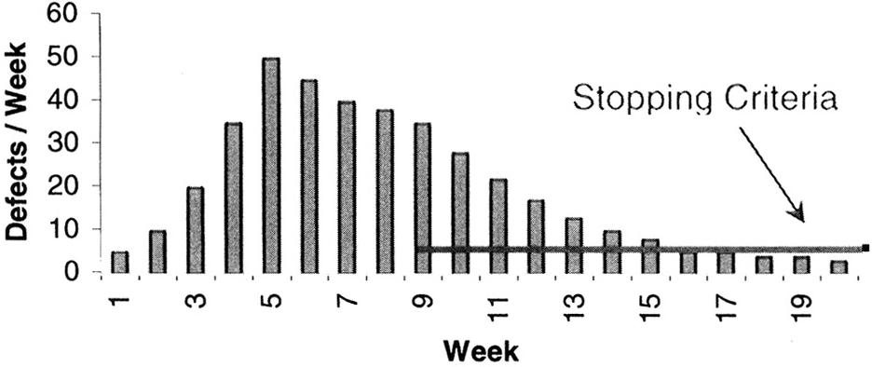
测试执行的结束条件
指定的时间段内没有发现新的缺陷

Slide 17
测试执行的结束条件
基于成本的考虑
  测试执行到一定阶段时，查找未发现的缺陷的成本逐渐增大，如果超过了由潜在缺陷所引起的代价，则可以停止测试
  不适用于要求高可靠性的软件：武器、医学设备、…
Notes:
Thus the cost of finding the "next" defect increases. At some point the cost of finding that defect exceeds the loss our organization would incur if we shipped the product with that defect. Clearly, it is (past) time to stop testing.
Not every system should use this criterion. Systems that require high reliability such as weapons systems, medical devices, industrial controls, and other safety-critical systems may require additional testing because of their risk and subsequent loss should a failure occur.

Slide 18

测试执行的结束条件
项目组达成一致
  基于技术、资金、开销等各种因素，项目组（包括管理层、开发、测试、市场销售）意见一致，认为可以停止测试

Slide 19
测试执行的结束条件
因时间进度、资源的限制必须结束
  一般是为了按计划尽快发布软件，抢占市场
  可能存在潜在的严重缺陷
  已知的缺陷可能还未修改

Slide 20
课程目录
执行测试
结束测试执行
监控测试执行
Notes:
A good test engineer has a 'test to break' attitude, an ability to take the point of view of the customer, a strong desire for quality, and an attention to detail. Tact and diplomacy are useful in maintaining a cooperative relationship with developers, and an ability to communicate with both technical (developers) and non-technical (customers, management) people is useful. Previous software development experience can be helpful as it provides a deeper understanding of the software development process, gives the tester an appreciation for the developers' point of view, and reduce the learning curve in automated test tool programming. Judgement skills are needed to assess high-risk areas of an application on which to focus testing efforts when time is limited.

Slide 21
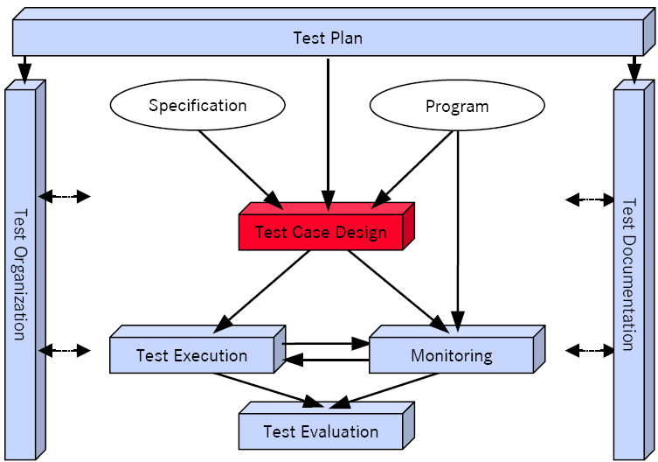
测试执行的监控

Slide 22
测试监控的任务和目的
记录和管理测试用例的执行状态
根据当前的执行状态，判定测试用例的设计质量和效率
  使用脚本进行自动测试
根据发现的缺陷分布，判定结束测试的条件是否成熟

Slide 23
测试监控的任务和目的
评估测软件的质量
  缺陷的数量、种类、…
评估开发过程的质量
  缺陷的分布、修复缺陷的时间、回归测试时发现的缺陷数量、…
评估测试工程师的表现
  是否按计划完成任务
  发现缺陷的数量

Slide 24
测试监控的内容
测试用例执行的进度 = 已执行的数目/总数目
  此数据只表明执行进度，不表示测试的成功率
  为了得到更精确的进度数据，可计算测试步骤数
Notes:
Item 50: Track the Execution of the Testing Program
Everyone involved in a software project wants to know when testing is completed. To be able to answer that question, it is imperative that test execution be tracked effectively. This is accomplished by collecting data, or metrics, showing the progress of testing. The metrics can help identify when corrections must be made in order to assure success. Additionally, using these metrics the test team can predict a release date for the application. If a release date has been predetermined, the metrics can be used to measure progress toward completion.
Progress metrics are collected iteratively during the stages of the test-execution cycle. Sample progress metrics include the following:
Test Procedure Execution Status (%) = executed number of test procedures / total number of test procedures. This execution status measurement is derived by dividing the number of test procedures already executed by the total number of test procedures planned. By reviewing this metric value, the test team can ascertain the number of percentage of test procedures remaining to be executed. This metric, by itself, does not provide an indication of the quality of the application. It provides information only about the progress of the test effort, without any indication of the success of the testing.
It is important to measure the test procedure steps executed, not just the number of test procedures executed. For example, one test procedure may contain 25 steps. If the tester successfully executes Steps 1 through 23, and then encounters a showstopper at Step 24, it is not very informative to report only that the entire test procedure failed; a more useful measurement of progress includes the number of steps executed. Measuring test-procedure execution status at the step level results in a highly granular progress metric.
The best way to track test procedure execution is by developing a matrix that contains the identifier of the build under test, a list of all test procedure names, the tester assigned to each test procedure, and the percentage complete, updated daily and measured by the number of test-procedure steps executed successfully versus total number of test-procedure steps planned. Many test-management or requirements-management tools can help automate this process.
Defect Aging = Span from date defect was opened to date defect was closed. Another important metric in determining progress status is the turnaround time for a defect to be corrected, also called defect aging. Defect aging is a high-level metric that verifies whether defects are being addressed in a timely manner. Using defect-aging data, the test team can conduct a trend analysis. For example, suppose 100 defects are recorded for a project. If documented past experience indicates that the development team can fix as many as 20 defects per day, the turnaround time for 100 problem reports may be estimated at one work-week. The defect-aging statistic, in this case, is an average of five days. If the defect-aging measure grows to 10?5 days, the slower response time of the developers making the corrections may affect the ability of the test team to meet scheduled deadlines.
Standard defect-aging measurement is not always applicable. It sometimes must be modified, depending on the complexity of the specific fix being implemented, among other criteria.
If developers don't fix defects in time, it can have a ripple effect throughout the project. Testers will run into related defects in another area, creating duplication when one timely fix might have prevented subsequent instances. In addition, the older a defect becomes, the more difficult it may be to correct it, since additional code may be built on top of it. Correcting the defect at a later point may have much larger implications on the software than if it had been corrected when originally discovered.
Defect Fix Time to Retest = Span from date defect was fixed and released in new build to date defect was retested. The defect fix retest metric provides a measure of whether the test team is retesting corrections at an adequate rate. If defects that have been fixed are not retested adequately and in a timely manner, this can hold up progress, since the developer cannot be assured that a fix has not introduced a new defect, or that the original problem has been properly corrected. This last point is especially important: Code that is being developed with the assumption that earlier code has been fixed will have to be reworked if that assumption proves incorrect. If defects are not being retested quickly enough, the testing team must be reminded of the importance of retesting fixes so developers can move forward, knowing their fixes have passed the test.
Defect Trend Analysis = Trend in number of defects found as the testing life cycle progresses. Defect trend analysis can help determine the trend in the identification of defects. Is the trend improving (i.e., are fewer defects being found over time) as the system testing phase is nearing completion, or is the trend worsening? This metric is closely related to "Newly opened defects." The number of newly opened defects should decline as the system-testing phase nears the end. If this is not the case, it may be an indicator of a severely flawed system.
If the number of defects found increases with each subsequent test release, assuming no new functionality is being delivered and the same code is being tested (changed only by the incorporation of code fixes), several possible causes may be indicated, such as:
improper code fixes for previous defects
incomplete testing coverage for earlier builds (new testing coverage discovers new defects)
inability to execute some tests until some of the defects have been fixed, allowing execution of those tests, which then find new defects
Quality of Fixes = Number of errors (newly introduced or reoccurring errors in previously working functionality) remaining per fix. This metric is also referred to as the recurrence ratio. It measures the percentage of fixes that introduce new errors into previously working functionality or break previously working functionality. The value obtained from this calculation provides a measure of the quality of the software corrections implemented in response to problem reports.
This metric helps the test team determine the degree to which previously working functionality is being adversely affected by software corrections. When this value is high, the test team must make developers aware of the problem.
Defect Density = Total number of defects found for a requirement / number of test procedures executed for that requirement. The defect-density metric is the average number of defects found per test procedure in a specific functional area or requirement. If there is a high defect density in a specific functional area, it is important to conduct a causal analysis using the following types of questions:
Is this functionality very complex, and therefore expected to exhibit high defect density?
Is there a problem with the design or implementation of the functionality?
Were inadequate resources assigned to the functionality, perhaps because its difficulty was underestimated?
Additionally, when evaluating defect density, the relative priority of the defect must be considered. For example, one application requirement may have as many as 50 low-priority defects and still satisfy acceptance criteria. Another requirement might have one open high-priority defect that prevents the acceptance criteria from being satisfied.
These are just few of the metrics that must be gathered to measure test-program execution; many others are available. The metrics described in this Item are a core set to track in order to identify any need for corrective activity, to highlight risk areas, and ultimately, to enable successful execution of the testing program.

Slide 25
测试监控的内容
缺陷的存活时间 =缺陷从open到closed的时间
  表明修改缺陷的效率

Slide 26
测试监控的内容
缺陷的趋势分析 --- 按照测试执行的时间顺序(以月、周、天为时间单位)，被发现的缺陷数量的分布
  如果越来越少，趋近于0，则考虑结束测试执行
  相反，则说明存在以下的问题：
    代码修改引发新的缺陷
    前一版本的测试存在覆盖率的问题，新的测试发现了原先未发现的缺陷
    必须先修改某些缺陷后才能继续测试，然后才发现其他的缺陷

Slide 27
测试监控的内容
缺陷分布密度 =对应于一项需求的总缺陷数/对应于该项需求的测使用例总数
  需要考虑缺陷的优先级和严重程度
  如果过多的缺陷集中在某项需求上，可能表明以下问题：
    该项功能需求是否过于复杂？
    该项的需求设计、实现是否有问题？
    分配给该项的开发资源是否不足？
    … …

Slide 28
测试监控的内容
缺陷修改质量 = 每次修改后发现的缺陷数量（包括重现的缺陷和由修改所引起的新缺陷）
  评价开发部门修复缺陷的质量
  如果修改某项功能后，此数值较高，测试部门应当及时通知开发部门

Slide 29
改进测试执行过程
基于质量风险分析，先测试最容易出现缺陷、对软件影响最大的部分
正确分析测试结果
… …

