Slide 1

Capstone Project Phase 1 • Fall Semester 2026
Team Members
Brandon Matias
Jonah Joseph
Khadijah Patience
Taki Eddine Boubekri
Course & Faculty
Professor: Sitaram Ayyagari
Course: ITAI-2277 AI Resources & References (CRN 21496)
True Homeownership & Cost-of-Living Predictor
A Hyper-Local Real Estate Affordability Platform

Slide 2


Project Selection Process
Ideas on the Table
Finalization Criteria
16-Week Feasibility: Preference for projects avoiding early data collection or hardware delays.
Smart Agriculture Sorter: CV and robotics system for classifying produce ripeness/defects.
Demo Impact: Must yield a high-quality, practical presentation (e.g., interactive web app).
Gaming Highlight Extractor: Automated post-match video analyzer detecting top gameplay reels.
Technical Diversity: Integration of Data Engineering, Tabular ML, and Web UI disciplines.
Cost-of-Living Predictor: Data-driven platform forecasting total itemized expenses based on ZIP code to determine true affordability. (Selected)
Hardware Independence: Low to zero physical hardware dependencies to minimize project risk.

Slide 3

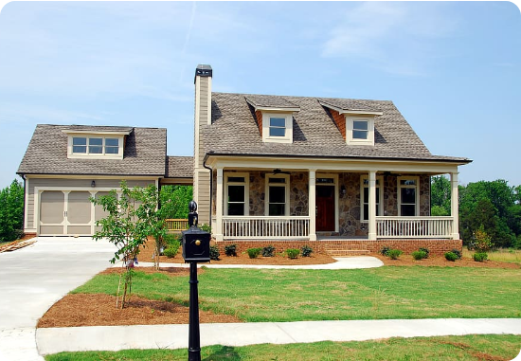
Project Idea & Use Case
The Concept: Home buyers understand mortgage rates, but often overlook day-to-day carrying costs. Our platform predicts the cost of living for select ZIP codes.
The system aggregates location-based data to estimate utility expenses (water, electric), insurance requirements (flood, storm), and regional grocery indexes.
Scope & Implementation
Industry / Sector: Real Estate, PropTech & Consumer Finance.
Geographic Scope: Nationwide (United States), localized at the ZIP code level.
Target Audience: Prospective homeowners verifying total financial affordability.

Slide 4








Technical Architecture & Stack
Data Sources
Model Category
User Interface
Hardware / Infra
Aggregated public tax records, municipal utility rate datasets, FEMA flood maps, and regional Consumer Price Index (CPI) data.
Multi-Output Tabular Regression for financial forecasting and Geospatial Risk Analysis mapping environmental insurance needs.
Interactive web dashboard developed using Python frameworks (Flask or Streamlit) for user-friendly, real-time geographic queries.
Standard development laptops (no physical hardware required). Pipeline and modeling facilitated by free cloud compute (Google Colab / GCP).

Slide 5
Project Plan & Resource Allocation
Team Member | Role | Primary Tasks | Resources
Khadijah Patience | Data Engineer | Sourcing tax, utility, and insurance datasets; building data pipelines.
Jonah Joseph | ML & Data Specialist | Developing Tabular Regression models for cost prediction & risk logic.
Brandon Matias | Full-Stack UI Dev | Building the web dashboard, integrating models via API, ensuring UX.
Taki Eddine Boubekri | Project Manager & QA | System integration, version control, end-to-end testing, and docs.

Slide 6
Questions?
Thank you for your time.

