Slide 1




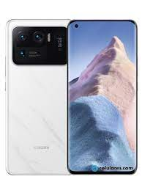
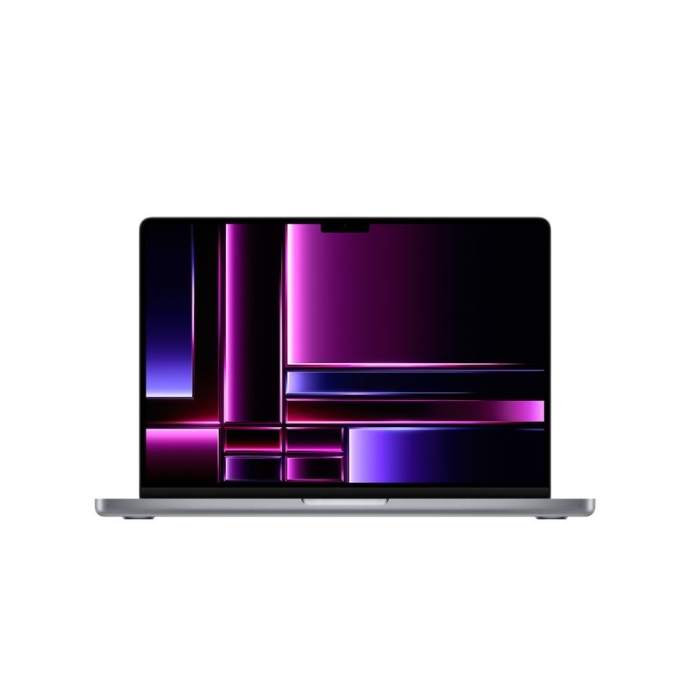




iPhone 13 Pro Precio: $21,999-$24,299 MXN
Samsung Galaxy S21 Ultra
Precio: $26,999-$31,499 MXN
Google Pixel 6 Pro Precio: $18,999-$21,199 MXN
OnePlus 9 Pro Precio: $21,999-$24,299 MXN
Xiaomi Mi 11 Ultra
Precio: $26,999-$29,199 MXN
MacBook Pro (2023) - Precio: $27,999-$54,999 MXN
Dell XPS 15 - Precio: $26,999-$54,999 MXN
HP Spectre x360 - Precio: $23,999-$39,999 MXN
Lenovo ThinkPad X1 Carbon - Precio: $27,999-$54,999 MXN
Asus ROG Zephyrus G14 - Precio: $26,999-$39,999 MXN

Slide 2

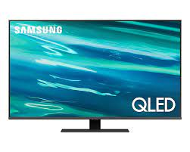


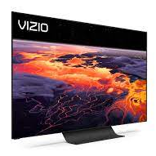





LG OLED C1 Precio: $34,999-$81,999 MXN
Samsung QLED Q80A - Precio: $29,999-$81,999 MXN
Sony BRAVIA XR A90J - Precio: $46,999-$116,999 MXN
TCL 6-Series (R635) - Precio: $13,999-$25,999 MXN
Vizio OLED 4K TV (OLED65-H1) - Precio: $34,999-$46,999 MXN
Apple AirPods Pro Precio : $4,999-$5,499 MXN
Sony WH-1000XM4
Precio: $5,999-$6,999 MXN
Bose QuietComfort
Precio : $5,999-$6,999 MXN
Jabra Elite 85t Precio : $3,999-$4,599 MXN
Sennheiser Momentum True 2
Precio : $4,999-$5,999 MXN

Slide 3
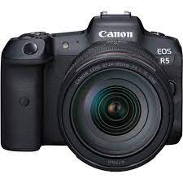
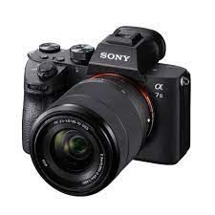
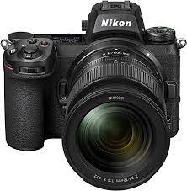
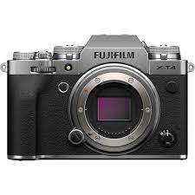
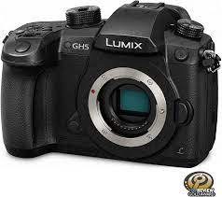
Canon EOS R5 - Precio: $89,999-$103,999 MXN
Sony Alpha A7 III - Precio: $41,999-$51,999 MXN
Nikon Z6 II - Precio: $41,999-$51,999 MXN
Fujifilm X-T4 - Precio: $39,999-$46,999 MXN
Panasonic Lumix GH5 - Precio: $29,999-$39,999 MXN

