Slide 1
$yrUP
Daniel Pulido, Paul Collins, Nirranjan Akilan, Nikhil Dasari, Brandon Coffey, Scott Pedley, Monish Ravishankar

Slide 2
Objective
To design a price tracking website that will allow shoppers to save money while making online purchases. We will pull price history data from several online retailers for various products to ensure our users can make the most informed decision before spending their hard earned money.

Slide 3
Cost Estimation
Function Point: 714.87 FP => 36 person-weeks, 6 weeks
Estimated Cost of Hardware:
Designed to accommodate target user base of 2000 users
Domain.Com’s Ultra Plan costs $13.75/month
Estimated Cost of Software:
Will be built from the ground up using frameworks such as React
Optional Software - Premium Slack account for collaboration
Estimated Cost of Personnel: $104,460
Average Salary for Front-end Developer: $127,483 ($61/hour)
Average Salary for Back-end Developer: $131,789 ($64/hour)

Slide 4
Project Timeline
(Week 2): User Interface Design
(Week 4): Tentative Deadline for MVP
Mid May 2023 (Week 6): Estimated Project Completion
April 2023 (Week 1): P​​roject Begins
(Week 3): Development & Testing begins
(Week 5): Making improvements to MVP

Slide 5
Functional REquirements
API calls to get product information that we update once a day and track for a set time (ex: a year).
A search bar where the user can type in an item and click on it to go to its page
A query function to find the cost of the item from all the different shopping websites
Have functionality to graph a time vs price graph visual for users to view
Functionality to register/login in and save user information
Allow users to bookmark products to their account
Display bookmarked items on the user’s homepage

Slide 6
Non-Functional REquirements
Usability requirement: Should be able to be used on desktop and mobile.
Performance requirement: All requests must be generated in 2 seconds or less.
Space requirement: No data should be stored on the user's computer.
Environmental requirement: The computer hosting the application’s server must be located in a dust free environment per American dust laws about server maintenance.
Operational requirement: The application must be able to gather price history once a day and track it for a year.
Development requirement: The application must implement object-oriented programming practices to ensure that price data calculations are abstracted from the user.
Accounting requirement: The application’s shareholders get a small commission for products purchased through the application.
Safety requirement: All user and cite data should be encrypted.

Slide 7
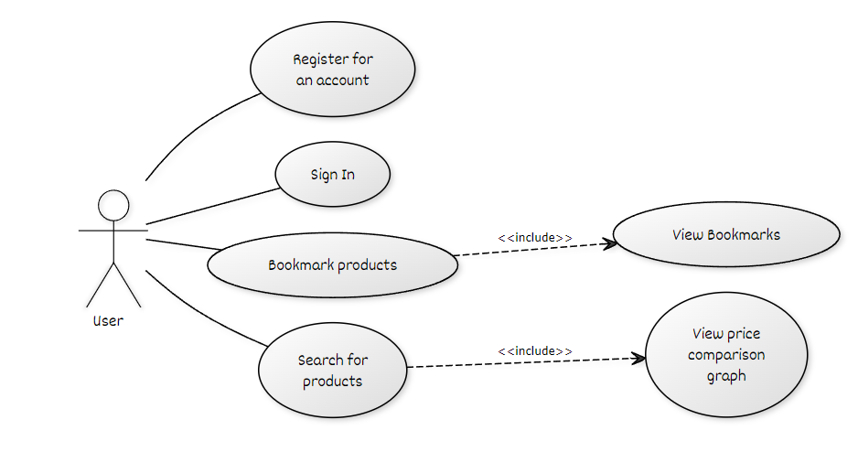
Use Case Diagram

Slide 8
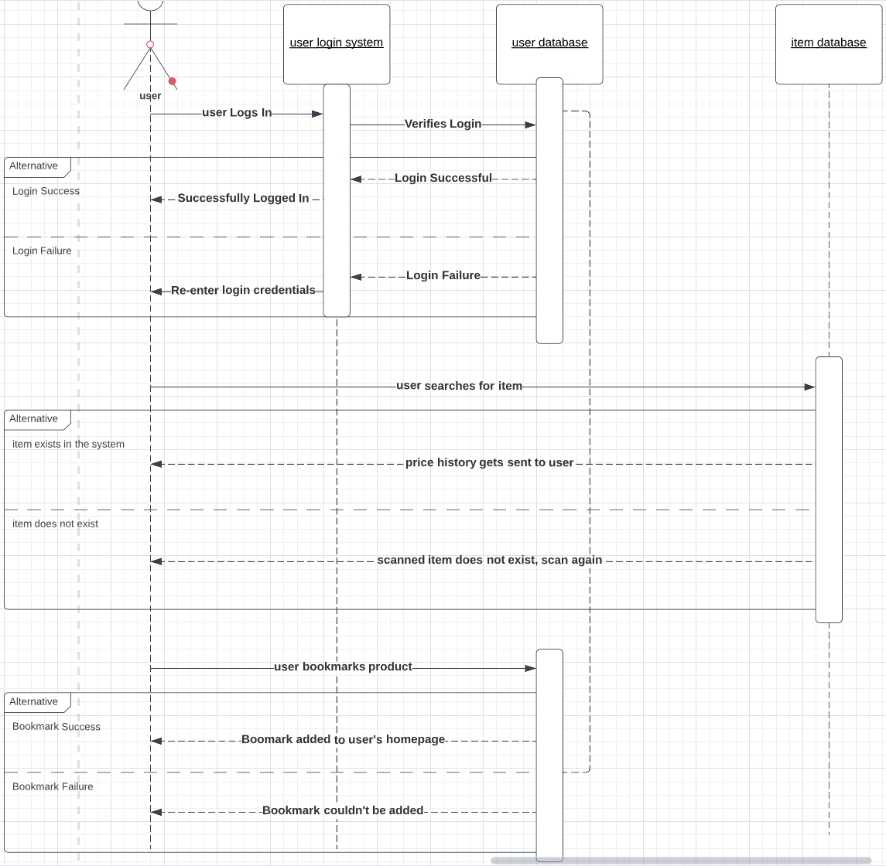
Sequence Diagram

Slide 9
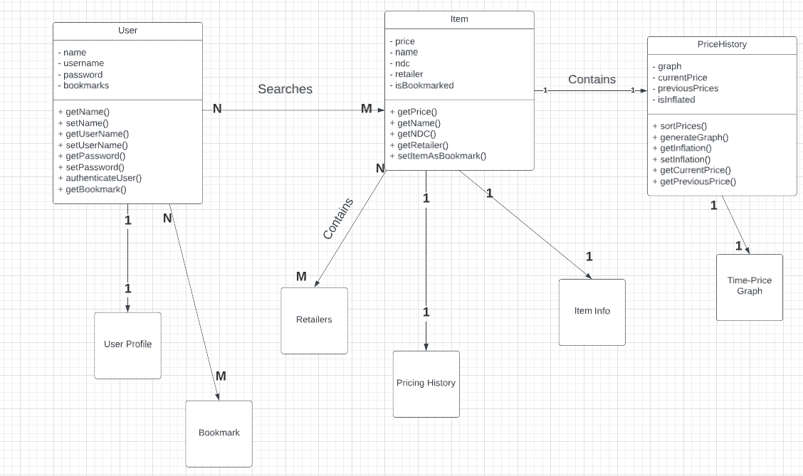
Class Diagram

Slide 10
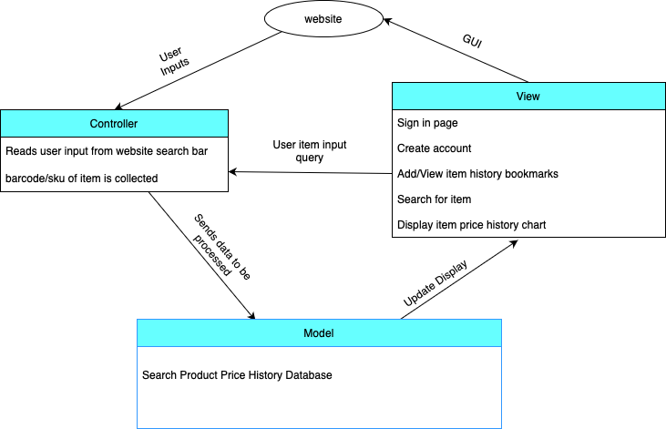
Model View Controller Design

Slide 11
Demo of User Interface Design
Live Demo Link

