Slide 1

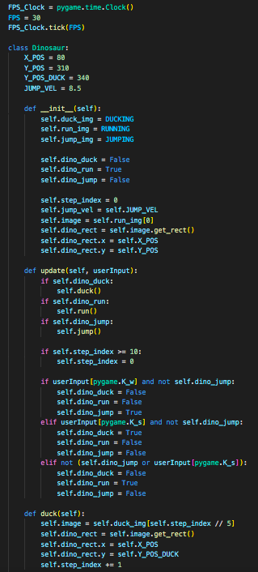
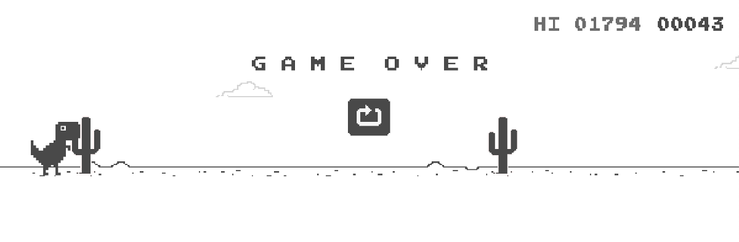
C h r o m e D I n o
Project by: Brandon McGrath
Original Code by: Codewmax
A spinoff of the classic game Chrome Dino!
Chrome Dino is the game that can be played when in the offline mode on Google Chrome. This code transforms this single-player game into a multiplayer game with many additional features.
Code: https://github.com/BrandonMcGrath3/chrome-dinosaur

