Slide 1
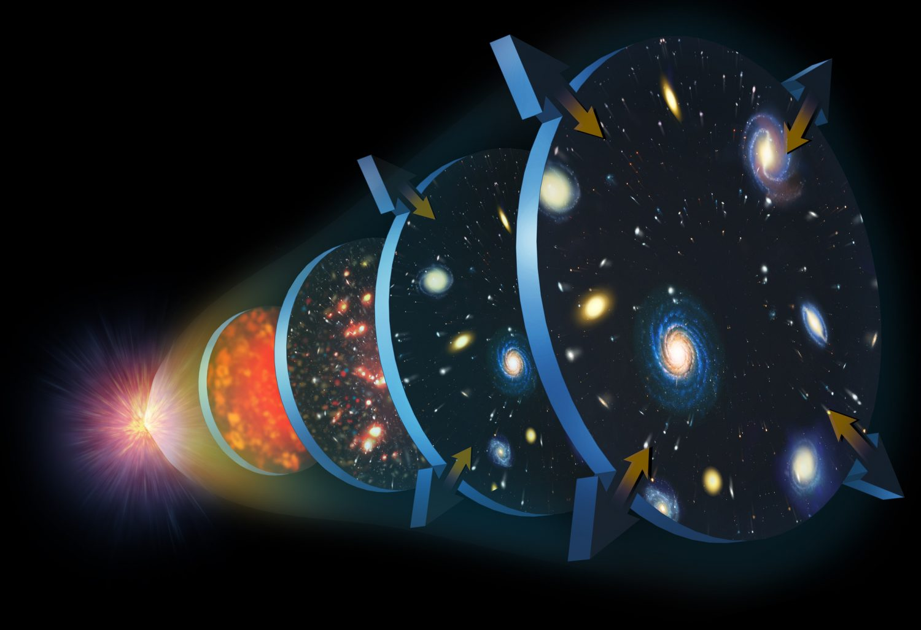

Real-World Astro Demo: Hubble’s Law
Brandon Radzom
IU Astronomy

Slide 2
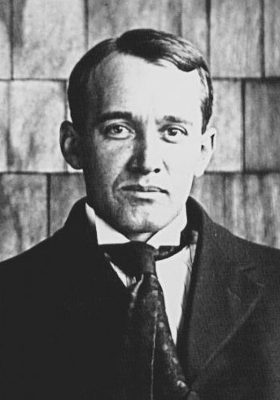
1912: Nebulae are receding
Vesto M. Slipher of Indiana University made the first Doppler measurement of a nebula (galaxy)
Its spectrum was redshifted so it must be receding!
The idea of other galaxies still controversial at the time
Slipher continued these observations and found a correlation between galaxy distance and redshift
Further galaxies were receding faster!
Did not connect to cosmological theories

Slide 3
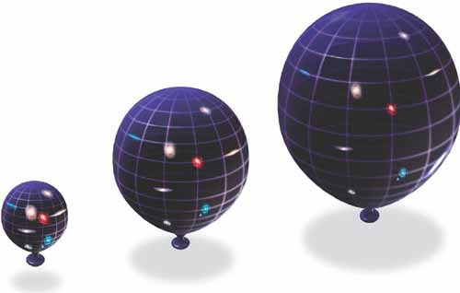
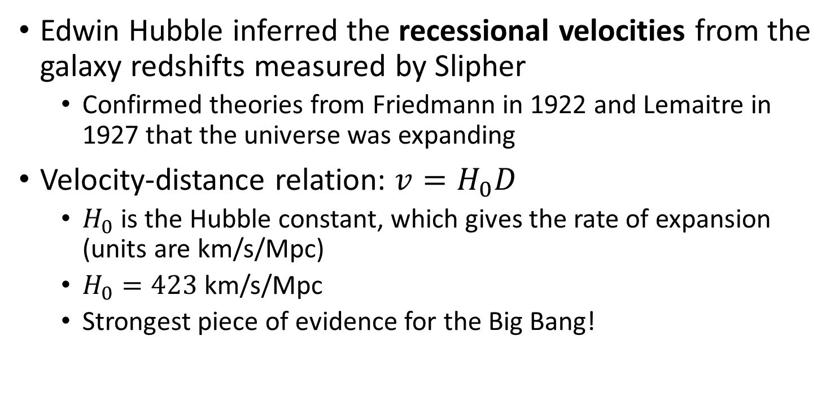
1929: Hubble’s Law: Universe is expanding
Edwin Hubble inferred the recessional velocities from the galaxy redshifts measured by Slipher
Confirmed theories from Friedmann in 1922 and Lemaitre in 1927 that the universe was expanding
Velocity-distance relation: $v=H_{0}D$
$H_{0}$ is the Hubble constant, which gives the rate of expansion (units are km/s/Mpc)
$H_{0}=423$ km/s/Mpc
Strongest piece of evidence for the Big Bang!

Slide 4
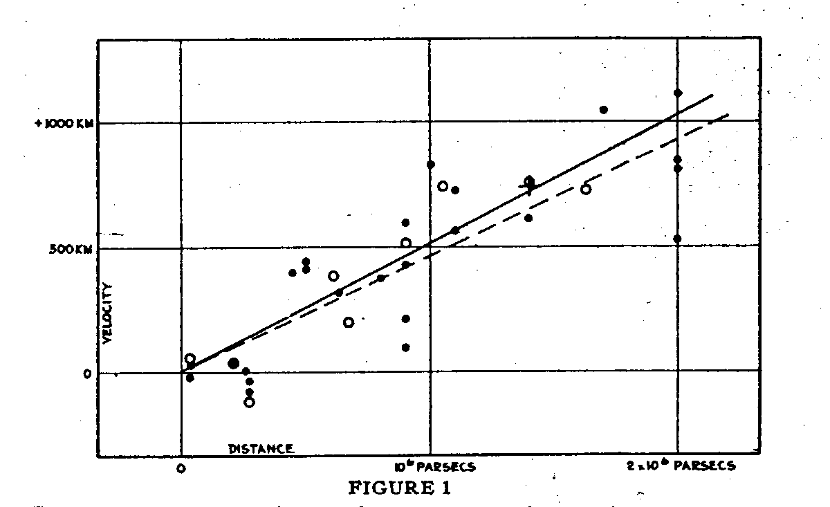
Hubble 1929 Result

Slide 5
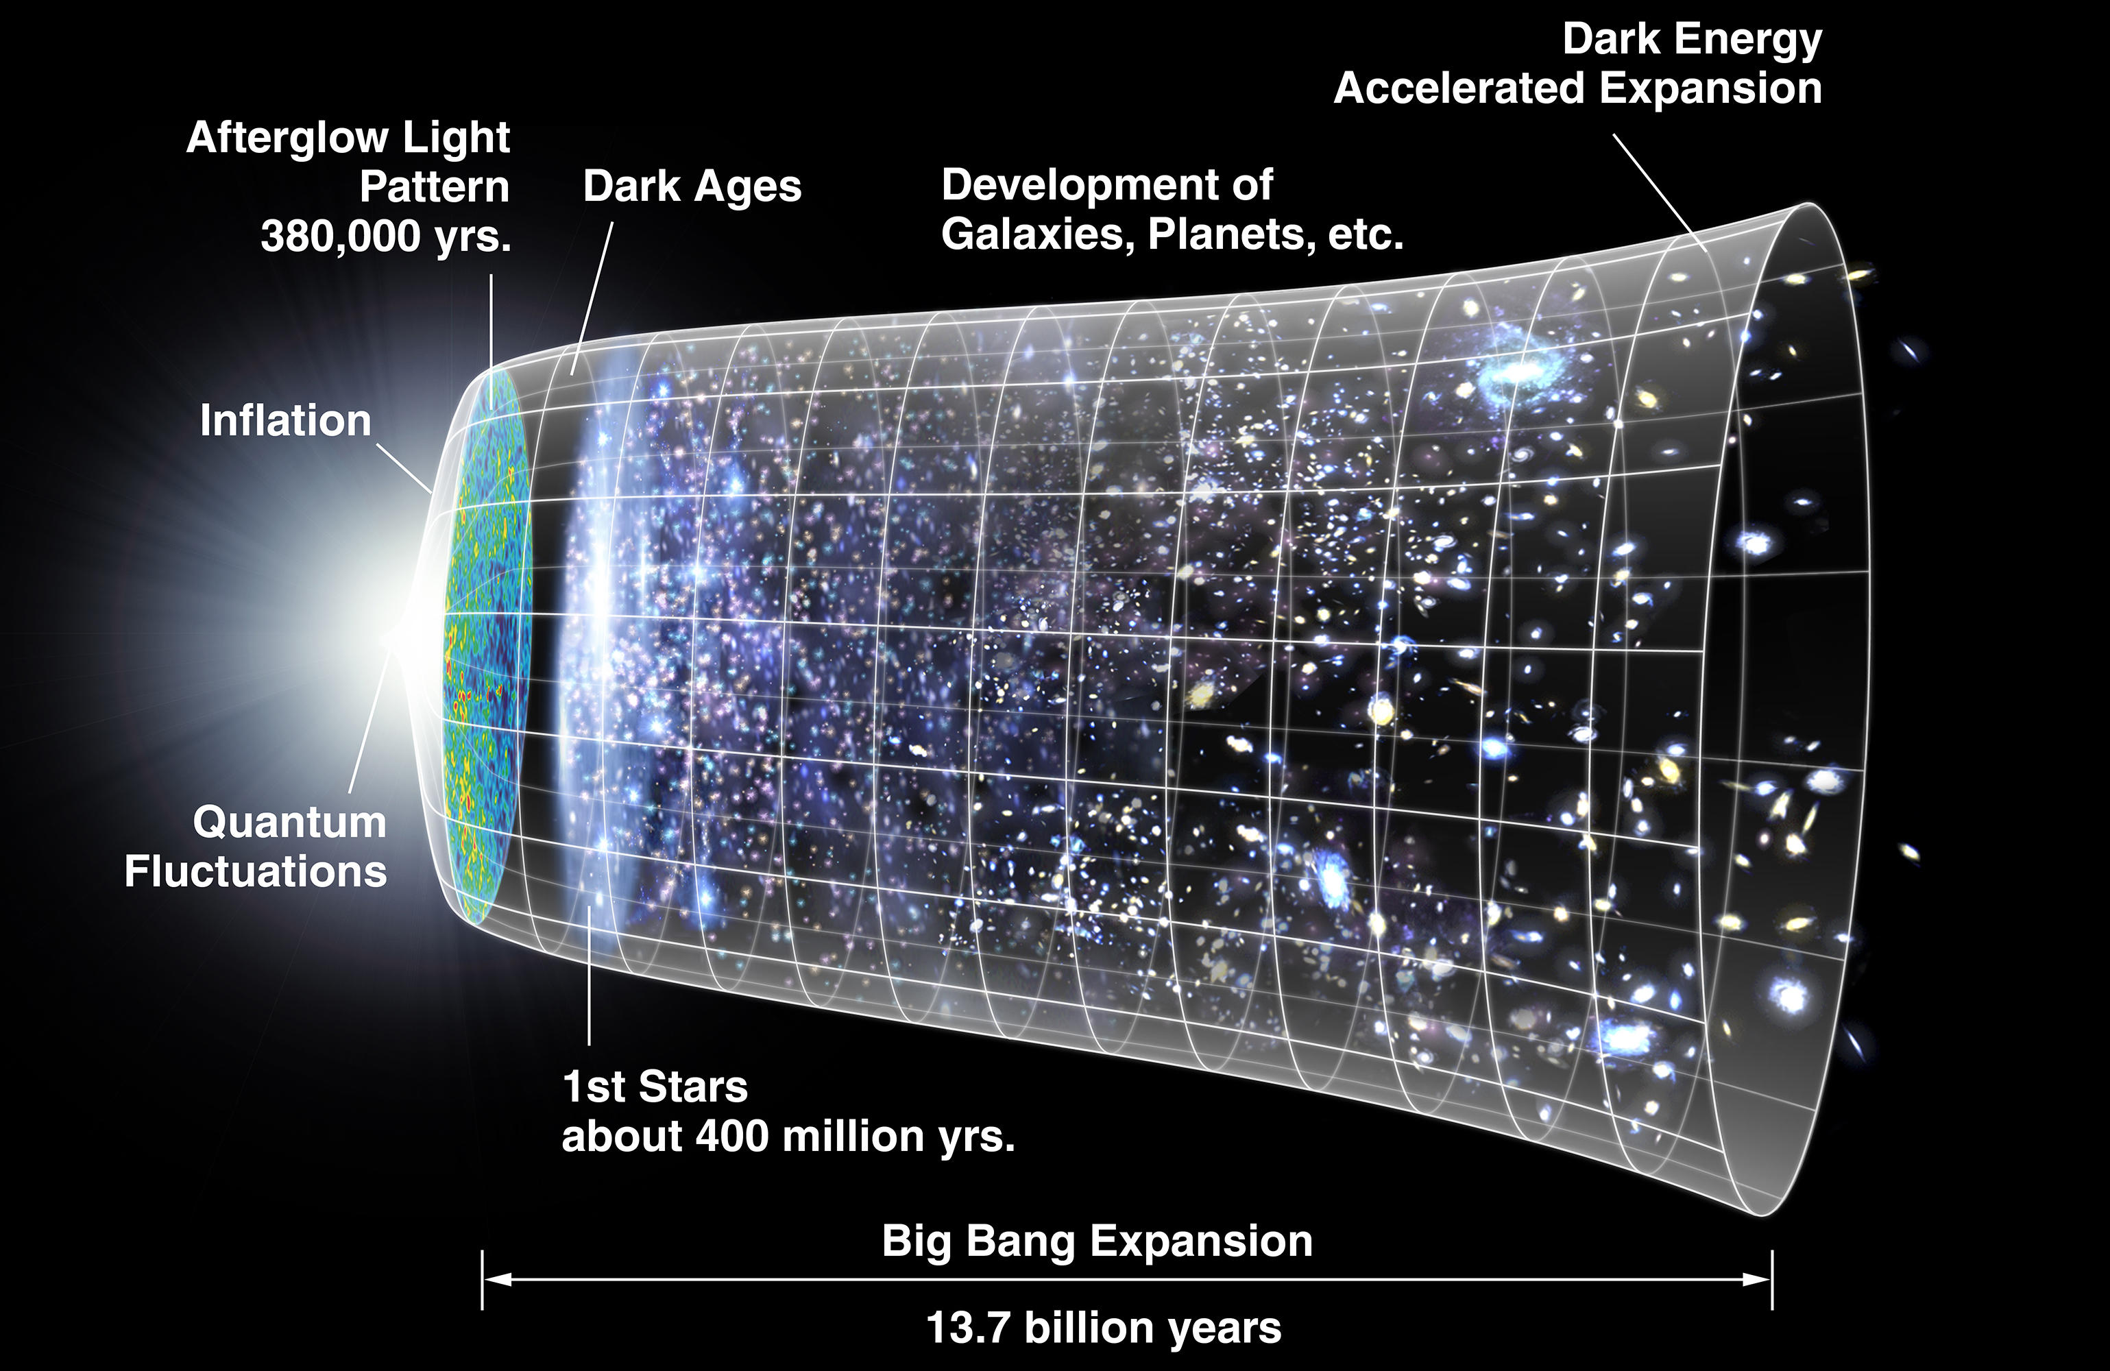

The Birth of Modern Cosmology!
$H_{0}=70$ km/s/Mpc

