Slide 1
The HR Diagram and NGC 2420
PyIU Crash Course
September 17, 2025

Slide 2
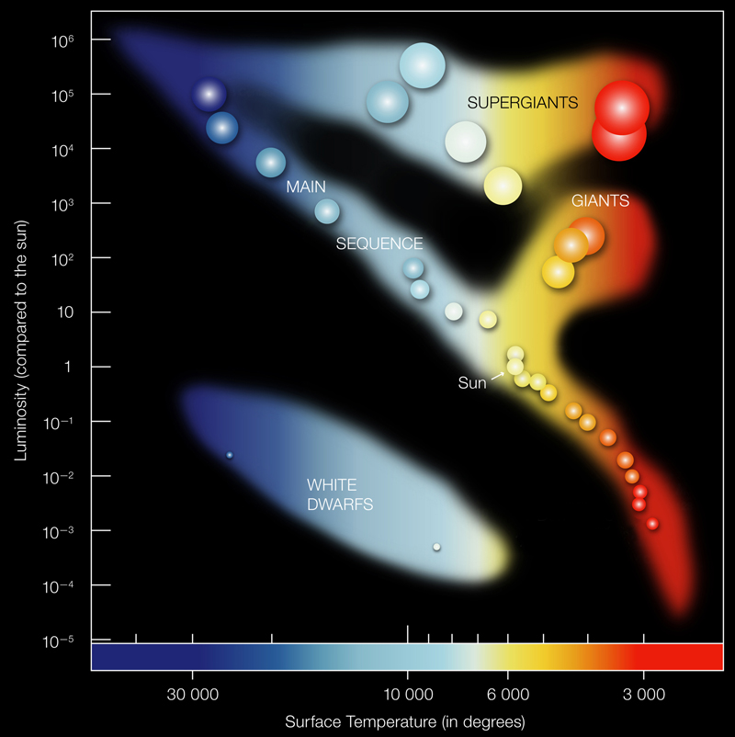
The HR Diagram
1911: Ejnar Hertzprung
1913: Henry Norris Russell
Temperature and luminosity of stars are related
Indicative of a star’s age and evolutionary state
Notes:
In 1911, Danish astronomer Ejnar Hertzsprung discovered that the temperature and luminosity (brightness) of stars are related, which was independently discovered by the American astronomer Henry Norris Russell in 1913, who plotted these quantities against each other for the first time. Named in honor of these two astronomers, the Hertzsprung-Russell (H-R) diagram has since become a fundamental tool in astronomy. Further research in the field has shown that, not only are temperature and luminosity related, but they are also indicative of a star's age and evolutionary state. Specifically, the clustering of stars in certain regions of the diagram tells us how long they spend in each phase of their life and the physics behind that evolutionary state.

Slide 3
The HR Diagram
Stars spend most of their life on the main sequence
All stars follow the same basic evolutionary sequence over different timescales:
Pre-main sequence
Main sequence
Giant
Death
Notes:
As depicted in the H-R diagram above, most stars lie along a narrow sequence running from the upper left (corresponding to hot, luminous stars) to the lower right (corresponding to cooler, less luminous stars). This region is called the main sequence, which is where most stars will spend most of their lives, including our Sun. The clear correlation between temperature and luminosity along the main sequence demonstrates that hotter stars are more luminous than cooler stars.
By comparing the H-R diagram with models of stellar evolution, astronomers have learned that stars generally undergo similar evolution tracks, just over vastly different timescales. This progression is as follows: 1) a brief pre-main sequence phase where a protostar forms and accretes mass, 2) a long main sequence phase where the star slowly burns (fuses) its hydrogen into helium in its core, 3) a short giant phase where the star stops core hydrogen burning and expands its radius significantly, and 4) a stellar death phase, where its outer layers are lost, either as a planetary nebula or a violent supernova, resulting in a hot, dense, relatively dim object. The exact details behind these evolutionary phases depend largely on the star's mass. Cooler stars like our Sun are lower in mass, so they tend to burn hydrogen more slowly and live longer, and will become red giants following the main sequence phase, and white dwarfs following the red giant phase. Hotter, more massive stars have shorter lifespans and can become supergiants, ultimately resulting in either a neutron star or a black hole. See Chapter 18.4 of Astronomy 2e for more on the H-R diagram and stellar evolution.

Slide 4
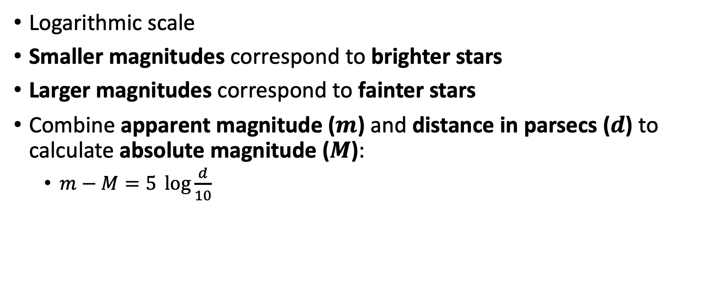
Magnitudes and Colors
Logarithmic scale
Smaller magnitudes correspond to brighter stars
Larger magnitudes correspond to fainter stars
Combine apparent magnitude ($m$) and distance in parsecs ($d$) to calculate absolute magnitude ($M$):
$m−M=5 \log{\frac{d}{10}}$
Notes:
In reality, astronomers cannot directly measure the luminosity, or intrinsic brightness, of a star. Instead, astronomers measure their apparent brightness, often reported in historic units called magnitudes. An important rule when dealing with magnitudes is that they are logarithmic, not linear, and that smaller magnitudes correspond to brighter objects while larger magnitudes correspond to dimmer objects. Then, astronomers combine their apparent magnitude with measurements of their distance to calculate their absolute magnitude, or intrinsic brightness. This is done using the famous distance modulus equation. A parsec is a common unit of distance in astronomy, equivalent to 3.26 light-years. There are many methods to measure astronomical distances. Stellar clusters, which comprise thousands of stars densely packed together, are a key tool here, as their stars lie at roughly the same distance. Thus, knowing the distance to one star in a cluster gives us the distance to all!

Slide 5

Magnitudes and Colors
Color is the difference between magnitudes in two different filters
Example: $B−V$ color
More negative colors indicate a hotter, bluer star
More positive colors indicate a cooler, redder star
Notes:
Similarly to luminosity, astronomers are not able to stick a temperature probe on the surface of other stars (let alone our own Sun!), and instead measure their color to estimate temperature. In astronomy, color refers to the difference between magnitudes measured in two filters (i.e., the difference in brightness emitted in two different wavelength regions). Most commonly, astronomers measure the apparent magnitudes of stars in the B and V filters, roughly centered on visible blue and green wavelengths, respectively. Therefore, colors are often measured as B-V, where more negative colors indicate a bluer, hotter star, while more positive colors indicate a redder, cooler star. See Chapter 17.1 of Astronomy 2e to read further on magnitudes.

Slide 6
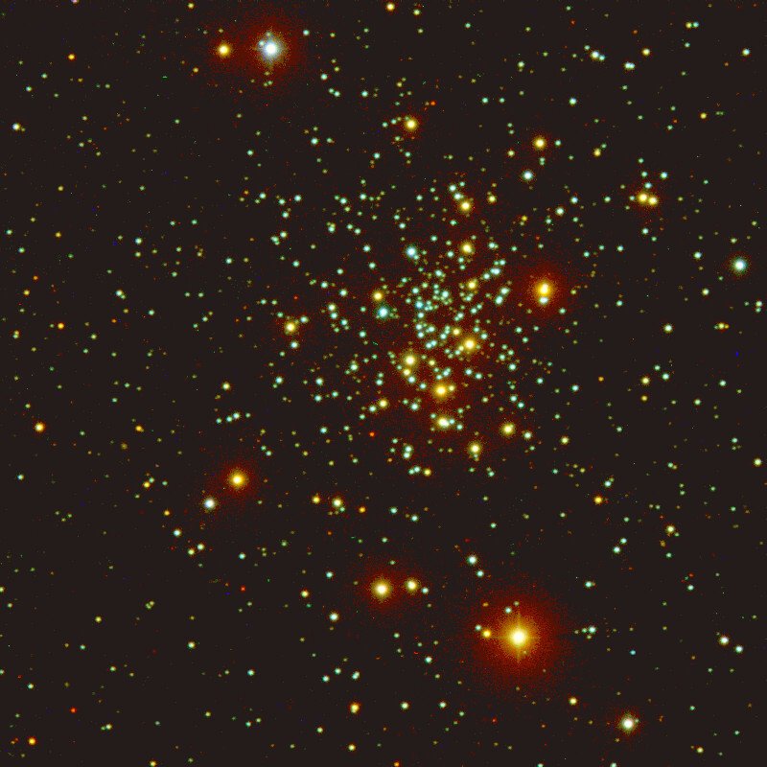
NGC 2420
Real data taken by IU astronomy grad students
Old, metal-poor cluster
Metals = elements other than hydrogen and helium
Metal abundances less than the sun
Apparent V magnitudes and B-V colors
Learn Python and construct your own HR diagram!
Notes:
This demo is designed to walk you through the fundamental components of Python, and incrementally apply them to construct and analyze your own H-R diagram based on real astronomical data obtained by Indiana University graduate students' use of the WIYN 0.9-meter telescope on Kitt Peak, AZ. You can read more about the telescope here: https://www.wiyn.org/0.9m/.
This demo uses selected data from open cluster NGC 2420 (pictured above). NGC 2420 is an old, metal-poor cluster, which means the abundances of elements other than hydrogen and helium are less than that of the sun. Apparent V magnitudes (corrected for reddening) and B-V colors are available on our GitHub. This file does not include every star in the cluster, but it is enough to make a representative H-R diagram.

