Slide 1
Java Full Stack August 2026
Capstone Presentation​
Team 1: Brandon Robare, Bryan Caskey,
Carter Bossong, Chad Wangolo
Notes:
Chad

Slide 2
Overview
User Stories
NFRs
Architecture Diagram
Front End
Messaging
Persistence
Deployment
AI Usage
Retrospective
Future Goals
Notes:
Chad

Slide 3
User Stories
EPIC: Agent adds an interaction for a user, it gets saved, and an event goes to Kafka.
User Stories:
As a user, I should be able to create an interaction.
As a user, I should be able to log in.
As an agent, I should be able to view interactions.
As an admin, I should be able to view a list of customers.
Notes:
Chad:
Enables agents to log customer interactions and emit events to Kafka, supported by role-based access for admins and agents.
As a group we decided to focus on the core user stories: secure user logins, customer list visibility, creating/ viewing interaction timelines.

Slide 4
NFRs
Security & Authorization: Secure API boundary using 30-minute JWTs; missing tokens return 401, wrong roles return 403.
Data Integrity & Durability: Commits are saved permanently in PostgreSQL even if the API; no sensitive summaries or PII are published to Kafka or logged.
Performance Targets: Key UI workflows (search, profiles, saving interactions) load under 2 second in 95% of cases; search powered by database index scans.
Accessibility & Compatibility: Designed with semantic HTML and plain CSS for keyboard navigation, screen reader support, and responsive layouts across
Observability & CI/CD: End-to-end request tracking using X-Correlation-ID across logs and Kafka events; zero hardcoded secrets with single-digest Docker deployments
Notes:
Chad:
Enforces 30-minute JWT bearer tokens, transactional PostgreSQL, saving without exposing PII to kafka, and sub 2 second target response times.
Ensures full accessibility via semantic HTML/CSS and end-to-end-observability using X-Correlation-ID across single-digest Docker deployments.

Slide 5
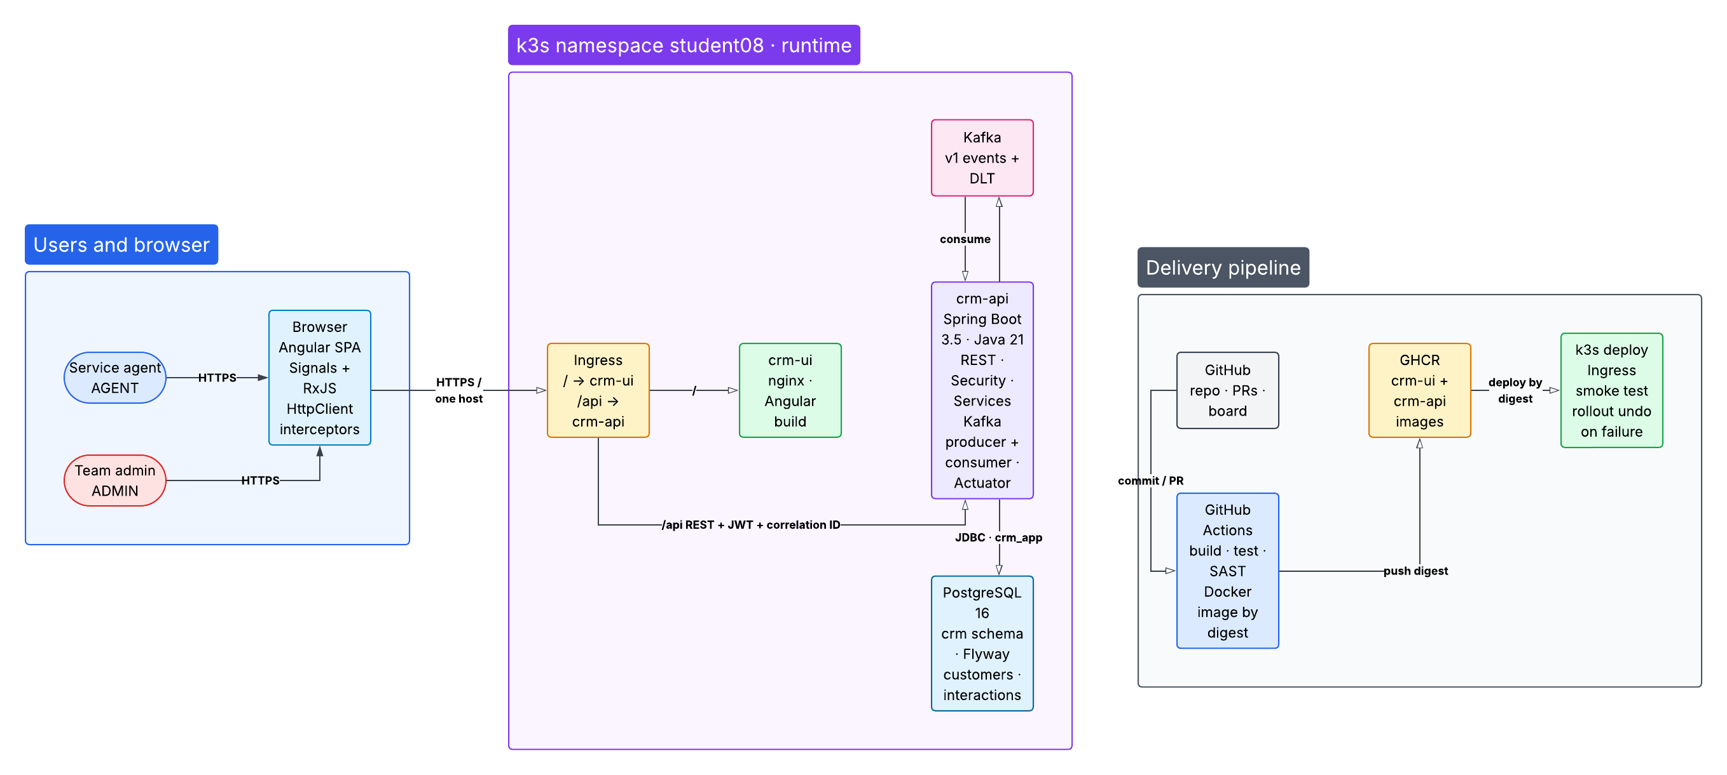
Architecture Diagram
Notes:
Carter
The application is split into frontend, backend, persistence, messaging, and deployment responsibilities.
Angular is the frontend that the user interacts with, while Spring Boot is the backend that handles API requests and business logic.
Postgres stores the customer and interaction data, making it our system of record
Kafka handles interaction events after successful database commit, such as when a new interaction is recorded.
The delivery pipeline uses Continuous Integration and Continuous Delivery, to test, build, and deploy the application

Slide 6
Front End
Angular SPA
JWT Bearer Authentication
RxJS
NGINX
Notes:
Carter
For the frontend, We used Angular as the main user interface for the CRM.
This is where users can log in, search for customers, view their information, and record interactions.
JWT authentication is used after login so the backend knows who the user is and what role they have.
RxJS helps Angular handle data coming back from the backend and update the page when that data arrives.
NGINX serves the Angular application to the browser in production.

Slide 7
Messaging
Record
interaction
PostgreSQL
commit
After-commit
publisher
Kafka topic
crm.customer.
interctions.v1
Publishes only after a successful database commit
Correlation ID links requests -> logs -> interaction event​
Notes:
Carter
For messaging, the flow starts when a customer interaction is recorded and saved to Postgres.
Once the database commit succeeds, the application publishes an interaction event to Kafka.
We chose to publish only after the commit so we do not send an event for an interaction that was rolled back or never actually saved.
We also include the correlation ID so the original request, backend logs, and Kafka event can all be connected if we need to trace what happened.

Slide 8






Persistence
One request path, four layers. Business rules in one.
crm-api · Spring Boot
/api/v1
JDBC
Controllers
Services
Repositories
Angular SPA
DTOs in / out
Problem Details errors
business rules
@Transactional
Spring Data JPA
entities stay inside
PostgreSQL
search · profile
timeline · form
system of record
Flyway-owned schema
after commit
V1__crm_schema.sql
Kafka listeners
crm.customer.interactions.v1
Notes:
Brandon
DIAGRAM - Request: controller > service > repository > PostgreSQL. Rules live only in the service.
- After the save commits, the service publishes an event to Kafka.
DECISION: publish after commit, not an outbox
- Why: an outbox is another table, a poller and more tests. Cut to make the deadline.
- Gain: we never announce a save that rolled back.
- Tradeoff: Kafka down = the save still succeeds, that one event is lost and logged.
- Outbox is the upgrade path.
- Only public IDs (CUS-1001) leave the API; database keys never do (ADR 0002).
- Flyway owns the schema; Hibernate only validates.
That saved row is what the pipeline protects.

Slide 9









Continuous Integration
One path for every change. Nothing is published unless every gate passes.
Six gates in parallel. All seven checks are required to merge.
Image holds the exact JAR tests ran on
Nothing reaches GHCR unless all gates pass
Every exception: owner, reason, expiry
required
required
frontend
backend
ng test (headless)
ng build
mvn verify
on PostgreSQL 16
required
required
required
main only
scan
sast
Dependency-Check
npm audit
CodeQL
Java · TS · Actions
Pull request
required
required
image
GHCR
or push to main
secrets
iac
hash-checked JAR
Trivy + DAST
before push
API + UI images
by sha256 digest
gitleaks
full git history
Trivy config
Terraform + Ansible
artifact-manifest.json
caught: critical CVE
Notes:
Brandon
- Six checks run in parallel on every PR. image waits for all six, then scans the built image.
- Only main pushes to GHCR, by sha256 digest. All seven checks required to merge.
- Tested JAR copied into the image (brief shows a multi-stage Dockerfile).
- Multi-stage compiles a second JAR the tests never ran. We hash-check the tested one and ship it.
- Three gates the brief doesn't ask for:
- gitleaks, full history: a deleted secret is still in git.
- Trivy config on k8s, Terraform, Ansible: catches risky settings like running as root.
- DAST: ZAP + 15 of our own probes hit the running image before push.
- Dependency-Check 12.2.2, not the course's 10.0.4.
- 10.0.4 can't read today's NVD data; 13.0.0 fails without an API key.
- Tradeoff: more gates to maintain. Parallel jobs + daily NVD cache keep runs to minutes.
CAUGHT
- Critical Spring CVE landed between a PR and its merge. main refused to push.
- Unused feature, fix needs Spring Boot 4 (off our stack): one scoped exception, owner, expires Dec 31. Thresholds never moved.

Slide 10






Continuous Delivery
A person decides when it ships. Production runs the exact digest CI built.
Green main run
Tag v0.1.4
Approval
Provenance check
Deploy by digest
API + UI digests
by the release owner
recorded in GitHub
same digests, no drift
backup first, API then UI
CD refuses to ship
Pass: becomes the known-good pair
Smoke
":latest" or any tag
another commit's build
an image not from GHCR
skipping smoke
Fail: rollback job,
1 min 24 s live
12 checks, 12/12
caught on v0.1.4
pending Terraform drift
a failed backup
Notes:
Brandon
- Tag a green main commit > reviewer approves > CD checks the digests came from that commit > backup > deploy API then UI > 12 smoke checks.
- Pass: the API + UI pair becomes known-good. Fail: rollback job restores the last good pair.
- No staging (lab plan: test / staging / prod).
- One namespace: staging would share prod's quota and token, which Lab 48 warns against.
- CI on real Postgres + DAST, and a full local k3s rehearsal, stand in. Logged as risk R-01.
- Rolling, not blue-green: blue-green needs two of everything; our 2-CPU quota fits one extra pod.
- Two refusal gates we added: Terraform drift, failed backup. No backup, no release.
- Drift stopped v0.1.4: we tagged before applying a Terraform change. Reviewed, applied, re-ran: 12/12.
- Rollback is one button, not automatic: a person ships, a person rolls back. Rehearsed live: 1 min 24 s.

Slide 11




Production on k3s
Beyond the brief
Trusted HTTPS from our own certificate
Two API pods, zero-downtime rollouts
Backup before every release
One k3s namespace = production
crm-ui
PostgreSQL 16
HTTPS
Let's Encrypt
nginx, non-root
2 GiB + backups
caught: untrusted cert
/api
Kafka (KRaft)
caught: dropped requests
Browser
Traefik Ingress
crm-api × 2
2 GiB volume
one host, one origin
Spring Boot, Java 21
Terraform: only the API gets in
CPU requests
steady 1350m, rollout ~1600m of 2000m
Memory requests
steady 2176 MiB, rollout ~2688 MiB of 3072 MiB
Notes:
Brandon
- One HTTPS address. Traefik sends /api to two API pods, everything else to the nginx UI.
- PostgreSQL + Kafka behind network rules: only the API gets in.
- Bars: our quota. A rollout fits with room.
- k3s, not OpenShift: it's the course cluster (Adel confirmed). Ingress not Route, kubectl not oc.
- Our own Let's Encrypt certificate.
- OpenShift's Route gives TLS; k3s served an untrusted default and smoke refused it.
- Didn't weaken the test (no curl -k). Free cert, no cluster admin. Renew by mid-December.
- Two API pods + 5 s shutdown drain: rollouts dropped ~13 of 5,000 requests, then 0 of 6,910.
- Backup before every release: image rollback can't undo bad data.
LIMIT: one server. Covers a crash or rollout, not losing the node.

Slide 12
Backup: security gates
Gate | Tool | Fails at | Stops | Exception
Java dependencies | OWASP Dependency-Check 12.2.2 | CVSS 7+ | merge + publish | scoped suppression
npm, runtime deps | npm audit --omit=dev | high | merge + publish | GHSA ID with expiry
Static analysis | CodeQL (Java, TS, Actions) | severity 7.0+ | merge + publish | rule + file with expiry
Secrets | gitleaks 8.30.1, full history | any finding | merge + publish | reasoned ignore entry
Kubernetes config | Trivy config | high | publish | trivyignore entry
Container image | Trivy 0.75.0, before push | critical | publish | version-scoped entry
Every exception has an owner, a reason and an expiry in docs/security-findings.csv. Thresholds are never lowered to go green.
Evidence index: Dependency scan + triage · Dependency gate · SAST gate · Secrets scan · Image gate (Trivy)
Notes:
Bryan
Checks java dependencies for vulnerabilities
Checks runtime dependencies for vulnerabilities
CodeQL analysis of code quality and integrity
Checks for leaked secrets
Check Kubernetes manifests and terraform config
Checks container images

Slide 13
AI Usage
Allowed
Boilerplate code generation (DTOs, Flyway, Kafka, Angular)
Test drafts
HCL/YAML sketches
Docs
Forbidden
Committing secrets or kubeconfig
Applying Terraform/Ansible to prod without approval
Copying proprietary third-party code
Notes:
Bryan
AI usage is allowed for simple, repetitive tasks that don't vary much from one project to the next, such as simple boilerplate code seen in most Spring Boot projects.
It is also allowed for code documentation, sketches, and drafting tests.
We explicitly disallow committing secrets, passwords, or other sensitive environment variables.
Nor do we allow plagiarism of third-party code or pushing code to production without testing and approval.

Slide 14
DEMO

Slide 15
Retrospective: Challenges
Changed to using k3s instead of OpenShift
Limited time
Staging development was scrapped due to constraints
Notes:
Bryan
There are a few challenges we had regarding the project that we would like to share with you.
First, we shifted from using Red Hat OpenShift to using k3s for our application platform in response to restricted access to the company OpenShift.
Second, while we wanted to develop a staging area for production code to receive dynamic runtime tests, we were unable to due to resource limitations.
Finally, limited time to complete the project meant that planning and setting up communications needed to happen as fast as possible.

Slide 16
Retrospective: What we would do different
Full CRUD operations on Customers and Interactions.
OpenShift deployment with staging area.
Blue-Green deployment method.
Notes:
Bryan
If we had more time and resources to work on the project, we would change a few things…
Extend the API for customers and interactions to include Full CRUD operation support.
Switch back to OpenShift deployment and implement the staging area.
Utilize a Blue-Green deployment method for seamless production releases.

Slide 17
Thank You

