Slide 1
Dawlab Inc.

Slide 2
Our Project Idea
To create a movie recommending application that takes a users personal movie preferences and uses that information to then recommend movies specifically tailored to that person.

Slide 3
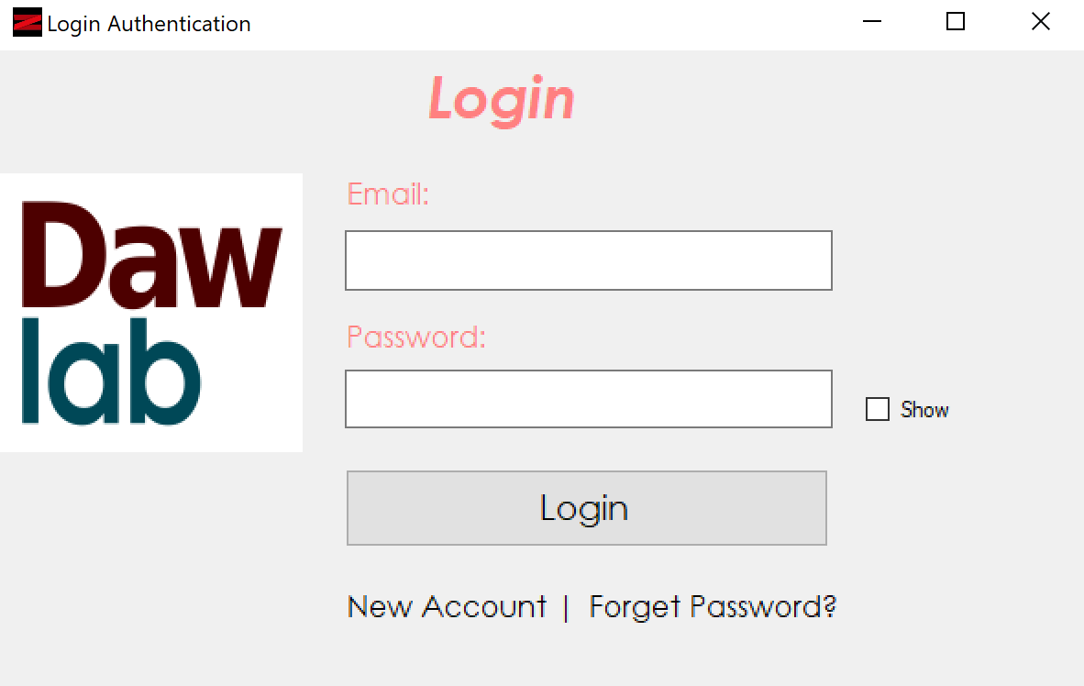
Movie Recommender User Login
This is the sign In page that both clients and administrators when using the application.

Slide 4
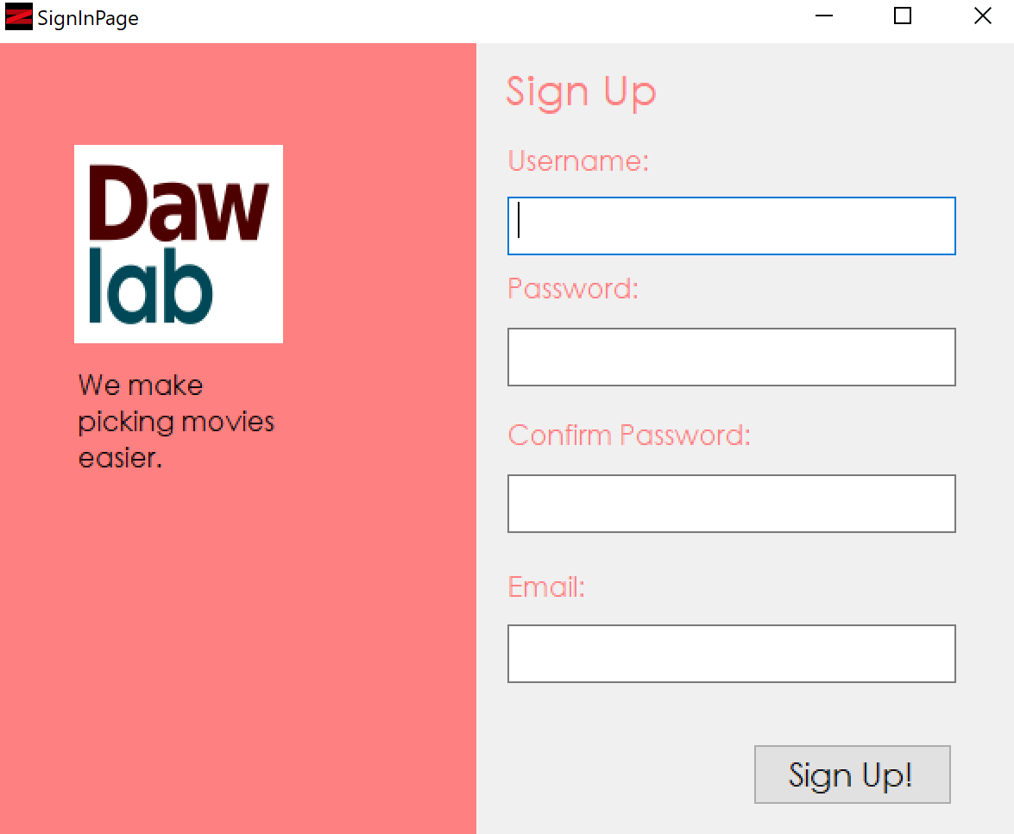
Movie Recommender New Account
If not an existing member, the user will be able to create a new profile

Slide 5
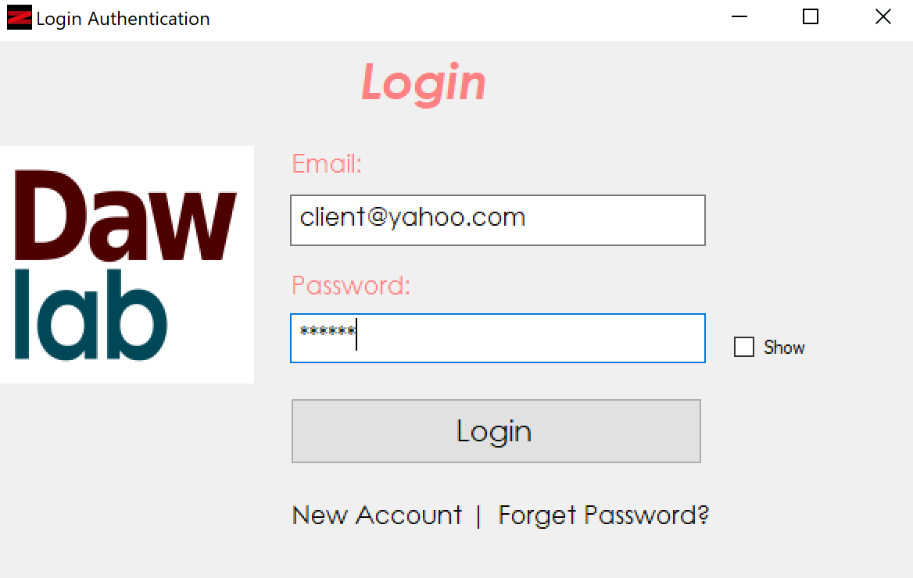
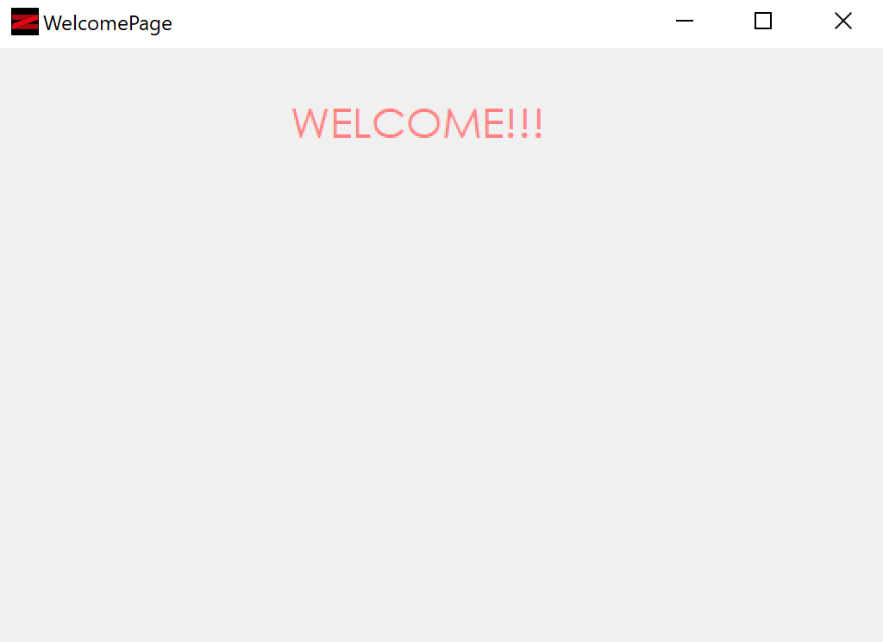
Movie Recommender Client Side

Slide 6
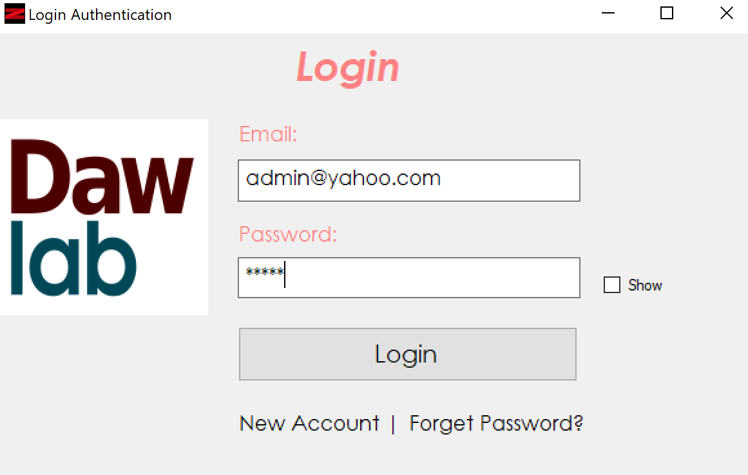
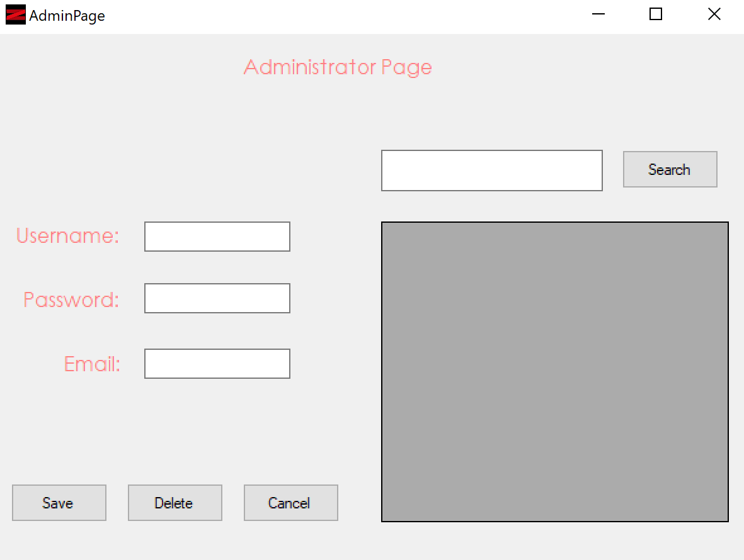
Movie Recommender Admin Side

Slide 7
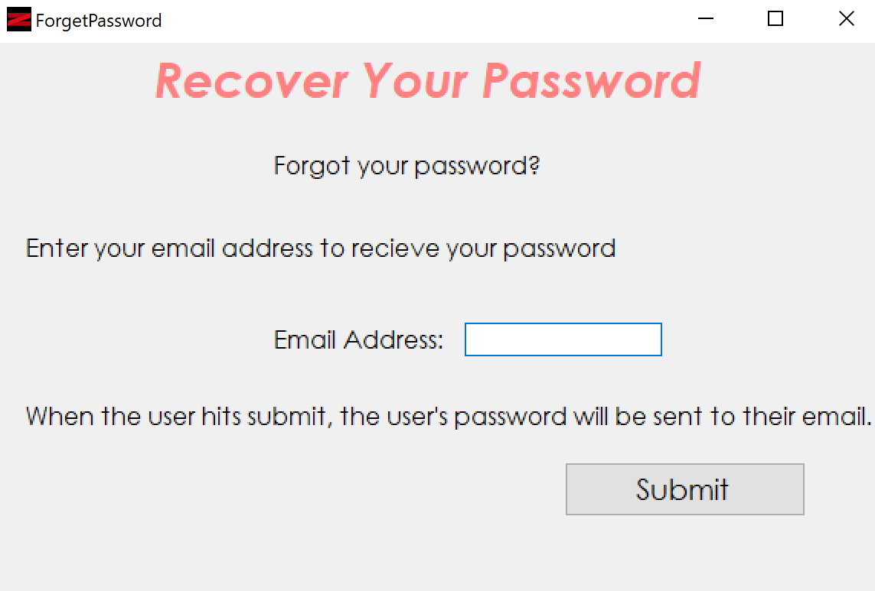
Movie Recommender Login Page
If the user forgot his or her password, they can retrieve it via an email

Slide 8
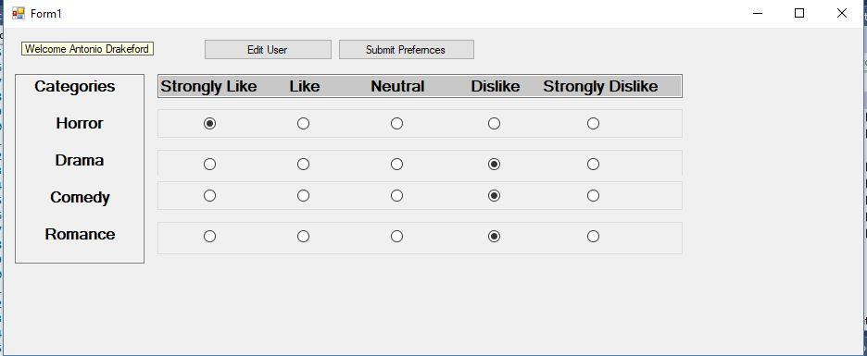
Movie Recommender Features
The movie recommender will take preferences from the user.

Slide 9
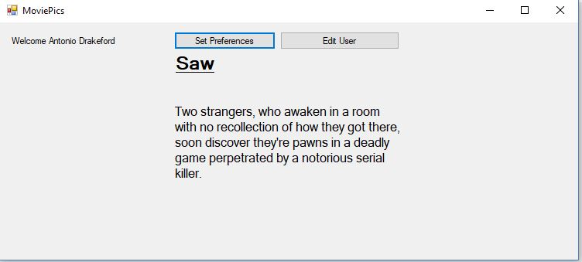
Movie Recommender Features
Then recommended a movie based on a score derived from the previously set preferences

Slide 10
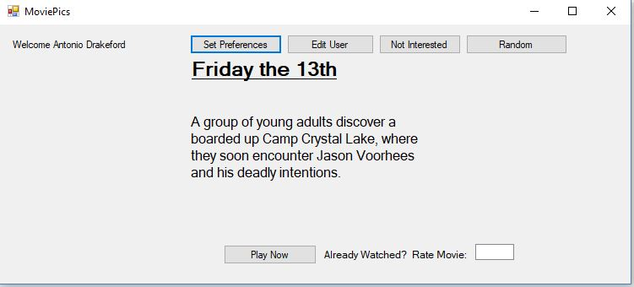
Movie Recommender Features
The “Not Interested” feature allows you to skip to the next recommended movie

Slide 11
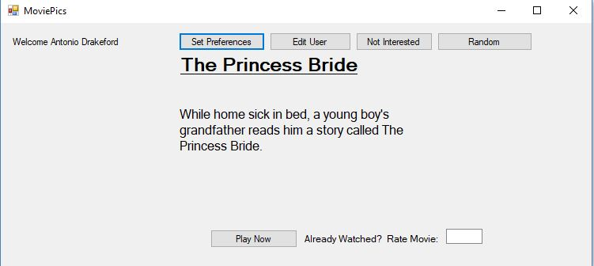
Movie Recommender Features
While the “Random” feature will recommend a movie you may not normally watch

Slide 12
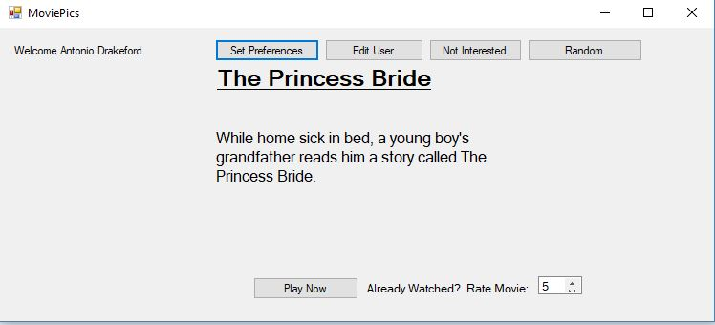
Movie Recommender Features
If you have already watched the movie, the “Rate Movie” feature will allow you to rate the movie so similar movies can be recommended

Slide 13
Relational Database Management System

Slide 14
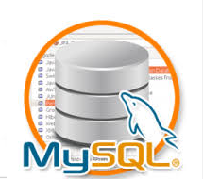
Dawlab Inc. DBMS uses MySQL plat form

Slide 15
This database apply Three SQL commands DDL, DML and DCL
DDL (Data Definition Language) source code uses to modify the database structure.
Create: table, index, view
Drop: delete object form the database
Alter: alter the database structure
Truncate: remove all record from the table
DDL
Create
Drop
Alter
Truncate

Slide 16
This database apply DML
DML (Data Manipulation Language) source code helps to insert, delete, select and update the database data that located in the tables.
DML
Insert
Delete
Select
Update

Slide 17
This database apply DCL
DCL (Data Control Language) command includes Grant and Revoke, which is the access privileges of the database.
Grant: gives privileges to users for access the database.
Revoke: withdraw the privilege of access the database.
DCL
Grant
Revoke

Slide 18
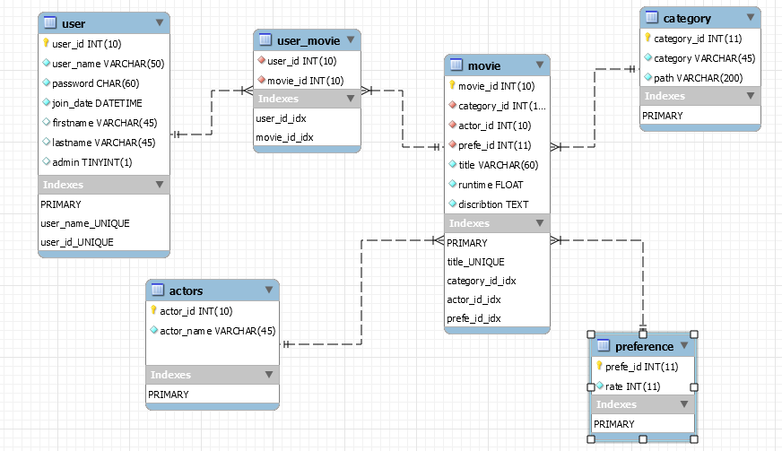
Database Entity Relationship Diagram

Slide 19
Testing
This database tables and data are normalized.
Dawlab Inc. Database are tested based on the above three SQL commands which is DDL, DML and DCL.
This database working well with CRUD(create, retrieve, update and delete)
It works without redundancy and duplication of the data.

Slide 20



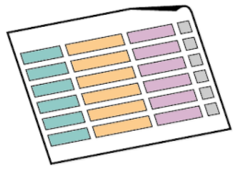
Security
Dawlab Inc. Database Apply Two methodology in order to secure the database.
1. Differentiate the privilege of the user by Applying DCL(Data Control Language )
Grant the user’s to access only from the view
Don’t allow to access database tables
Granted only from view

Slide 21
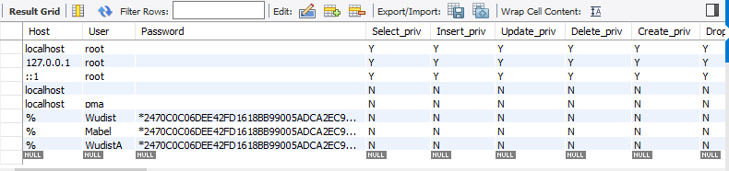
Security
The Dawlab Inc. programmers granted for Insert, update and select
Programmers are not allowed to delete
DBA administrator only have full privilege to manipulate the database.

Slide 22
Security
2. Data Encryption
Data encryption protect sensitive data from SQL-injection
MySQL database have built-in encryption(aes_encrypt) and decryption(aes_dycrypt) function
Dawlab Inc. applied encryption for the sack of security
Hackers might use SQL- injection and they might get the all of database data, but if data encryption will be applied on the system they will not allowed to access or to identify what in their. See the following sample table.

Slide 23
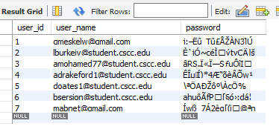
Security
encrypted sensitive (password) data

Slide 24
Dawlab Inc. Data Dictionary
Database-Name | Table Type | Table Name | key Column | Field Name | Data Type | Field Size | Note
moviestream | table | user | PK,UN,AI | user_id | int | 10
moviestream | table | user | UN | user_name | varchar | 50
moviestream | table | user |  | password | char | 60
moviestream | table | user |  | join_date | datetime
moviestream | table | user |  | firstname | varchar | 45
moviestream | table | user |  | lastname | varchar | 45
moviestream | table | user |  | admin | tinyint
moviestream | table | movie | PK,UN,AI | movie_id | int | 10
moviestream | table | movie | FK | category_id | int | 11
moviestream | table | movie | FK | actor_id | int | 10
moviestream | table | movie | FK | prefe_id | int | 11
moviestream | table | movie | UN | title | varchar | 60
moviestream | table | movie |  | runtime | float
moviestream | table | movie |  | discribtion | text
moviestream | table | user_movie | FK, UN | user_id | int | 10
moviestream | table | user_movie | FK,UN | movie_id | int | 10
moviestream | table | actors | PK,UN | actor_id | int | 10
moviestream | table | actors |  | actor_name | varchar | 45
moviestream | table | category | PK | category_id | int | 11
moviestream | table | category |  | category | varchar | 45
moviestream | table | category |  | path | varchar | 200
moviestream | table | preference | PK | prefe_id | int | 11
moviestream | table | preference |  | rate | int | 11
moviestream | view | username |  | user_name | varchar | 50
moviestream | view | username |  | firstname | varchar | 45

Slide 25
Building the website

Slide 26
Technology Stack
Client side ui: Bootstrap4 and jQuery
Client side markup: HTML5 and CSS
Server sidelanguage: Python
Development Framework: Django

Slide 27
About Django
Python web framework
Very opinionated, for rapid application development
Uses the MVC (Model View Controller) Architectural Pattern
Uses server side rendering
Has a built in object relational mapper

Slide 28
How Django works
models.py
urls.py
views.py
templates

Slide 29
Hosting the Website

Slide 30
What it is being hosted on
Using a raspberry pi as a server
A raspberryPi is a small circuit board that runs a linux os that I used to set up and host a public server

Slide 31
Gaining Access from Outside My Local Network
In order to have access to the website from outside my internet connection I had set up a port forward on my router
After that I configured my allowedhost to my public ip address
It uses my public ip-address as well as the port I set up to forward to it as its url
Since its my public ip-address this allows it to be accessed from outside my home network

Slide 32
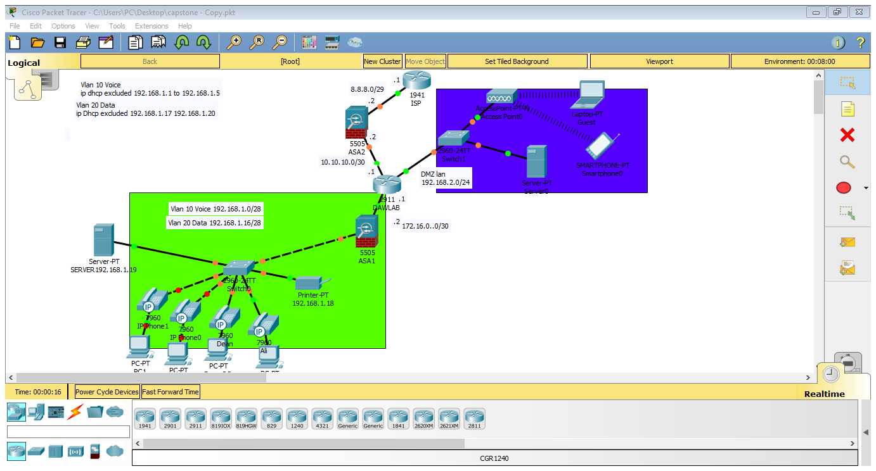

Network Configuration

Slide 33
Hardware Configuration
Dell OptiPlex 7450 All-in-One (6)
Cisco switch 2960 (2 )
Printer- Brother MFC-L8900cdw laser all-in one
Cisco SPA 504G4-Line IP Phone (6 phones)
Dell PowerEdge T640 Tower Server (2)

Slide 34
Software Configurations
Windows 10 Pro 64-bit – OEM
Microsoft Office 365 business premium
Adobe Acrobat Professional 2017 for Windows
Window server 2016 - OEM

Slide 35
The End
Thank you so much
Any questions!!!

Slide 36
Some of the picture that located in this presentation are taken from google for educational purpose.

