Slide 1
Microservices using Azure Service Fabric
Brandon Sharp lead developer - Ag Connections
@brandonsharp

Slide 2
What are microservices?
Small, single purpose
Independently deployable
Inherently scalable
Communicate via well-known interfaces (HTTP/REST, AMQP, etc.)

Slide 3
What are the pros/cons?
Pros
Cons
Small, self contained applications make it easy to maintain code & onboard new devs.
Allows for more rapid iteration
Better scalability
Greater development flexibility (different languages, tools, etc.)
Fault isolation
Added deployment complexity
Requires more logging, and custom tooling to diagnose problems.
Requires more up-front planning and API/contract design

Slide 4
Azure Service Fabric
Built and used internally by Microsoft for 5 years prior to public availability
Drives many existing Azure services, like DocumentDB, Azure SQL, Cortana, InTune, etc.
Allows creation of stateless and stateful services
Stateful services are replicated automatically
Automatically handles failover, rolling upgrades, lifecycle management, etc.
Simple, .NET-based programming model
Supports hosting custom applications as well

Slide 5
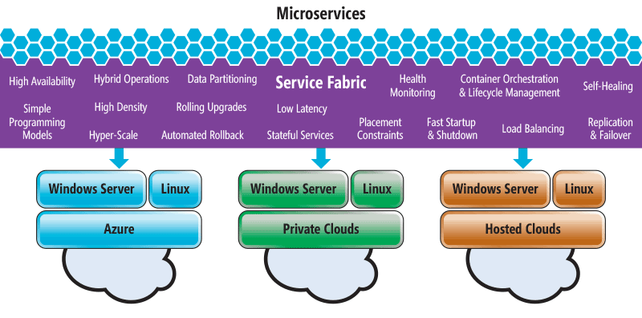
Azure Service Fabric

Slide 6
Deployment Model
Node 0
Node 1
Node 2
Node 3
Node 4
Application

Slide 7
Stateful Programming Models
Reliable Services
Reliable Actors
Store data in a LINQ-enabled, reliable collection (dictionary or queue). Storing data locally reduces network overhead & latency
Simple programming model
Supports custom communication models (Web API, TCP, remoting, etc.)
Small, independent units of state & logic
Single-threaded programming model
Support timers & reminders
Automatic partitioning & lifecycle management

Slide 8
Demo
Gateway API (stateless)
Library Service (stateful)
Book Actors

Slide 9
Resources
https://github.com/BrandonSharp/ServiceFabricDemo
https://channel9.msdn.com/Events/Build/2016/B874
https://blogs.msdn.microsoft.com/azureservicefabric/
https://azure.microsoft.com/en-us/services/service-fabric/

