Slide 1
Tools and Automation for
Abstraction in STE
Tom Melham
Oxford University
joint work with
Sara Adams & Magnus Bjørk
Oxford University
Robert Jones & Carl Seger
Intel Corporation
September 2007

Slide 2
Micro-Architectural Algorithms
C
CAM
R
REG FILE
Q
QUEUE

Slide 3
Proving RTL Properties
=
hit = (query ∈ C)
⏐
Combine
, (query ∈ C) hit
, (query ∉ C) ¬hit
=
=
⏐
⏐
STE
STE
CAM
hit
CAM
hit
query
query

Slide 4
Algorithm Verification
components
algorithm
data Q
operations
properties
data R
operations
properties
query ∈ C
QUEUE
=
⏐
C[i] := y
CAM
data C
operations
properties
REG FILE

Slide 5
Property Specific Abstraction
Assume A, show P with simplified model:
Key to handling complexity.
=
, A P
⏐
ABSTRACTION

Slide 6
Abstraction in STE
You already use this
  automatic ‘cone of influence’ reduction
  Xs on irrelevant inputs
  manual use of symbolic indexing
Going further
  symbolic indexing in very complex cases
  automatic abstraction in STE

Slide 7
Symbolic Trajectory Evaluation
Syntax of formulas
Assertions
STE model checking
f := n is 0
| n is 1
| f₁ ∧ f₂
| N f
| E → f
P := STE(A,C)_{M}
φ P iff φ A ⇒ C
=
= M
|
|
A ⇒ C
response
stimulus

Slide 8
The State Space Lattice
Possible values on each node
Exploit don’t cares in circuit:
0
1
unknown value
X
0
… 0
X
1
1

Slide 9
The State Space Lattice
Access is via the specification
Resulting data abstraction
0
a is 0 ∧ c is 1 ⇒ out is 0
X
1
lower in lattice (more Xs)
A' ⇒ C
A ⇒ C
[ technically: δ(A' ) ≤ δ(A) ]

Slide 10
Role of Guards
Let you ‘turn on/off’ parts of assertions
v → a is 0 ∧ v → b is 0 ⇒ out is 0
=
0
a is 0 ⇒ out is 0
X
X
b is 0 ⇒ out is 0
0

Slide 11
Abbreviation
n is E = E → (n is 1) ∧ E → (n is 0)
Hence, for example:
v
v
i is v ⇒ out is v
=
0
1
i is 0 ⇒ out is 1
1
0
i is 1 ⇒ out is 0

Slide 12
Symbolic Indexing - Intuition
Task, verify this circuit
Idea - test all 8 possible input patterns
Better idea – exploit don’t cares:
a
b
o
c
010 011 000 001 100 101 110 111
0XX
X0X
XX0
111

Slide 13
Symbolic Indexing - Intuition
Task, verify this circuit
Idea - test all 8 possible input patterns
Better idea – exploit don’t cares:
a
b
o
c
010 011 000 001 100 101 110 111
0XX
X0X
XX0
111

Slide 14
Symbolic Indexing - Intuition
Group the four cases
with a formula (‘symbolic’) representation having Boolean variables (‘index’) p, q.
Big win when the representation has lots of sharing among the cases. Need good encoding!
STE uses a ‘dual rail’ representation.
p,q:
0XX
X0X
abstract-state(p,q)
XX0
111

Slide 15
Abstraction Example
Direct STE:
Abstraction:
- i.e. no abstraction at all!
a
a,b,c:
b
o
000
c
001
010
011
100
¬a → (a is 0) ∧ a → (a is 1) ∧
¬b → (b is 0) ∧ b → (b is 1) ∧
¬c → (c is 0) ∧ c → (c is 1) ∧
⇒
¬(a ∧ b ∧c) → (o is 0) ∧
(a ∧ b ∧c) → (o is 1)
101
110
111

Slide 16
Abstraction Example
Abstracted STE:
Abstraction:
a
p,q:
0XX
b
o
X0X
c
XX0
111
¬p ∧¬q → (a is 0) ∧
¬p ∧ q → (b is 0) ∧
p ∧¬q → (c is 0) ∧
p ∧ q → (a is 1) ∧ (b is 1) ∧ (c is 1)
⇒
¬(p ∧ q) → (o is 0) ∧
(p ∧ q) → (o is 1)
p q
a b c
0 0
0 X X
0 1
X 0 X
1 0
X X 0
1 1
1 1 1
3 completely symmetric cases + 1 extra

Slide 17
Embedded Memory Arrays
Simple CAM
Abstraction (Pandey et al. 1997)
Problem
query
D
=
D
=
=
=
=
hit
=
T
=
=
D
D
C2
X
Index over which position holds D.
C3
X
C4
X

Slide 18
Pros and Cons
Pros: powerful abstraction mechanism
  can make an exponential verification linear
  critical enabler for CAM and memories
Cons: manual encoding difficult
  discovery of good abstraction schemes hard
  coverage non-obvious, false positives possible
  composition of results non-trivial

Slide 19
Abstraction Transformations
The Melham/Jones transformation approach
Coverage condition: B must cover all cases that A did
Special case: scheme A has no abstraction at all.
Abstraction scheme B
A' ⇒ C'
‘reindexing relation’
R
Abstraction scheme A
A ⇒ C

Slide 20
Abstraction Re-Indexing Relations
Specify relationship between indexes:
Example:
R(p,q, a,b,c)
= ¬p ∧ ¬q ⊃ ¬a
∧ ¬p ∧ q ⊃ ¬b
∧ p ∧ ¬q ⊃ ¬c
∧ p ∧ q ⊃ (a ∧ b ∧ c)
R(xs,ts)
xs
ts
(new)
(old)
a,b,c:
000
index
variables
index target
variables
001
010
p,q:
011
0XX
100
X0X
101
XX0
110
111
111

Slide 21
Abstraction Re-Indexing Relations
Specify relationship between indexes:
Example:
R(p,q, a,b,c)
= ¬p ∧ ¬q ⊃ ¬a
∧ ¬p ∧ q ⊃ ¬b
∧ p ∧ ¬q ⊃ ¬c
∧ p ∧ q ⊃ (a ∧ b ∧ c)
R(xs,ts)
xs
ts
(new)
(old)
a,b,c:
000
index
variables
index target
variables
001
010
p,q:
011
0XX
100
X0X
101
XX0
110
111
111

Slide 22
Abstraction Re-Indexing Relations
Specify relationship between indexes:
Example:
R(p,q, a,b,c)
= ¬p ∧ ¬q ⊃ ¬a
∧ ¬p ∧ q ⊃ ¬b
∧ p ∧ ¬q ⊃ ¬c
∧ p ∧ q ⊃ (a ∧ b ∧ c)
R(xs,ts)
xs
ts
(new)
(old)
a,b,c:
000
index
variables
index target
variables
001
010
p,q:
011
0XX
100
X0X
101
XX0
110
111
111

Slide 23
Abstraction Re-Indexing Relations
Specify relationship between indexes:
Example:
R(p,q, a,b,c)
= ¬p ∧ ¬q ⊃ ¬a
∧ ¬p ∧ q ⊃ ¬b
∧ p ∧ ¬q ⊃ ¬c
∧ p ∧ q ⊃ (a ∧ b ∧ c)
R(xs,ts)
xs
ts
(new)
(old)
a,b,c:
000
index
variables
index target
variables
001
010
p,q:
011
0XX
100
X0X
101
XX0
110
111
111

Slide 24
Abstraction Re-Indexing Relations
Specify relationship between indexes:
Example:
R(p,q, a,b,c)
= ¬p ∧ ¬q ⊃ ¬a
∧ ¬p ∧ q ⊃ ¬b
∧ p ∧ ¬q ⊃ ¬c
∧ p ∧ q ⊃ (a ∧ b ∧ c)
R(xs,ts)
xs
ts
(new)
(old)
a,b,c:
000
index
variables
index target
variables
001
010
p,q:
011
0XX
100
X0X
101
XX0
110
111
111

Slide 25
Applying R - Preimage Operations
Preimage
xs
R
ts
P_{R} = ∃ts. R(xs,ts) ∧ P(ts)
P
Complement preimage
(¬P)_{R} = ∃ts. R(xs,ts) ∧ ¬P(ts)
¬P
Strong preimage
P^{R} = ∃ts. R(xs,ts) ∧ P(ts)
∧ ¬∃ts. R(xs,ts) ∧ ¬ P(ts)

Slide 26
The Abstraction Transformation
Preimage of formula
Strong preimage
(n is 0)_{R} = n is 0
(n is 1)_{R} = n is 1
(f ∧ g)_{R} = f_{R} ∧ g_{R}
(P → f)_{R} = P_{R} → f_{R}
(N f)_{R} = N f_{R}
(n is 0)^{R} = n is 0
(n is 1)^{R} = n is 1
(f ∧ g)^{R} = f ^{R} ∧ g^{R}
(P → f)^{R} = P^{R} → f ^{R}
(N f)^{R} = N f ^{R}
Theorem
Theorem
R ⊃ δ(f ) ≤ δ(f_{R})
R ⊃ δ(f ^{R}) ≤ δ(f )
[ the hard part is to make this calculation fast ]

Slide 27
Re-Indexing an STE Property
Apply indexing:
Example:
A ⇒ C
¬a → (a is 0)
weaken
‘strengthen’
¬p ∧ ¬q ⊃ ¬a
∧ ¬p ∧ q ⊃ ¬b
∧ p ∧ ¬q ⊃ ¬c
∧ p ∧ q ⊃ (a ∧ b ∧ c)
R
R
A^{R} ⇒ C_{R}
¬p∧¬q → (a is 0)
(¬a)_{R} = (¬p∧¬q) ∨ (¬p∧q) ∨ (p∧¬q)
-
(a)_{R} = (¬p∧q) ∨ (p∧¬q) ∨ (p∧q)
=
(¬a)^{R} = (¬p∧¬q)

Slide 28
Example
Direct STE proof:
Abstracted proof:
p q
a b c
a
0 0
0 X X
b
o
c
0 1
X 0 X
1 0
X X 0
¬a → (a is 0) ∧ a → (a is 1) ∧
¬b → (b is 0) ∧ b → (b is 1) ∧
¬c → (c is 0) ∧ c → (c is 1) ∧
⇒
¬(a ∧ b ∧c) → (o is 0) ∧
(a ∧ b ∧c) → (o is 1)
1 1
1 1 1
¬p ∧¬q → (a is 0) ∧
¬p ∧ q → (b is 0) ∧
p ∧¬q → (c is 0) ∧
p ∧ q → (a is 1) ∧ (b is 1) ∧ (c is 1)
⇒
¬(p ∧ q) → (o is 0) ∧
(p ∧ q) → (o is 1)

Slide 29
Justification
discard null indexes
∃ts.R(xs,ts)
=
A^{R} ⇒ C_{R}
⏐
true by construction
R(xs,ts)
=
A^{R} ⇒ C_{R}
⏐
R(xs,ts) ⊃ δ(C) ≤ δ(C_{R})
R(xs,ts)
=
A^{R} ⇒ C
⏐
R(xs,ts) ⊃ δ(A^{R}) ≤ δ(A)
R(xs,ts)
=
A ⇒ C
⏐
∃xs.R(xs,ts)
=
A ⇒ C
⏐
∀ts. ∃xs. R(xs,ts)
=
A ⇒ C
⏐
indexing coverage
proof obligation

Slide 30
False Negatives (Abstraction)
Specification:
Abstracted:
p q
a b c
a
b
o
0 0
0 X X
c
0 1
X 0 X
1 0
X X 1
¬a → (a is 0) ∧ a → (a is 1) ∧
¬b → (b is 0) ∧ b → (b is 1) ∧
¬c → (c is 0) ∧ c → (c is 1) ∧
⇒
¬(a ∧ b ∧c) → (o is 0) ∧
(a ∧ b ∧c) → (o is 1)
1 1
1 1 0
¬p ∧¬q → (a is 0) ∧
¬p ∧ q → (b is 0) ∧
p ∧¬q → (c is 1) ∧
p ∧ q → (a is 1) ∧ (b is 1) ∧ (c is 0)
⇒
T → (o is 0) ∧
p ∧¬q → (o is 1)

Slide 31
Pros and Cons
Pros:
  correctness of indexing scheme machine-checkable
  compositionality of verification results
  very general method
Cons: manual encoding difficult
  still have to discover relation!
  coverage checking can be expensive or exponential

Slide 32
Automatic Abstraction – Overview
Start with I/O specification
  a Boolean expression of the input variables
  expresses essence of function to be verified
  uncluttered with circuit optimizations
Analyze spec syntax to compute relation
  find internal components with don’t care functionality
  introduce a variables to index don’t care cases
  propagate back to inputs
Apply using Melham/Jones to STE property
  no abstraction initially, one variable per node in STE property
  coverage requirement satisfied by construction

Slide 33
Basic Idea - Back Propagation
Aim: find inputs that force the output to be true/false
    [true condition, false condition]
Basic method
  start from output, with [ x₀, x₀ ]
  propagate back through gates
  when given a choice, introduce a new variable (index)
Propagation rules
[ f, x ∧ g ]
[ g, f ]
[ f, g ]
[ f, g ]
[ f, x ∧ g ]
[ f, g ]
[ f ∨ h, g ∨ i ]
[ h, i ]

Slide 34
Getting the Relation
When you reach an input variable
make a sub-relation
Indexing relation is the conjunction of these.
a
[ f, g ]
f → a ∧ g → a

Slide 35
Example – Output is [1,0]
[ 0, x ]
[ 0, 1 ]
a
[ 1, 0 ]
[ x, 0 ]
[ 1, 0 ]
b
[ 0, x ]
[ 1, 0 ]
c
x → a ∧ x → b ∧ 1 → c
x
a b c
0
X 1 1
1
0 X 1

Slide 36
Example – Output is [0,1]
[ x, 0 ]
[ x, 0 ]
a
[ 0, x ]
[ 0, 1 ]
b
[ 0, x ]
[ x, 0 ]
c
[ 0, x ]
x → a ∧ x → b ∧ x → c
x
a b c
0
X X 0
1
1 0 X

Slide 37
Example – Output is [q,q ]
[ qx, qy ]
[ qx, q ]
[ q, qx ]
a
[ q, q ]
b
[ qy, qx ]
[ qx, qy ]
c
[ q, q x ]
q x y
a b c
0 0 0
X X 0
0 1 0
1 0 X
q x → a ∧ q y → a ∧
q y → b ∧ q x → b ∧
q → c ∧ q x → c
0 1 0
X X 0
0 1 1
1 0 X
1 0 0
X 1 1
1 1 0
X 1 1
1 1 0
0 X 1
1 1 1
0 X 1

Slide 38
Making it Work - Encoding
Basic algorithm
  sees only 2-input ANDs
  fresh variables on every choice → no sharing
Better algorithm
  recognize n-input ANDs → better encoding
  recognize XNOR-gates as well
  re-use variables when safe → more sharing

Slide 39
Making it Work – Abstraction
Basic algorithm
  looks for maximal number of abstractions
Better algorithm
  allow declaration of ‘symbolic constants’
  these are inputs not to abstract

Slide 40
Making it Work – Melham/Jones
Basic algorithm
  expensive pre-image quantifier calculations
  need to prove coverage requirement
Better algorithm
  no pre-image quantifications
    exploit knowledge of form of relation computed
  coverage satisfied by construction

Slide 41
Results
Automatically verifies CAMs and memories:
  rediscovers published abstraction schemes
Extends the applicability of symbolic indexing
  verifies scheduler, not otherwise feasible
  discovers new, non-obvious abstraction scheme

Slide 42
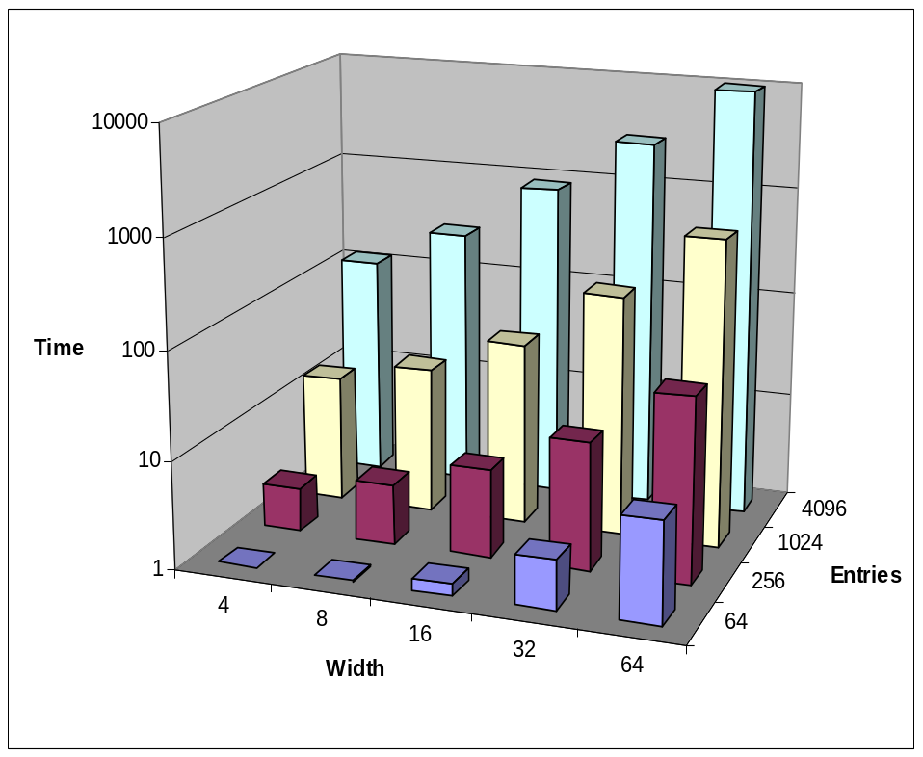
Memory Read Verification
A typical memory read specification, verified against a reasonably realistic memory implementation.
Address bits (manually) declared symbolic constants.
Run times very good.
Abstraction relation computed essentially identical to manually devised ones.

Slide 43
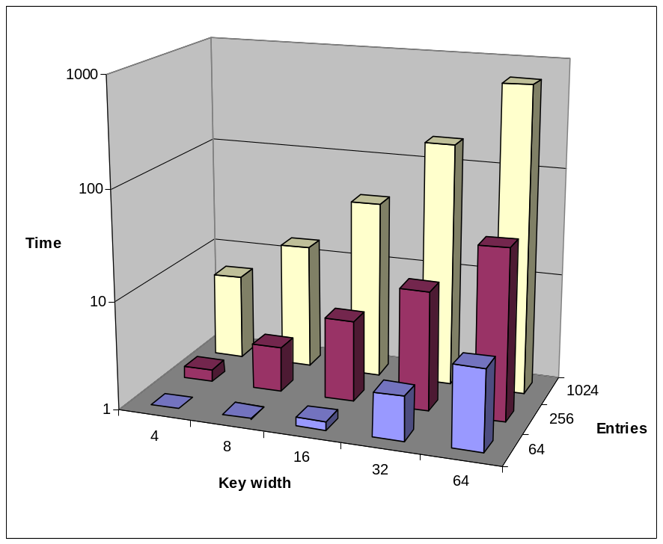
CAM Verification
A typical CAM-hit specification was verified against two implementations.
  simple, direct
  mimicked error-correction
Search key bits (manually) declared symbolic constants.
Run times very good.
Simple implementation within reach of SAT, but error-correcting one not.

Slide 44
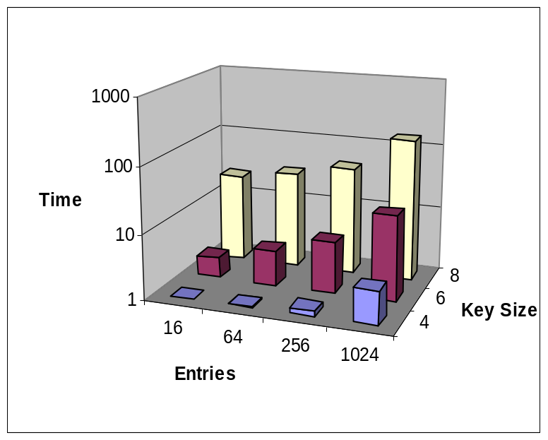
Scheduler Verification
A simple scheduler:
Specification: retrieve the oldest ready entry.
Verification not feasible without symbolic indexing.
age
rdy
...
addr
...
valid
...
Abstraction scheme found:
  index over address of oldest
  then index first bit from MSB of younger entries that differs from the oldest!

Slide 45
Future Work
Dependency on the structure of the specification.
  Can we build a structure-independent approach without requiring a BDD for the specification?
How to get good encodings (when to introduce new variables and when to share).
The use of symbolic indexing in SAT based STE.
  Preliminary results show that indexing does not appear to help SAT solvers at all!
What to do when over-abstraction happens.
  Abstraction refinement, feedback tools
Extending this work to GSTE.

Slide 46
Backup

Slide 47
Memory Read Example
Transformation:
Indexing scheme:
=
data = M[a]
⏐
a
M
i
v
i
=
a=0 ⊃ data=M[0]
a=1 ⊃ data=M[1]
a=2 ⊃ data=M[2]
...
⏐
i
v
a
M[0] M[1] M[2] ...
0
v
0
v X X ...
1
v
1
X v X ...
=
a=i ∧ M[i]=v ⊃ data=v
⏐
2
v
2
X X v ...
...
...
(per-bit)

Slide 48
Environmental Constraints
Use parametric:
R(xs,ts)
...
parametric P
R(xs,[P](ts’))
=
A[P] ⇒ C[P]
⏐
∃xs.R(xs,[P](ts’))
=
A[P] ⇒ C[P]
⏐
∀ts’. ∃xs. R(xs,[P](ts’))
=
A[P] ⇒ C[P]
⏐
=
A ⇒ C
P
⏐
effect of P on R is computed
can ‘merge’ partitions of R
can introduce null indexes

Slide 49
Example
Problem to prove:
Index relation:
p q
a b c
a=b
a
o = a ∧ c
0 0
0 X X
b
o
c
0 1
X 0 X
1 0
X X 0
1 1
1 1 1
¬p → (a is 0) ∧ (b is 0)
p ∧¬q → (c is 0) ∧
p ∧ q → (a is 1) ∧ (b is 1) ∧ (c is 1)
⇒
¬(p ∧ q) → (o is 0) ∧
p ∧ q → (o is 1)
[a ⇒ v, b ⇒ v ]
p q
a b c
0 0
0 0 X
0 1
0 0 X
1 0
X X 0
1 1
1 1 1

Slide 50
CAM Example
Problem to prove:
Abstraction scheme:
v
q
i
v
q
M[0] M[1] M[2] M[3]
M
v
=
0
v
v
v X X X
v
=
=
hit
1
v
v
X v X X
=
2
v
v
X X v X
3
v
v
X X X v
q ∈ M
=
hit=1
⏐
...
R[q∈M]
=
A[q∈M ] ⇒ hit
⏐
=
A[q∈M ] ⇒ hit
⏐
q ∈ M
=
A ⇒ hit
⏐

Slide 51
CAM Example - Problem!
Problem to prove:
Index relation:
q
i
v
q
M[0] M[1] M[2] M[3]
M
=
0
v
v
v X X X
=
=
hit
1
v
v
X v X X
=
2
v
v
X X v X
3
v
v
X X X v
q ∈ M
=
hit=1
⏐
...
R[q∈M]
=
A[q∈M ] ⇒ hit
⏐
q=M[0] ∨ q=M[1] ∨ q=M[2] ∨ q=M[3]
=
A[q∈M ] ⇒ hit
⏐
q ∈ M
=
A ⇒ hit
⏐

Slide 52
Solution - Index the Environment
(q=M[0] ∨ q=M[1] ∨ q=M[2] ∨ q=M[3])_{R}
Trivial theorem-prover proof
(q=M[0])_{R} ∨ (q=M[1])_{R} ∨ (q=M[2])_{R} ∨ (q=M[3])_{R}
BDDs/SAT
...

Slide 53
Two Ideas - Which is Right?
Try P_{R} ⊃ residual?
Try P^{R} ⊃ residual?
?
?
P_{R} ⊃ Q
P^{R} ⊃ Q
R
R
STE
STE
=
A^{R}[∃ts.R] ⇒ C_{R}[∃ts.R]
=
A^{R}[∃ts.R] ⇒ C_{R}[∃ts.R]
P
P
⏐
⏐
P, R
=
A^{R} ⇒ C_{R}
P, R
=
A^{R} ⇒ C_{R}
⏐
⏐
=
A ⇒ C
=
A ⇒ C
P
P
⏐
⏐
∀ts. P(ts) ⊃ ∃xs. R(xs,ts)
∀ts. P(ts) ⊃ ∃xs. R(xs,ts)

Slide 54
Neither!
P_{R} - false negatives:
P^{R} - false positives:
xs
R
ts
xs
R
ts
P
P
¬P
¬P

Slide 55
Neither!
P_{R} - false negatives:
P^{R} - false positives:
xs
R
ts
xs
R
ts
P

P

¬P
¬P
Need to eliminate overlap

Slide 56
Stronger Side Conditions
P_{R} ⊃ Q
1: no overlap
∀xs. P_{R}(xs) ⊃ ¬ ((¬P)_{R}(xs))
I.e. (P^{R} = P_{R})
R
2: empty (¬P)_{R}
STE
∀ts. (∃xs. R(xs,ts)) ⊃ P(ts)
=
A^{R}[∃ts.R] ⇒ C_{R}[∃ts.R]
P
⏐
P, R
=
A^{R} ⇒ C_{R}
⏐
∀ts. P(ts) ⊃ ∃xs. R(xs,ts)
=
A ⇒ C
P
⏐
3: exact partitioning
∀ts. P(ts) = ∃xs. R(xs,ts)

Slide 57
Side Condition Checking
Methods:
  BDDs
  SAT
  Theorem Proving
CAM is trivial:
q ∈ M
=
∃i v. (v = q) ∧ ∀j∈{0..3}. i=j ⊃ M[i]=v
Or correct-by-construction:
[P₁,P₂,…,P_{n}]
R
make
Prove that ‘make’ is correct.

Slide 58
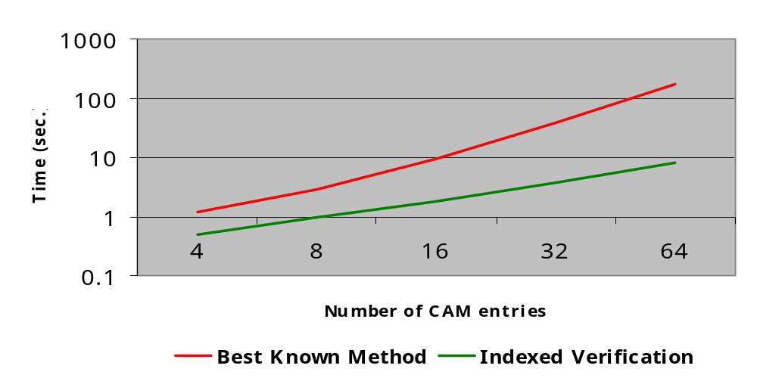
Experimental Results
Verification of ‘hit’ for 64 × n CAM
(index by hit position)

