Slide 1
Relational STE and Theorem Proving for Formal Verification of Industrial Circuit Designs
John O’Leary and Roope Kaivola, Intel
Tom Melham, Oxford

Slide 2
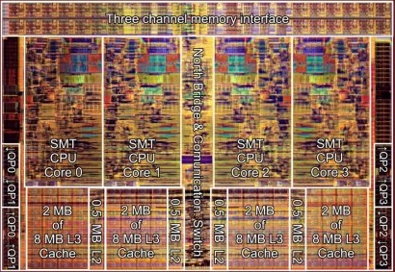
CPU datapath verification at Intel
Thousands of operations
Integer, FP, SSE, AVX, …
“Miscellaneous”
Various operating modes, flags, faults
Live RTL, changing frequently until a few weeks before tapeout

Slide 3
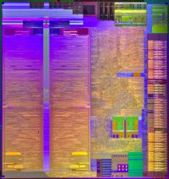
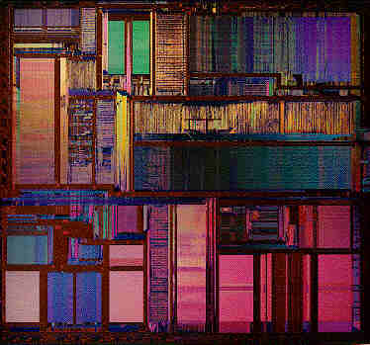

Scaling up
Tens of designs
Different optimization points
Different teams
Different countries
Not only CPUs
Not all have FV experts on staff

Slide 4
Integer multiplier
S1
S2
S1 = Σ BE_{i} * 2^{ki}
Booth
Encoder
BE_{i}
Partial Products Generation
PP_{i} = S2 * BE_{i}
PP_{i}
P = Σ PP_{i} * 2^{ki}
Wallace Tree Adder Network
PROD

Slide 5
The multiplier zoo
S1
S2
Booth
Encoder
10-20 multipliers
Hand designed
Hand optimized
All different
BE_{i}
Partial Products Generation
PP_{i}
Wallace Tree Adder Network
PROD

Slide 6
FV challenges
Varying specs and verification strategies
Implementation changes from design to design
Multiplier always requires decomposition
Ten designers but not ten multiplier FV experts
Same story for integer, MMX, FP, SSE, GPU flavors of multiplication, addition, division, …
Some operations require even more intricate decomposition

Slide 7
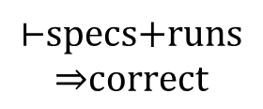
The solution
Regression
Development
CVE
Parameters
Per-design specs
Verification runs
Deduction
$$\text{⊢}\text{specs}\text{+}\text{runs}$$
$$\text{⇒}\text{correct}$$

Slide 8
The solution done right
An executable logic for writing the specs and verification scripts: reFLect
A symbolic simulator that admits relational specifications written in logic: rSTE
A tightly integrated theorem prover for executing the deductive proofs: Goaled

Slide 9
The solution done right
An executable logic for writing the specs and verification scripts: applicative common lisp
A symbolic simulator that admits relational specifications written in logic: ESIM+GL
A tightly integrated theorem prover for executing the deductive proofs: ACL2
[Slobodová et al, MEMOCODE’11]

Slide 10
The reFLect Language
Core syntax:
n,o,p ::= k | v | n o | λp. n o | ⟨ n ⟩ | ^n:σ
… plus extensions driven by necessity
BDDs built in as a primitive type
Quotient types
Overloading
Named function parameters
Records
Possibly unsafe features: references, I/O, recursion
pattern matching
reflection

Slide 11
Higher Order Logic of reFLect
HOL, following Church:
Logic =
The reFLect logic:
Logic =
λ-calculus
+
logical constants
+
rules
reFLect
+
logical constants
+
rules
Basic idea in both systems:
n → p means ├ n = p
Define ∀, ∃, etc by axioms
Add rules for function equality
Proof by evaluation

Slide 12
Goaled Theorem Prover
LCF-style implementation, following in the footsteps of HOL and HOL Light
Thm is a protected data type, constructible only through a small set of trusted function calls (a.k.a. inference rules)
Features driven by necessity
Theories: of reFLect data types, natural numbers, integers, rationals, lists, pairs, reFLect ADTs
Proof automation: rewriting, first order solving, linear arithmetic
Bitstring arithmetic
Support for the reflect language extensions

Slide 13
The last bit
An executable logic for writing the specs and verification scripts: reFLect
A symbolic simulator that admits relational specifications written in logic: rSTE
A tightly integrated theorem prover for executing the deductive proofs: Goaled

Slide 14
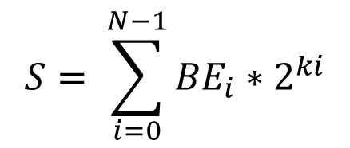
Limitations of STE
S
Trajectory assertion:
ckt |= [[ S is v ==>> (BE_{i} is f_{i}(v)) ]]
But,
You need a special purpose reasoning system for this special purpose logic
Relational specifications cannot be expressed directly
Booth
Encoder
BE_{i}
$$S= \sum_{i=0}^{N−1}{{BE}_{i}∗2^{ki}}$$

Slide 15
Relational STE
STE’s antecedent and consequent are replaced with lists of constraints
A constraint is a relationship between a finite set of circuit nodes at specified points in time
Idea:
rSTE ckt cin cout means “In any behavior of ckt in which all of the constraints cin hold, all of the constraints cout hold”

Slide 16


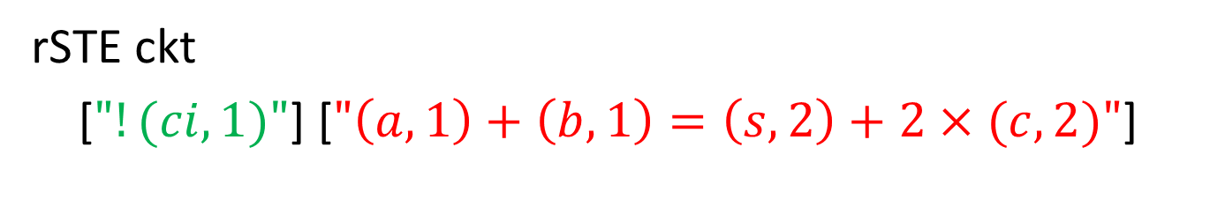



Relational STE Intuition
ci
$$(ci,1)$$
$$(a,1)$$
a
Full Add
s
$$(b,1)$$
b
$$(s,2)$$
c
$$(c,2)$$
rSTE ckt
[$"!(ci, 1)"$] [$"\left(a,1\right)+\left(b,1\right)=\left(s,2\right)+2×(c,2)"$]

Slide 17
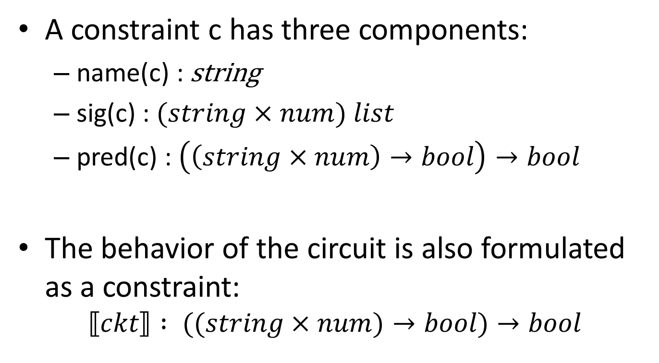
Constraints
A constraint c has three components:
name(c) : string
sig(c) : $(string×num) list$
pred(c) : $\left(\left(string×num\right)→bool\right)→bool$
The behavior of the circuit is also formulated as a constraint:
$$⟦ckt⟧ : ((string×num)→bool)→bool$$

Slide 18
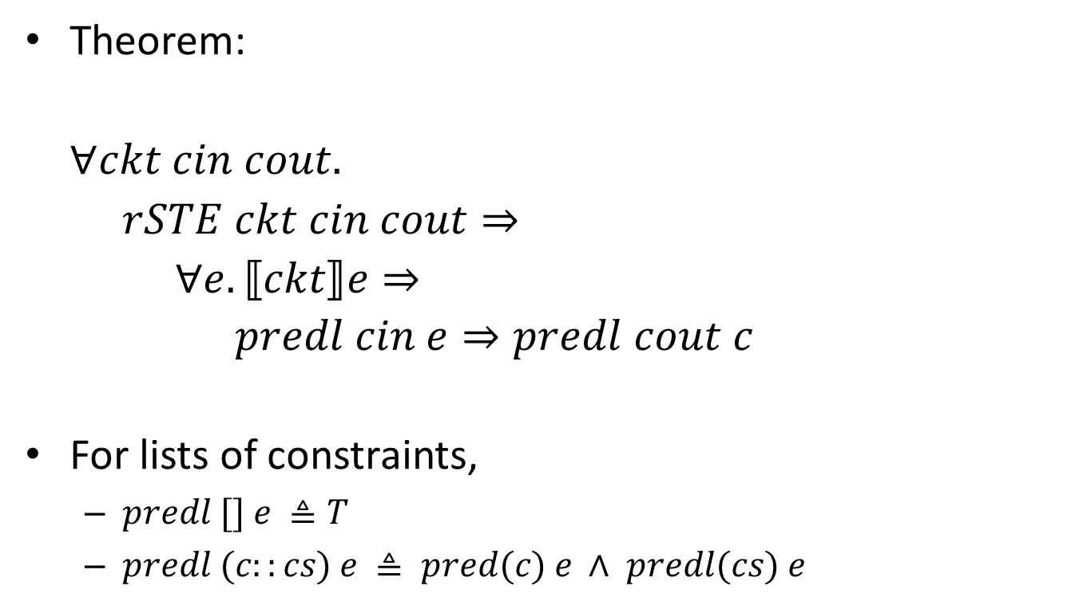
From Relational STE to Logic
Theorem:
$∀ckt cin cout.$
$rSTE ckt cin cout⇒$
$∀e. ⟦ckt⟧e⇒$
$predl cin e⇒predl cout c$
For lists of constraints,
$predl [] e ≜T$
$predl (c::cs) e ≜ pred(c) e ∧ predl(cs) e$

Slide 19
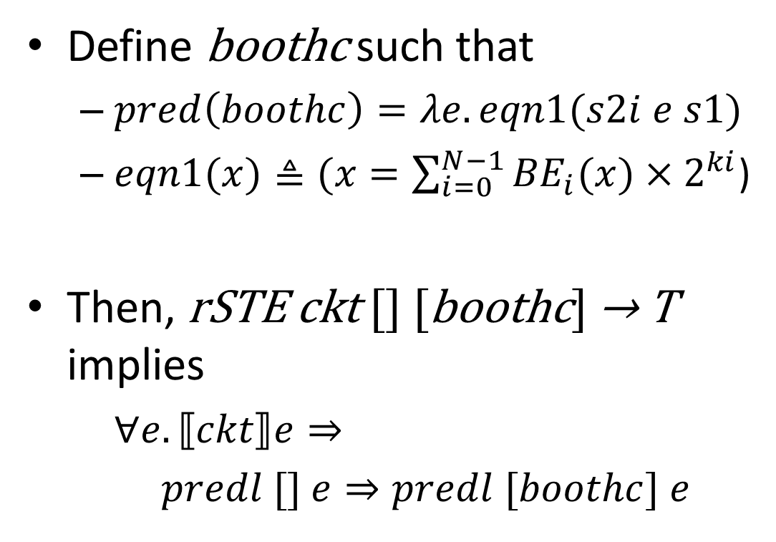
Relational STE in Action
Define boothc such that
$pred\left(boothc\right)=λe.eqn1(s2i e s1)$
$eqn1(x)≜(x=\sum_{i=0}^{N−1}{{BE}_{i}(x)×2^{ki}}$)
Then, rSTE ckt [] [boothc] → T implies
$∀e. ⟦ckt⟧e⇒$
$predl [] e⇒predl [boothc] e$
S1
Booth
Encoder
BE_{i}

Slide 20
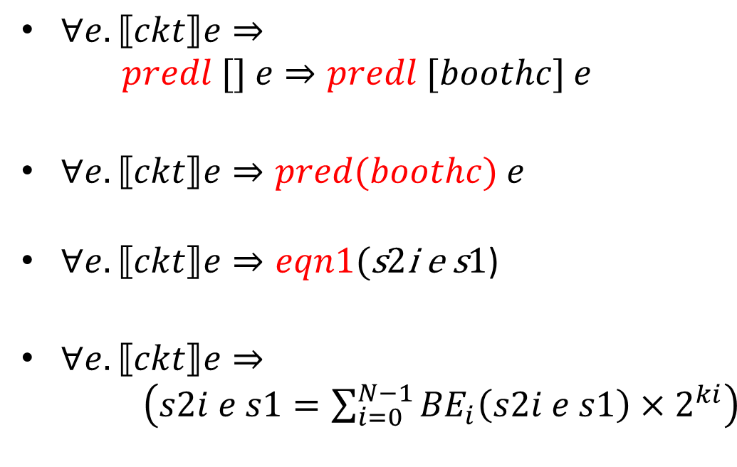
Relational STE in Action
$∀e. ⟦ckt⟧e⇒$ $predl [] e⇒predl [boothc] e$
$∀e. ⟦ckt⟧e⇒pred(boothc) e$
$∀e. ⟦ckt⟧e⇒eqn1($s2i e s1)
$∀e. ⟦ckt⟧e⇒ \left(s2i e s1=\sum_{i=0}^{N−1}{{BE}_{i}\left(s2i e s1\right)×2^{ki}}\right)$
S1
Booth
Encoder
BE_{i}

Slide 21
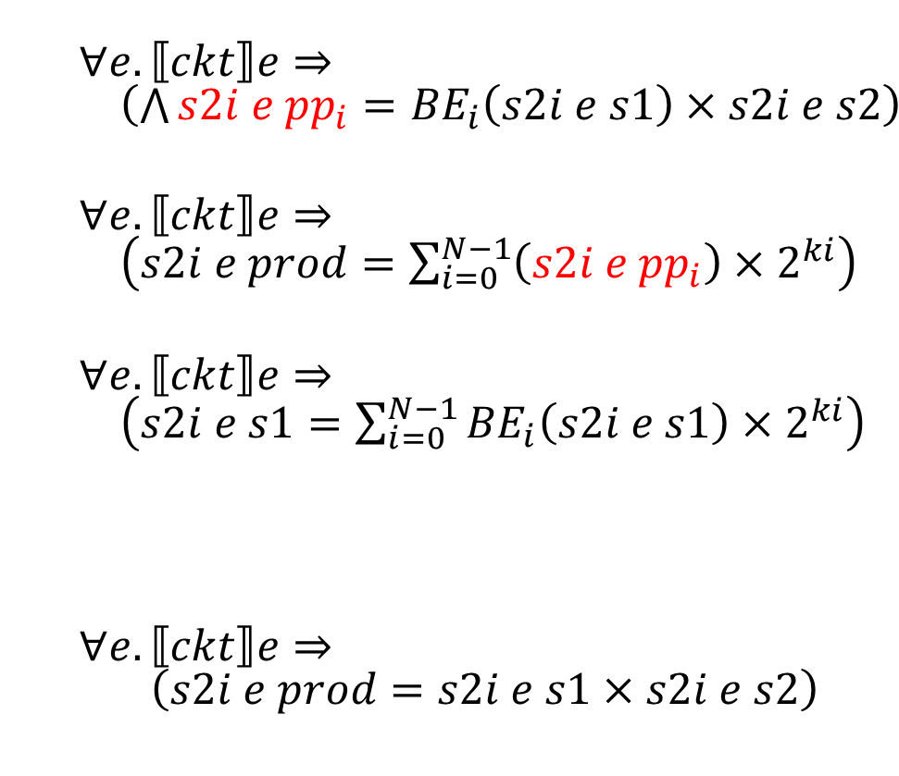
Completing a Multiplier proof
$∀e. ⟦ckt⟧e⇒ \left(\bigwedge{s2i e {pp}_{i}}={BE}_{i}\left(s2i e s1\right)×s2i e s2\right)$
$∀e. ⟦ckt⟧e⇒ \left(s2i e prod=\sum_{i=0}^{N−1}{\left(s2i e {pp}_{i}\right)×2^{ki}}\right)$
$∀e. ⟦ckt⟧e⇒ \left(s2i e s1=\sum_{i=0}^{N−1}{{BE}_{i}\left(s2i e s1\right)×2^{ki}}\right)$
$∀e. ⟦ckt⟧e⇒ \left(s2i e prod=s2i e s1×s2i e s2\right)$
S1
S2
Booth
Encoder
BE_{i}(S1)
Partial Products Generation
PP_{i}
Wallace Tree Adder Network
PROD

Slide 22
Proof engineering
Additional arguments to rSTE
Constant antecedent: clock, reset
rSTE options: bdd variable ordering, param, …
Not shown here, but see paper
Analysis of CVE verification scripts
N layers of function calls between input parameters and generation of specs
Much deductive effort toward exposing the specs
Routine rewriting, also not shown here

Slide 23
Status and prospects
reFLect and rSTE are the main workhorses of datapath verification across Intel
Frameworks for integer and FP multipliers, FMAs, adders, divide/sqrt are widely deployed
Goaled checking of integer multipliers is used on a mainline design project and being pushed to others
We plan to integrate Goaled checking with our other frameworks

