Slide 1
AutoCite
TJC Team 2

Slide 2
autocite/about
AutoCite
(automated - citations)
AutoCite is a website citation machine meant to expedite the process of creating citations for papers in both Chicago or APA format.

Slide 3
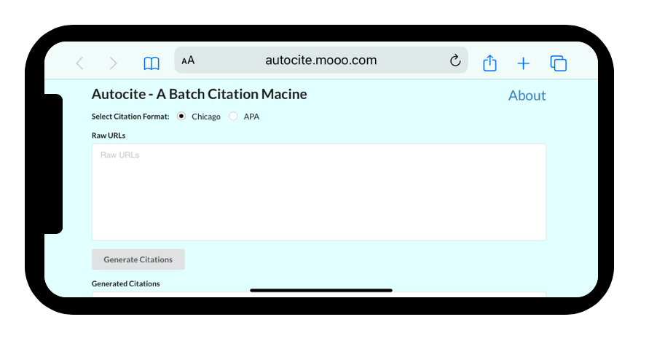
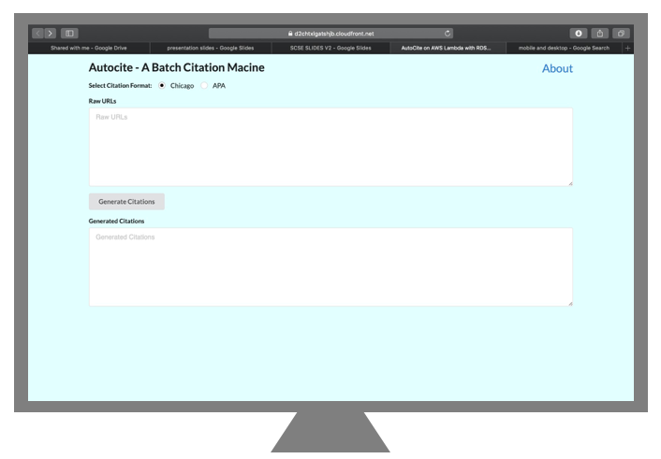
autocite/about
Mobile
Desktop

Slide 4
Target Audience
Students and Researchers

Slide 5

How to use

Slide 6

Live Demo
Notes:
https://www.dell.com/en-sg
https://www8.hp.com/sg/en/home.html
https://www.apple.com/
https://www.straitstimes.com/singapore/readers-rewarded-for-alerting-st-to-news-worthy-stories
https://www.channelnewsasia.com/news/cnainsider/india-entrepreneur-kinexcs-chinese-integration-immigrant-12280904
https://www.infosecinstitute.com/
https://www.facebook.com/
https://www.google.com/drive/
https://www.challenger.com.sg/
https://www.intel.sg/content/www/xa/en/homepage.html

Slide 7
Strengths:
Batch Citations
Beauty in a Click
Accurate Citations
1
2
3

Slide 8
Speed Test Results
*Sample Size of 10 Links
CitationMachine
266.87 s
Before Cache
9.71 s
After Cache
2.00 s
Notes:
https://www.dell.com/en-sg
https://www8.hp.com/sg/en/home.html
https://www.apple.com/
https://www.straitstimes.com/singapore/readers-rewarded-for-alerting-st-to-news-worthy-stories
https://www.channelnewsasia.com/news/cnainsider/india-entrepreneur-kinexcs-chinese-integration-immigrant-12280904
https://www.infosecinstitute.com/
https://www.facebook.com/
https://www.google.com/drive/
https://www.challenger.com.sg/
https://www.intel.sg/content/www/xa/en/homepage.html

Slide 9



5
0
Redirects
CitationMachine.net
Autocite
Notes:
Citation Machine: 5 clicks and 1 copy-paste per citation
Autocite: 1 copy paste, 1 click for “infinite” citations

Slide 10

How It Works

Slide 11






API Gateway
RDS
S3
Lambda
CloudFront

Slide 12
Overview
Accessing the Webpage
Creating the Citations

Slide 13
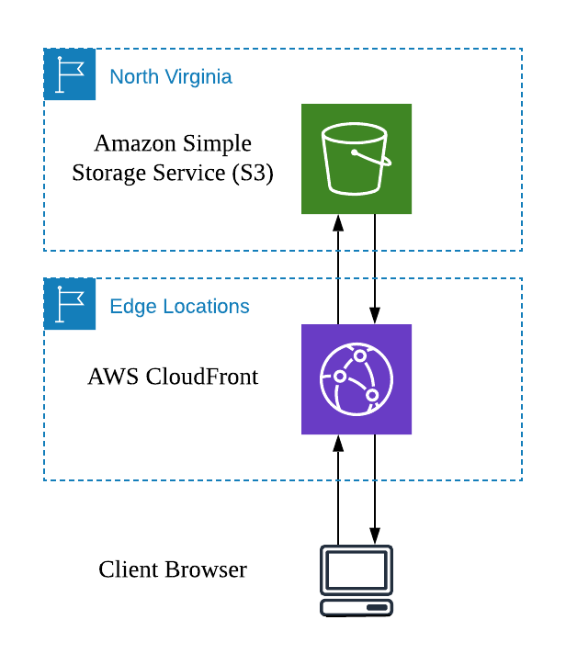
Access Webpage

Slide 14


AWS Simple Storage Services
Serverless Static Website Hosting
Low Maintenance
Low Latency
High Reliability

Slide 15

AWS CloudFront
Global Content Delivery Network for S3 Hosted Files
Even Lower Latency
Transport Layer Security (SSL)

Slide 16
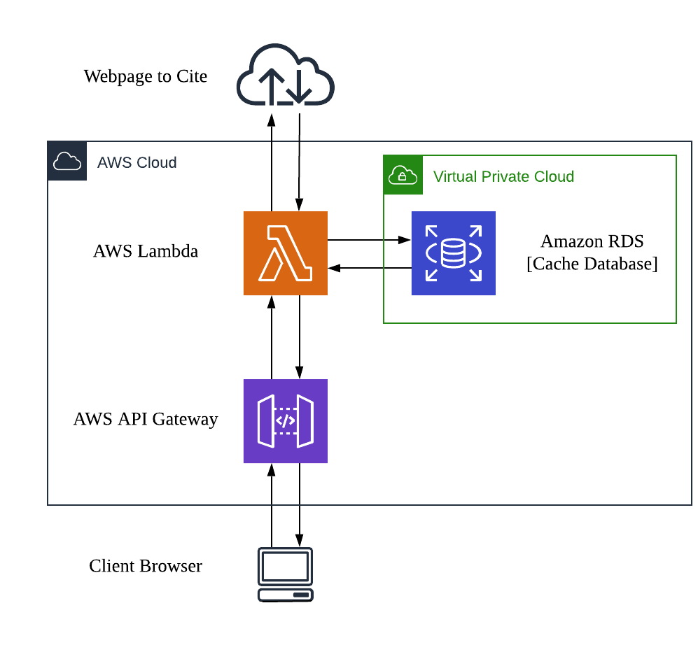
Making Citations

Slide 17

AWS Lambda
Asynchronous Invocation of Functions
Low Maintenance
Automatic Scaling with Demand
Parallel Computing
Pay-Per-Use
Notes:
Time = max(queries) != sum(queries) due to parallel computing

Slide 18
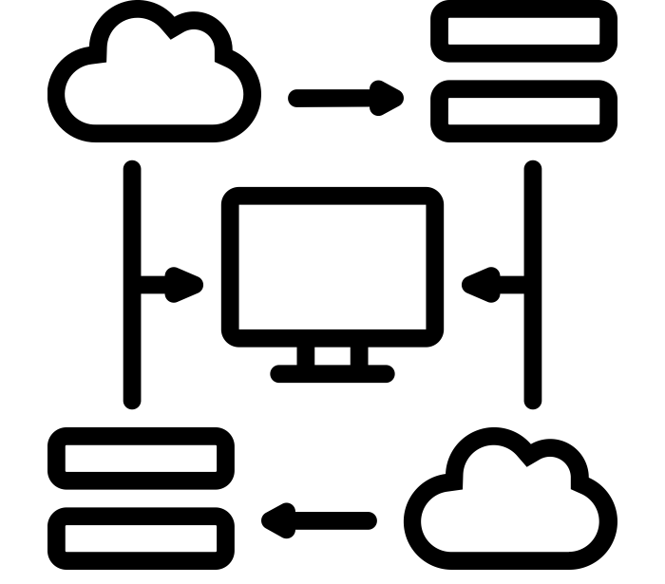
AWS API Gateway
Route HTTP Request to Lambda Trigger
Trigger Lambda from HTTP Post Request
Allows Website to Invoke Lambda Function

Slide 19


AWS Relational Database Service
MySQL Database to Store Cached Citations
Scalability
Fast Access
High Reliability
Low Maintenance
Notes:
Fast Access: SSD Storage
Scalability: Easy to add additional storage when necessary
High Reliability: Less likely to be down and to experience data loss
Low Latency: Accessed from lambda function in North Virginia, thus lambda can quickly connect to RDS
Low maintenance: Don't need to worry about spoilt hard drives or software updates

Slide 20



Areas for Improvement
WAF
Textract
Comprehend
Security Improvements
DDOS Protection of Lambda Function with AWS Web Application Firewall
Variety of Citations
Different types of reference material. I.e. PDF Documents, Journal Articles, etc
Quality of Citations
Better Machine Learning for More Accurate Citations
Notes:
Note that AWS WAF is not available with the AWS Educate Starter Account
https://medium.com/@acrosson/extracting-names-emails-and-phone-numbers-5d576354baa [Using Machine Learning To identify names which could potentially be authors] [Amazon Comprehend]
PDF and Journal Citations can incorporate Textract

Slide 21

Thank You!
Visit AutoCite at
“https://tinyurl.com/autocite”
Powered By:

