Slide 1
Android Testing/Debugging
TsungYi, Tsai

Slide 2
Testing Environment
Physical Machine
AVD, Emulator
Company for Android Testing (such as http://testdroid.com/ )

Slide 3
Debug
LogCat
Memory Usage Analysis
BugSense
ACRA
Runtime Logging

Slide 4
LogCat
It is a good practice to use Log.d() and LogCat to debug at Development.
But you should not call any Log.d() or Log.i() in the release version!

Slide 5
Memory Leak Debug Tool
On Android Studio, We can use Android Device Monitor to analysis the allocated memory.
Tools >> Android >> Android Device Monitor
Hint: On Eclipse, you can try to use MAT - Memory Analyzer

Slide 6
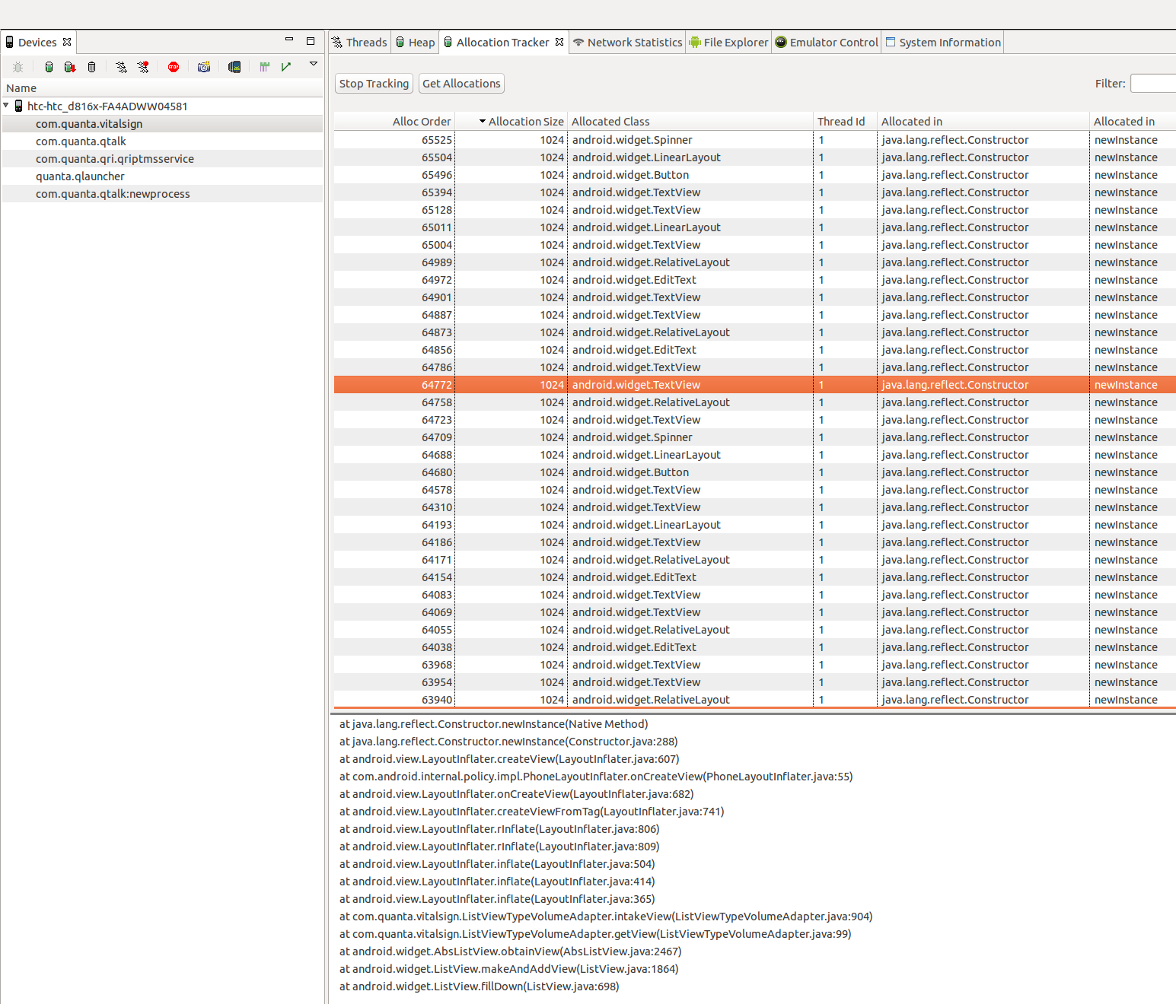

Slide 7
BugSense (Splunk MINT)
The Splunk MINT SDK will collect crash, performance and usage data for your app and send it to our Cloud servers.
Disadvantages:
It require Internet Permission, and always connect to the Internet.
It only provide the record when Exception happens. sometimes, it is not enough for debugging.

Slide 8
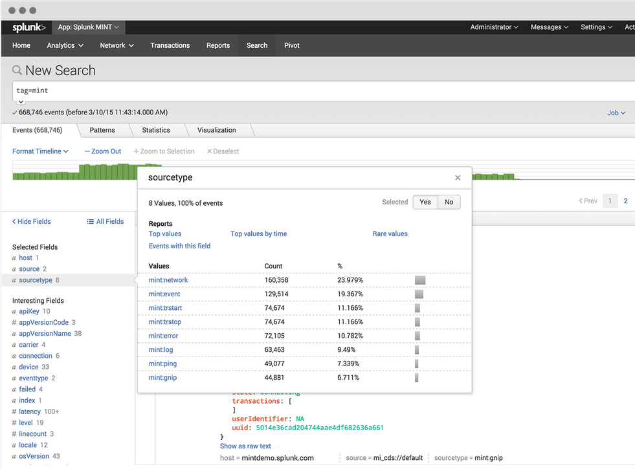

Slide 9
ACRA
ACRA is a Open Source project similar to BugSense. The License is Apache 2.0
Please refer: https://github.com/ACRA/acra

Slide 10
Store Runtime Log to File
Use standard java.util.logging function to write log to file at runtime.
But note that:
Let user can select turn on logging or not.
You should delete old records to control the file size.
Let user can upload the record file when Error happen.

Slide 11
Testing
Unit Testing
UI Testing
Espresso
UI Automator Viewer
Monkey
Build-in monkey
Monkey runner
Adb getEvent/sendEvent
StrictMode

Slide 12
Unit Testing

Slide 13
Unit Testing
Create a testing Package (Android Studio Project):
In the Package Explorer, right-click on the /src directory and select New > Folder > Java Folder, and Set the location to src/androidTest/java
Right-click on the new java Folder and select New > Package. and Set the Name field to UnitTests
No need to update builde.gradle file

Slide 14
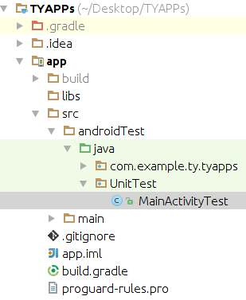
Unit Testing
Create a testing Package (Android Studio Project):

Slide 15
Unit Testing
Create a testing Package (Old Android Project):
Create new Directory call “tests” under the Project
In the Package Explorer, right-click on the /tests directory and select New > Folder > Java Folder, and Set the new location to “tests/java/”
Right-click on the new java Folder and select New > Package. and Set the Name field to UnitTests
update builde.gradle file:
SourceSets {
// Move the tests to tests/java, tests/res, etc...
androidTest.setRoot('tests')
}

Slide 16
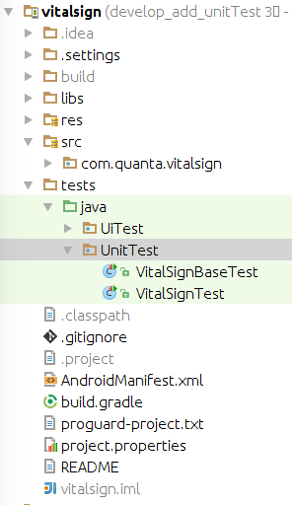
Unit Testing
Create a testing Package (Old Android Project):

Slide 17
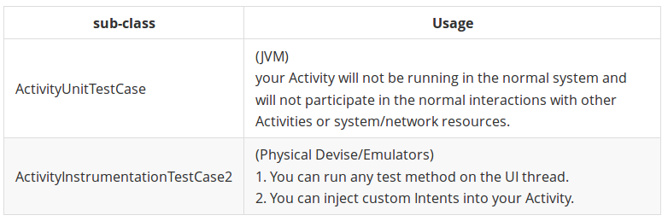
Unit Testing
Set Up Your Test Class
Right-click on the test package you created, and select New > Class. and Set the Name field to XXXTest (for example, MainActivityTest) and click Finish.
Extend to one of the sub-classes of ActivityTestCase

Slide 18
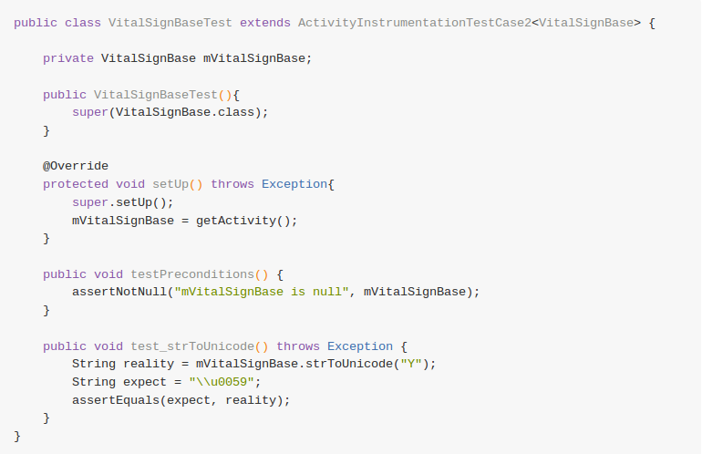
Unit Testing
Add public testing methods. Method name must start with test.

Slide 19
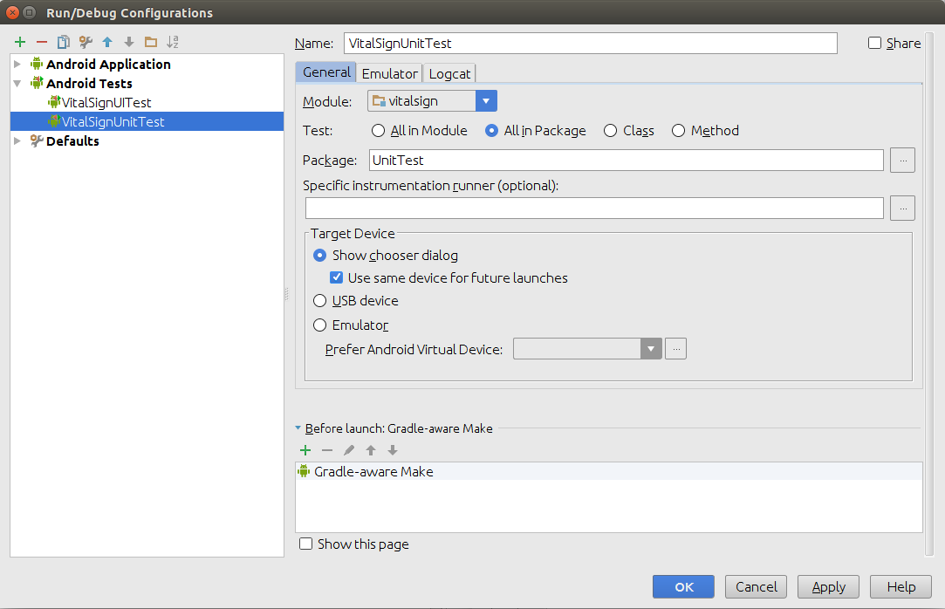
Unit Testing
Run Testing
Set up new testing configuration:
Run >> Edit Configurations... >> Add New Configuration:"Android Testing"

Slide 20
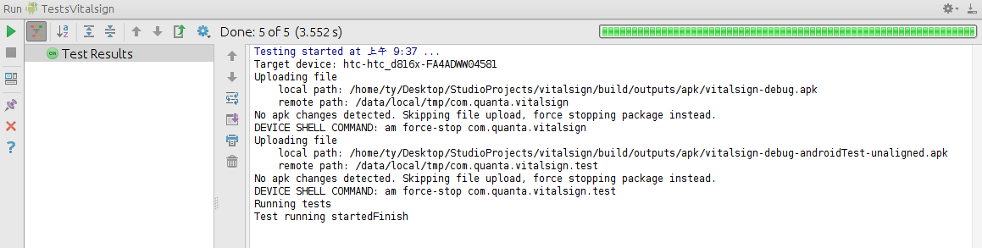
Unit Testing
Run Testing
Check testing result

Slide 21
UI Testing

Slide 22
UI Testing via Espresso
Why Espresso:
simulate user interactions within a single target app.
able to simulate a user flow across multiple activities in the target app

Slide 23
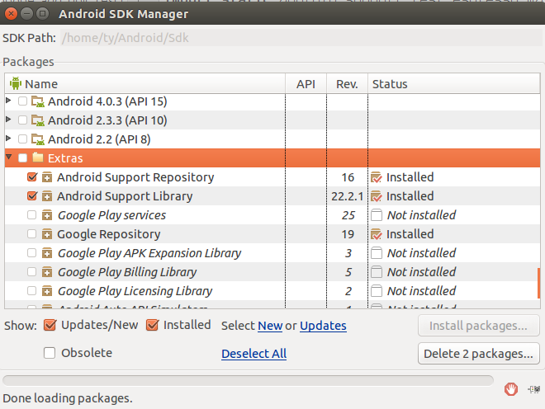
UI Testing via Espresso
Install the Android Testing Support Library:
Tools >> Android >> SDK Manager >> Extras >> Install Android Support Repository & Android Support Library.

Slide 24
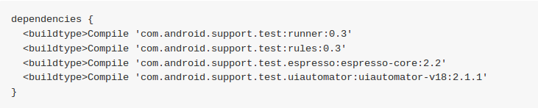
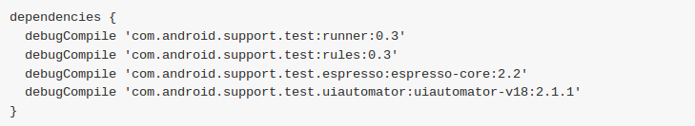
UI Testing via Espresso
Update build.gradle file:
Specify your Android testing dependencies.
For example:

Slide 25
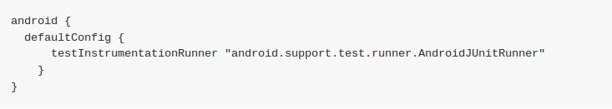

UI Testing via Espresso
Set up the testInstrumentationRunner
use jcenter as repositories

Slide 26
UI Testing via Espresso
Turn off animations on your test device
Leaving system animations turned on in the test device might cause unexpected results or may lead your test to fail. Turn off animations from Settings by opening Developing Options and turning all the following options off
Window animation scale
Transition animation scale
Animator duration scale

Slide 27
UI Testing via Espresso
Create a testing Package
Similar to Unit Testing, But create another package “UiTest” under java folder

Slide 28
UI Testing via Espresso
Using Espresso with ActivityInstrumentationTestCase2
public class VitalSignTest extends ActivityInstrumentationTestCase2<VitalSign> {
private VitalSign mVitalSign;
public VitalSignTest(){
super(VitalSign.class);
}
protected void setUp() throws Exception{
super.setUp();
injectInstrumentation(InstrumentationRegistry.getInstrumentation());
mVitalSign = getActivity();
}
public void test_temperature_abnormal_input(){
onView(withId(R.id.vitalsign_temperature_input))
.perform(replaceText("5"), pressKey(KeyEvent.KEYCODE_ENTER), closeSoftKeyboard());
//verify that the wrong value does not clean
onView(withId(R.id.vitalsign_temperature_input))
.check(matches(withText("5")));
// verify the text color should change to 'R.color.value_abnormal'
EditText temperature = (EditText) mVitalSign.findViewById(R.id.vitalsign_temperature_input);
assertEquals(mVitalSign.getResources().getColorStateList(R.color.value_abnormal), temperature.getTextColors());
}
}

Slide 29
UI Testing via Espresso
Using Espresso with ActivityInstrumentationTestCase2
OnView(): Activity Componenet Control
OnData(): AdapterView Componenet Control
perform(ViewAction... viewActions)
ViewActions:
click()
typeText("String")/ReplaceText("String")/clearText()...
pressKey(int keyCode)
scrollTo()
check():
doesNotExist()
matches(Matcher)
selectedDescendantsMatch(Matcher selector, Matcher matcher)

Slide 30
UI Testing via UI Automator Viewer
provides a UiDevice class to access and perform operations on the device on which the target app is running. such as:
Change the device rotation
Press the Back, Home, or Menu buttons
Open the notification shade
Take a screenshot of the current window

Slide 31
Monkey Testing

Slide 32
Outline
Why Monkey Test
Monkey Test Methods & Tools:
Basic Monkey Test
Monkey Test with script
Monkey Runner

Slide 33
Monkey Testing
Why Monkey?
The Monkey is a command-line tool that runs on your emulator or device and generates pseudo-random streams of user events such as clicks, touches, or gestures, as well as a number of system-level events.
If your application crashes or receives any sort of unhandled exception or generates not responding error, the Monkey will stop and report the error.
Monkey is suitable for stress testing

Slide 34
Why Monkey Test?
Functional Test: simulate user’s random behavior.
Stress Test: by running massive random operations.
Very Easy: No need to write complicate codes and mockups.

Slide 35
Basic Monkey Test
$ adb shell monkey –p com.medicalcart.service 500
Advantage | Weakness
Simple, easy, really random behavior. If your application crashes or receives any sort of unhandled exception or generates not responding error, the Monkey will stop and report the error | Not always perform operations on your application. Ex: When monkey press home button or back button…
Reference: https://developer.android.com/studio/test/monkey.html

Slide 36
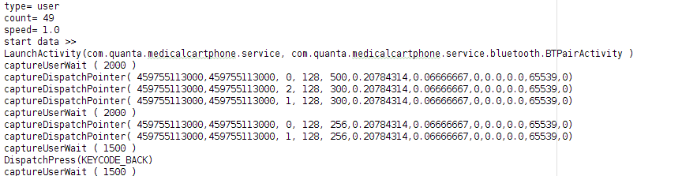
Monkey Test with script
$ adb push case1.script /sdcard/Download
$ adb shell monkey –f /sdcard/Download/case1.script
case1.script:

Slide 37
$ sudo adb shell monkey -p com.quanta.vitalsign -v 50
:Monkey: seed=1438888806935 count=50
:AllowPackage: com.quanta.vitalsign
:IncludeCategory: android.intent.category.LAUNCHER
:IncludeCategory: android.intent.category.MONKEY
// Event percentages:
// 0: 15.0%
// 1: 10.0%
// 2: 2.0%
// 3: 15.0%
// 4: -0.0%
// 5: 25.0%
// 6: 15.0%
// 7: 2.0%
// 8: 2.0%
// 9: 1.0%
// 10: 13.0%
:Switch: #Intent;action=android.intent.action.MAIN;category=android.intent.category.LAUNCHER;launchFlags=0x10200000;component=com.quanta.vitalsign/.Login;end
// Allowing start of Intent { act=android.intent.action.MAIN cat=[android.intent.category.LAUNCHER] cmp=com.quanta.vitalsign/.Login } in package com.quanta.vitalsign
:Sending Touch (ACTION_DOWN): 0:(347.0,300.0)
:Sending Touch (ACTION_UP): 0:(350.37814,298.497)
:Sending Trackball (ACTION_MOVE): 0:(2.0,2.0)
:Sending Trackball (ACTION_UP): 0:(0.0,0.0)
:Switch: #Intent;action=android.intent.action.MAIN;category=android.intent.category.LAUNCHER;launchFlags=0x10200000;component=com.quanta.vitalsign/.Login;end
// Allowing start of Intent { act=android.intent.action.MAIN cat=[android.intent.category.LAUNCHER] cmp=com.quanta.vitalsign/.Login } in package com.quanta.vitalsign
:Sending Flip keyboardOpen=false
:Sending Trackball (ACTION_MOVE): 0:(-5.0,-1.0)
:Sending Trackball (ACTION_UP): 0:(0.0,0.0)
:Sending Touch (ACTION_DOWN): 0:(508.0,919.0)
:Sending Touch (ACTION_UP): 0:(522.2911,917.87726)
:Sending Touch (ACTION_DOWN): 0:(612.0,398.0)
:Sending Touch (ACTION_UP): 0:(630.60333,408.68585)
:Sending Touch (ACTION_DOWN): 0:(457.0,62.0)
:Sending Touch (ACTION_UP): 0:(458.8939,65.03747)
:Sending Trackball (ACTION_MOVE): 0:(-2.0,-2.0)
Events injected: 50
:Sending rotation degree=0, persist=false
:Dropped: keys=0 pointers=0 trackballs=0 flips=0 rotations=0
## Network stats: elapsed time=180ms (0ms mobile, 0ms wifi, 180ms not connected)
// Monkey finished

Slide 38
Monkey Test with script
Advantage | Weakness
Focus on testing target application If your application crashes or receives any sort of unhandled exception or generates not responding error, the Monkey will stop and report the error | No document explain the detail about the functions used in the script. Hard code, not random. You have to put the script file to target machine first.
Reference: http://eeepage.info/monkey-android/

Slide 39
Monkey Runner
Multiple device control: The monkeyrunner API can apply one or more test suites across multiple devices or emulators. You can physically attach all the devices or start up all the emulators configuration programmatically at once, connect to each one in turn programmatically, run one or more tests, and then shut down the emulator.
Functional testing: monkeyrunner can run an automated start-to-finish test of an Android application. You provide input values with keystrokes or touch events, and view the results as screenshots.
Regression testing - monkeyrunner can test application stability by running an application and comparing its output screenshots to a set of screenshots that are known to be correct.
Extensible automation - Since monkeyrunner is an API toolkit, you can develop an entire system of Python-based modules and programs for controlling Android devices

Slide 40
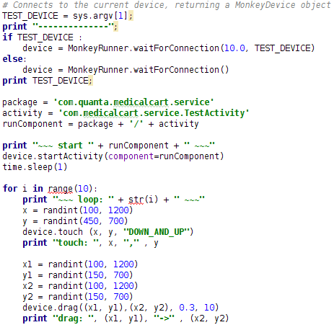
MonkeyRunner
$ ~/Android/Sdk/tools/monkeyrunner testcase1.py W9PDZDAE60
testcase1.py
Simulate random press and drag

Slide 41
MonkeyRunner: Python API Modules
MonkeyRunner
connecting monkeyrunner to a device or emulator.
MonkeyDevices
Perform operations on target device
MonkeyImage
Represents a screen capture image.

Slide 42
Monkeyrunner APIs:
waitForConnection (float timeout, string deviceId) | make a connection between the monkeyrunner backend and the specified device or emulator.

Slide 43
MonkeyDevices APIs
startActivity (…) | Start
drag (tuple start, tuple end, float duration, integer steps) | Simulates a drag
touch (integer x, integer y, integer type) | Simulates a click ※Hint: simulate long click by drag((x,y), (x,y), 2, 1)
press (string keycode, dictionary type) | ‘KEYCODE_HOME’, ‘KEYCODE_BACK’, ‘KEYCODE_APP_SWITCH’, …
installPackage (string path) | Install package onto this device.
removePackage (string package) | Deletes the specified package from this device
shell (string cmd) | Executes an adb shell command and returns the result
reboot (string into) | Reboots this device
broadcastIntent (…) | Send Broadcasts
takeSnapshot() | Captures the entire screen

Slide 44
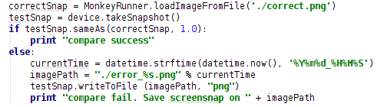
MonkeyImage
sameAs (MonkeyImage other, float percent) | Compares this MonkeyImage object to another
writeToFile (string path, string format) | save current image to the file
※ Example: Load image from file and compare:

Slide 45
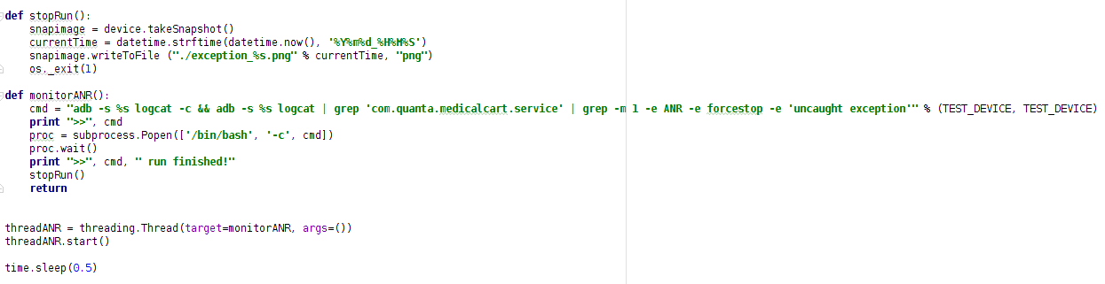
MonkeyRunner: ANR/Exception Detection
Monkeyrunner does not stop and report error when target application crash. Therefore, we have to monitor log by ourselves.

Slide 46
Monkey runner
Advantage | Weakness
Focus on testing target application Run python script, very easy to simulate random behaviors. | Not stop and report error when target application crash due to unhandled exception or ANR. Solution: parse log on python script! “Crtl + C ” to leave monkey runner will cause some exception when performing monkey runner again. Solution: run again. Different devices have different (x,y) range. You have to write different python script for different devices.
Reference: https://developer.android.com/studio/test/monkeyrunner/index.html

Slide 47
StrictMode

Slide 48
StrictMode
To catch accidental disk or network access on the application's main thread, where UI operations are received and animations take place.
Keeping disk and network operations off the main thread makes for much smoother, more responsive applications.

Slide 49
StrictMode
public void onCreate() {
if (DEVELOPER_MODE) {
StrictMode.setThreadPolicy(new StrictMode.ThreadPolicy.Builder()
.detectDiskReads()
.detectDiskWrites()
.detectNetwork() // or .detectAll() for all detectable problems
.penaltyLog()
.build());
StrictMode.setVmPolicy(new StrictMode.VmPolicy.Builder()
.detectLeakedSqlLiteObjects()
.detectLeakedClosableObjects()
.penaltyLog()
.penaltyDeath()
.build());
}
super.onCreate();
}

Slide 50
Useful reference:
- https://developer.android.com/training/testing.html
- https://stuff.mit.edu/afs/sipb/project/android/docs/tools/testing/activity_test.html

Slide 51
Any Questions?

