Slide 1
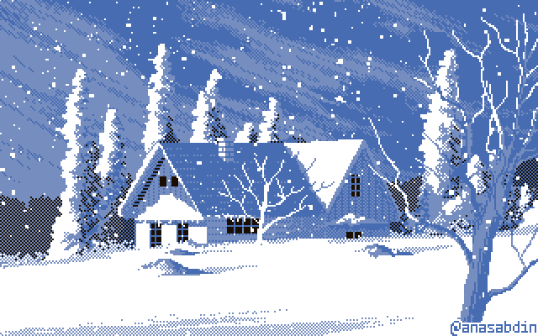
ARTICFACTS
Brandon Bósquez Gonzal
Group 5
Final Project

Slide 2
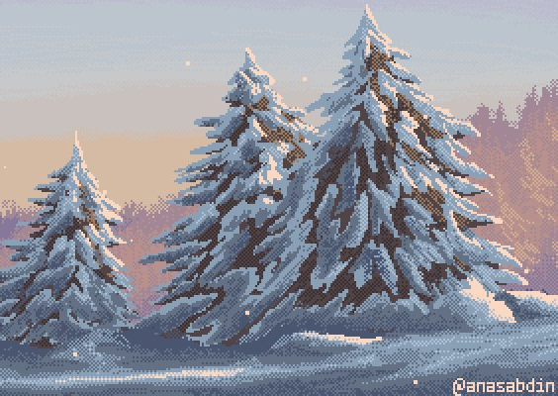
BACKSTORY – VISION
The setting is Finland. The National Museum of Finland in Helsinki is preparing for it's annual and biggest exhibition. This year's topic is "Finnish Historic and Cultural Artifacts". These artifacts are stored all over the major cities in Finland and were supposed to be sent by truck to Helsinki. This year, a very harsh winter has hit Finland and the roads are all blocked by meters of snow! You are the best pilot in the country, and have been contacted by the museum, tasked with flying all over Finland to collect these precious artifacts. You have limited time as the exhibition is only in 10 days. Only you can make the exhibition be a success!

Slide 3

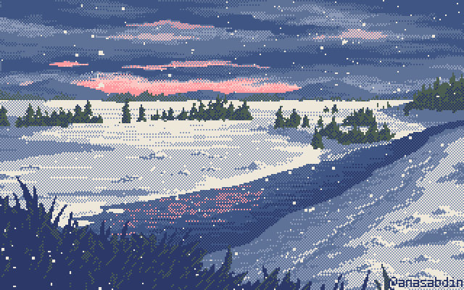
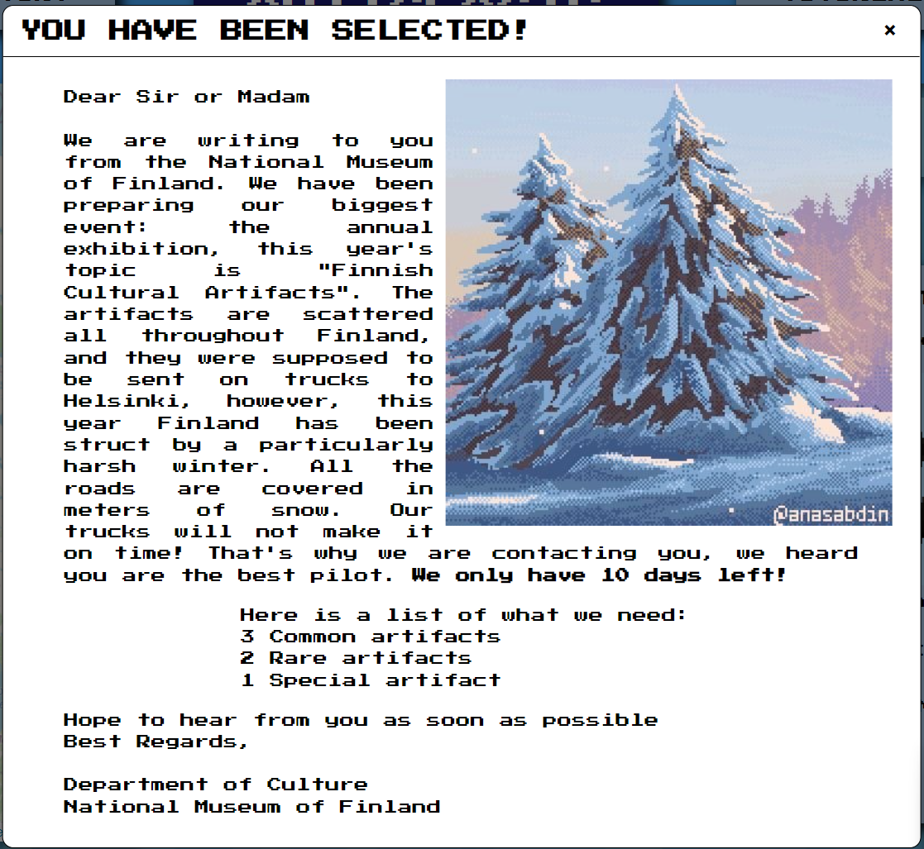
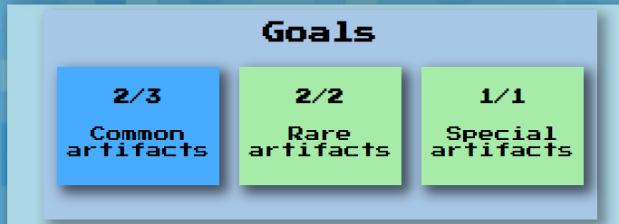
GOALS

Slide 4
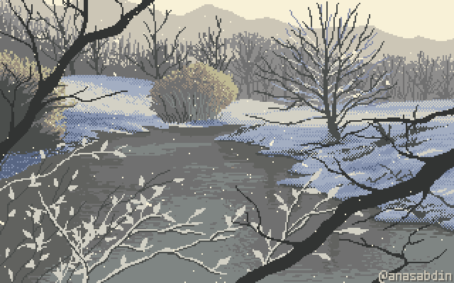
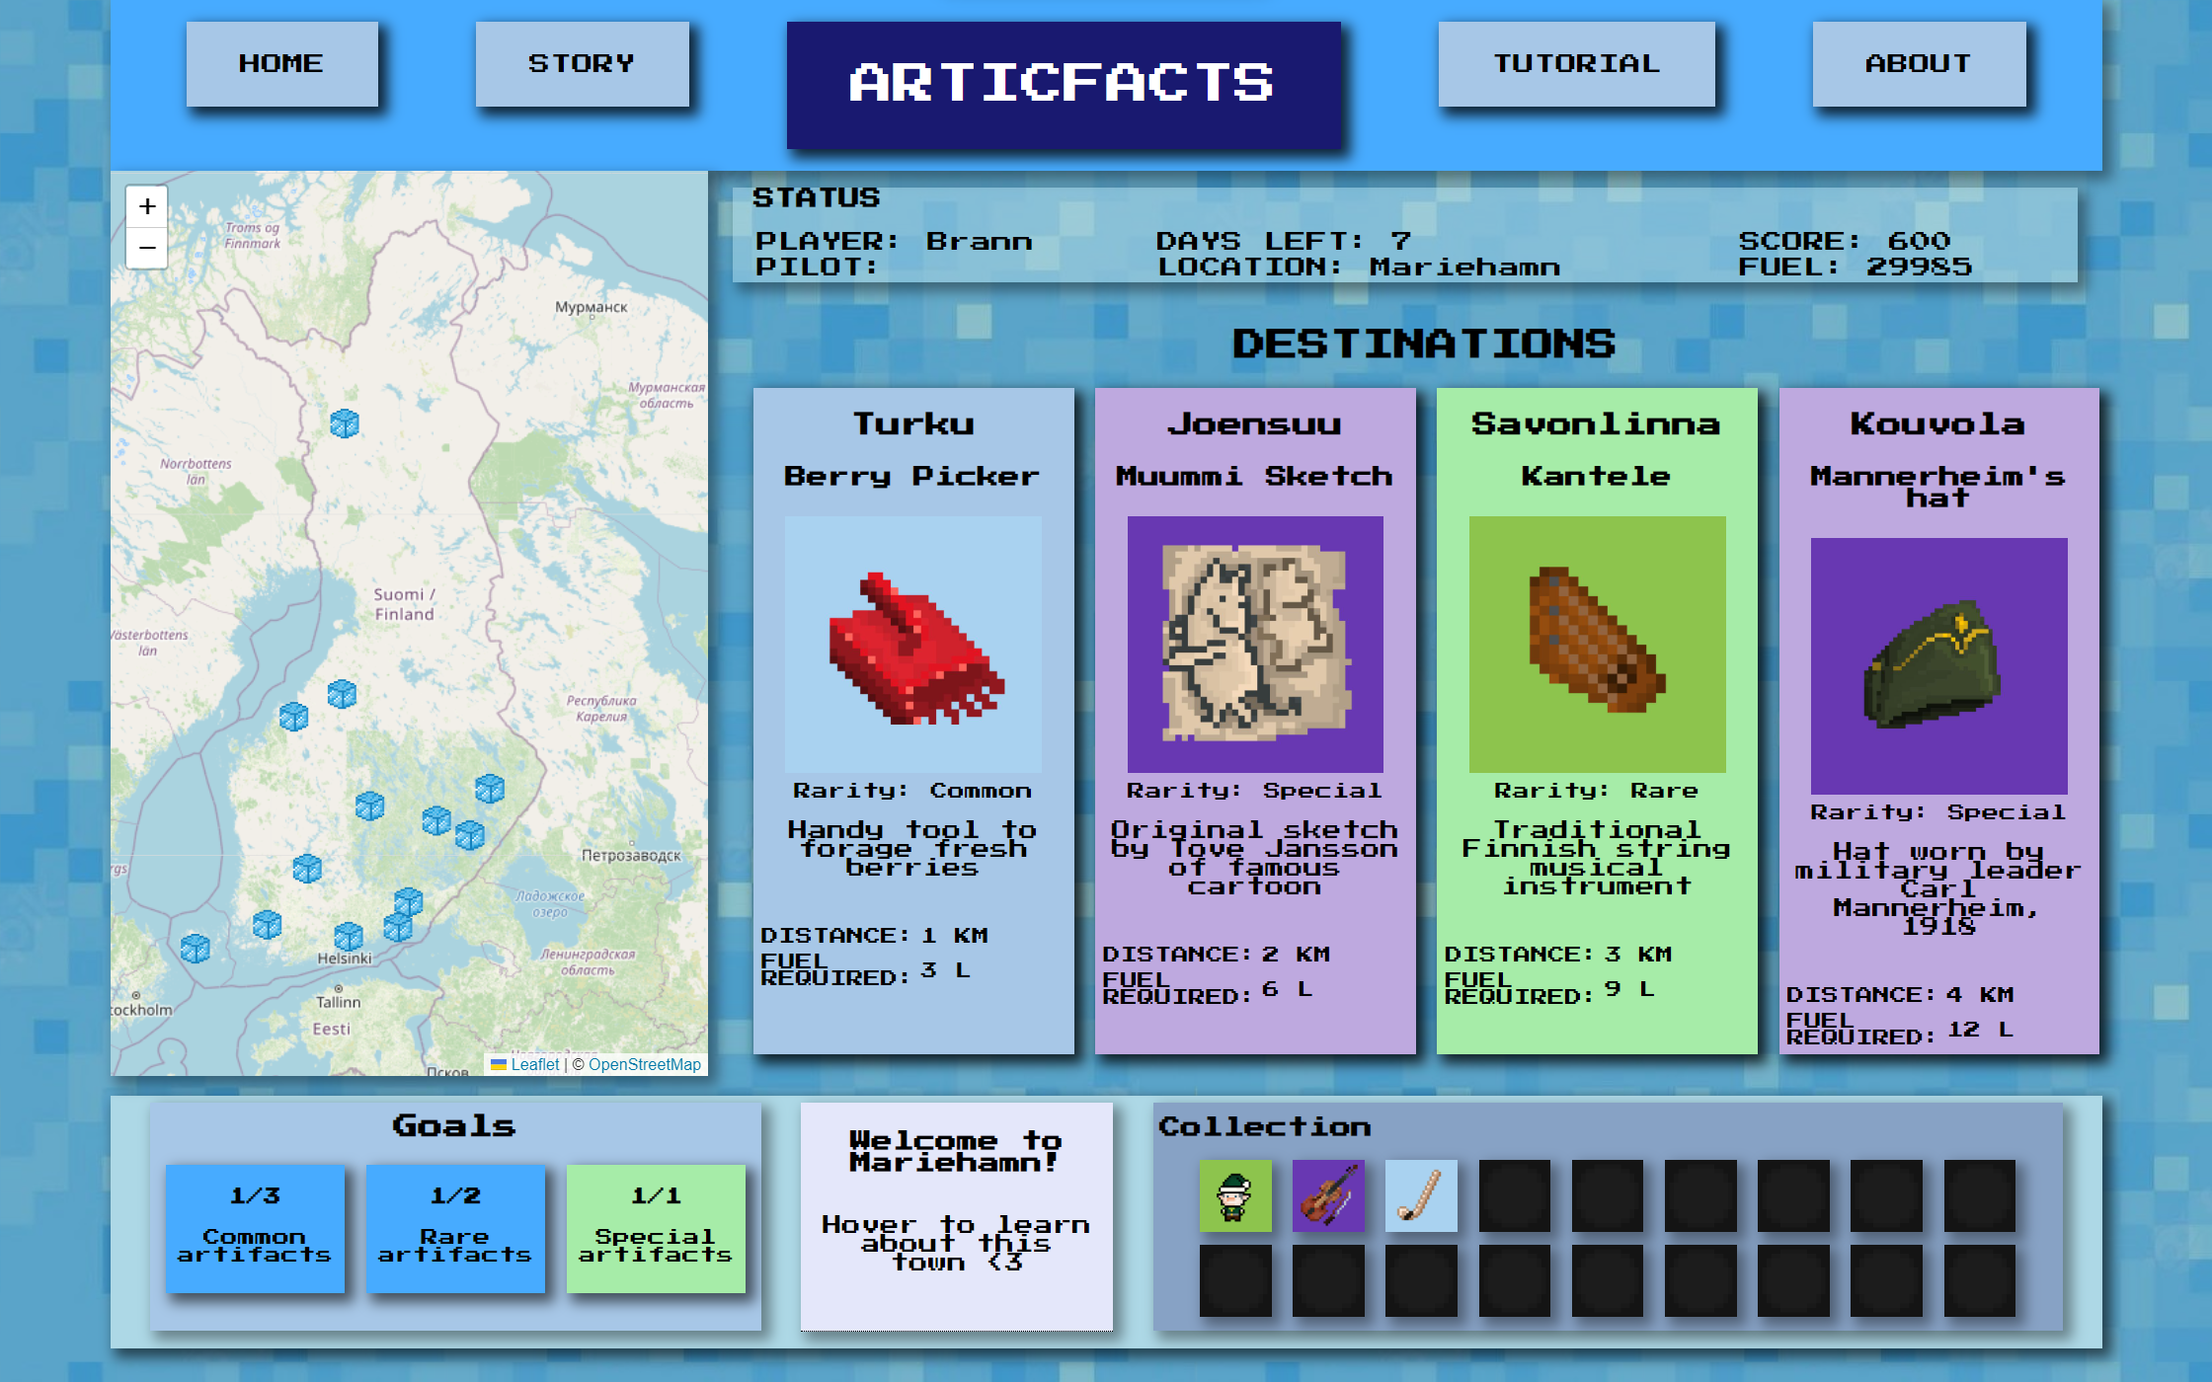
USER INTERFACE

Slide 5
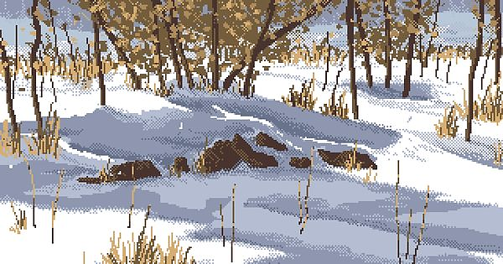
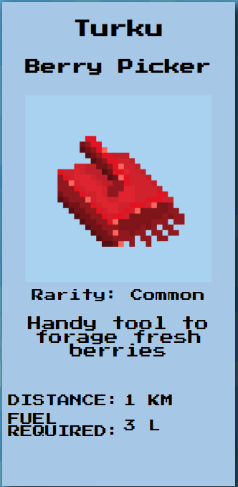
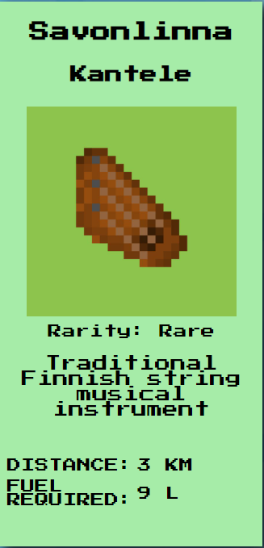
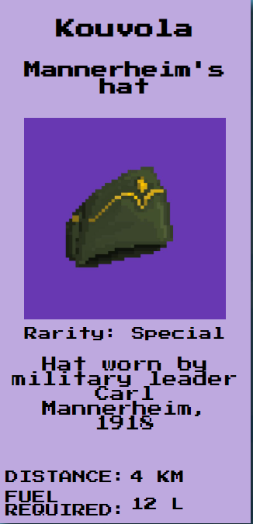
ARTIFACTS AND TOWNS
1
2
3

Slide 6
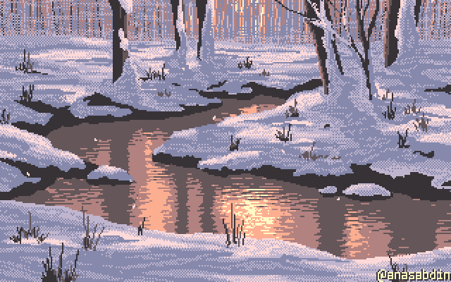
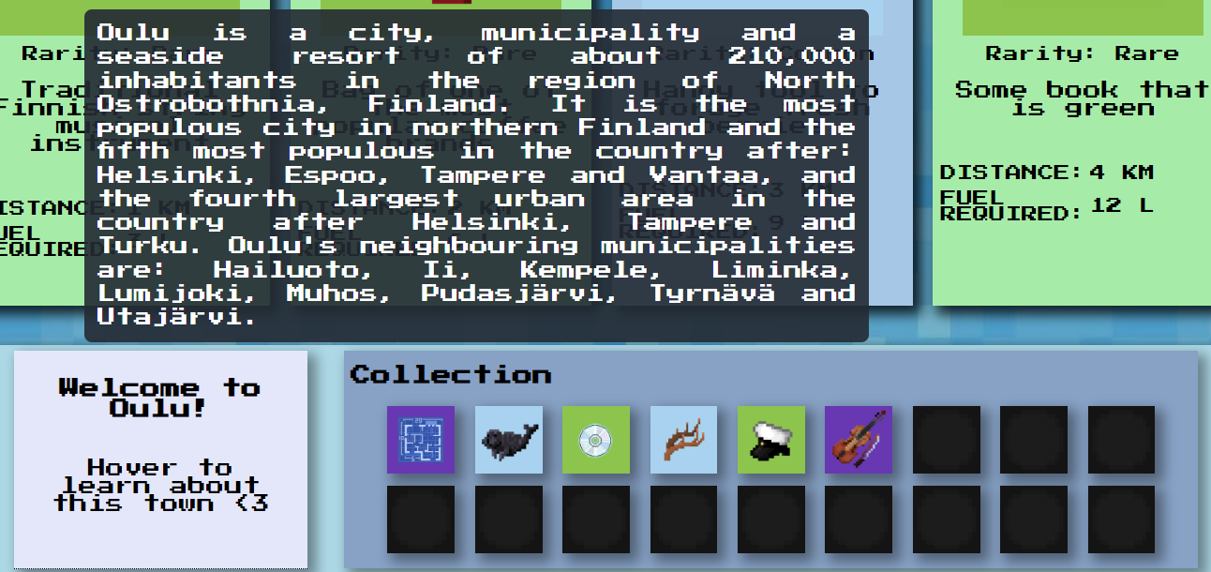
2nd API

Slide 7
LESSONS LEARNED
Time management
Dividing workload in small pieces
Goal setting as a strategy
Technical and practical skills

Slide 8
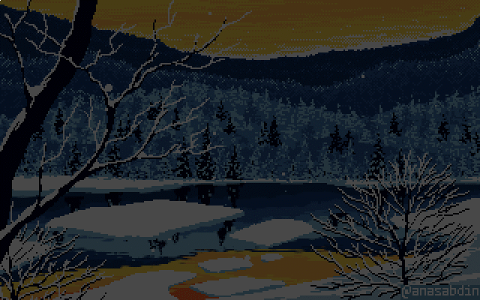
TECHNOLOGIES USED
SQL Database - Database created specifically for the game, storing all the necessary information for the game to run
Python - Backend - Server using Flask - Object oriented programming used for ease of development
HTML and CSS - Frontend - Webpage used for the UI
JavaScript - Middleman between Frontend and Backend

Slide 9
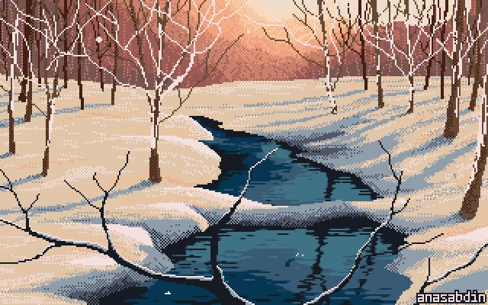
Gracias :D

