Slide 1

Deep Machine learning
Brandon Martinez

Slide 2
Introduction & Motivation

Slide 3
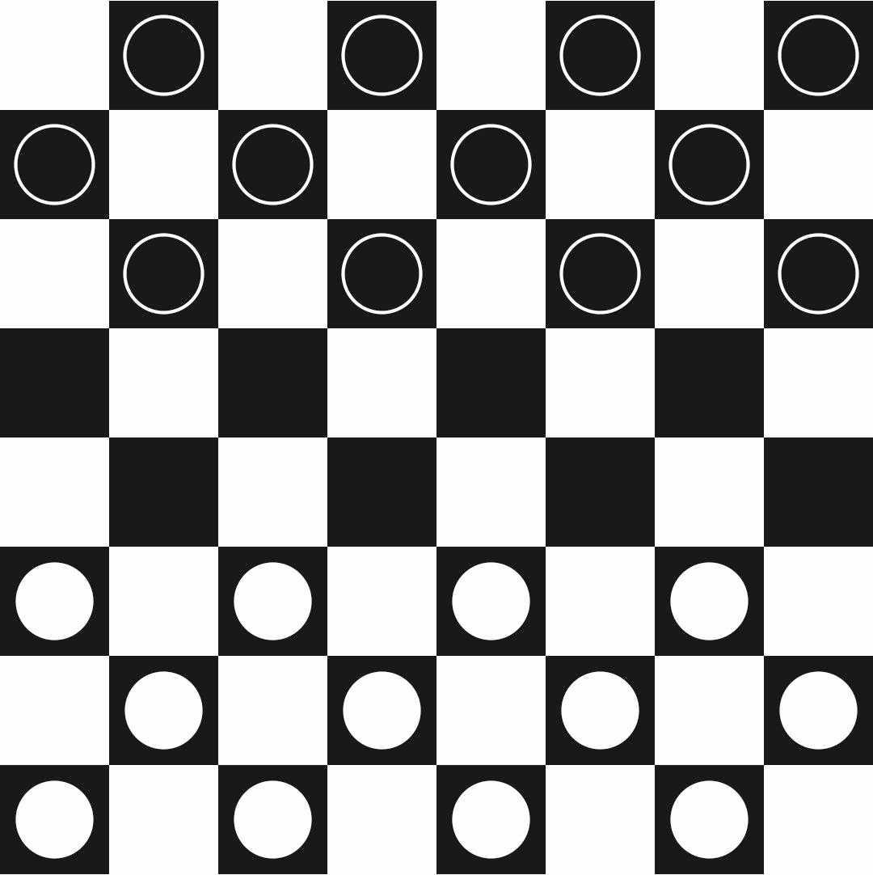
What is Machine Learning?
"Machine learning is the study of computer algorithms that improve automatically through experience and by the use of data." - Google
Improving performance P, at tasks T, based on experience E (Tom M. Mitchell)
Example: Checkers

Slide 4
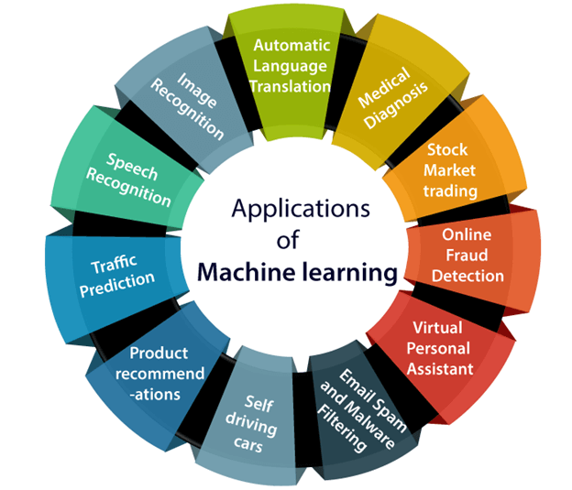
Reasons to study ML
Numerous daily applications
Discover historical influences
Practice AI
SMART Manufacturing
Alerts
Finances
Organization

Slide 5
Methods

Slide 6
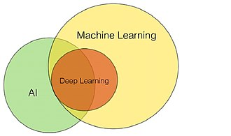
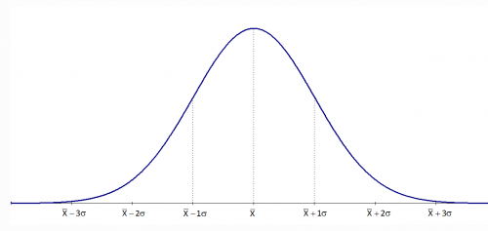
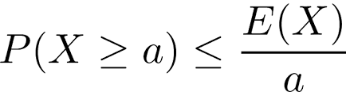
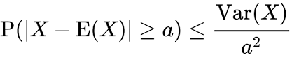

Machine Learning Theory
Generalization vs. Optimization
Generalization: Ideal vs. Estimate
Markov's and Chebyshev's Inequalities
Law of Large Numbers
Chernoff Bounds
Optimization: Training vs. Testing samples
Loss Function: Categorical Crossentropy
Optimizer: Adam – Stochastic Gradient Descent
Validation balance (0.2 - 80% for training and 20% for optimization)
Supervised vs. Unsupervised Learning
Markov's Inequality
Chebyshev's Inequality
Chernoff Bounds

Slide 7
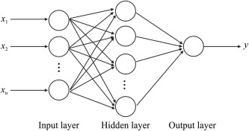
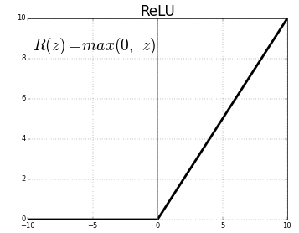

Multilayer Perceptron
Neural Network model
Divided by Input, Output, and Hidden (Deep) Layers
Each neuron contains a bias and activation function
Using rectified linear unit (ReLU) and softmax functions
Softmax Distribution Function
Rectified Linear Function

Slide 8
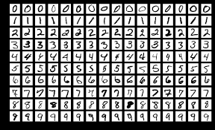
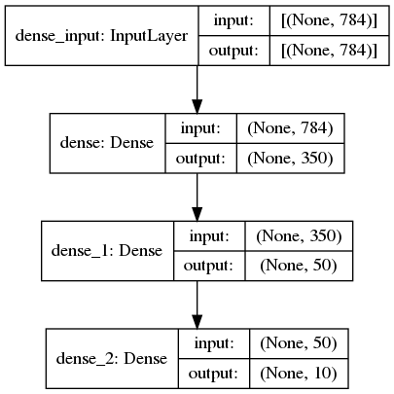
MNIST Dataset
Standardized 60,000 samples of 28x28 pixels
Used Jupyter Python with TensorFlow and Keras Packages
Configurations include model architecture, epochs, and batch size
Model has optimal performance of 97.8% accuracy

Slide 9
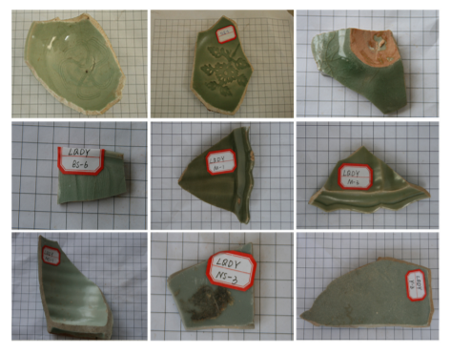
Learning Chinese Celadon
Ziyang He et al. research on ceramics from Longquan and Jingdezhen kilns from 4 eras
Jingdezhen celadon imitation of Longquan explains raw material and firing technology similarities
Energy dispersive X-ray fluorescence (EDXRF) identified chemical composition of celadon body and glaze

Slide 10
Ceramics Data and Approach
Data has 7 classes of ceramics with 17 features of chemical components
Each feature has 88 entries
Normalize the data using Pandas
Convert 7 classes into 7 categorical numbers into binary
Experimented with various nodal shapes and deep layers with MLP
50,000-100,000 epochs with 150 batch size and 0.2 validation split

Slide 11
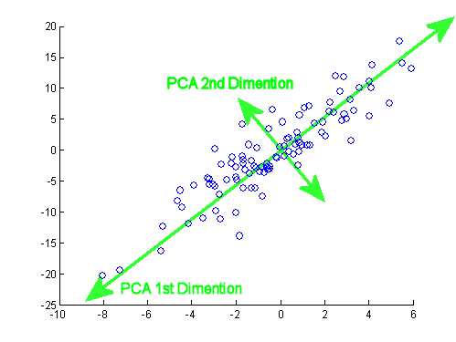
Data Redundancy
PCA – Principal Component Analysis
Determines which features are informative/redundant to test the model
Allows for quicker compilement while losing minimal information to learn
Uses linear algebra (Matrix Multiplication) to find PCA's with datasets of higher dimensions
PC1 is determined by the highest sum of distances between each point's orthogonal projection on the line and the origin. PC2 follows the same rule and is orthogonal to PC1.

Slide 12
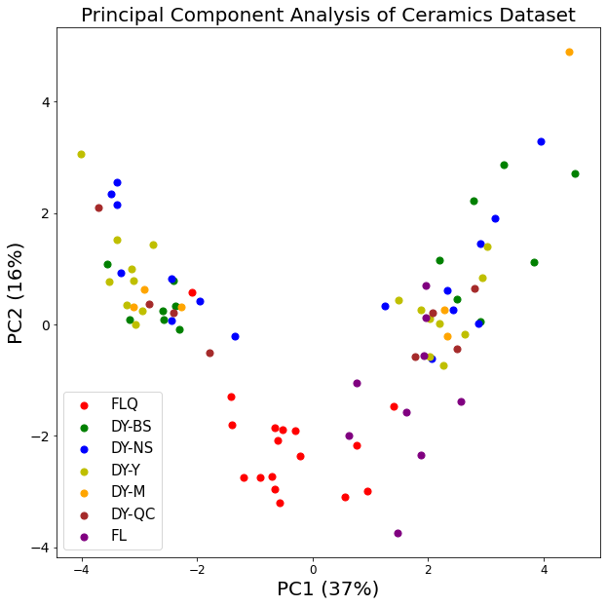
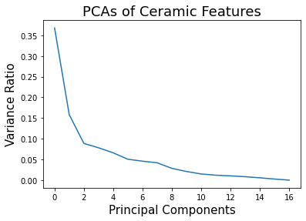
Data Redundancy
2 highest PCA's consists 53% of the data's variation
Blue, Green, Yellow, Brown, and Orange have similar distributions
They're not so different from each other?

Slide 13
Findings

Slide 14
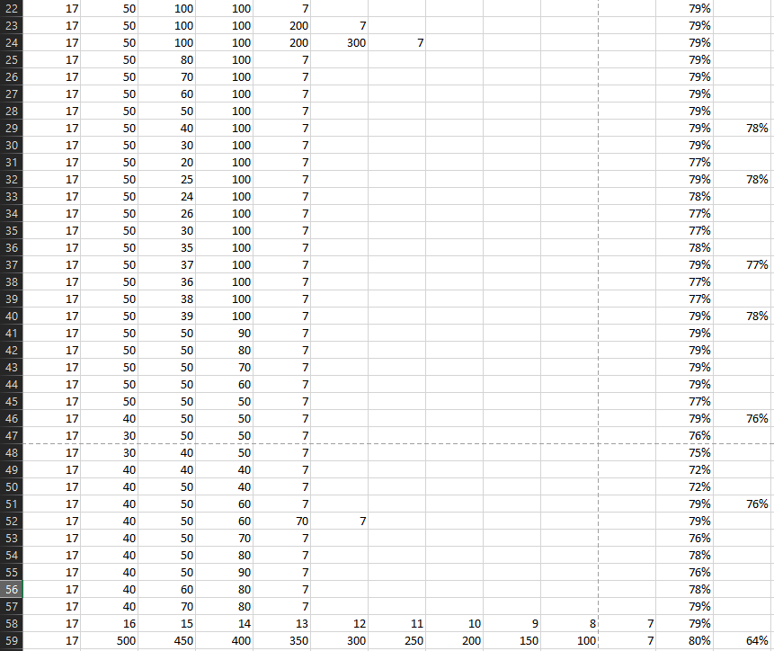

Slide 15
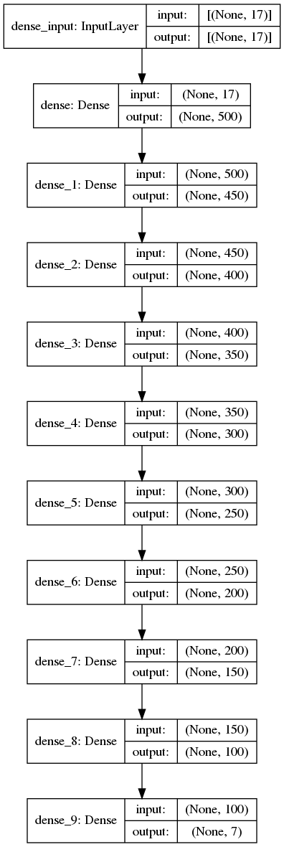
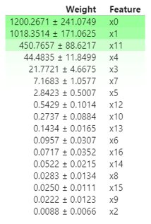
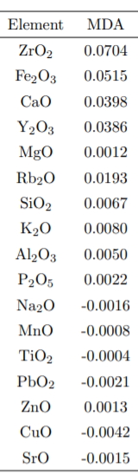
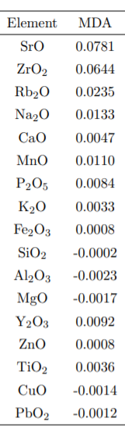
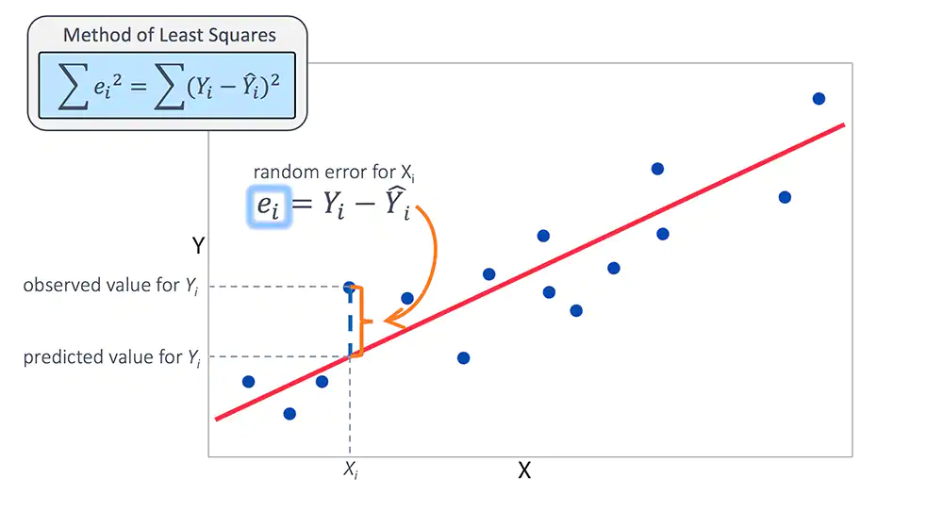
Model and Results
Reached most optimal performance of 80% accuracy
Permutation Importance with Linear Regression Model
Mixed Body Glaze
0 = Al2O3
1 = CaO
2 = CuO
3 = Fe2O3
4 = K2O
5 = MgO
6 = MnO
7 = Na2O
8 = P2O5
9 = PbO2
10 = Rb2O
11 = SiO2
12 = SrO
13 = TiO2
14 = Y2O3
15 = ZnO
16 = ZrO2

Slide 16
Conclusion
Short datasets and simple models with low precision deviate much from the ideal mean
More epochs, nodes and layers produce optimal prediction of models
There will always be lost and new information to learn

Slide 17
Future steps

Slide 18
Progress
Use R's RandomForest for MDA and MDG values
Use a larger dataset for improved optimization and PCA simplicity
Generalize unseen data from today's Chinese kilns
Different ML systems
Decision trees
Support-vector machines
Regression analysis
Bayesian networks
Genetic algorithms

Slide 19


Acknowledgements
Thank you to Professor Ali Shokoufandeh, Professor Masoud Soroush, Daniel Schwartz, NSF, and Drexel University's SMREU Program

Slide 20
References
Chris; L, A. How to create an mlp classifier with TensorFlow 2 and Keras https://www.machinecurve.com/index.php/2019/07/27/how-to-create-a-basic-mlp-classifier-with-the-keras-sequential-api/ (accessed Aug 2, 2021).
Goodfellow, I., Y. Bengio, and A. Courville (2016), Deep Learning, MIT Press, http://www.deeplearningbook.org.
He, Z., Zhang, M., & Zhang, H. (2016). Data-driven research on chemical features of Jingdezhen and Longquan celadon by energy dispersive X-ray fluorescence. Ceramics International, 42(4), 5123-5129.
Mitchell, T. M. Introduction. In Machine learning; McGraw-Hill, 1997.
THE MNIST database http://yann.lecun.com/exdb/mnist/ (accessed Aug 2, 2021).

