Slide 1
Book1
File created on: 6/28/20 12:50:04 PM PDT

Slide 2
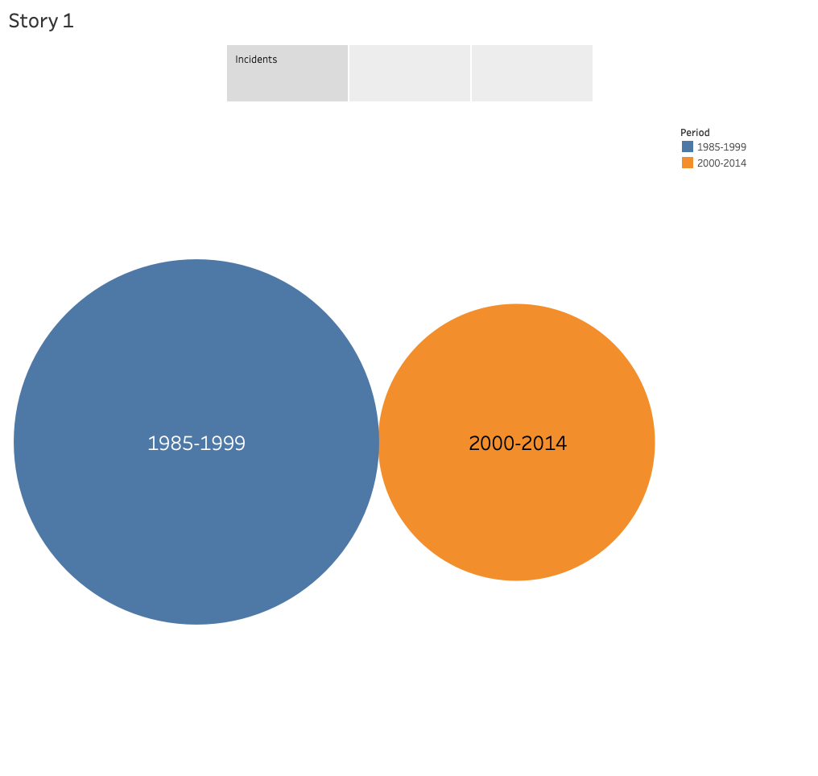

Slide 3
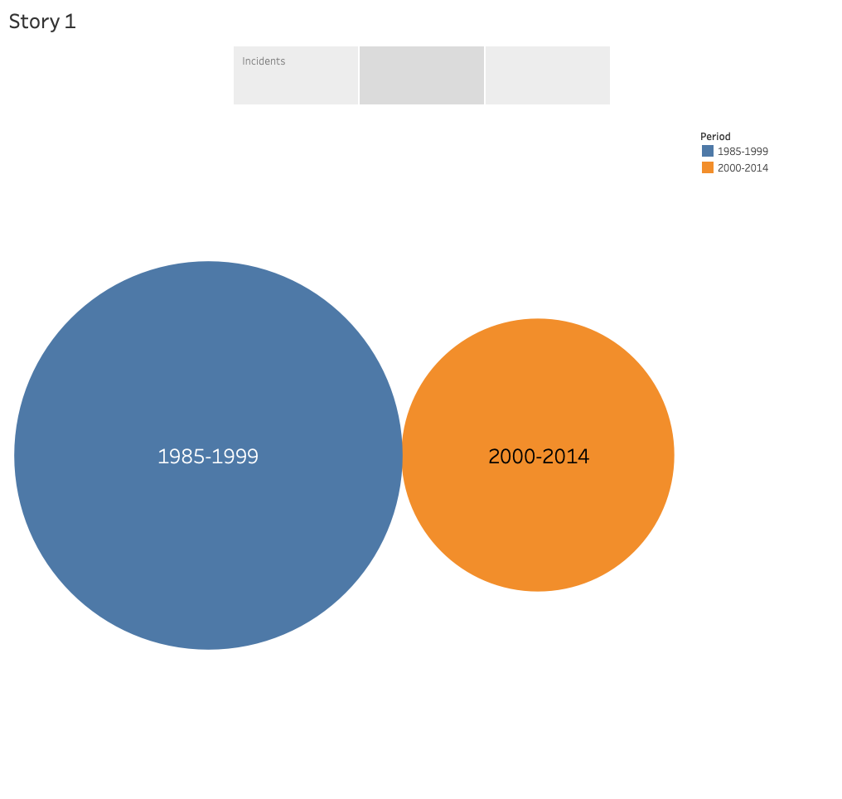

Slide 4
