Slide 1
ExecutiveSummary
File created on: 6/28/20 2:29:44 PM PDT

Slide 2
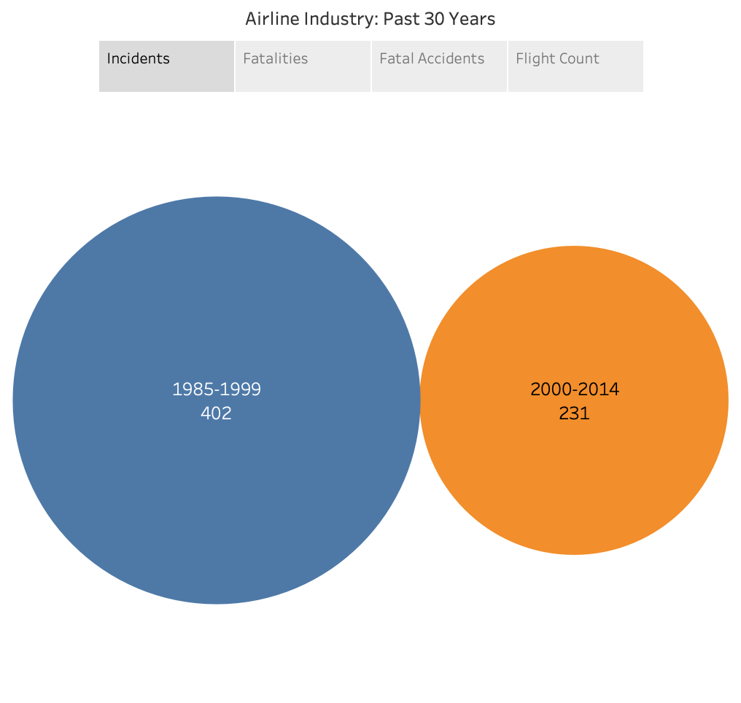

Slide 3
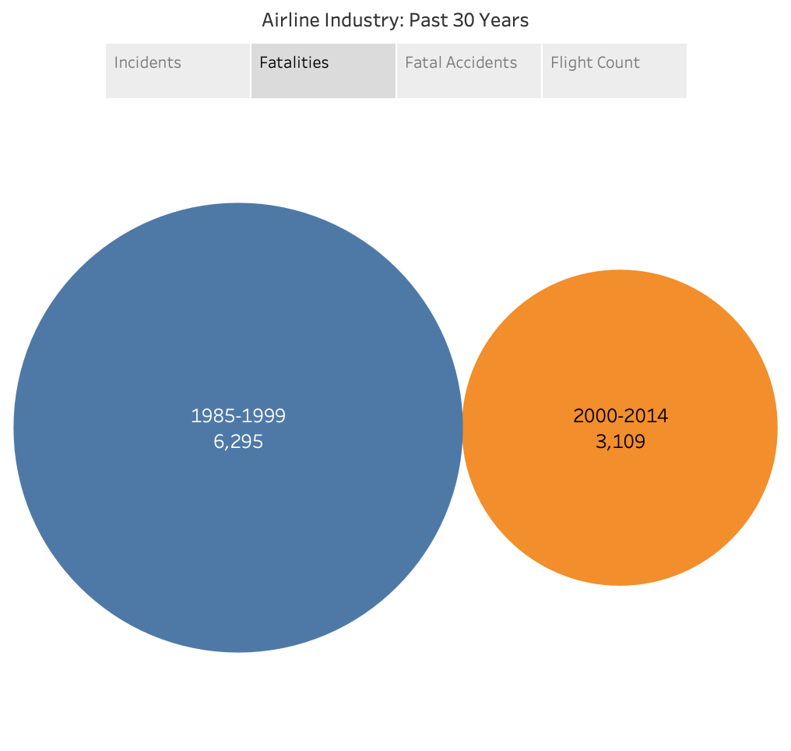

Slide 4
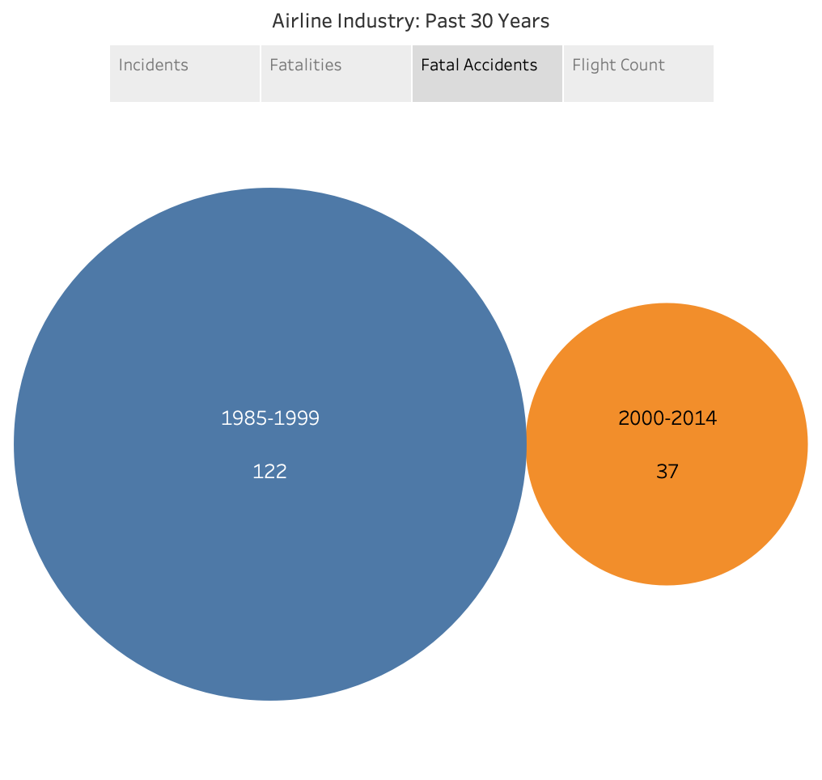

Slide 5
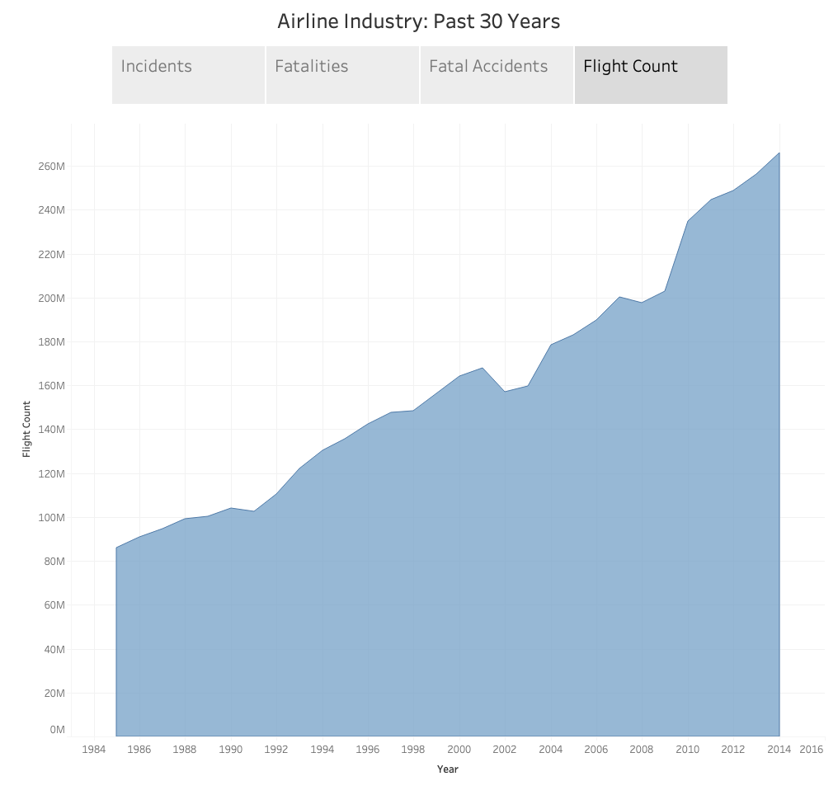

Slide 6
Summary
Over the past 30 years, flying has become safer
Comparing 1985-1999 to 2000-2014:
Incidents are 66% less likely
Fatalities are 71% less likely
Fatal Accidents are 82% less likely

Slide 7
References
Air Transport, Registered Carrier Departures Worldwide | Data. https://data.worldbank.org/indicator/IS.AIR.DPRT?end=2014&start=1985. Accessed 28 June 2020.

