Slide 1
Bluetooth Travel Sensors Austin, TX
Brandon Sams

Slide 2
Overview
Austin, TX has Bluetooth sensors all over the city
Tracks movement of Bluetooth devices
Able to infer which are most likely vehicles
Data is available from here in two formats:
API
.csv file
Traffic Match Summary Records will be the table of focus
Broken into 15 minute intervals
Filtered down to vehicles

Slide 3
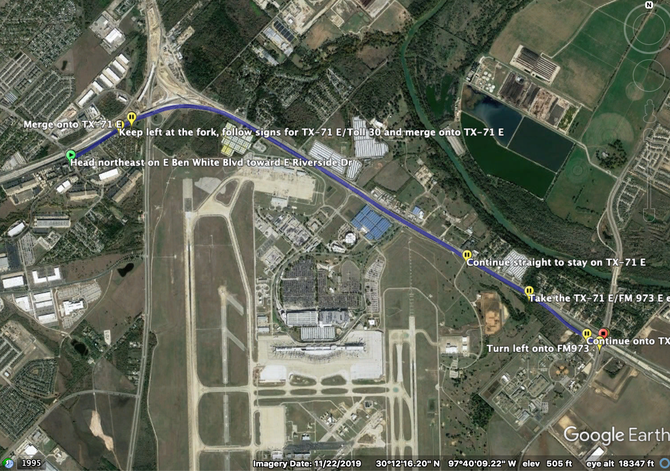
Pick a segment to Focus on

Slide 4
Pick a segment for analysis
Segment between Ben White/Riverside and Ben White/FM 973
Length: 3.63 Miles
Variations in Traffic Flow
Large volume of Traffic Flow
Main Road

Slide 5
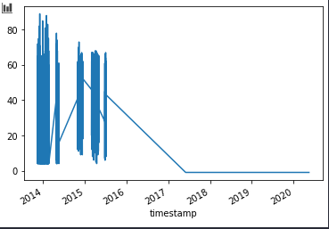
Choosing a Data Source: Plot Speed Records
From API Query:
From CSV file:

Slide 6
Large Gaps in Data
When plotting data such as speed, we see that this dataset has not been maintained for some time
Most recent data has a speed of -1, which appears to be the null value
There was a period from early 2014 where the data seems consistent
It is not clear if this lack of data is due to the filtering not being done on the data recently, or if the data is not being collected anymore

