Slide 1
SQL – Part 1
IS201 - 27 Jan 2020

Slide 2
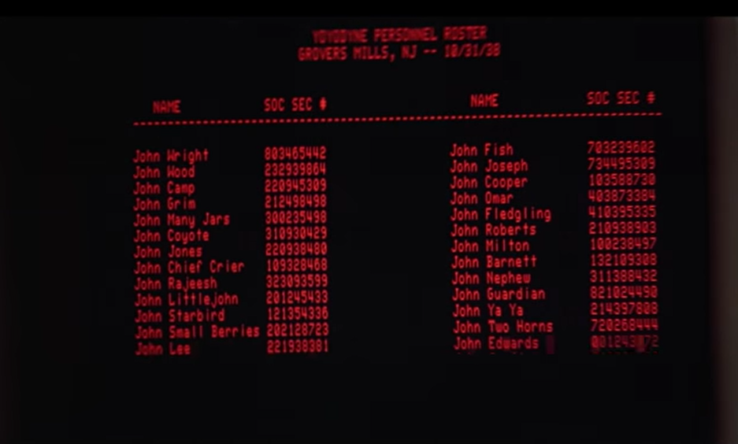

Slide 3
Announcements
ER Diagram Quiz Due Today at 11:59
Do the whole Lesson 3.3 – spend some time on it!
SQL Project Due Friday
Start early. This will take you hours and you will probably need help from the TAs.
Midterm on Data Storage and Extraction due Saturday (all of this info is in MyEducator)
A Big one – you have 2 hours 30 minutes to complete
Data Quality: 6 Questions, 24 points
ERDs: 8 Questions, 32 points
SQL Multiple Choice: 8 Questions, 32 points
SQL Skills (written): 9 Questions, 72 points
150 minutes / 31 questions = 4.8 minutes per question. SQL will take longer than multiple choice.

Slide 4
Exam Preparation
The exam is open-book and open WWW (web). But you cannot get help from another person.
Some of the questions will require you to upload a data set into data.world and to perform queries like the ones we will be doing in class today!
The best practice will be the exercises in the lesson (follow, along, don’t just watch the videos), the project (Due Friday), and the extra practice sets.
Jump ahead to unit 3.4 (Midterm Exam) in MyEducator TODAY and read the preparatory material so you know what to expect.

Slide 5

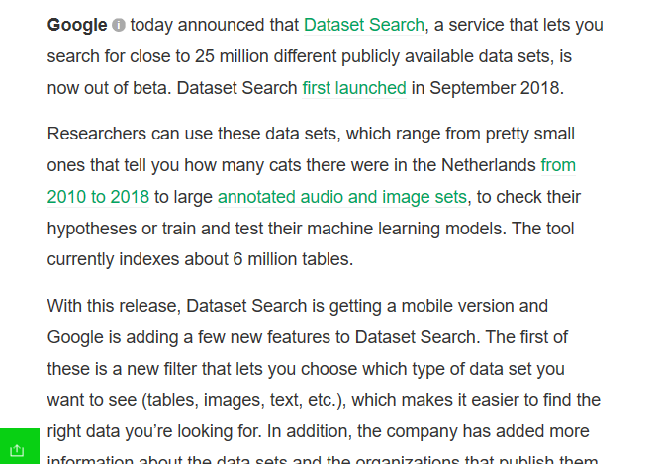


https://techcrunch.com/2020/01/23/googles-dataset-search-comes-out-of-beta/

Slide 6
Preparing a Data Set on data.world
Create an account on data.world. You’ll be using it a lot!
Create a new dataset
Upload the dataset - .csv and .xlsx are supported
Select the … “More” menu.
Select “Query”

Slide 7
SQL Queries
SELECT – FROM
WHERE
ORDER BY
GROUP BY, MAX(), MIN(), AVG()
COUNT(), SUM()
Other filters for WHERE: < > = != BETWEEN LIKE

Slide 8
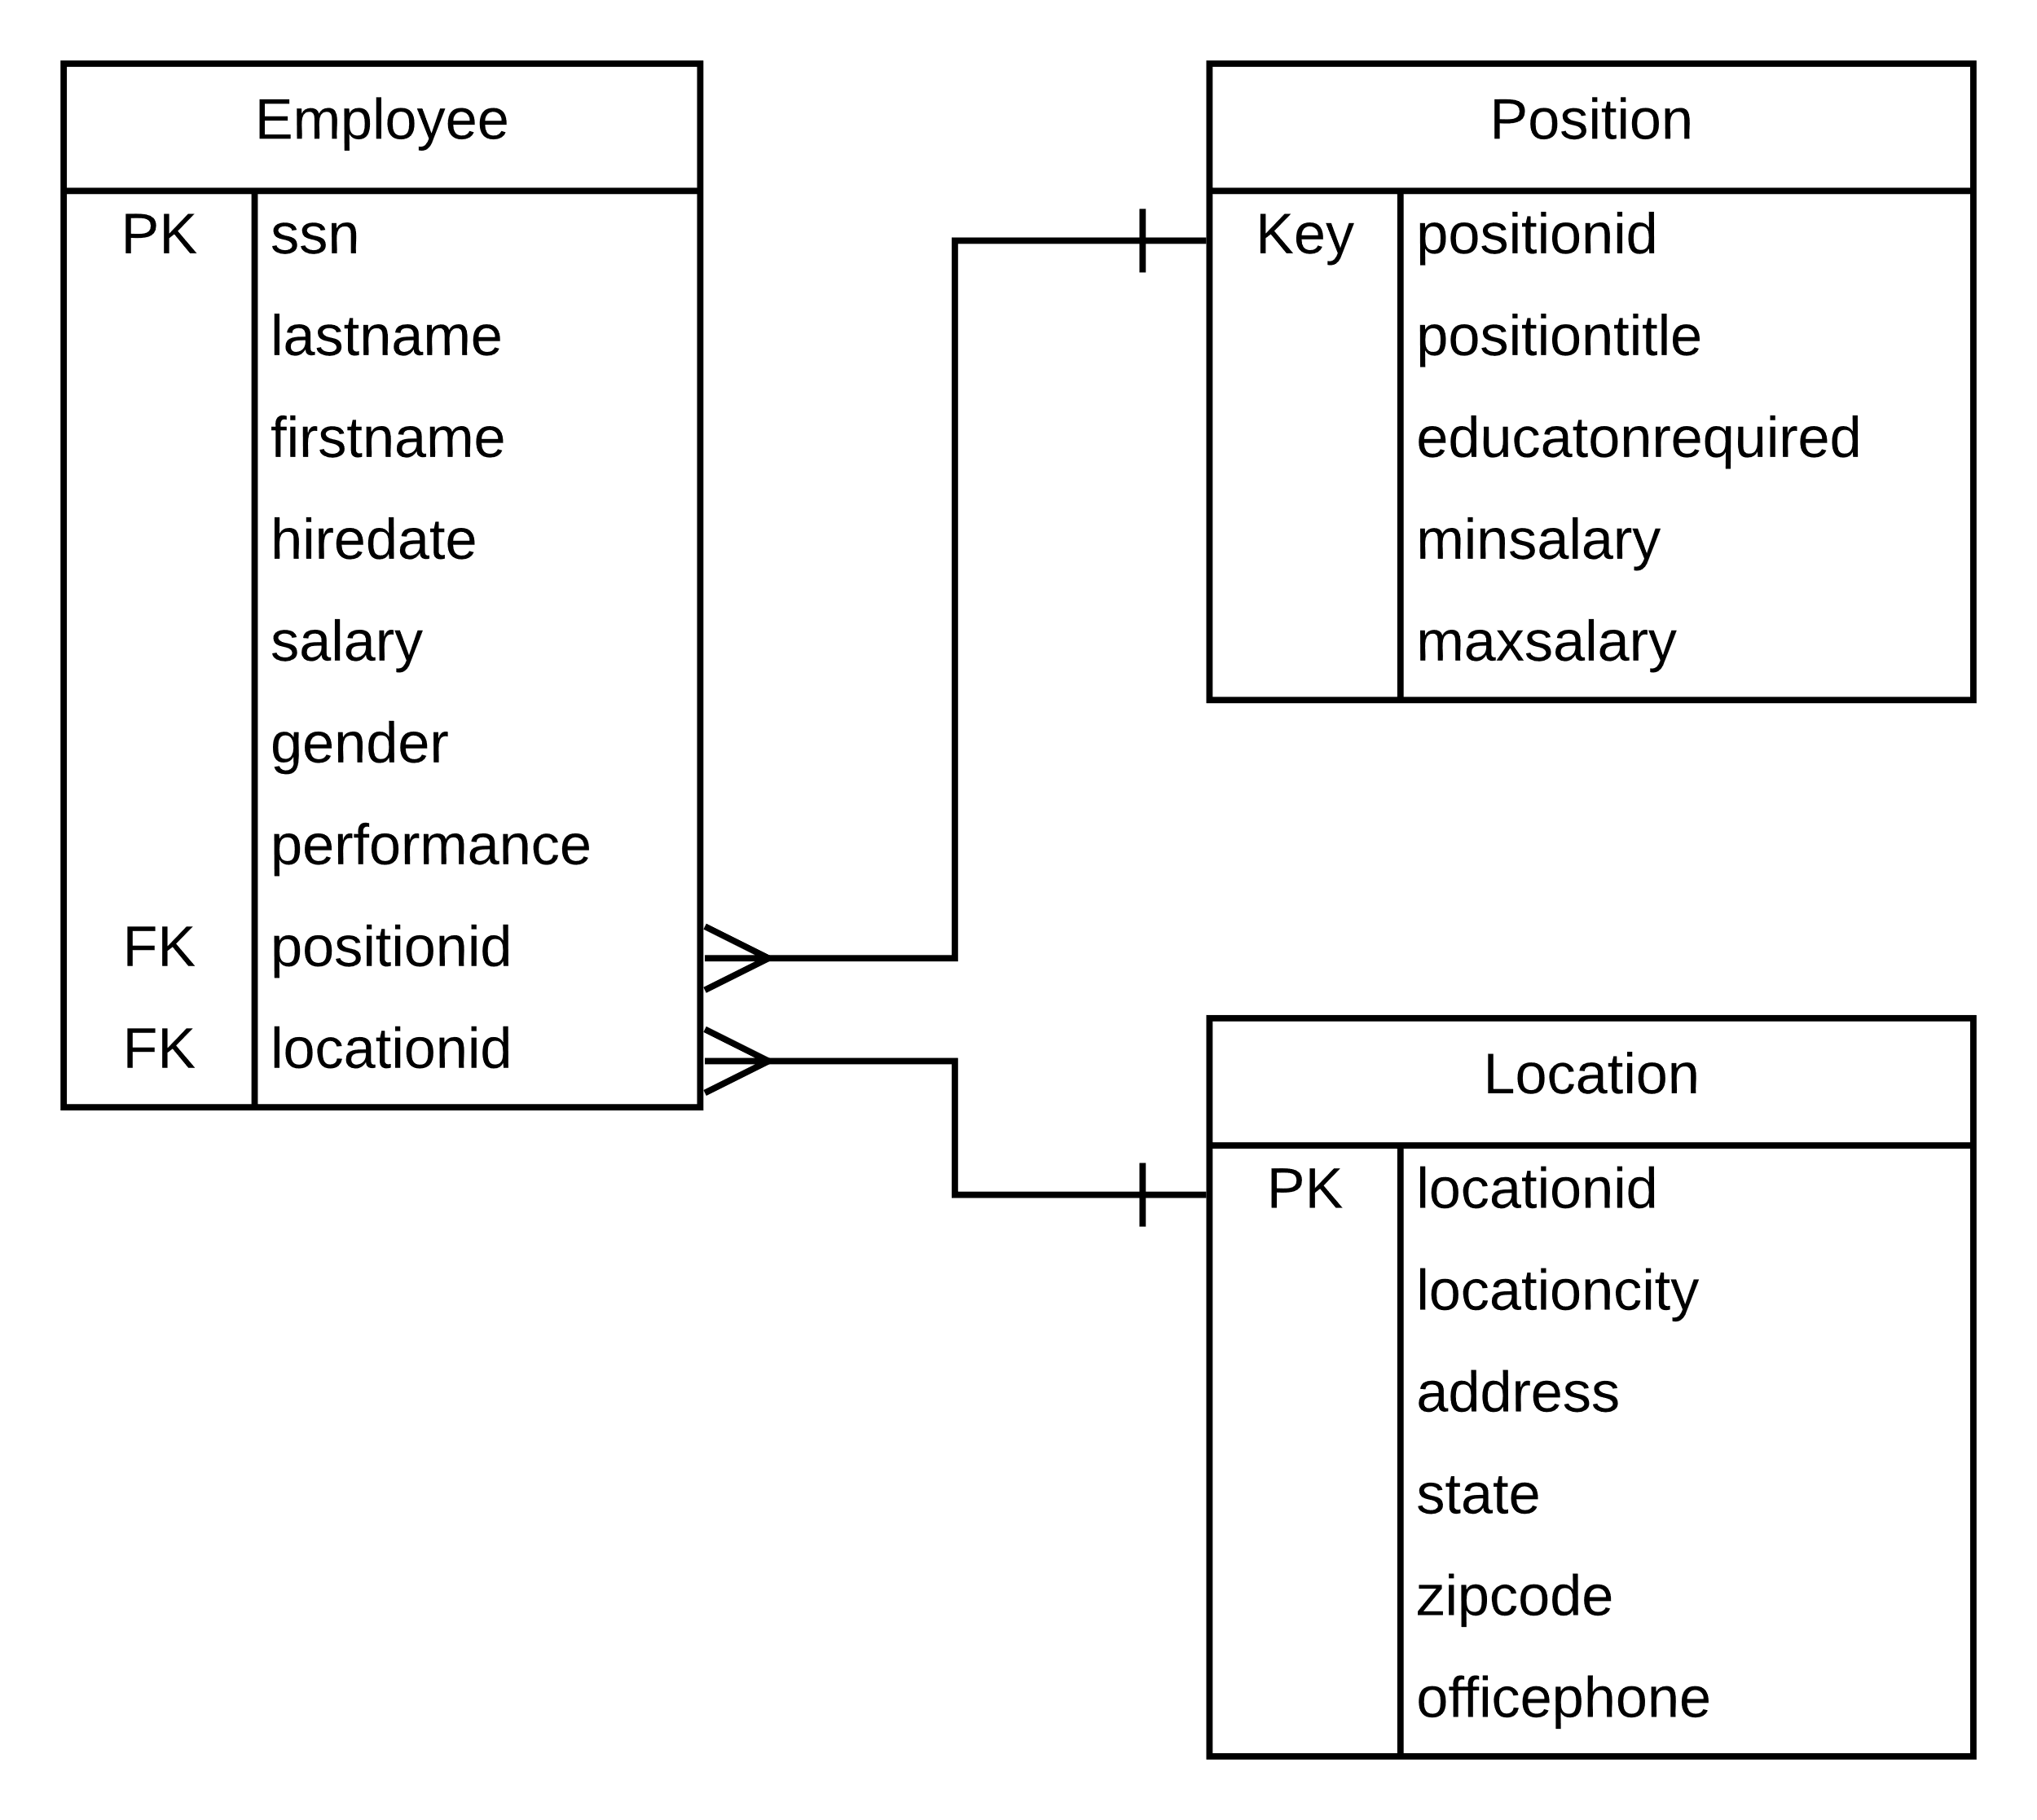
Goldstar ERD

Slide 9
More SQL (if we have time)

