Slide 1
Augmented Reality, Conversational Interfaces, AI as a Service, Digital Twins and More
iNACOL 2018
Brandt Redd
http://BrandtRedd.org
Session Links:
https://brandtredd.org/inacol2018.html
https://inacolsymposium2018.zerista.com/event/member/515270

Slide 2
Learning Objectives
Develop or increase understanding of at least two emerging technologies such as Augmented Reality, Conversational Interfaces, AI as a Service, Digital Twins, and others.
Understand, through in-session discussion and debate, how one or more of these technologies will impact your own learning or teaching environment.
Apply a strategy for researching emerging technologies and evaluating them in behalf of your learning institution.

Slide 3
Sources
Horizon Report (Formerly New Media Foundation, Now Educause) https://library.educause.edu/resources/2018/8/2018-nmc-horizon-report
Gartner Top 10 Strategic Technology Trends for 2018 https://www.gartner.com/smarterwithgartner/gartner-top-10-strategic-technology-trends-for-2018
Forbes 7 Technology Trends That Will Dominate 2918 https://www.forbes.com/sites/jaysondemers/2017/12/30/7-technology-trends-that-will-dominate-2018/#51c38b6d57d7

Slide 4
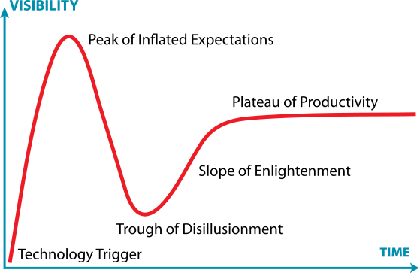
Technology Hype Cycle
Source: Wikipedia – Gartner Hype Cycle

Slide 5
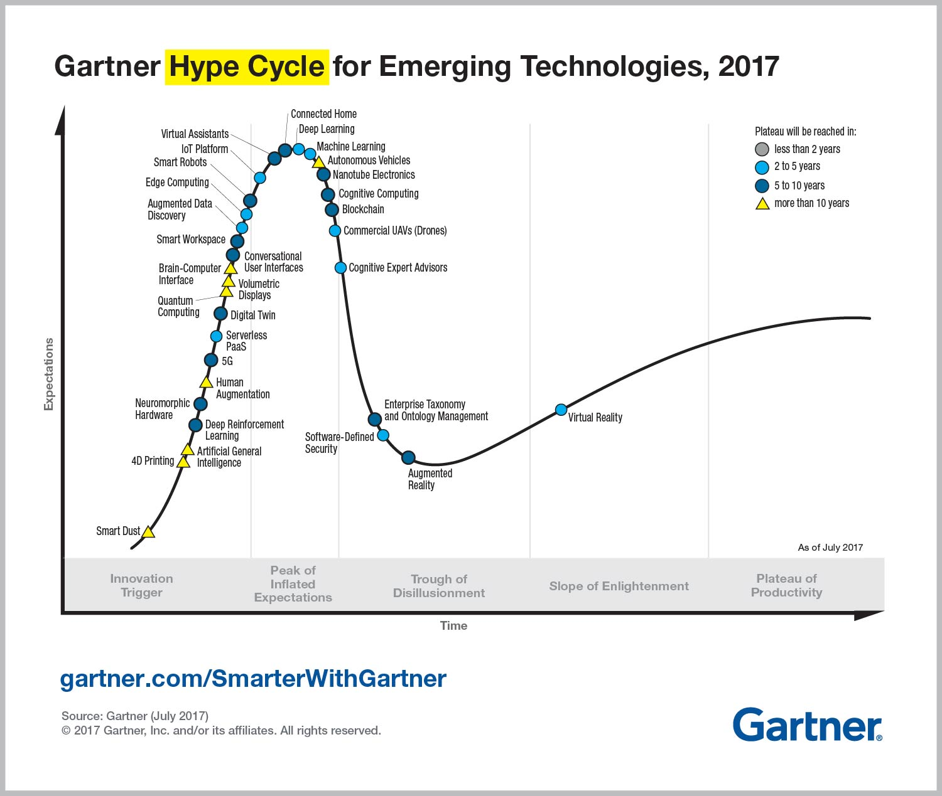
Blockchain
Cognitive Expert Advisors
Digital Twin
Augmented Reality

Slide 6
Evaluating Technology
Impact – must result in improved student learning.
Relevant
Realistic
Ready
Carlos Moreno: “Unapologetically, Relentlessly, Student-Centered”

Slide 7
Agenda
AI as a Service
Conversational Interfaces
Augmented Reality
Digital Twins
Notes:
I chose these because they’re getting press, not because they passed any sort of evaluation.
Our process, in this session, will be to practice evaluating these. Your results may vary according to your institutional needs.

Slide 8
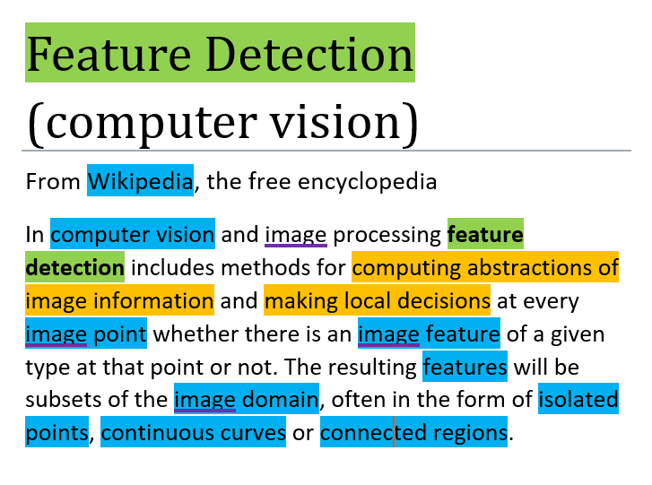
AI As a Service
Machine Learning
Voice Recognition
Assessment Scoring
Predictive Analytics
Cognitive Computing
Image Recognition / Computer Vision
Natural Language Interpretation
Feature Recognition
Grammar and Content Analysis and Feedback
Assessment Composition
Optimization Systems
Analyze large data sets
Detect sensitive features
Optimize for outcome
Digital Assistants
Notes:
Examples: Face recognition and matching, license plate reading.
Machine Learning uses pre-scored content. A training set is used to train the AI engine and then a validation set is used to see if the training worked.
Most machine learning systems result in effective algorithms but it is difficult to tell how they work. And they may be sensitive to a correlate rather than the actual feature. For example, essays may be scored according to how may multi-syllabic words are used.
Pre-processing to detect features may make AI more effective and easier to interpret how it functions.
Optimization

Slide 9
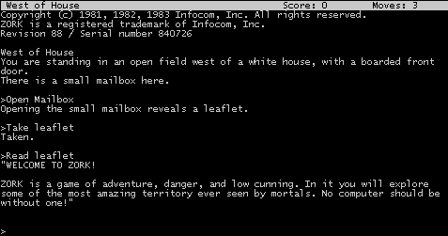
Conversational Interfaces
Examples
Amazon Alexa
Apple Siri
Microsoft Cortana
“Hey Google”
WeChat Chatbots (China)
Zork
In Education
Intelligent Tutoring Systems (ITS)

Slide 10
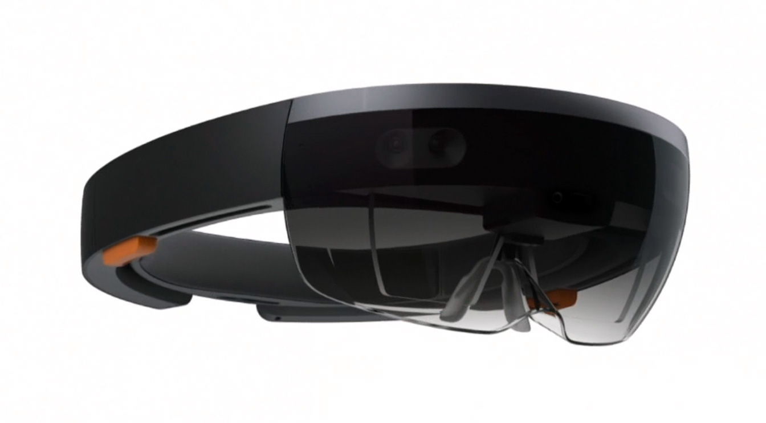
Augmented Reality
We can also include virtual reality.
Adding information or items to our view of the real world.
Notes:
Relevant, Realistic, Ready

Slide 11
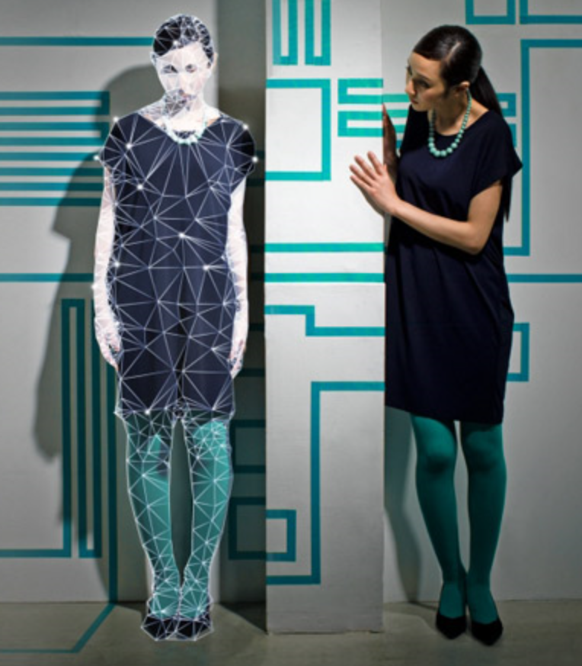
Digital Twins
A digital representation of a real-world object.
In education, a “student model” indicating what we know about a student’s competencies.
Security and Privacy Implications

Slide 12
A Data View of Personalized Learning
The intersection between data about students and data about content.
“Personalized learning occurs at the intersection between data about students and data about content.
To work, both must be aligned to standards.

Slide 13
Review
Trend Watchers: Gartner, Forbes, CNet, EdWeek, etc.
Rubric: Relevant, Realistic, Ready
Theory of learning enhancement must precede theory of technology innovation.

Slide 14
Q&A
Resources & References
https://brandtredd.org
https://brandtredd.org/inacol2018.html
https://inacolsymposium2018.zerista.com/event/ member/515270
https://library.educause.edu/resources/2018/8/2018-nmc-horizon-report
https://www.gartner.com/smarterwithgartner/gartner-top-10-strategic-technology-trends-for-2018
https://www.forbes.com/sites/jaysondemers/2017/12/30/7-technology-trends-that-will-dominate-2018/#51c38b6d57d7

