Slide 1
Web Development Bootstrap, Embedding, and Fun with HTML
2020-04-08 – IS201 - Prof Redd
To follow along on today’s lesson, download the “Business Casual” bootstrap theme from:
https://startbootstrap.com/themes/business-casual/
“I invite all, including those not of our faith, to fast and pray on Good Friday, April 10, that the present pandemic may be controlled, caregivers protected, the economy strengthened and life normalized.” -President Russel M. Nelson, https://www.churchofjesuschrist.org/church/news/president-nelson-asks-latter-day-saints-to-unite-our-faith-once-again-in-fast-on-good-friday

Slide 2
Announcements (All Repeats)
Digital Dialog
Share your website ideas there.
A few have participated. Contributions count toward extra credit.
Got your domain names? (MyEducator 6.6)
Only two more assignments
WebDev Walkthrough – Due Today, April 8
Web Development Final Project – Due Date Extended to April 18
The final project is also your final exam!
Accounts for 15% of your final grade.
The assignment is to build a personal resume site. If you want to do some other, professional, site. Please get my permission in advance.
Monday will be a review of all you need to know for the final project.

Slide 3
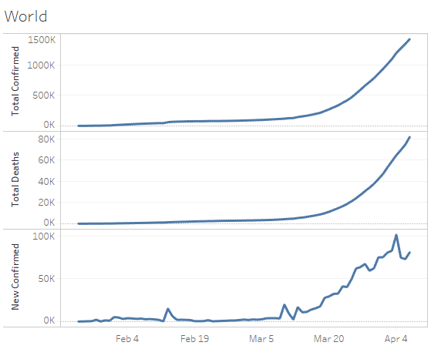
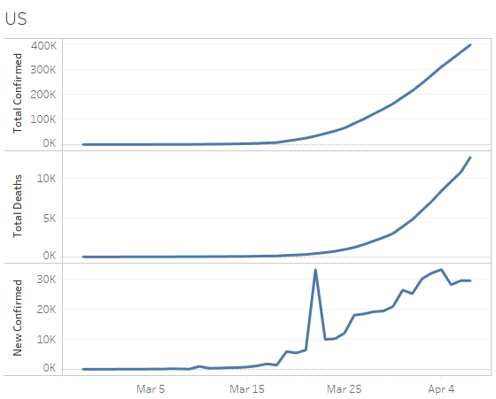
COVID-19 Data Update
https://brandtredd.org/COVID-19/DataInfo

Slide 4
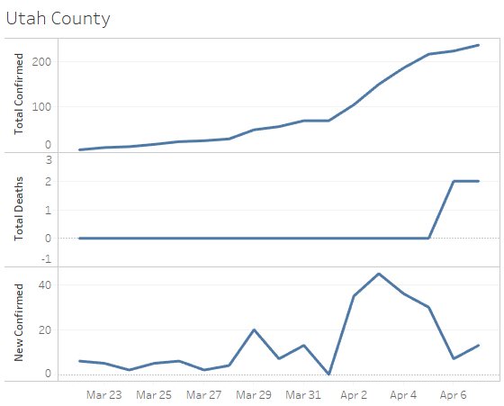
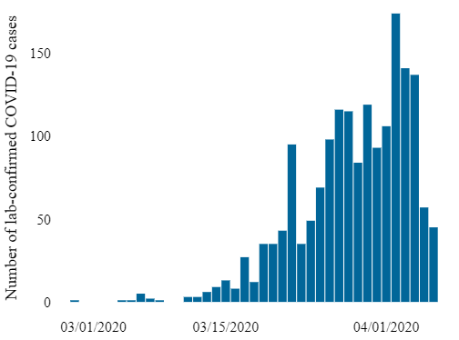
Utah COVID-19
State of Utah
New Cases
https://coronavirus.utah.gov/case-counts/

Slide 5
Today’s Agenda
Bootstrap Themes
Embedding Tableau
Embedding Other Stuff
Fun with HTML in other contexts

Slide 6
Bootstrap Themes Approved for your Final Project
Clean Blog https://startbootstrap.com/themes/clean-blog/
Business Casual https://startbootstrap.com/themes/business-casual/

