Slide 1
Entity-Relationship Diagramming
IS 201
Notes:
Finish Goldstar and/or NFL ERD if you couldn’t last time.
Has=humor, not typo

Slide 2
Announcements
No quiz today – ERD quiz on Monday. You are strongly encouraged to do it today.
Project due next Friday (31 January)
Midterm Exam due next Saturday (1 February)
Check the schedule on LearningSuite regularly – there are tips that will help you be prepared for what’s coming!

Slide 3
Sample: Comprehensive Learner Record
US DoD Advanced Distributed Learning Lab (US-ADL)
IMS Global
US Chamber of Commerce T3 Innovation Network
IEEE Learning Technology Standards Committee

Slide 4
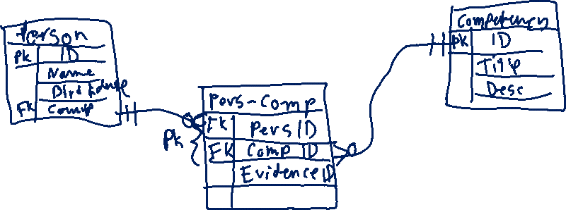
Comprehensive Learner Record

Slide 5
Building Models
Why are models useful?
Less cognitive load
Picture worth 1000 words
Entity relationship diagram (ERD) is one of most popular approaches to data modeling
Shows entities, attributes, and relationships among entities

Slide 6

Diagramming Attributes
Entity Name
Order
OrderNo(PK)
OrderDate
Primary Key
Attributes
M
∞
Cardinality
1
Relationship
Customer
CustomerNo(PK)
CustomerName
CustomerPhone

Slide 7
Attributes
Characteristics that describe entities
Customer: Number, Name, Phone
Vendor: Number, Name, Phone
Order: Number, Date
Item: Number, Description, Price
Customer
CustomerNo(PK)
CustomerName
CustomerPhone

Slide 8
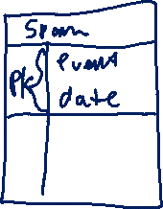
Primary Keys
Primary key (PK) is an attribute or set of attributes that can be used to identify individual instances of an entity
The value of a primary key is unique for each instance
What are your primary keys?
SSN, Fingerprint, netID, Student ID, email, etc.

Slide 9
Types of Primary Keys
Artificial Key – no real meaning, just unique ID (internal use)
PositionID, PlayerID, TeamID, CoachID
e.g., 1, 2, 3, 4 etc.
Semantic Key – describes or defines entity (also external use)
Team Name, Team Location
e.g., Jazz, Utah, james.eric.gaskin@gmail.com, (801) 636-2985
Composite Key – multiple attributes
Happens in relationship tables produced from M:M
e.g., IS201-001
Simple Key – single attribute

Slide 10
Cardinality
Cardinality is the maximum number of instances of one entity for a single instance of the related entity
e.g. Customers to orders (just hypothetical)
One Order is ordered by (at most) One Customer AND One Customer can order (at most) Many Orders
One Order is ordered by (at most) One Customer AND One Customer can order (at most) One Order
One Customer can order (at most) Many Orders AND One Order can be ordered by (at most) Many Customers
1:M
1:1
M:M

Slide 11
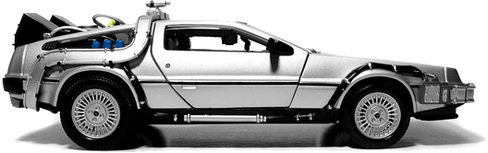
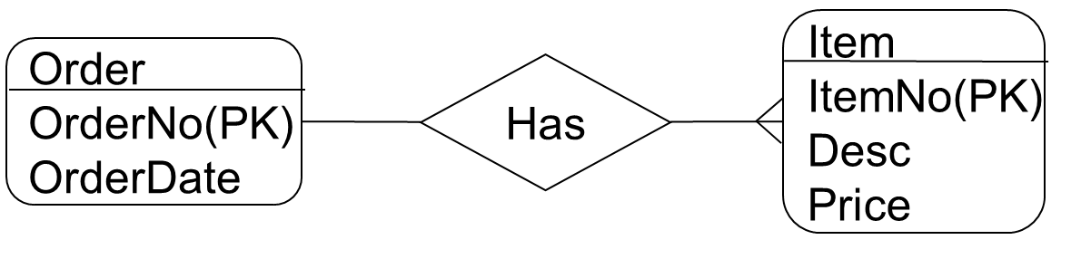
Serializable vs. non-serializable
Do you need to keep track of specific products?
Serializable (has own ID number, transferable)
Cars, guns, etc.
Non-serializable (no ID, don’t care if transferred)
Toilet paper, food, most things you find at grocery store
How would an ERD differ for these two types of products
Serialized
Virtual
Notes:
For serialized items, they can belong to at most, a single order. However, with general or virtual items, they can belong to at most, many orders.

Slide 12
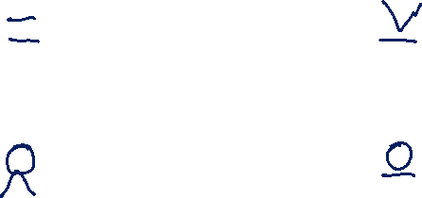
Cardinality Exercise (assume serialized)
Customer
Item
Order
Order
Notes:
Remember to assume instances, rather than generals. So, for Customer, this is referring to customer #27 (Joe Schmoe), rather than customers at large. For item, this means I am talking about a specific item (e.g., that bottle of shampoo, not the one next to it) rather than that type of shampoo (Head ‘n Shoulders). That particular bottle of shampoo can belong to at most, only one order.

Slide 13
Cardinality Exercise Solution
Customer
Item
Order
Order
Notes:
There are exceptions to this set of cardinalities, for example, in realestate. More than one customer can purchase the same home at the same time. – it’s called co-signing.

Slide 14
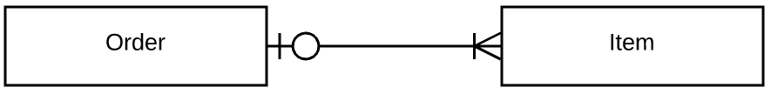
Minimum Cardinalities
Sometimes it is necessary to include minimum cardinalities, particularly in optional relationships.
This ERD says, 1 order must have at least one item (min), but may have many items (max), AND one item can belong to zero orders (min), but can only belong to at most 1 order (max). (This implies serialized items.)
When in doubt, include minimum cardinalities

Slide 15
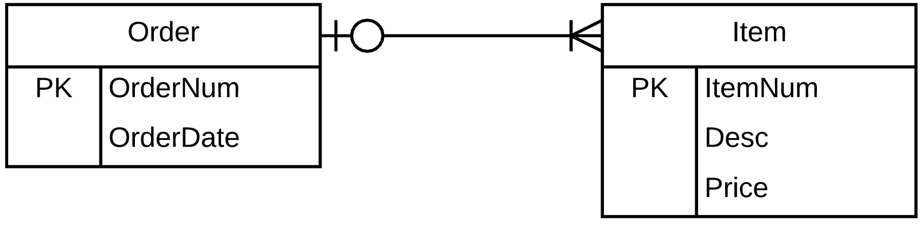
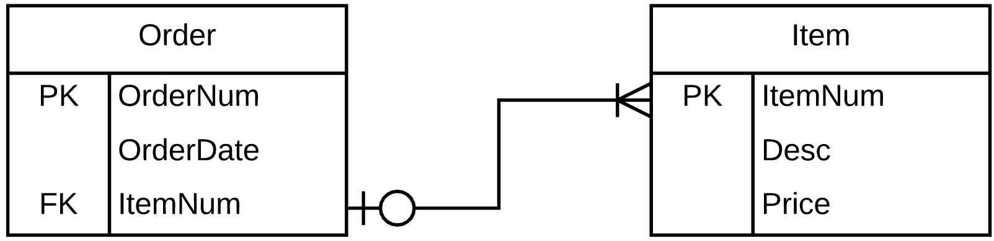
Simple, expanded, & full view
Simple
Expanded
Full View
Notes:
Simple is just the entities connected with cardinalities
Expanded includes attributes, including primary keys and cardinalities
Full includes foreign keys directly connected to primary keys
(assuming serialized items for these ERDs)

Slide 16
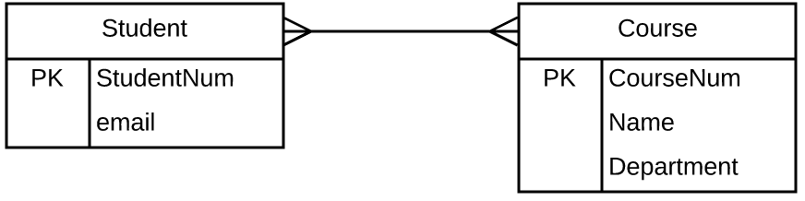
Map M:M
For M:M relationships
Create new table with both names hyphenated, or using the name of the relationship between the two entities
e.g., Student-Course
Columns of the table are the attributes of the relationship (if any unique)
Primary key of the new table includes the primary keys of all participating entities

Slide 17
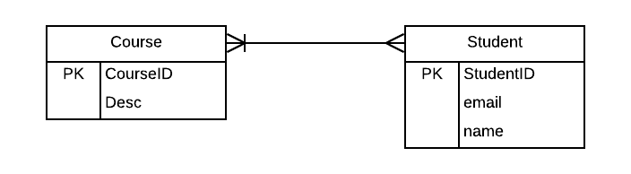
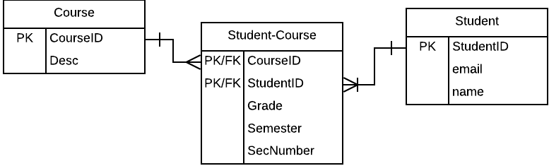
M:M Example
Notes:
PK/FK for both

Slide 18
Map Non-M:M Relationships
For each relationship in which one side’s cardinality is 1 and the other is any cardinality (1 or M), you will use the primary key of one of the entities to create a new column in the other table:
if the cardinality is 1:M, create the new column in the table on the M side (the primary key of the 1 side becomes a foreign key in the M side)
if the cardinality is 1:1, check to see if there is optional participation on one side; if so, create the new column in the table on the optional side (the primary key of the required side becomes a foreign key in the optional side)

Slide 19
Complicated relationship…
We have an optional side and a many side. So, which one gets the foreign key???
Many > Optional > 1
Notes:
This should only occur in a serialized scenario. In such a case, the many side gets the foreign key. This means though, that the item may have an empty order field until it is purchased. This also implies that you want to keep track of that item after it is purchased (this is true for all serialized items).

Slide 20

M:M example (you make full ERD)
A player always has a position, but may have multiple positions. A position is always filled by a player, but may be filled by multiple players. Players have an ID, Name, Height, and Weight. Positions have a Name and distinction of Offence/Defense. A player in a position has a string associated with that position.
Notes:
Goldstar already did 1:M, so we won’t do that again.

Slide 21
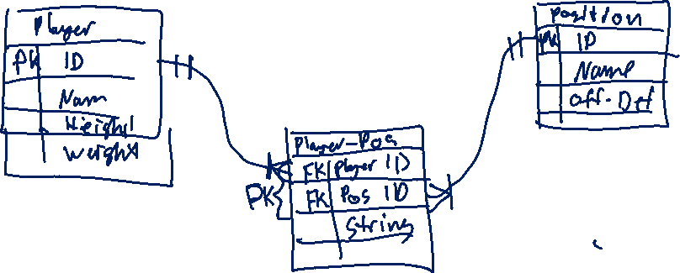

Slide 22
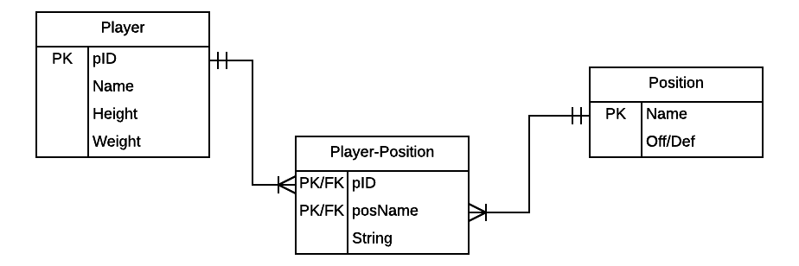
M:M Solution

Slide 23
In-Class Practice Cases
Learning Suite – Content - 2020-01-22 Practice Cases
Or: http://bit.ly/2tyEfjR

Slide 24
1:1 Example (you make full ERD)
Every team has a head coach, and only one head coach. Every head coach that we record in our database is in charge of only one team. We want to record the head coach’s ID, start date, first name and last name. We want to record the team’s name, mascot, and city.

Slide 25
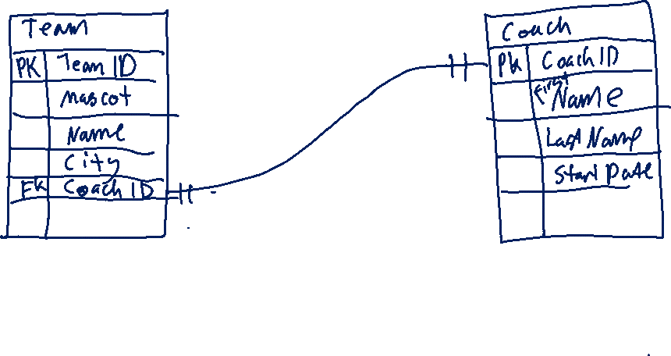
1:1

Slide 26
1:Optional (you make simple and full ERD)
Every player is eligible for a scholarship, but many do not receive them. Every scholarship exists in the database, with an amount associated with it, regardless of whether the scholarship has been awarded. We want to record the player’s ID, name, height, and weight. In addition to the amount each scholarship has an ID, expiration, start date, and a minimum GPA requirement.

Slide 27
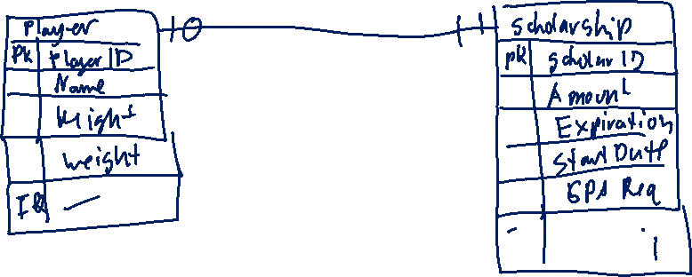
1:Optional

Slide 28
Practice Case – Book of Life LLC.
Book of Life, LLC (“BoL”) has decided to start using databases to track its many clients. Each of their clients either has, had, or will have a mortal body. That mortal body has a birthdate, expiration date, and name. While in the mortal body, clients are prone to commit many sins, and every sin is committed by at least one client. At the end of the client’s mortal engagement, they must return to BoL’s offices to review BoL’s records on their mortal life. BoL would like to track the client’s name (which may differ from the name of the mortal body) and gender (which is eternal); the type and severity of each sin, as well as whether a particular sin has been resolved properly.

Slide 29
Book of Life

Slide 30
Practice Case – Ranch ERD
Each ranch has many livestock. Livestock belong to a single ranch at any given time. Each livestock is tagged with at least one tag, but each tag only ever belongs to a single livestock at a time. Each ranch usually has a ranch manager, but not always. Every ranch manager only manages one ranch at a time. Every ranch has at least one ranch hand (worker), and each ranch hand has the option to work at multiple ranches. Ranch hands have a maximum allowed hours and an hourly rate that differs from ranch to ranch. The database needs to track the following: Ranch license, ranch address, ranch type; ranch manager name and phone; ranch hand employee ID, phone and email; livestock ID, age, gender, type; tag ID and tag type; maximum allowed hours and the hourly rate for each ranch hand at each ranch.

Slide 31
Ranch

