Slide 1
VBA Loops, Object-Oriented Programming
IS201 – Brandt Redd – Session 11

Slide 2
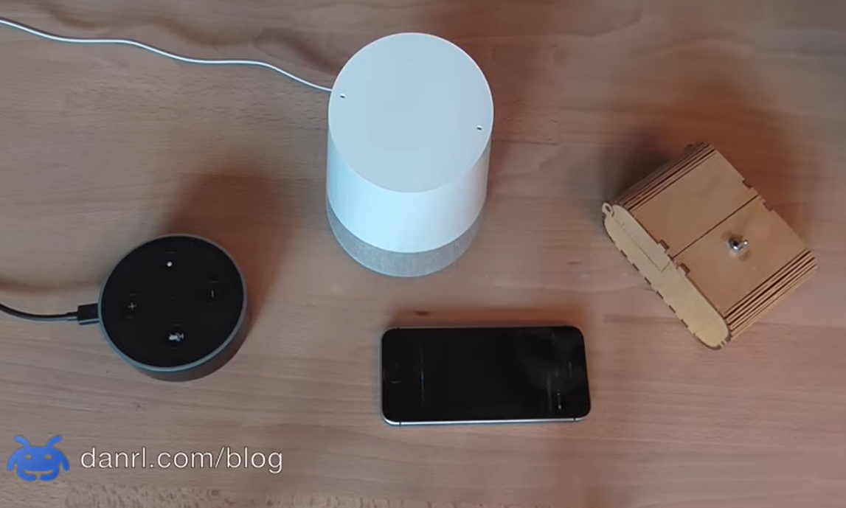
Infinite Loop
https://www.youtube.com/watch?v=vmINGWsyWX0

Slide 3
Announcements
Monday: President’s Day Holiday
Monday Classes on Tuesday the 18th (across all of BYU)!
Module 4.4. VBA Navigation and Conditionals HW Due on Tuesday the 18th
Start on your VBA homework early and expect the tasks to take several hours. Don’t wait until due dates for help!
Sample data for today: LearningSuite – Content – Data Sets – Cities Spreadsheet
You Can Do This!

Slide 4
Structured Programming
✓Procedure
VBA: Sub (meaning Subroutine)
✓Function
VBA: Function
✓Comment
VBA: 'Single Quote
✓Variable
VBA: Dim … As
✓Conditional
VBA: If … Then ... Else … ElseIf … End If
Select Case
VBA: Select Case … Case … End Select
Loops
VBA: Do Until Loop
VBA: Do Loop Until
VBA: While Wend
VBA: For Next
VBA: For Each

Slide 5
Select Case

Slide 6
Structured Programming
✓Procedure
VBA: Sub (meaning Subroutine)
✓Function
VBA: Function
✓Comment
VBA: 'Single Quote
✓Variable
VBA: Dim … As
✓Conditional
VBA: If … Then ... Else … ElseIf … End If
✓Select Case
VBA: Select Case … Case … End Select
Loops
VBA: Do Until Loop
VBA: Do Loop Until
VBA: While Wend
VBA: For Next
VBA: For Each

Slide 7
Loops
Finally, writing a program is faster than doing the work by hand.

Slide 8
Structured Programming
✓Procedure
VBA: Sub (meaning Subroutine)
✓Function
VBA: Function
✓Comment
VBA: 'Single Quote
✓Variable
VBA: Dim … As
✓Conditional
VBA: If … Then ... Else … ElseIf … End If
✓Select Case
VBA: Select Case … Case … End Select
✓Loops
VBA: Do Until Loop
VBA: Do Loop Until
VBA: While Wend
VBA: For Next
VBA: For Each

Slide 9
Syntax: Subroutine vs Function
width = InputBox("Enter the width.")
MsgBox "Task is complete.“
continue = MsgBox("Do you have another complaint?")
It doesn’t matter whether you’re calling a subroutine or a function. It matters whether you’re treating it like a subroutine or a function – whether you use the returned value or ignore it.

Slide 10
Syntax = has two meanings: Assign & Equals
Assignment
Dim i As Integer i = 5
Equals Test
If i = 5 Then MsgBox "i is 5“ End If
Both
Dim b As Boolean b = i = 5

Slide 11
Some More Theory Object-Oriented Programming

Slide 12
Simple Grammar
Imperative Sentence:
(You) Prepare for the Test
Subject (Implied)
Verb
Object

Slide 13
Simple Computer Grammar
Imperative Sentence
(Computer) MsgBox “Hello, World”
Subject (Implied)
Verb
Object

Slide 14
Add A Subject
John, Walk The Dog
Subject
Verb
Object

Slide 15
Object-Oriented Programming
ActiveCell.Replace "Fred", "George"
Subject
Verb
Objects

Slide 16
Object-Oriented Programming
Objects Have
Properties
ActiveCell.Value = 5
height = Range(“A4”).Height
Methods
Sheets.Add()
ThisWorkbook.PrintOut
Range("A1:C6“).ClearContents
Properties of Objects may be Objects
Range("A4:D7").Cells(1, 2).Font.Name
Methods may return Objects
Range("A4“).End(xlDown).Activate

Slide 17
Excel Objects
ThisWorkbook
Sheets
ActiveSheet
Cells
ActiveCell
Range
Application
Examples
Sheets("Sheet1“)
Cells(1, 5)
Range("B4")
Range("B4:C8")

Slide 18
Useful Methods
Cell.Activate
Range.Select
Cell.End(xlDown)
xlUp, xlToLeft, xlToRight
Range.ClearContents
Range.ClearFormats
Useful Properties
Cell.Value
Cell.Row
Cell.Column
Cell.Address
Cell.Font.Bold
Cell.CurrentRegion
Cell.Formula
Range.Columns
Range.Rows
Range.ColumnWidth
Range.Offset
Range.VerticalAlignment
Font.Color
Most Cell properties can be used on Range and visa versa.

Slide 19
Syntax: Assigning Objects to Variables
Must use the “Set” keyword when assigning objects.
Sub Sample()
Dim i As Integer
Dim o As Object
Dim cell As Object
i = 5
Set o = Range("A1:B2")
For Each cell In o
cell.Value = i
Next cell
End Sub

Slide 20
Variable Types in VBA
Type | Data Type | Range | Bytes | Bits
Integer | “Short” Integers | -32768 to 32767 | 2 | 16
Long | “Long” Integers | -2,147,483,648 to 2,147,483,647 | 4 | 32
Single | Real number with single precision | ±2.4 × 10³⁸ | 4 | 32
Double | Real number with double precision | ±4.9 × 10³²⁴ | 8 | 64
String | Text of all sorts | Strings up to 2 billion characters in length. | 1 byte per character
Boolean | Logical “True” or “False” | “True”, “False” | 2 | 1
Currency | Monetary values with up to 4 decimal places. Avoids rounding. | ±922 Trillion | 8 | 64
Date | Combination of both date and time | 0100-01-01 to 9999-12-31 | 8 | 64
Variant | Any of the above types. |  | 16 | 128

