Slide 1
Web Development Final Project Walkthrough
2020-04-13 – IS201 - Prof Redd
To follow along on today’s lesson, download the “Business Casual” bootstrap theme (same as last Wednesday):
https://startbootstrap.com/themes/business-casual/
“When we have conquered this﻿—and we will﻿—may we be equally committed to freeing the world from the virus of hunger, freeing neighborhoods and nations from the virus of poverty. May we hope for schools where students are taught﻿—not terrified they will be shot﻿—and for the gift of personal dignity for every child of God, unmarred by any form of racial, ethnic, or religious prejudice.” - Elder Jeffrey R. Holland – April 2020 General Conference, Sunday Morning Session.

Slide 2
Announcements (All Repeats)
Digital Dialog
Share your website ideas there.
A few have participated. Contributions count toward extra credit.
Got your domain names? (MyEducator 6.6)
Web Development Final Project – Due Date Extended to This Saturday, April 18
The final project is also your final exam!
Accounts for 15% of your final grade.
The assignment is to build a personal resume site. If you want to do some other, professional, site. Please get my permission by end of day today!
Monday will be a review of all you need to know for the final project.

Slide 3
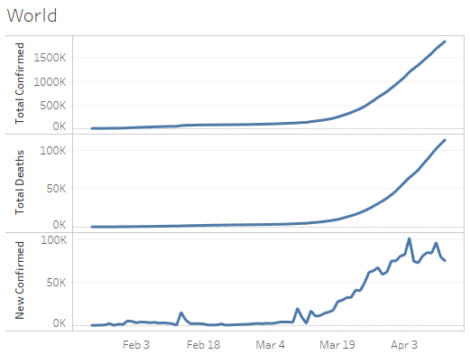
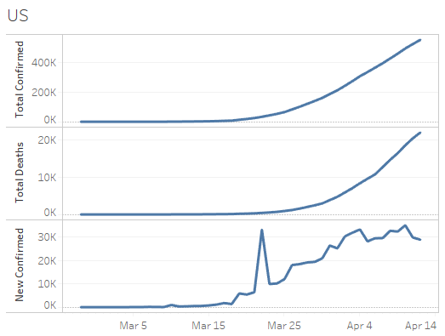
COVID-19 Data Update
https://brandtredd.org/COVID-19

Slide 4
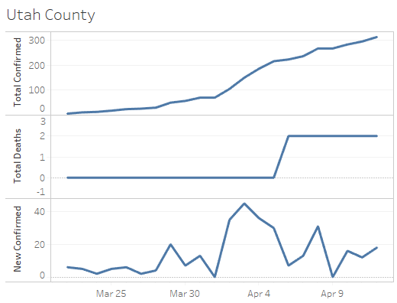
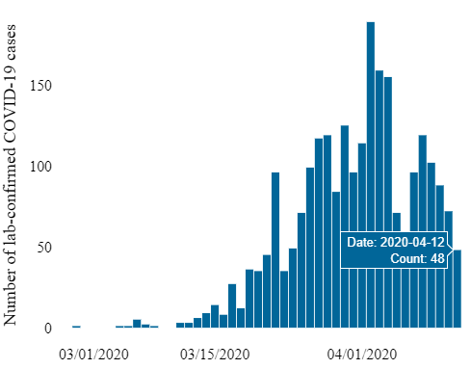
Utah COVID-19
State of Utah
New Cases
https://coronavirus.utah.gov/case-counts/

Slide 5
Requirements (This is a summary, authoritative requirements are in 6.6)
Bootstrap Theme
Index Page (The default, starting page.)
“About Me” page (“About Us” if you have permission for a non-resume site)
Tableau Page
Has its own styles, not based on Bootstrap.
Has four embedded Tableau charts

Slide 6
Requirements: Folder Structure
Root Folder
Index.html – the default entry point for your site
html Folder
aboutme.html
tableau.html
Any other html files other than index.html.
images Folder
All images used on your website
Including any that came with the bootstrap theme. (Rename the bootstrap “img” folder to “images”)
styles Folder
All .css files
Including those that came with the Bootstrap theme (rename the “css” folder to “styles”)

Slide 7
Requirements: In Your Pages
Put a comment at the top of every html file including your name and the date you last edited it.
Format code with tabs.
Custom background on every page (may be consistent or different across pages)
Tab Title, meaningful, on every page <head><title>
Navigation links from every page to every other page.
Link to an External Page somewhere on your site.
At least Four Custom Styles with at least Four Attributes in your .css file that override the BootStrap theme and are used in your index.html and aboutme.html pages.
Resume with Education, Work Experience, and Skills sections included on your site (typically part of the aboutme.html page)
Two on-page anchors (with links to them)
Three Images between the index and aboutme pages
alt="description" on every image.
An ordered list on your resume.
An unordered list on your resume.
Playable Video somewhere on your site
Your Contact Information (may use fake email and phone if you prefer)

Slide 8
Requirements: Tableau Page
Custom Stylesheet Called “bootstyles.css” (no Bootstrap for this page)
Three <div> elements with custom positioning styles
Navigation <div> contains navigation links
Expands and contracts horizontally with the window size.
Links to all other pages must be here. They don’t have to follow the same stile as other pages.
Tableau <div> main body
Expands and contracts horizontally and vertically
Four Tableau Charts that explain the following:
How are profits faring in the 50 states
How has one of the highest-profit states fared for the last two years by profit, by month.
How are the profits within that state doing in each product category.
For the most profitable category, forecast sales.
Each chart must have a caption that explains the chart.
Footer <div> bottom of the page
Expands and contracts horizontally.
Includes copyright, credit, etc.

Slide 9
Bootstrap Themes Approved for your Final Project
Clean Blog https://startbootstrap.com/themes/clean-blog/
Business Casual https://startbootstrap.com/themes/business-casual/

