Slide 1
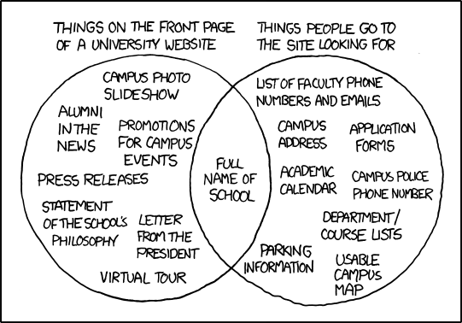
Web Development Introduction to HTML
2020-03-30 – IS201 - Prof Redd
“These unique challenges will pass in due time.” -President Russel M. Nelson, “Message of Hope During COVID-19 Outbreak https://newsroom.churchofjesuschrist.org/article/president-nelson-message-covid-19
XKCD: https://xkcd.com/773

Slide 2
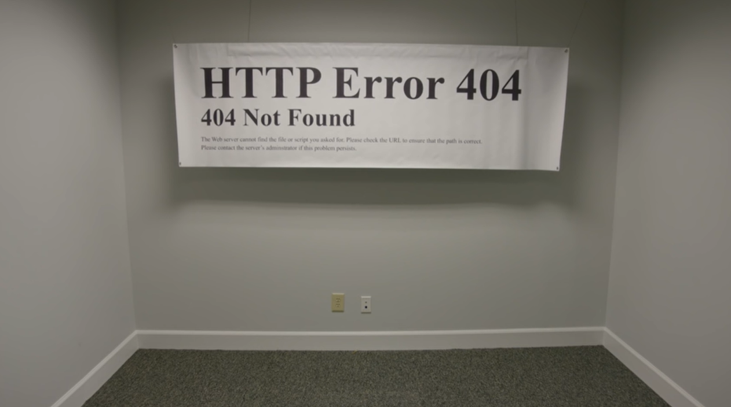
Websites in Real Life
https://www.youtube.com/watch?v=yrFomOrE33Q

Slide 3
Announcements
Digital Dialog
Share your website ideas there.
Get your domain name ASAP. We’ll start building websites next week!
Details are in the LearningSuite Schedule
Video instructions are at the beginning of MyEducator 6.6
You’ll get a bunch of spam email offering to help you build your website. Ignore them. They will dissipate in 2-3 days.
Only two more assignments
WebDev Walkthrough – Due Wednesday, April 8
Web Development Final Project – Due April 15
The final project is also your final exam!
Accounts for 15% of your final grade.

Slide 4
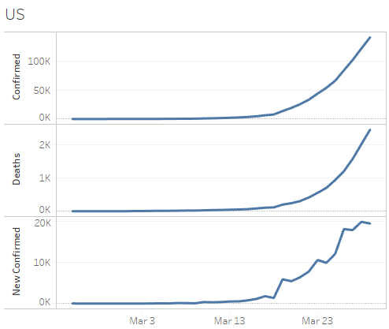
COVID-19 Data Update
https://brandtredd.org/files/IS201/COVID-19-data

Slide 5
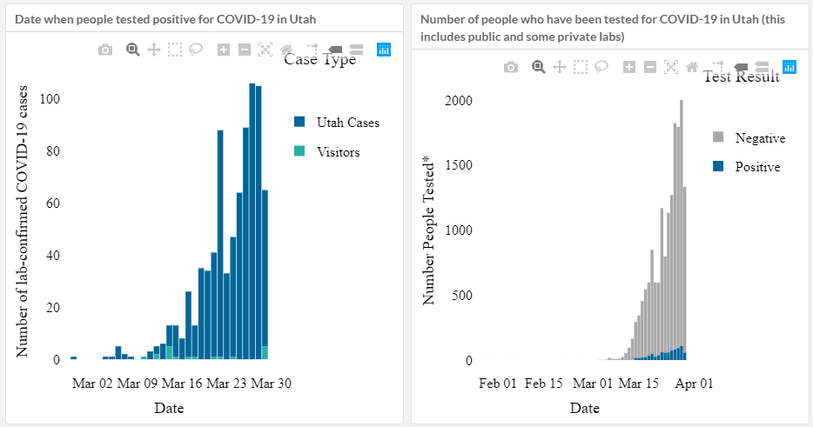
Utah COVID-19
New Cases
Tests Performed
https://coronavirus.utah.gov/case-counts/

Slide 6
Web Site Hosting
How your computer finds a website. E.g. bollard.brandtredd.com
Services you need to host a website.
Asks the root name server for “.com” for the IP address of the DNS server for brandtredd.com.
Asks the DNS server for brandredd.com server what the IP address is for bollard.brandtredd.com.
Asks the web server for the actual page.
Doman name registration: Establishes your ownership of the name and indicates the IP address of your name servers.
Domain Name Service (DNS) for your domain. (Usually bundled with domain registration.)
Web server. (Often offered by the same company that does DNS. But frequently separated.
Conveniently, BYU Domains does all three for you! Instructions are in first video of 6.6. Start on that early!

Slide 7
Some of My Websites
https://BrandtRedd.org (with misspellings)
https://www.OfThat.com – My primary blog
https://www.edmatrix.org – Directory of Learning Standards
https://www.thatwhichunites.us - Blog
https://bollard.brandtredd.com – Brandt’s Bollard Blog
http://www.filemeta.org/

Slide 8
Fundamentals of HTML
<html>
<head>
<title>
<body>
<h1>
<ul>
<li>
<br/>
<p>
<img src="" alt="">
<a href="“>
id=""
<!-- comment -->

