Slide 1
VBA Exam Review
IS201 – 2020-03-02 - Prof Redd

Slide 2
Upcoming Schedule
In-Class
Today: VBA Exam Review
Wednesday 3/2: Introduction to Business Intelligence and Data Mining (Chapter 5)
Monday 3/9: Prof Redd in Washington D.C. Data Conference Practice Tableau with TAs
Homework and Exam
Wednesday 3/2: Olympus Tours Due (Unit 4.6)
Saturday 3/7: VBA Programming Midterm Due (Unit 4.8)
Sometime this week, download and install Tableau (instructions on LearningSuite schedule)

Slide 3
VBA Exam Overview
Three Hours Timed
Declining Points for Late Submissions
30 Minutes Over – No Credit
Open Book, Open Web, but no help from anyone.
Structure
Download Excel Workbook (for use on later problems)
Five Multiple Choice Questions based on the SDLC chapter
Three VBA programming problems of increasing difficulty
Partial credit is given for VBA problems!
Build them incrementally – get the minimal function working, save, and add features one at a time.
Better to get partial credit for an on-time submission than to finish but submit late!
Save frequently – in case of infinite loop bugs that freeze Excel.
Review the outline in MyEducator 4.8 TODAY so you know how to prepare.

Slide 4
Systems Development Lifecycle (SDLC)
Planning
Assemble Team
Analyze Feasibility
Requirements Matrix
Project Approval
Analysis
Requirements Definition Document
Design
Concept, Algorithms, User Experience (UX)
Development
Programming
Testing
Unit Testing
Integration Testing
System Testing
User Acceptance Testing
Implementation
Options: Direct Conversion, Parallel Conversion, Phased Conversion, Pilot Conversion
Maintenance
Bug Fixes
Enhancements
Help Desk

Slide 5
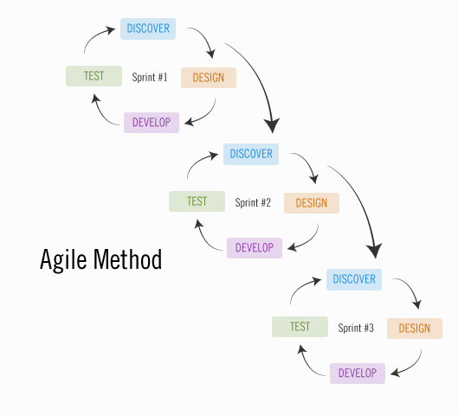
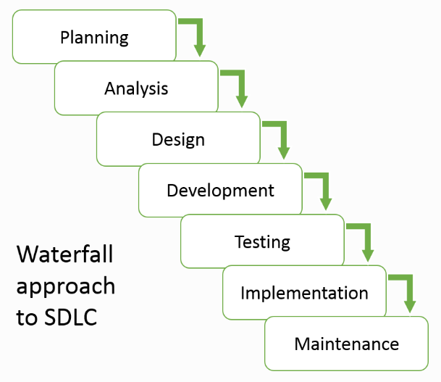

Slide 6
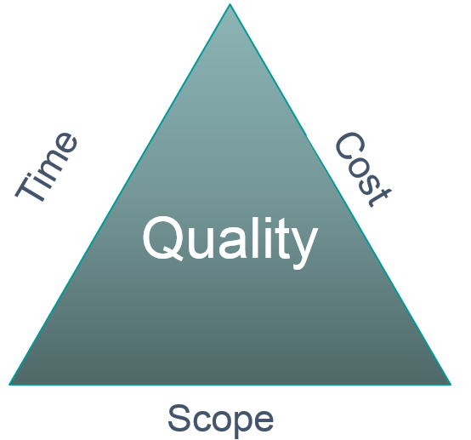

Slide 7
VBA Programming
LearningSuite – Content – Data Sets – Exam Review Spreadsheet

