Slide 1
Web Development CSS Positioning
2020-04-06 – IS201 - Prof Redd
“These unique challenges will pass in due time.” -President Russel M. Nelson, “Message of Hope During COVID-19 Outbreak https://newsroom.churchofjesuschrist.org/article/president-nelson-message-covid-19

Slide 2
Announcements (Mostly Repeats)
Digital Dialog
Share your website ideas there.
A few have participated. Contributions count toward extra credit.
Got your domain names? (MyEducator 6.6)
Only two more assignments
WebDev Walkthrough – Due This Wednesday, April 8
Web Development Final Project – Due Date Extended to April 18
The final project is also your final exam!
Accounts for 15% of your final grade.
The assignment is to build a personal resume site. If you want to do some other, professional, site. Please get my permission in advance.

Slide 3
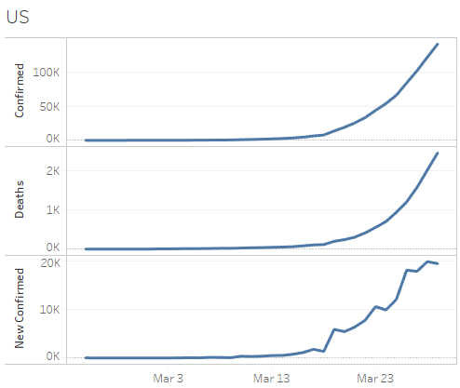
COVID-19 Data Update
https://brandtredd.org/files/IS201/COVID-19-data

Slide 4
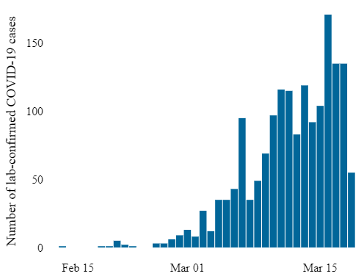
Utah COVID-19
New Cases
https://coronavirus.utah.gov/case-counts/

Slide 5
Stylesheet Positioning Elements and Units
display: (none, inline, block, inline-block)
position: (static, absolute, fixed)
left, right, top, bottom
height, width
z-index
Absolute units:
px: “browser” pixels. Approx 1/96 inch
pt: points. 1/72 inch
in: inches
mm: millimeters
others
Relative units
em: One “M” in the current font
rem: One “M” in the <body> font size
%: Fraction of the parent element
others
A good CSS Reference is at: https://www.w3schools.com/cssref/default.asp

